Slide 1
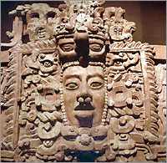
Chapter 11
The America’s
On the
Eve of
INVASION

Slide 2
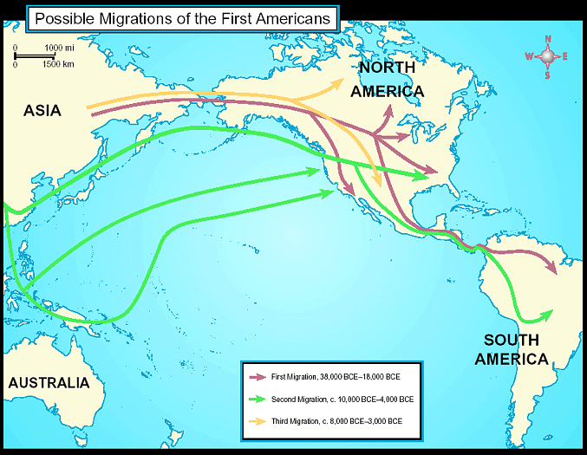
Early Human Migrations

Slide 3
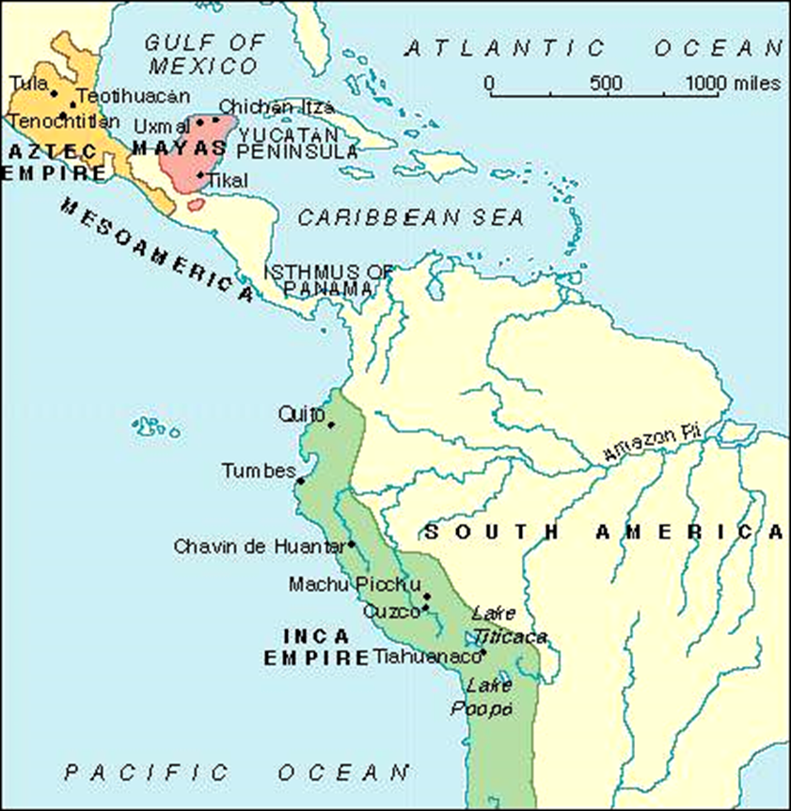
Introduction
Mesoamerican civilizations during the postclassical period
Remained entirely separate from those of the Old World
Built on earlier precedents from the classical period
Similar to Asia and Mediterranean world
Formed large cities
Elaborate political and economic organization
Elaborate cultural systems
Highly developed agriculture yielding a unique foods
Formation of imperial states
Aztec Empire
Inca Empire

Slide 4
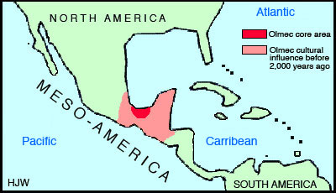
The Olmec (1200 BCE – 200 CE)
Theocratic
God center (main god- jaguar)
Mexico’s first established civilization
Advanced calendar
Concept of zero
Know little about political structure, culture, or disappearance

Slide 5
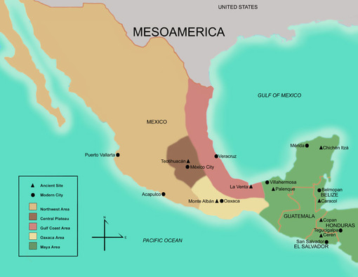
Postclassic Mesoamerica 1000-1500 C.E.
8th century – significant political and cultural change
Collapse of Teotihuacan in central Mexico
Abandonment of the classical Maya cities

Slide 6
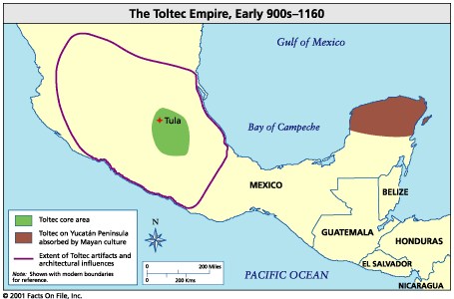
The Toltecs (968-1150)
The Toltecs
Migrated into central Mexico from the north
Adopted a militaristic ethic from people already living in the area
Created a large empire whose influence extended far beyond central Mexico
Established a capital at Tula in 968
Central Mexico
Sedentary people
Cult of sacrifice and war
Portrayed in Toltec art

Slide 7
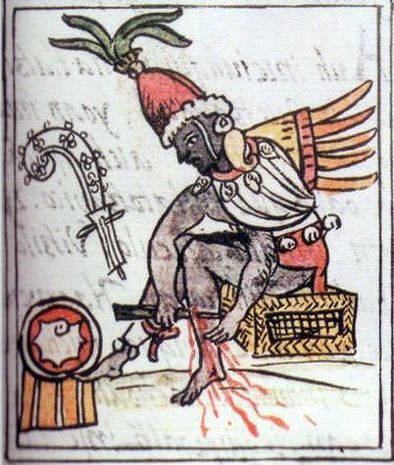
Toltec Heritage
Topiltzin
Toltec leader and apparently a priest dedicated to the god Quetzalcoatl (the Feathered Serpent)
Confused with the god himself
Involved in a struggle for priestly or political power with another group
He and his followers went into exile, promising to return to claim his throne
Sailed to Yucatan
Legend of Topiltzin-Quetzalcoatl
Well known by Aztecs and may have influenced their response when the Europeans arrived

Slide 8
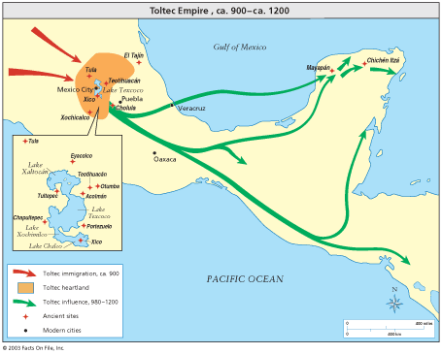
The Toltecs
Created an empire that extended over much of central Mexico
Capital – Tula
1000 C.E. – Chichen Itza in Yucatan conquered by Toltec warriors
Ruled for a long time by central Mexican dynasties or by Maya rulers under Toltec influence
1150 – Toltec Empire collapse
Destroyed by nomadic invaders from the north

Slide 9
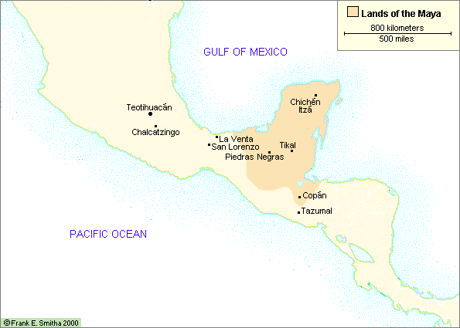
Lands of the Mayans
The Yucatan Peninsula

Slide 10
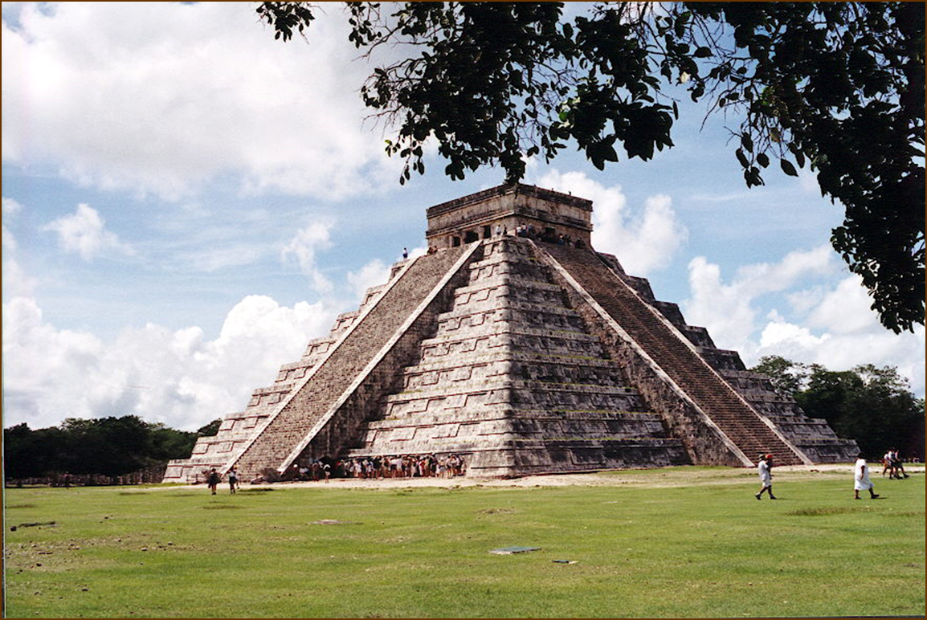
The Maya
Flourished between A.D. 300-900
Built splendid temples and pyramids and developed a complicated calendar
Explanations for the decline include invasion, internal revolt or a natural disaster (volcanic eruption)

Slide 11
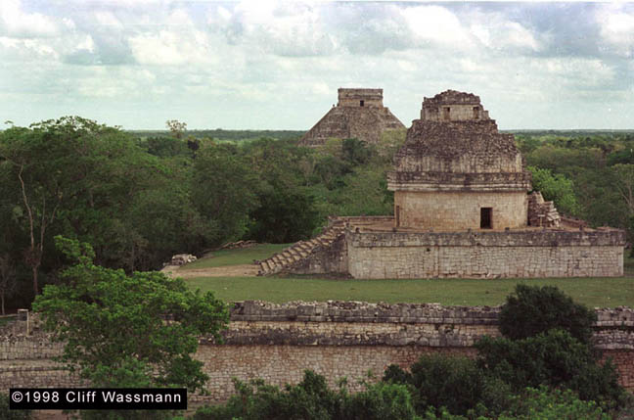
Chichen-Itza - Observatory

Slide 12
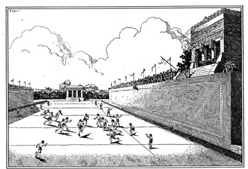
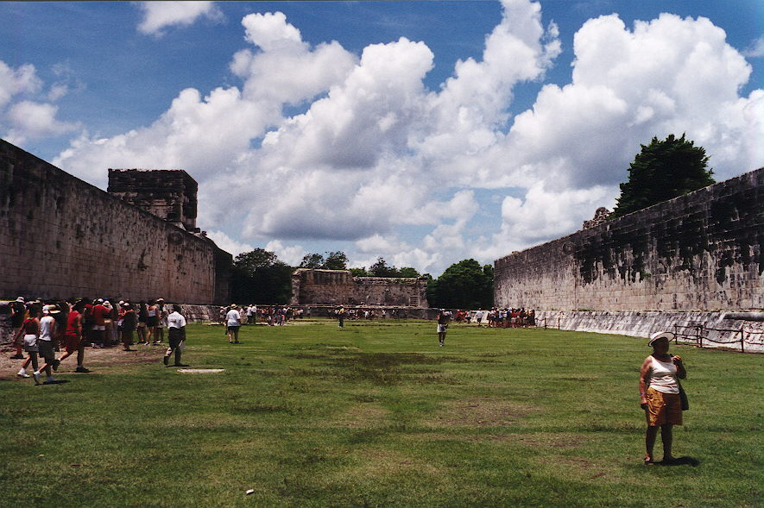
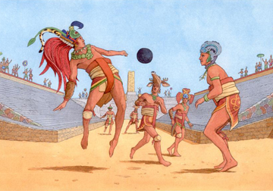
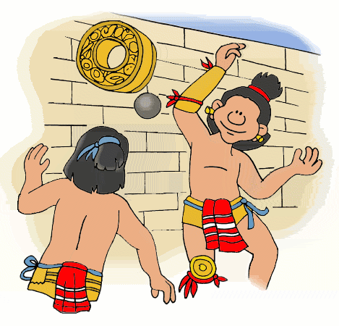
Chichen-Itza - Ball Court

Slide 13
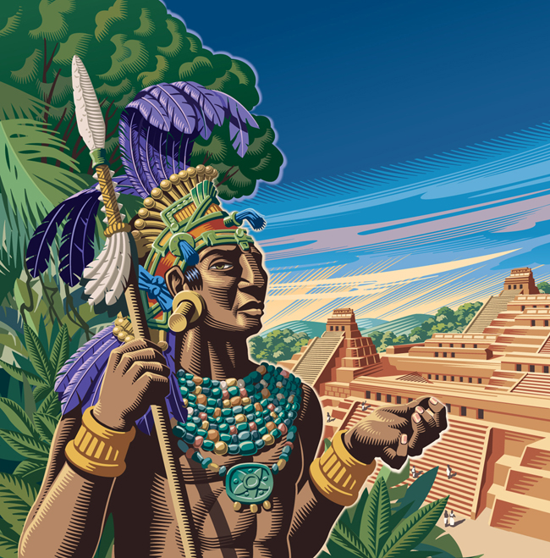
Maya – Political & Social Structure
Mayan cities were built around a central pyramid topped by a shrine to the gods
Composed of city states each governed by a hereditary ruling class and were often at war with each other
Rulers claimed to have descended from the gods

Slide 14
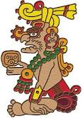
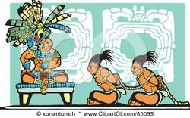
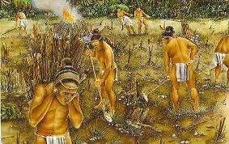
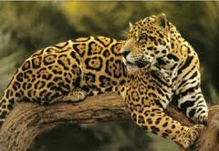
Crucial to Mayan civilization was its belief that all of life was in the hands of divine powers
Soldiers captured in battle became slaves and war leaders were used for human sacrifice
Itzamna

Slide 15
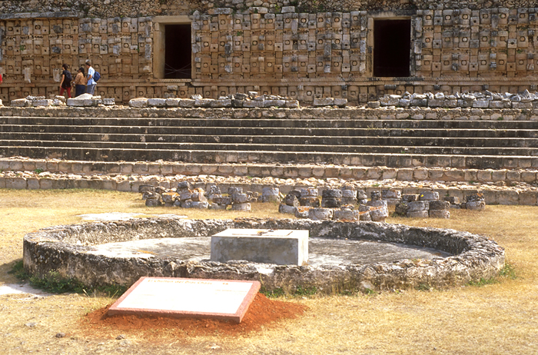
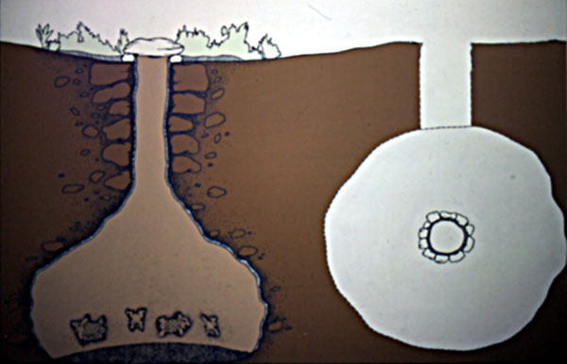
Mayan Underground Granaries: Chultunes

Slide 16
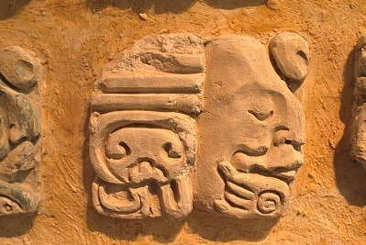
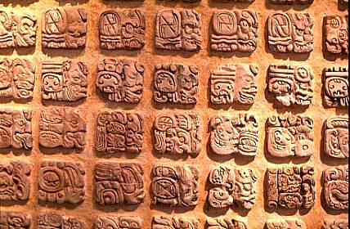
Maya - Writings
Created a sophisticated writing system based on hieroglyphs
Because the Spanish could not read the system they burned most books/writings
Wrote on bark, clay, jade, bone, shells and stone monuments

Slide 17
Mayan Glyphs
sky king house child city
Mayan Mathematics

Slide 18
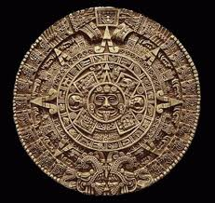
Maya - Calendar
Created in 3114 B.C. and was scheduled to finish December 23, 2012
Based on the solar calendar and a sacred calendar
Only trained priests could
read the calendar

Slide 19
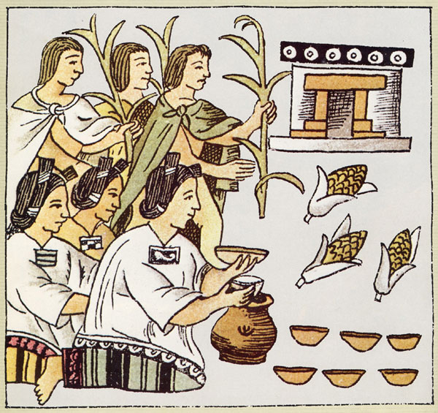
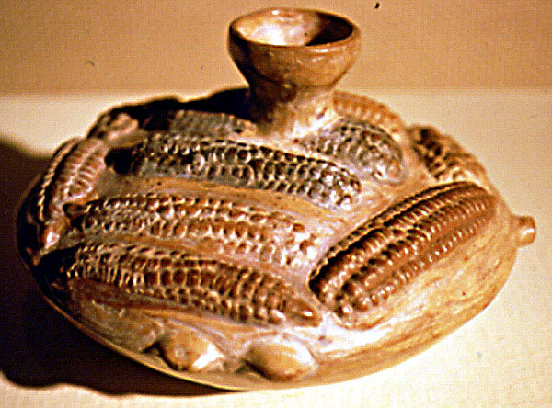
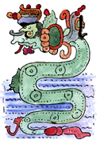
Mayan Cultivation of Maize
Chac, God of Rain -->

Slide 20
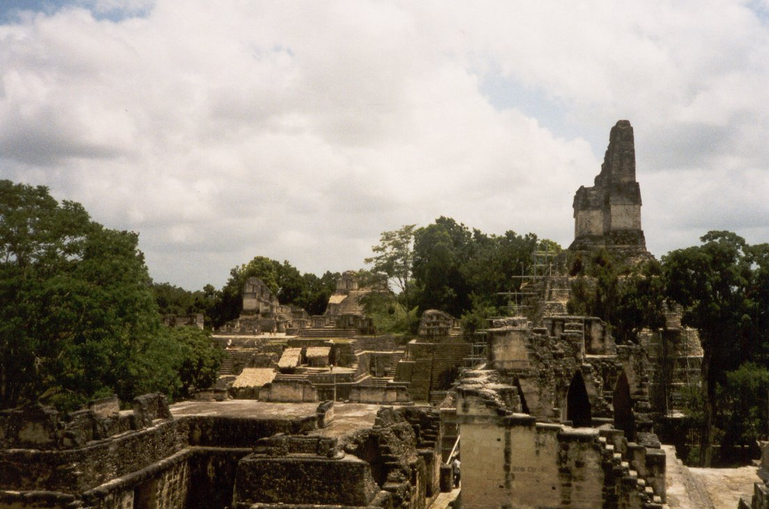
Tikal - Main Court

Slide 21
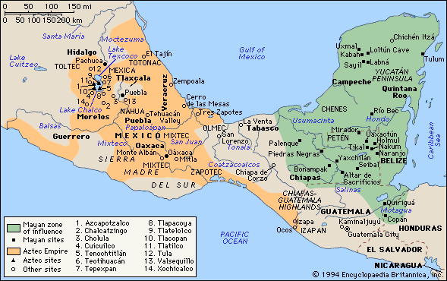
Lands of the Aztecs (aka Mexica)

Slide 22
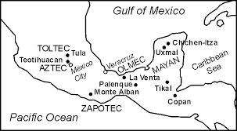
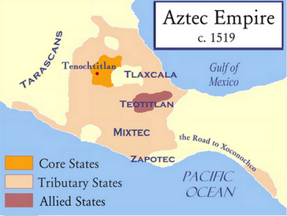
Aztec Rise to Power
Aztecs migrated into the valley around 1325 following the fall of the Toltec empire
After fall of Tula, center of population and political power in central Mexico shifted to valley of Mexico and especially to shores of large chain of lakes in that basin
Rich aquatic environment; shores of the lakes were dotted with settlements and towns (dense populations)

Slide 23
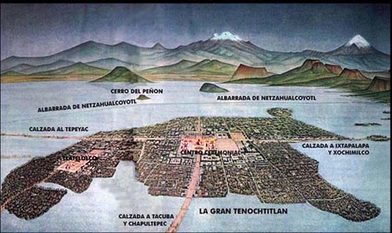
3000 square miles in basin of the valley (400 square miles under water)
Lakes became heartland and population center in postclassical period
Various people and cities jockeyed for control of lakes
Through a series of alliances with and against the other city-states, the Aztecs were able to emerge as an independent power, eventually building a great empire

Slide 24
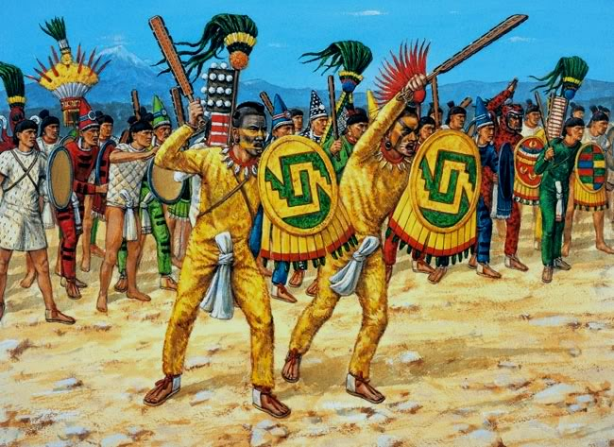
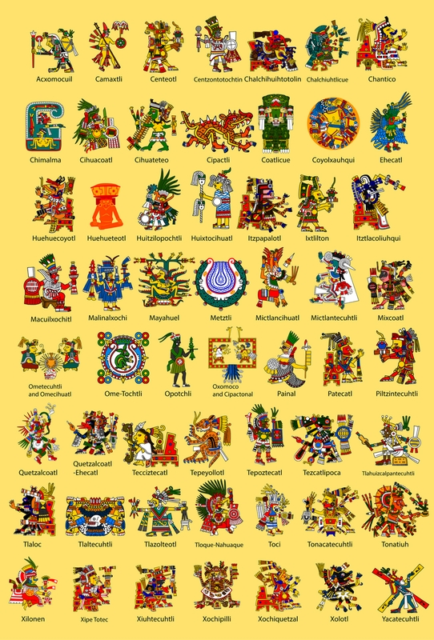
Aztecs
Spoke Nahuatl
Language of the Toltecs
An intrusive and militant group
Distrusted and disliked by other dominant groups in area
Tough warriors
Fanatical followers of gods
Offered sacrifices
1428 – Aztecs emerge as independent power

Slide 25
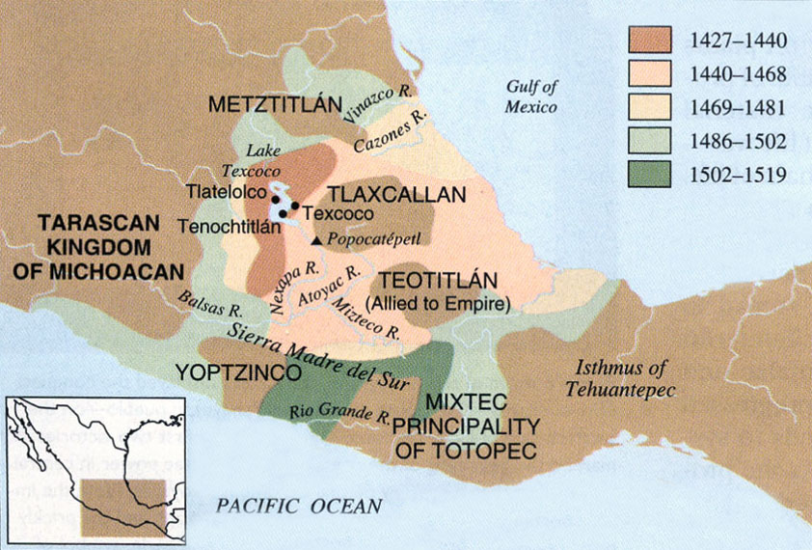
Aztec – Social Contract
The Aztecs created a conquest empire
strengthened the position of nobles
The ruler of Tenochitlan emerged from this process as a supreme ruler with wide powers
Subject peoples forced to pay tribute, surrender lands, and sometimes do military service for growing Aztec Empire

Slide 26
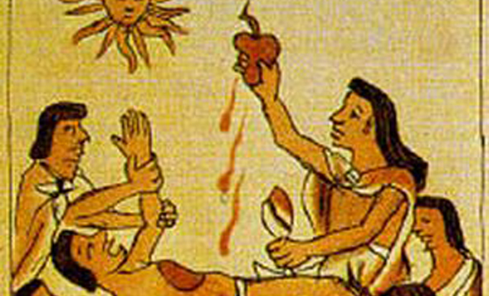
Aztec society changed in the process of expansion and conquest
Loose organization of clans to a stratified society under authority of supreme ruler
Tlacaelel – prime minister and advisor under three rulers
Human sacrifice greatly expanded
Military class played a central role as suppliers of war captives to be used as sacrificial victims
By the time of Moctezuma II, Aztec state was dominated by King who represented civil power and served as representative of gods on earth

Slide 27
Religion and the Ideology of Conquest
Religion in the Aztec Empire
A vast, uniting, and sometimes oppressive force
128 major deities - traditional deities of Mesoamerica
Gods of rain, fire, water, corn, the sky, and the sun
Yearly festivals and ceremonies that involved feasting and dancing along with penance and sacrifice
Three major themes or cults
1. gods of fertility and the agricultural cycle
The god of rain, water, maize, and fertility
2. Creator deities
Great gods and goddesses who had brought universe into being
3. Cult of warfare and sacrifice
Built on preexisting Mesoamerican traditions

Slide 28
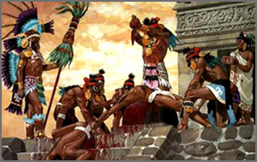
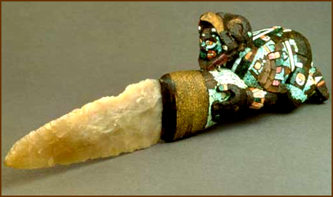
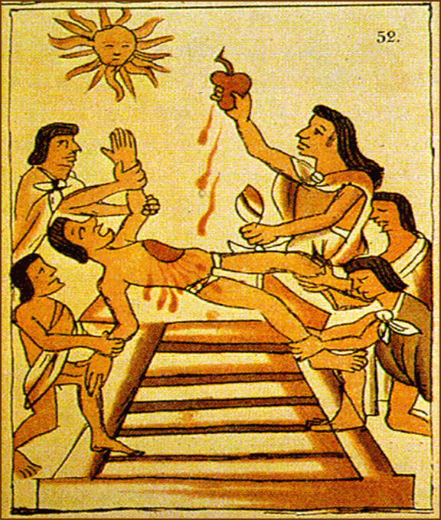
Human sacrifice
Long been a part of Mesoamerican religion
Expanded considerably in the postclassical period of militarism
Types and frequency of sacrificed increased
religious conviction or tactic of terror for political control?

Slide 29
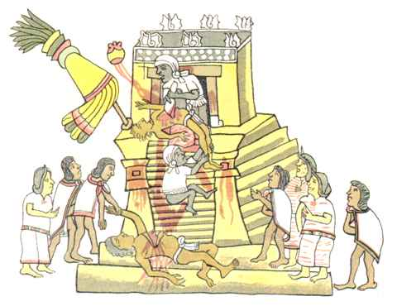
Heart Sacrifice on an Aztec Temple Pyramid

Slide 30
Aztecs also concerned themselves with many of the great religious and spiritual questions
Is there life after death?
What is the meaning of life?
What does it mean to live a good life?
Do the gods really exist?

Slide 31
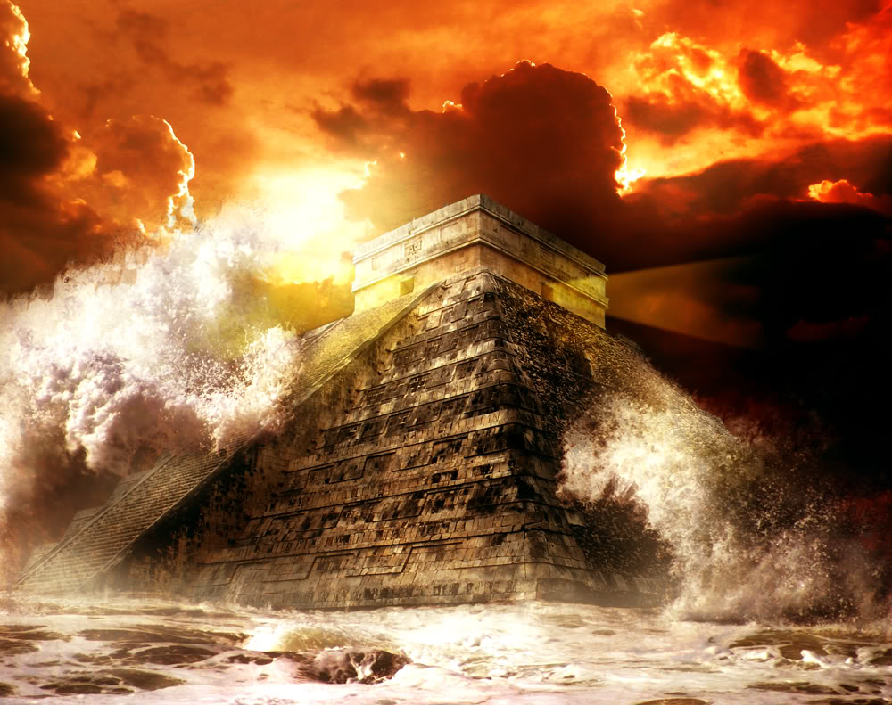
Aztecs believed in a cyclical view of history
World had been destroyed four time before and would destroyed again
Eventually… sacrifices would be insufficient and the gods would again bring catastrophe

Slide 32
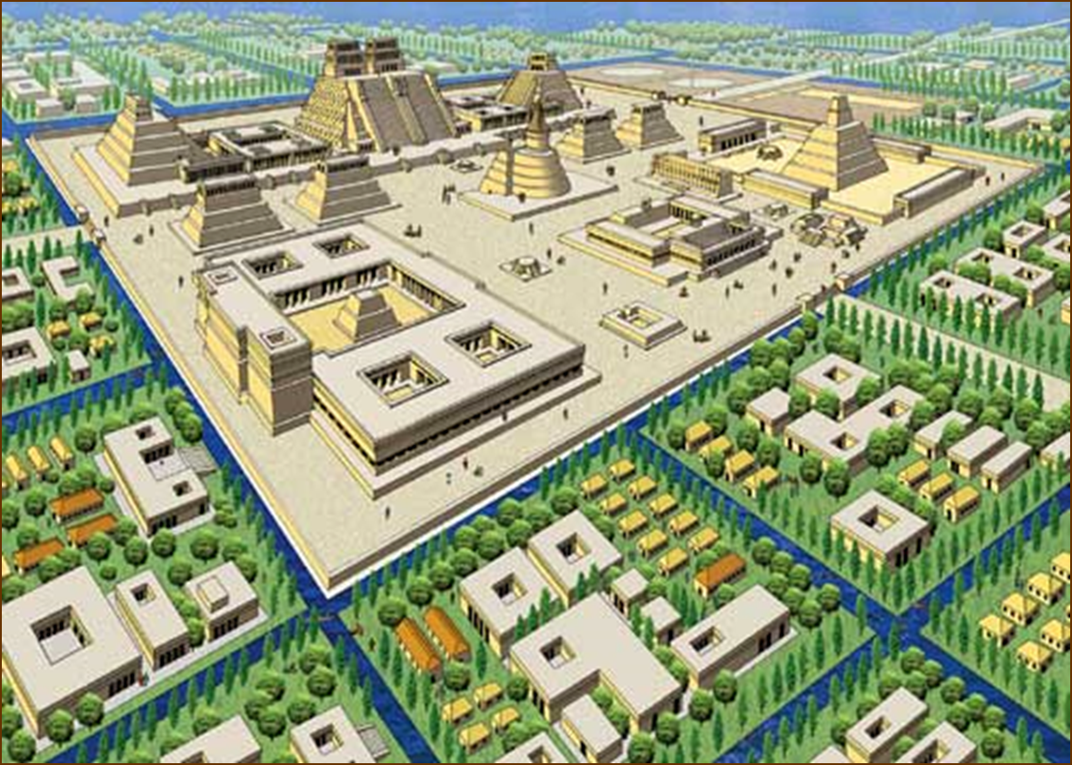
Tenochtitlan: The Foundation of Heaven
Tenochtitlan
Capital city of the Aztec Empire
Great metropolis, with a central zone of palaces and temples
Surrounded by adobe brick residential districts, smaller palaces, and markets
Drew tribute and support from its allies and dependents

Slide 33
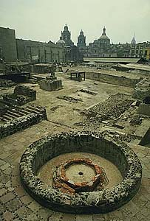
Ruins of the City Center, Tenochtitlan

Slide 34
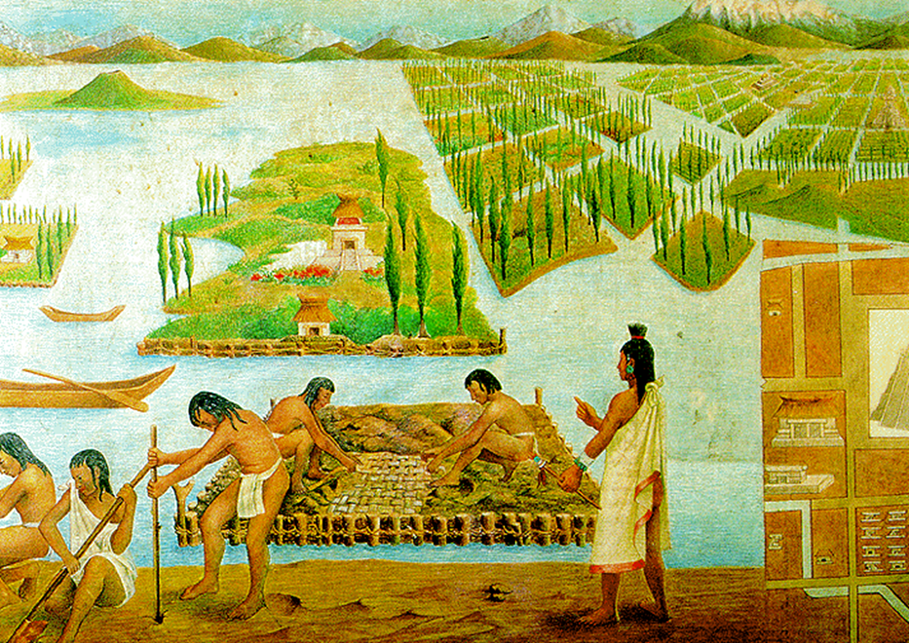
Feeding the People
Aztec Empire food production depended on traditional forms of agriculture and on innovations developed by Aztecs
Food demanded as tribute
Tribute – economic and political function, concentrating power and wealth in Aztec capital
Chinampas
Intensive form of agriculture utilizing floating beds and artificial islands
Beds of aquatic weeds, mud, and earth were placed in frames made of cane and rooted to the lake floor
17 feet long, 100 to 330 feet wide
20,000 chinampas

Slide 35
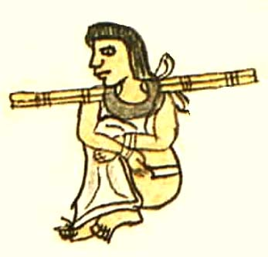
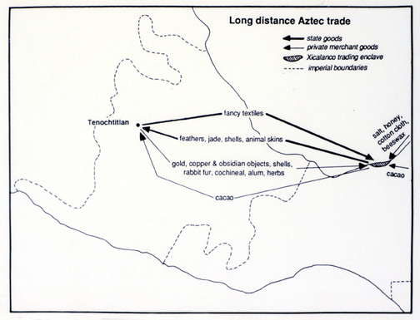
Some land reserved for nobility and worked by slaves from conquered people
A merchant class (pochteca) developed
Specialized in long-distance trade in luxury items
The government
Controlled all trade
Managed the collection and redistribution of tribute
Surrendered – paid less tribute
Tribute payments – food, slaves, and sacrificial victims

Slide 36
Widening Social Gulf
Aztecs had been divided into seven calpulli, or clans
No longer only kinship groups but also residential groupings
Neighbors, allies, and dependents
Distributed land to heads of households
Organized military units in times of war
Maintained a temple and school
Governed by councils of families heads
Not all families were equal, nor were all calpulli equal status
Every person, noble, and commoner belonged to a calpulli

Slide 37
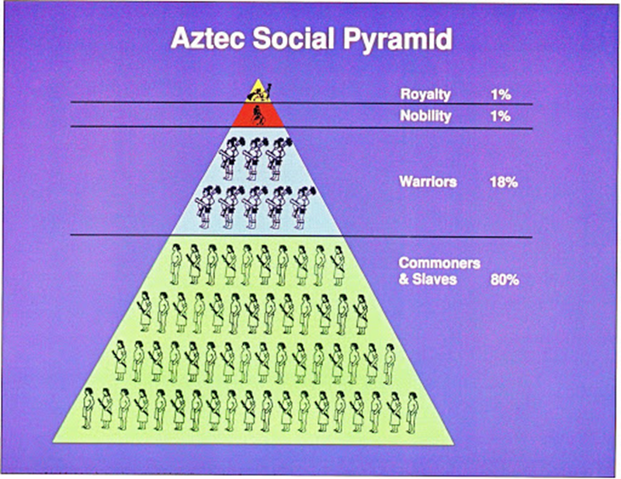
As the Aztec power increased, the calpulli had been transformed, and other forms of social stratification emerged
Class of Nobility developed
Came from privileged families in the most distinguished calpulli
Accumulated high offices, private lands, and other advantages
Most born into class
Some commoners might be promoted as nobles
Controlled the priesthood and the military leadership

Slide 38
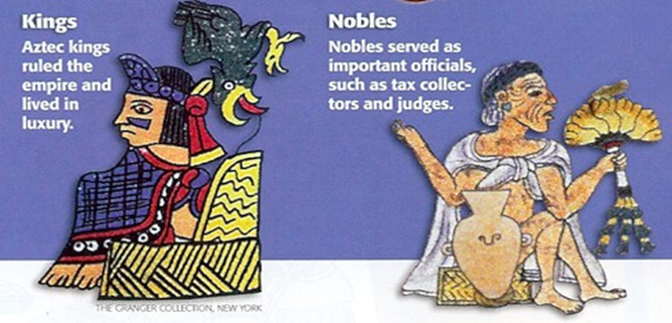
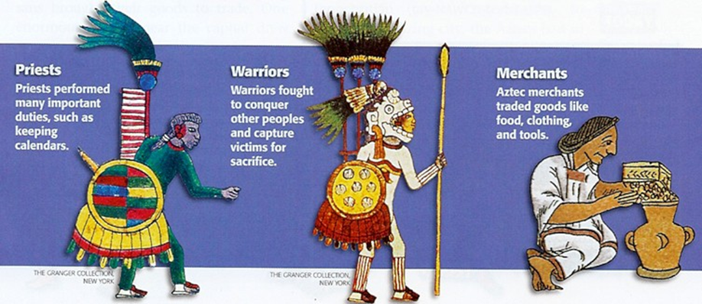
Social gap between the nobility and commoners increased as empire grew
Social distinctions made apparent by the use of and restrictions on clothing, hairstyles, uniforms, and other symbols of rank

Slide 39
As nobility broke free from their old calpulli and acquired private lands, a new class of workers created
Similar to serfs
Worked as laborers on these lands
Did not control land and worked at the will of others
Status was low, but still above slaves
Slaves – war captives, criminals, or people who had sold themselves into captivity to escape hunger

Slide 40
Scribes, artisans, and healers all were part of an intermediate group
Especially important in the larger cities

Slide 42
Overcoming Technological Constraints
Aztec women
Peasant women – worked in fields, but their primary domain was the household, where child-rearing and cooking took up much time
Marriages often arranged
Virginity at marriage highly regarded for young women
Polygamy existed among the nobility
Peasants – monogamous
Could inherit property
Remained subordinate in political and social life

Slide 43
Technology of the Americas limited social development
Women spent six hours a day grinding corn by hand on stone boards to prepare the household’s food
Without the wheel or suitable animals for power, the Indian civilizations were unable to free women from the 40 hours a week that went into preparing basic food

Slide 44
A Tribute Empire
Each city-state ruled by a speaker chosen from the nobility
Great speaker – ruler of Tenochtitlan
The Emperor
Great private wealth and public power
Increasingly considered a living god
Magnificent court
Surrounded with elaborate riturals
Prime Minister
Tremendous power
Usually a close relative of the ruler

Slide 45
During a century of Aztec expansion, a social and political transformation had taken place
The position and nature of the old calpulli clans had changed radically
Newly powerful nobility
Emergence of an absolute ruler
Local rulers were tribute collectors for Aztec overlords
City-states left unchanged if they recognized Aztec supremacy and met obligations of labor and tribute
Many revolts against Aztec rule or a particular tribute burden

Slide 46
Destruction of the Aztecs
1519 a Spanish conquistador named Hernan Cortes landed at Veracruz
Made alliances with city states that were tired of Aztec rule
Aztec leader Montezuma offered gifts of gold and let Europeans stay
Cortes took Montezuma hostage and a revolt began
Hernan Cortes

Slide 47
Montezuma 1466-1520
Montezuma became the Aztec ruler in 1502. He was a strong leader who enlarged the Aztec Empire. One Spaniard observed, “The great Montezuma was about 40 years old of good height and well proportioned, slender but of the natural color and shade of an Indian.” At first, Montezuma believed that Hernan Cortes was a representative of Quetzalcoatl, the god who had departed from his homeland centuries before. Montezuma offered gold to the foreigners and gave them a palace to use while they were in the city. Too late he realized that Cortes and his men wanted land and treasure. The Spanish claimed that his own people, angry with his policies killed Montezuma.

Slide 48
Aztecs had no immunity to new diseases of the Europeans
Millions died
Cortes received more soldiers and destroyed the Aztec cities

Slide 49
World of the Incas
Inca Empire
Developed around same time Aztecs were extending control over much of Mesoamerica
Great imperial state
Formed along Andean highlands
3000 miles in extent
Highly centralized
Extensive irrigated agriculture
Notable achievements in architecture and metallaurgy
Genius for state organization and bureaucratic control over peoples of different cultures and languages

Slide 50
Cuzco: Ancient Capital of the Inca (11,000 ft. above sea level)

Slide 51
Inca Rise to Power
The most successful group of ten clans controlled a region near Cuzco
By 1438 these clans, under the leadership of their ruler, or Inca, Pachacuti, were able to establish their government over much of the highland region
By 1527 the Inca empire stretched from what is now Colombia to Chile in the Andean region
Inca armies were constantly on the march, extending control over a vast territory
Between 9 to 13 million people of different ethnic backgrounds and languages came under Inca rule

Slide 52
Conquest and Religion
The cult of ancestors
Extremely important in Inca belief
Deceased rulers were mummified and then treated as intermediaries with the gods
Paraded in public during festivals
Offered food and gifts

Slide 53
Split inheritance
All political titles of the ruler went to his successor but all his palaces, wealth, land, and possessions remained in the hands of his male descendants
Used them to support the cult of the dead Inca’s mummy for eternity
Each new Inca ruler needed to secure land and wealth
Created a need for expansion

Slide 54
Inca religion
Held the sun to be the highest deity
Similar to the Aztecs
Considered the Inca (ruler) to be the sun’s representative on earth
Temple of the Sun
Located in Cuzco
Center of state religion
Confined the mummies of the past Incas
Huacas – holy shrines
Prayers offered
Animals, goods, and humans sacrificed

Slide 55
Techniques of Inca Imperial Rule
The empire was ruled by the Inca
Considered almost a god
Ruled from his court at Cuzco
High priest
Usually a close relative of ruler
Nobles
Responsible for state bureaucracy
Empire divided into four provinces
Each run by a governor
Divided further

Slide 56
Local rulers, called curacas
Often permitted to retain power in return for securing tribute for the Incas
Exempt from paying tribute
Received labor or produce from those in their control

Slide 57
Unifying the Inca Empire
Quechua language
Complex system of roads built, with bridges and causeways when needed
Way stations (tambos)
Placed about a day’s walk apart
Served as inns, storehouses, and supply centers for Inca armies on the move
Served as relay points for the system of runners who carried messages throughout the empire
10,000

Slide 58
The Inca Empire extracted land and labor from subject populations
Conquered peoples
Enlisted in Inca armies under Inca officers
Rewarded with goods from new conquest
Received access to goods not previously available to them
Must be loyal and pay tribute
Provided labor for large building and irrigation projects
State claimed all resources and redistributed them
Divided conquered areas into lands for the people, lands for the state, and lands for the sun

Slide 59
Inca women
Required to weave high-quality cloth for the court and for religious purposes
Some taken as concubines for the Inca
Some selected as servants at the temples
Others worked in the fields, wove cloth, and cared for the household
Emphasis on military virtues reinforced inequality of men and women
Marriage between people of own social group
Expected to care for children

Slide 60
Inca nobles
Greatly privileged
Distinguished by dress and custom
Noticeably absent in most of the Inca Empire was long distance trade
Incas’ emphasis on self sufficiency and state regulation of production and surplus limited trade

Slide 61
Machu Picchu

Slide 62
Inca Cultural Achievements
Beautiful pottery and cloth were produced in specialized workshops
Metalworking among most advanced in Americas
Artisans worked gold and silver
Used copper and some bronze for weapons and tools
Quipu – took census and financial records
Water management
Extensive road system
Agricultural terraces

Slide 63
Over 100 Different Types of Potatoes Cultivated by the Incans

Slide 64
Machu Picchu

Slide 65
Comparing Inca vs. Aztec
Both the Incas and the Aztecs
represented the imperial stage of political development
Tribute states
intensive agricultural systems (chinampas, terrace farming)
the nobility served as the administrative bureaucracy
allowed the continued existence of local governments subject to the payment of tribute
Religion (sun God)
Social structure (supreme ruler, nobles)
Technological skill
Elaborate culture
Large cities (urban centers)
Built on traditions on predecessors
Differences
Aztecs – developed market, merchants; Incas – undeveloped market, lacked merchants
Aztecs – leave local cultures alone as long as they paid tribute; Incas – included local cultures into Empire
Aztecs – writing system; Incas – lack writing system (quipu – recordkeeping)

Slide 66
Destruction of the Inca
1531 Francisco Pizarro landed in S. America and brought steel weapons, gunpowder and horses
The Inca had seen NONE of these
Experienced an epidemic of smallpox and like the Aztecs died of disease
Francisco Pizarro

