Slide 1
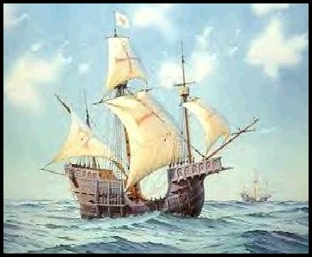
Chapter 17
The WEST AND THE WORLD
GOLD, GLORY and GOD!

Slide 2
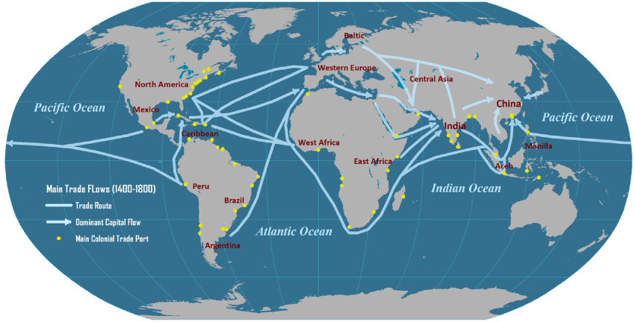
Introduction
After the fifteenth century, explorers and conquistadors from western Europe hacked out empires in the Americas and redefined the nature of international exchange
Shift of power
Rate of international trade also increased in some portions of Old World
Southeast Asia

Slide 3
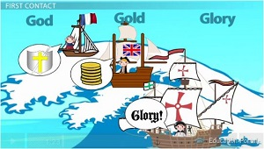
Motives for European Exploration
Crusades → by-pass intermediaries to get to Asia
Renaissance → curiosity about other lands and peoples
Reformation → refugees & missionaries
Monarchs seeking new sources of revenue
Technological advances
Fame and fortune

Slide 4
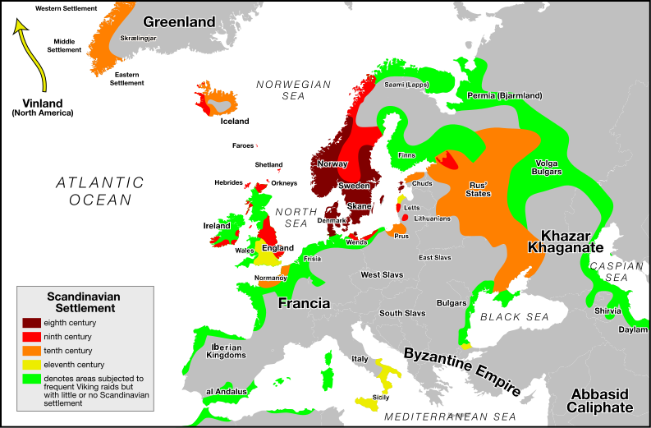
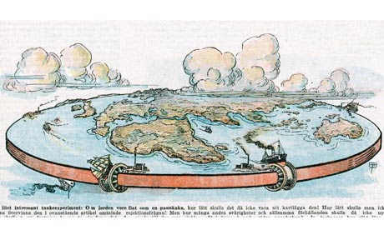
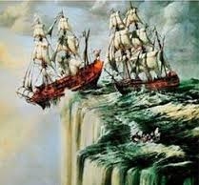
The West's First Outreach: Maritime Power
Since 1100 -Various European leaders (merchants, princes, and clergy) become increasing aware of the larger world around them
Crusades
Mongols
European disadvantages
Viking adventurers from Scandinavia had crossed the Atlantic in the 10th century, reaching Greenland and then North America
Many Europeans continued to believe the earth was flat

Slide 5
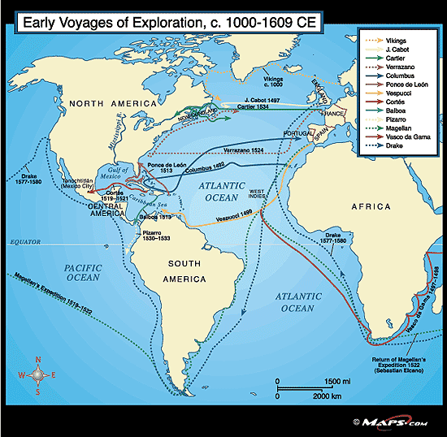
1291 – Europeans launch a more consistent effort at expansion
Motivated by fears of Ottoman Empire and lack of gold to pay for Asian imports
Ships could not travel far

Slide 6
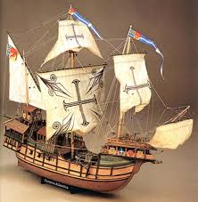
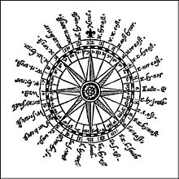
New Technology: A Key to Power
15th century – technological improvements
Ships
Europeans developed a deep-draft, round-hulled sailing ship
Designed for ocean traffic
Carry heavier weapons
Compass (copied from Arabs) and improved mapmaking
Allowed more proficient navigation for long voyages
Metalwork
Allowed Western metalsmiths to devise first guns and cannons
Gunpowder/explosives
Chinese invention
Military advantage

Slide 7
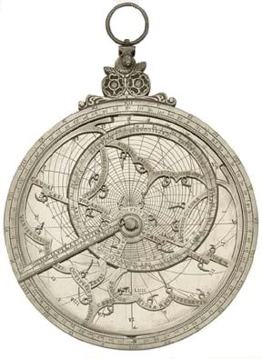
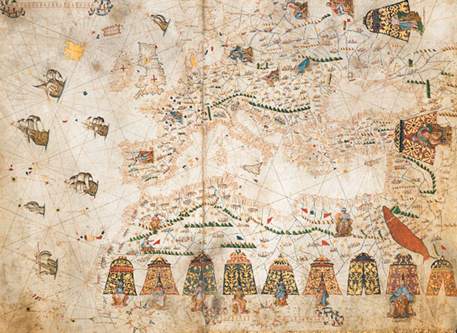
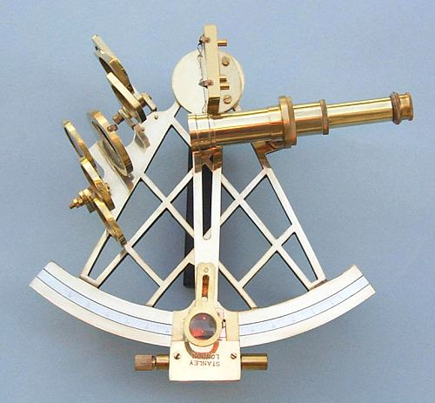
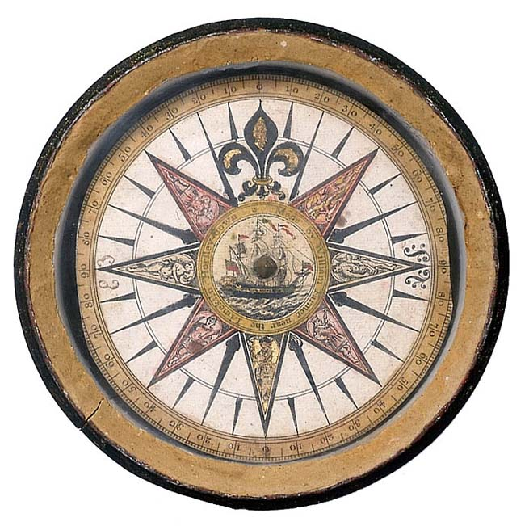
New Maritime Technologies
Better Maps [Portulan]
Hartman Astrolabe (1532)
Mariner’s Compass
Sextant

Slide 8
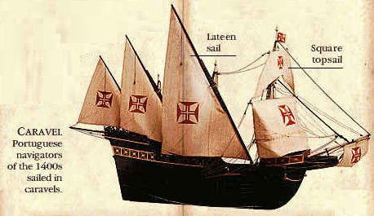
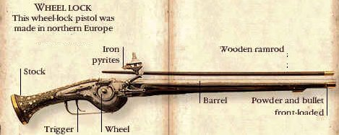
New Weapons Technology

Slide 9
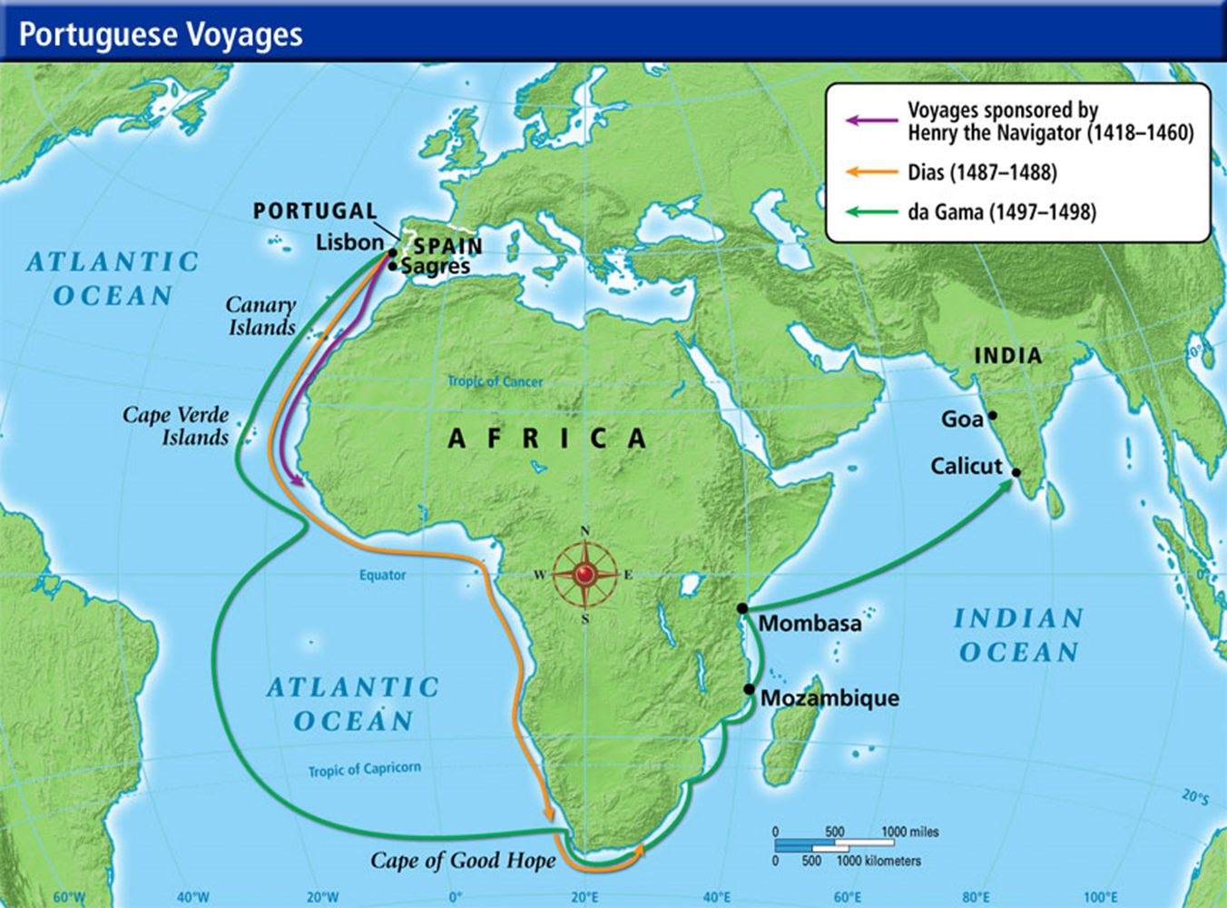
Portugal
Portugal's rulers
Excited for discovery
Wanted to cause harm to Muslim world
Thirst for wealth
15th century - Prince Henry the Navigator
Organized the first voyages along the Atlantic coast of Africa
1434- Portuguese began to press down African coast
Brought back slaves, spices, and stories of gold

Slide 10
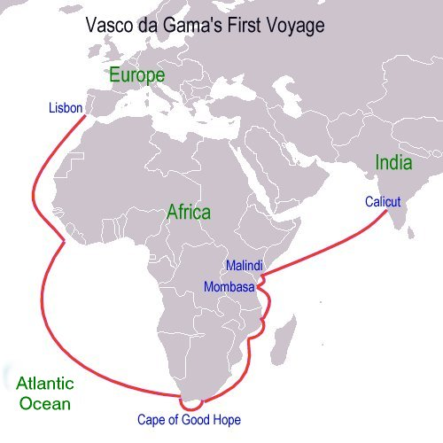
Vasco de Gama
succeeded in sailing around the Cape of Good Hope at Africa's southern tip
1498 - The first Portuguese captain to successfully reach India
Would give Europeans more access to luxury cloths and spice

Slide 11
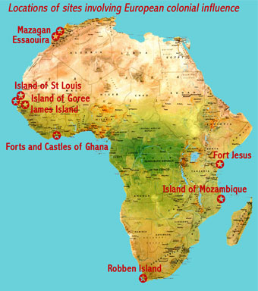
Forts
Set up by Portuguese on the coasts of Africa and India
Protect their commercial interests
Foreshadowing of Portuguese colonies
1514- the Portuguese had reached as far as the islands of Indonesia (center for spices) and China
1542 – Expedition reaches Japan

Slide 12
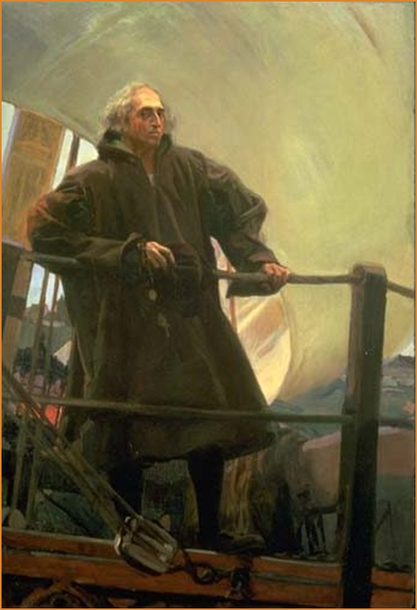
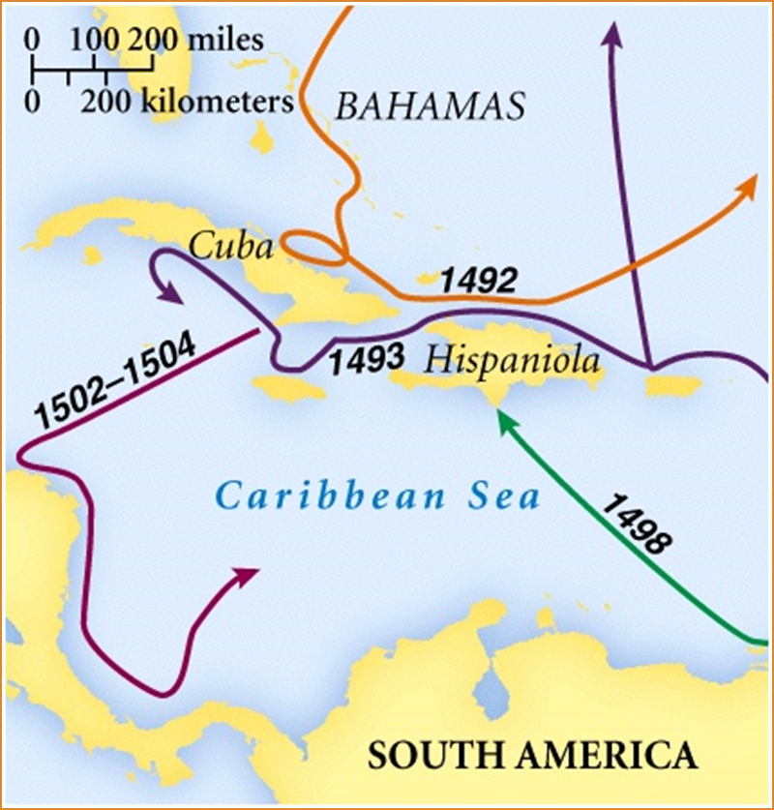
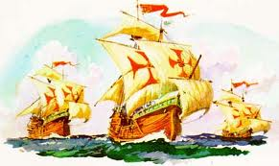
SPAIN
Spain
1492 - Freed from Muslim rule
Desire to convert others to Christianity
Interested in riches
1492 – first expedition of Christopher Columbus
Supported by the newly united Spanish Monarchy
Set sail for a westward route to India
led to the “discovery” of the Americas (New World)

Slide 13
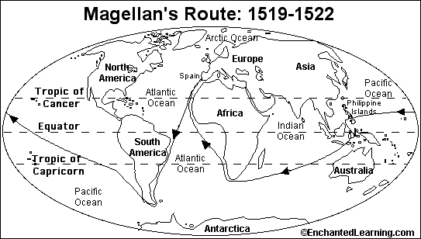
1519 – Spanish expedition under Ferdinand Magellan
Sailed around the tip of South America into the Pacific
1521 – reached Indonesian islands
First trip around the world
Claimed the Philippines
Held until 1898

Slide 14
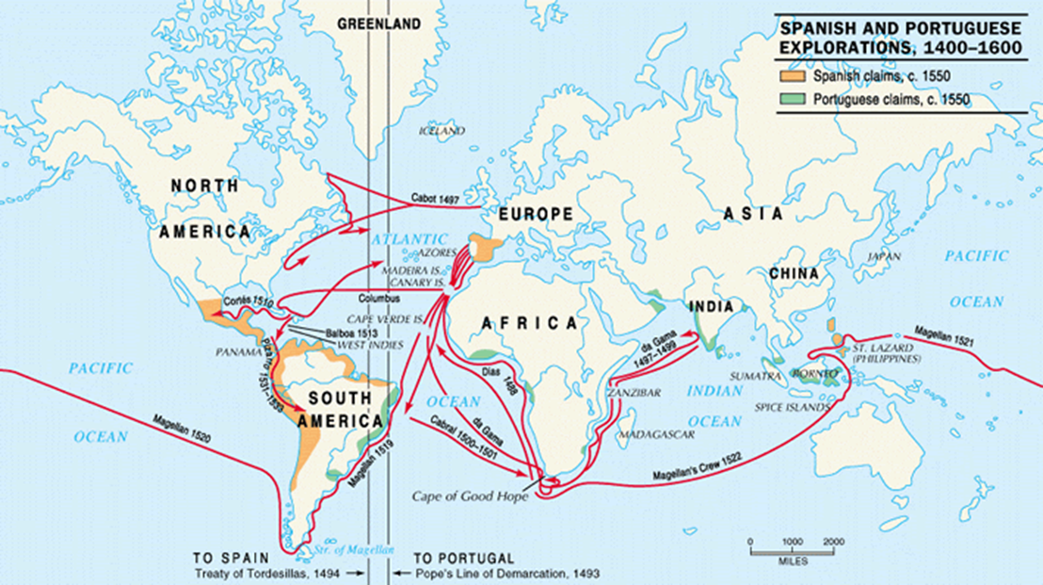
First round of exploration complete
Portugal
Coastal holdings in parts of Africa and India
Claim on Brazil
Spain
Philippines
Various Pacific islands
Bulk of Americas

Slide 15
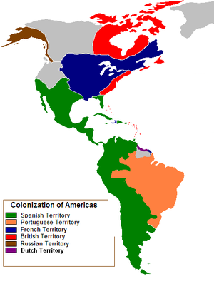
Northern European Expeditions
16th century – Northern Europe begins exploring
France and England
Strong monarchies
Britain and Holland (Dutch)
Protestants want to rival Catholics
Improve design of ocean vessels
Lighter, faster ships
1534 - French explorers first reached Canada
Pressed inland along the system of waterways to the Great Lakes and Mississippi River valley

Slide 16
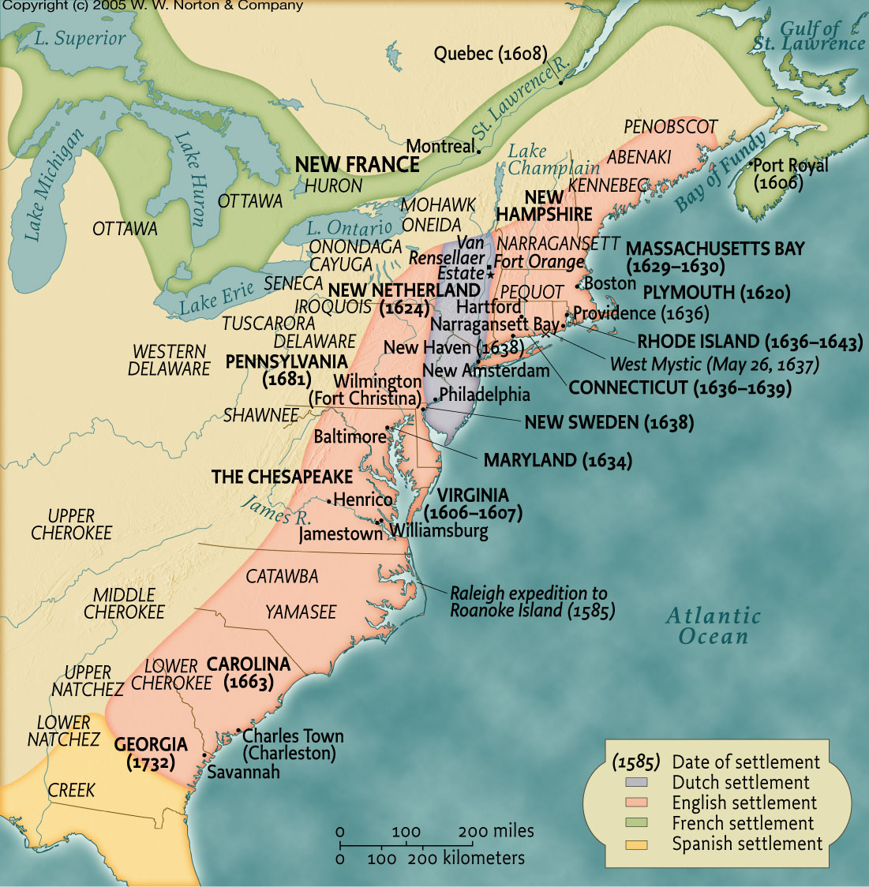
17th century -Britain
colonizes east coast of North America

Slide 17
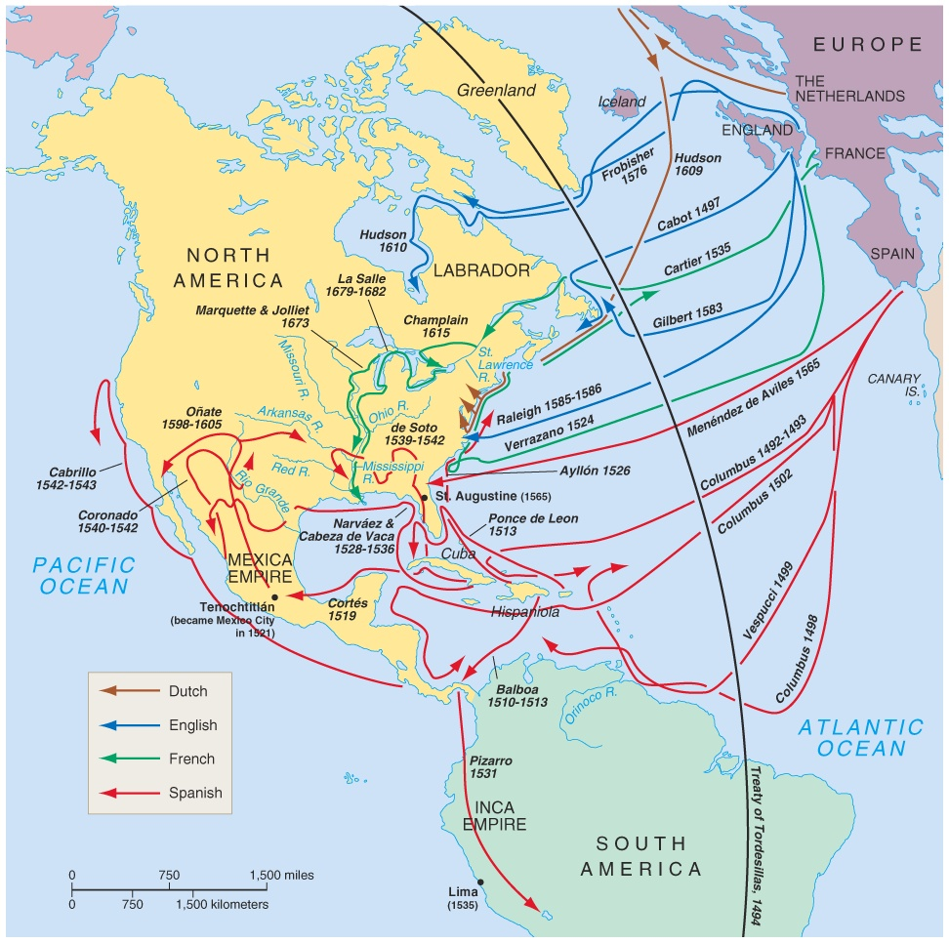
Atlantic Explorations

Slide 18
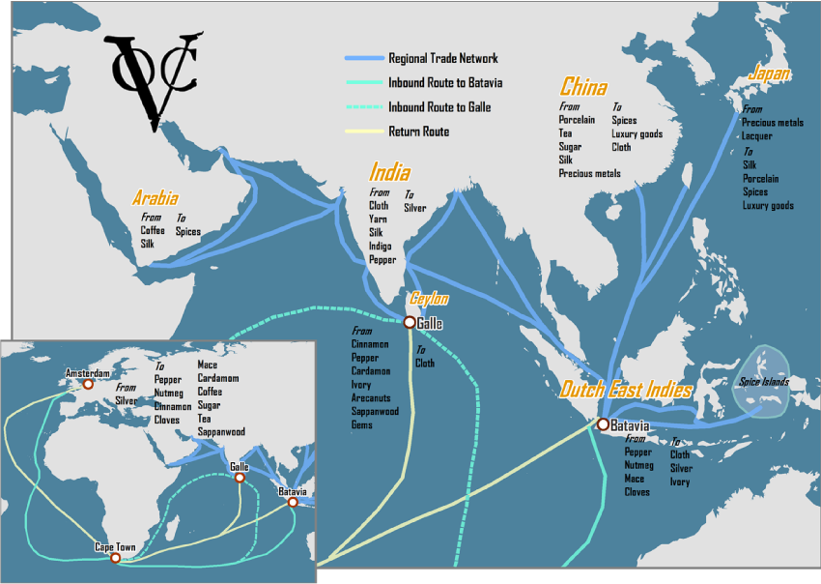
Early 17th century – The Dutch ousted the Portuguese from the Indonesian islands
Set up private trading company

Slide 19
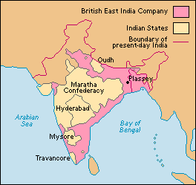
Creation of The Dutch East India Company and the British East India Company
Companies given government monopolies of trade in regions designated
Had rights to raise armies, tax, and regulate money
Amassed great commercial fortunes
Acted like independent governments in regions they claimed

Slide 20
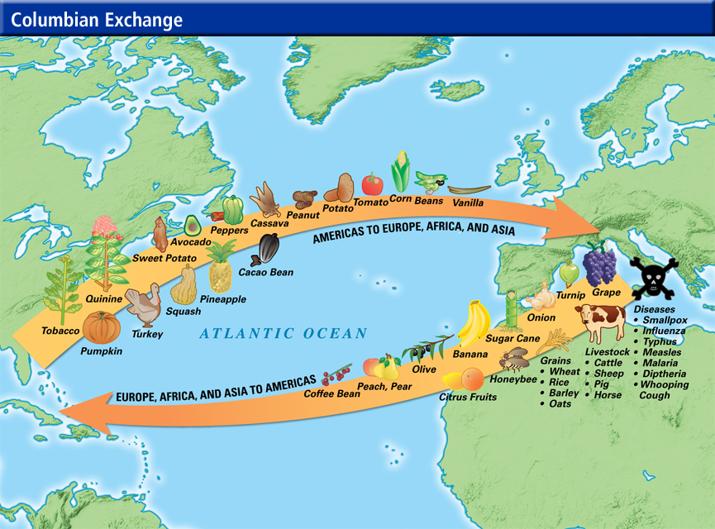

Slide 21
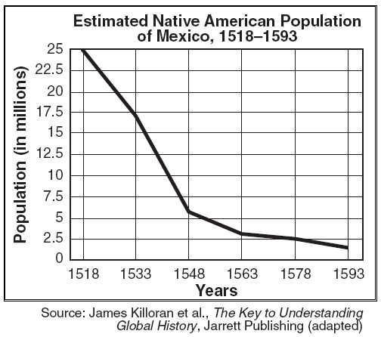
The Columbian exchange
16th-17th centuries - The indigenous peoples in the Americas suffered massive population loss
No natural immunities
80% of native population die
Opportunity for Europeans to forge a partially new population of their own citizens
Would lead to Atlantic Slave Trade

Slide 22
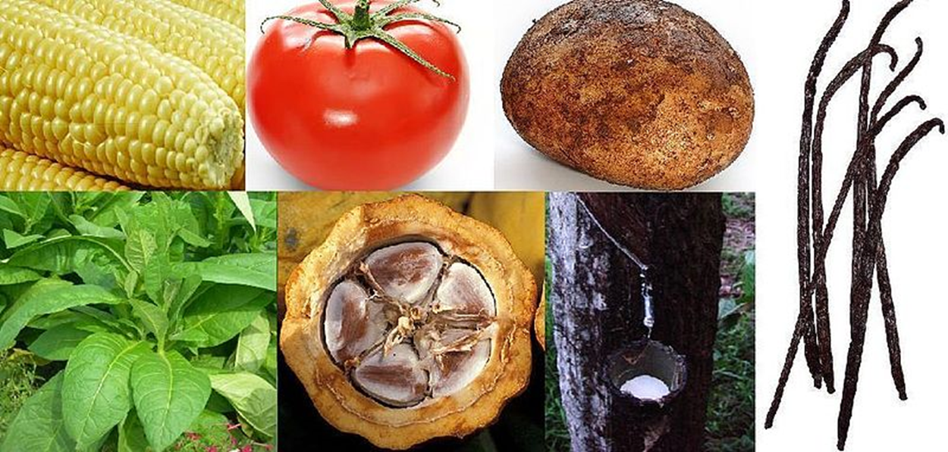
New world crops were spread rapidly by Western merchants
Americas
European and Asian animals were introduced, which had previously lacked animal power
Europe
Use of tobacco, sugar, and coffee spread
Corn and potato adopted later (late 17th century)
China, the Mediterranean, and parts of Africa
American corn and potatoes introduced
Triggered large population increases
New World native plants. Clockwise, from top left: 1. Maize 2. Tomato 3. Potato 4. Vanilla 5. Pará rubber tree 6. Cacao 7. Tobacco

Slide 23
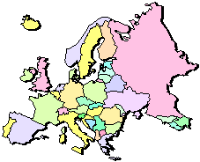
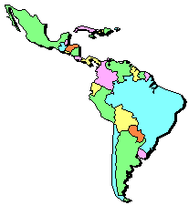
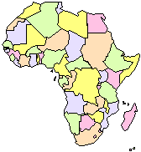
The “Columbian Exchange”
Squash | Avocado | Peppers | Sweet Potatoes
Turkey | Pumpkin | Tobacco | Quinine
Cocoa | Pineapple | Cassava | POTATO
Peanut | TOMATO | Vanilla | MAIZE
 | Syphilis
Trinkets
Liquor
GUNS
Olive | COFFEE BEAN | Banana | Rice
Onion | Turnip | Honeybee | Barley
Grape | Peach | SUGAR CANE | Oats
Citrus Fruits | Pear | Wheat | HORSE
Cattle | Sheep | Pigs | Smallpox
Flu | Typhus | Measles | Malaria
Diptheria | Whooping Cough

Slide 24
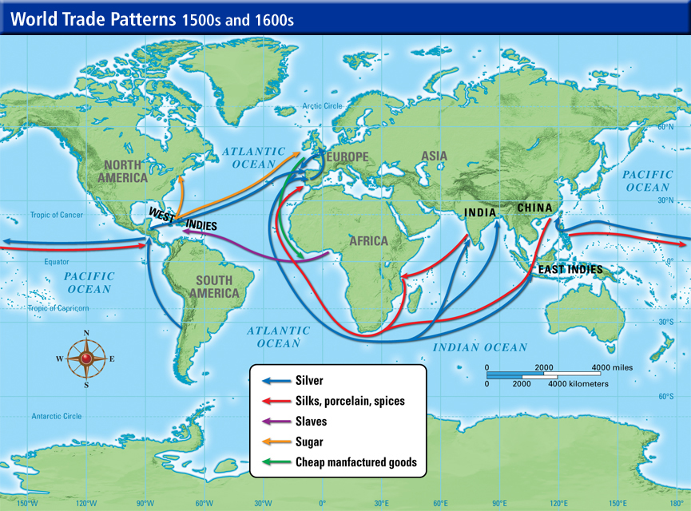
The West's Commercial Outreach
East coast of Africa – Muslim traders remained active
Trade continued with Middle East
However…
Western Europe dominated a great deal of oceanic shipping
Europe’s overall profits increase
Great merchant companies increased the European ability to determine the framework for international trade

Slide 25
Although western Europe did not conquer much inland territory in Africa or Asia, it did seek a limited network of secure harbors
Led by Spain and Portugal
17th century - Ports along west coast of Africa, parts of Indian subcontinent, and islands of southeast Asia
Served as areas for contact with overland traders (usually local merchants)
Provides access to inland goods not directly within the reach of the West

Slide 26
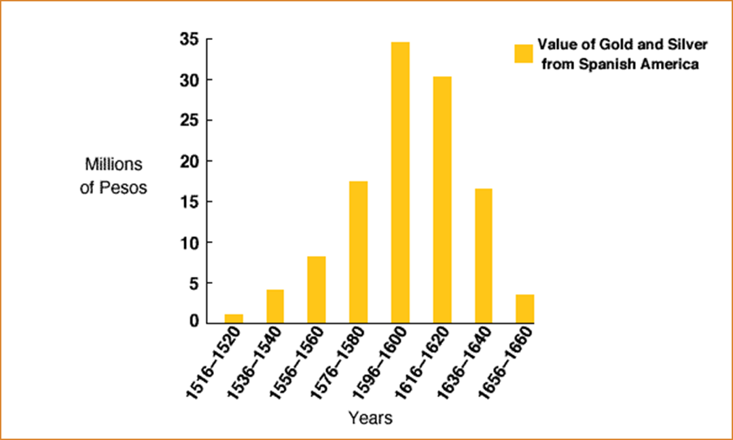
Imbalances in world trade
The greatest competition in world trade emerged between European nations themselves
Spain
Briefly dominates trade because of silver imports from Americas, but lacked a good banking system
England, France, and Holland
Profited more from world trade
Merchants had firmer status

Slide 27
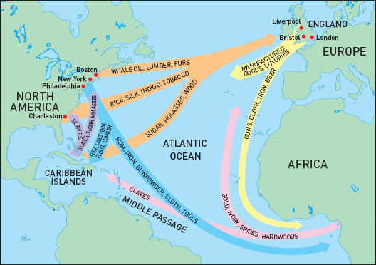
Western Europe expanded its manufacturing operations
Export – finished goods
Guns and cloth
Import – unprocessed goods
Silver and sugar

Slide 28
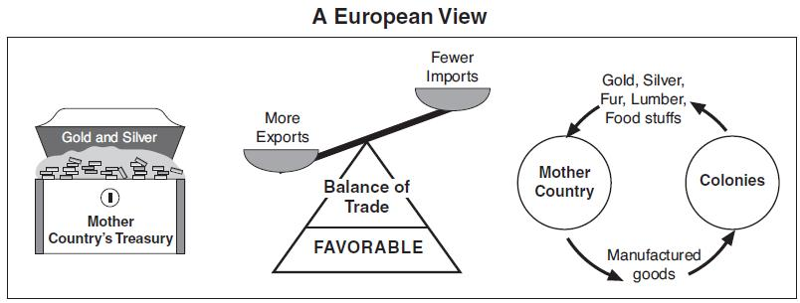
Mercantilism – Political/economic theory
Used by powerful European nations
Favorable balance of trade
Limit imports
Tariffs
Increase exports on own ships
Accumulate precious metals

Slide 29
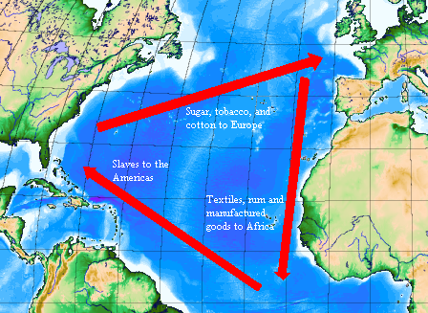
Parts of Sub –Saharan Africa
Mainly as suppliers of slaves
Supplier of unprocessed goods
Imported manufactured products from Europe

Slide 30
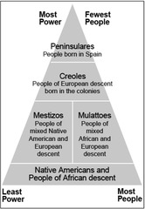
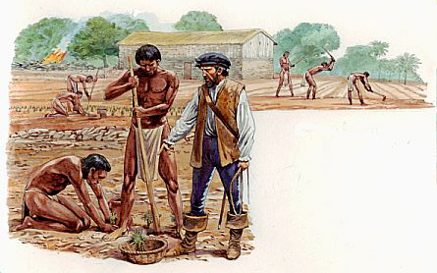
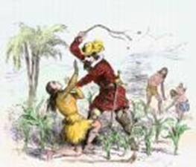
A System of International Inequality
Coercive labor systems
Atlantic Slave Trade
Latin America, the Caribbean, and the southern British colonies
Encomienda System
Forced labor of Indigenous peoples
Provided peninsulares with land and a specified number of native laborers
Peninsulares expected to protect natives, teach them Spanish, and convert them to Christianity

Slide 31
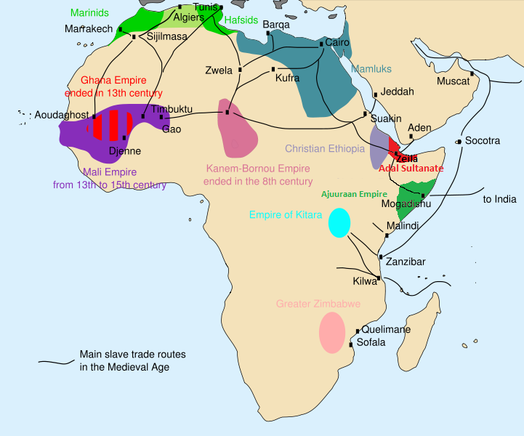
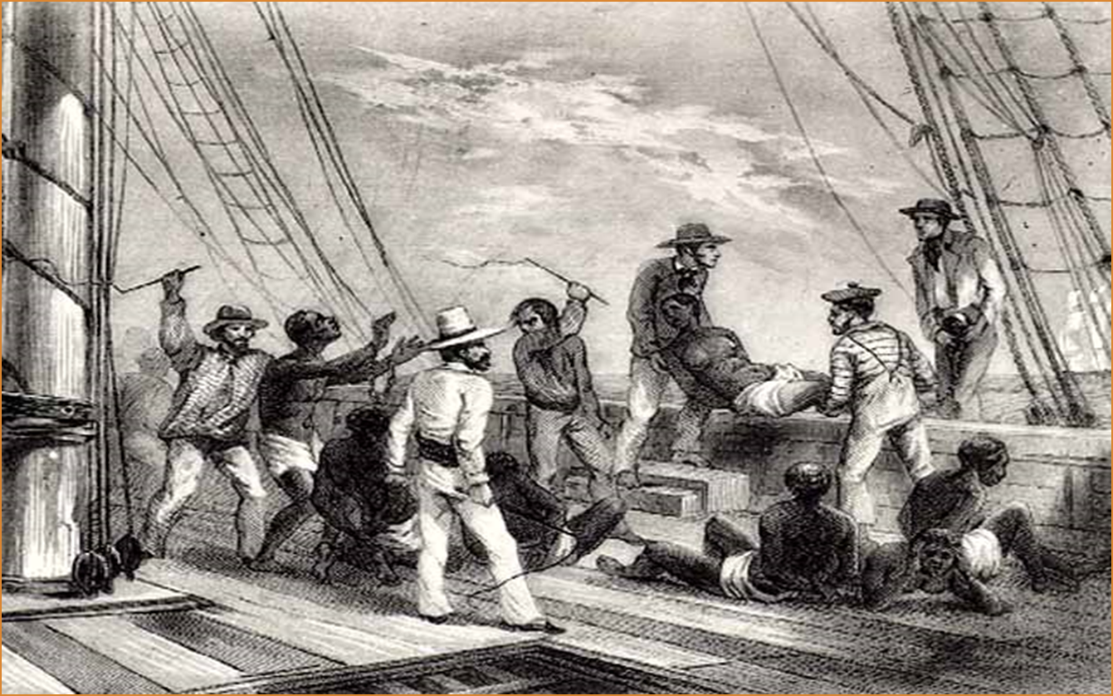
Existed in Africa before the coming of the Europeans
Portuguese replaced European slaves with Africans
Africans worked on sugar plantations
Between 16th and 19th centuries- about 10-12 million Africans shipped to the Americas
The Slave Trade

Slide 32
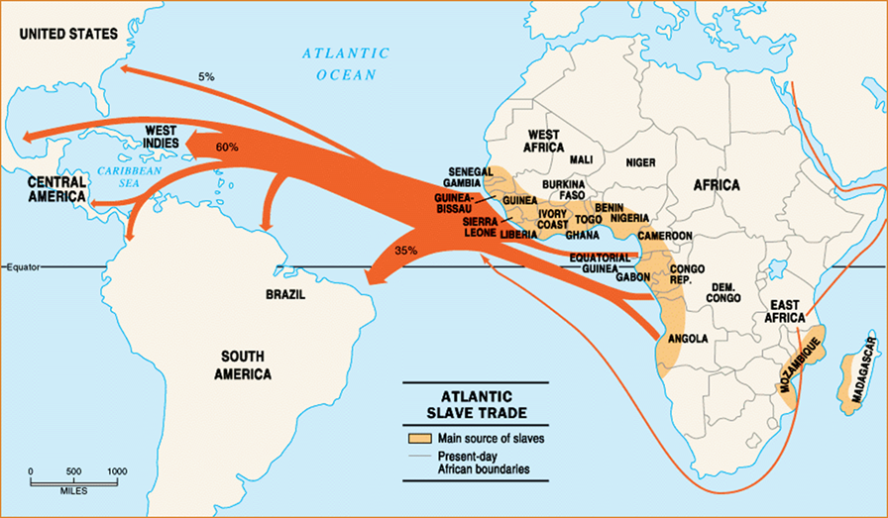

Slide 33
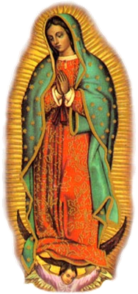
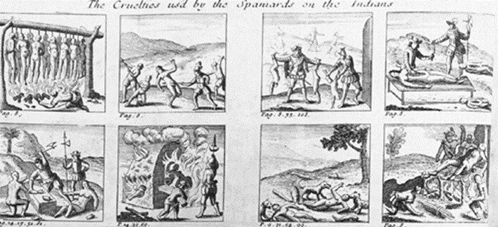
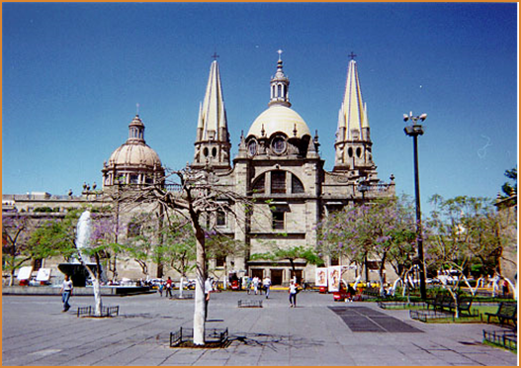
The Western control of the seas permitted Europeans to achieve dominance over a variety of cultures and peoples
Most colonies were immediately reduced to dependent status within the world trade system
Western leaders fostered colonialism as a means of creating controlled markets for manufactured goods

Slide 34
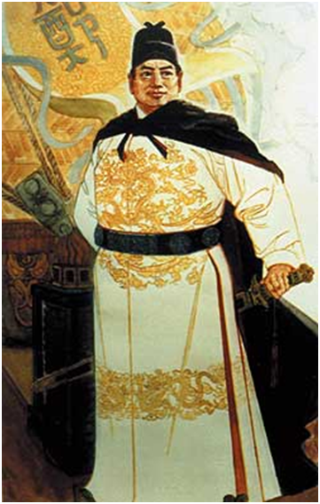
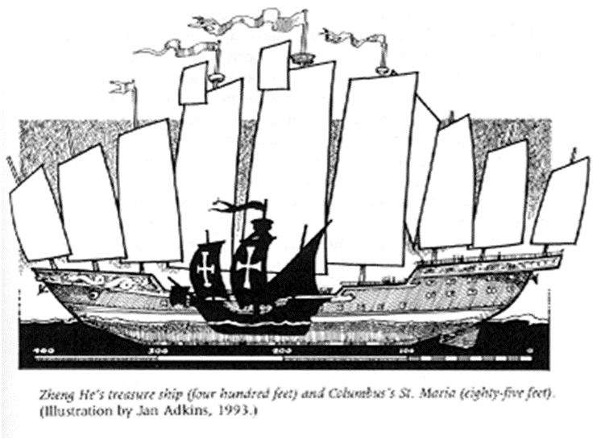
How much of the world economy?
18th century – East Asia remained most fully and consciously outside new world economy
China
Early 15th century: Abandoned large scale international trade
Avoided involvement with international trade on someone else’s terms
Europeans sent a large amount of silver to China to pay for goods they wanted
Depended on extensive government regulation, backed by a coastal navy (to keep Europeans in check)
Did not keep up with European developments (but also was not subservient to European merchants)
Had no need for outside goods
Europeans wanted their goods (“china”)

Slide 35
Japan
Stayed out of the new international trade network
17th-19th centuries – almost complete isolation
Leaders worried about the impact of Western culture
Internal divisions among warring lords
Threat of guns posed to samurai military dominance
Japanese were forbidden to travel or trade abroad
Small Christian minority suppressed

Slide 36
16th Century – Mughal Empire in India (like Ottoman and Safavid Empires in Middle East)
Focused on internal development and land based expansion and commerce
World trade was a sideline
Russia
stayed outside of network until the 18th century
Largely agricultural society
Conducted much of trade with nomadic people in central Asia
Africa
Not very influenced by world trade patterns
Exception: slave-trade

Slide 37
The expansionist trend
16th century – South America, the West Indies, part of North America, and some regions in west Africa
Dependencies
Late 17th century, Europeans move into India…
Western traders advance into India as Mughal empire began to fall apart
British and French East India Companies have increasing roles in international trade and administration
Early 18th century – Britain passes tariffs against cotton made from India
Intent : use India as a market for British-processed goods

Slide 38
From an Indian Observer
“But such is the little regard which they (the British) show to the people of this kingdom, and such their apathy and indifference for their welfare, that the people under their dominion groan everywhere, and are reduced to poverty and distress”

Slide 39
The Americas: Loosely Controlled Colonies
European guns, horses, and iron weapons offered advantages for the Europeans
Spain moved first
Spanish colonized several Western Indian islands soon after Columbus’s first voyage
First Hispaniola
Next…Cuba, Jamaica, and Puerto Rico

Slide 40
1509 – Spanish begin settlement on the mainland (in search of gold)
First colony established in what is now Panama
Under the direction of Vasco de Balboa
Separate expedition from Cuba launched the Spanish conquest of the Aztecs in Mexico
1531 – Expedition toward the Inca Empire
Hard fighting needed for victory
Several colonial expeditions spread from Columbia, other parts of the Andes, and portions of Argentina

Slide 41
Francisco Pizarro (1478-1541)
Attacked the divided Inca empire with 180 men
Capturing Emperor Atahuallpa, he accepted a large ransom and then strangled him
Founded Lima
At a dinner in 1541, was assassinated by a group of Inca rebels

Slide 42
Cycle of Conquest & Colonization
Explorers
Conquistadores
Official European Colony!
Missionaries
Permanent Settlers

Slide 43
The Treaty of Tordesillas, 1494
Line drawn by the Pope to satisfy tension between Portugal and Spain over colonial territory

Slide 44
Early colonies in the Americas typically were developed by small bands of gold-hungry Europeans
Loosely controlled by colonial administrations back home
Colonial rulers often established only loose controls over Indian populations at first
Content with tribute
Gradually… more formal administration spread as agricultural settlements were established
Official colonial systems took shape
Bureaucrats sent from Spain and Portugal
Active missionary efforts
Christianize the Indians

Slide 45
British and French North America: Backwater Colonies
European nations remained largely disinterested in the Atlantic colonies
supplied less valuable raw materials
Although the southern British colonies of the Atlantic coast did develop plantation economies, coercive labor systems, and patterns similar to the Caribbean and Latin America, as a whole, the North American colonies were of less economic value than their Latin American counterparts

Slide 46
British colonies were closer to European models of government, religion, and political theory.
Much of the Indian population reduced by disease and war
With less direct intervention on the part of the mother countries, the Atlantic colonies produced their own merchant class and engaged in international trade.
British attempts to regulate colonial trade came late in the eighteenth century and contributed to rebellion, the American Revolution
Influenced by the Enlightenment

Slide 47
Denser settlement led to almost total elimination of the indigenous populations of the Atlantic colonies
Colonists did not intermarry extensively with indigenous groups, as had occurred in Latin America
1700 - In plantation economies, colonists imported African slaves
More important to southern colonies
18th century – 23% of the population of English colonies was of African origin

Slide 48
North America and western civilization
Family patterns similar
Nuclear unit
Family affection
Even when colonies rebelled against European control (1776) they moved in the name of Western political ideas and economic goals against the dependency the British tried to imposed
Established a government that responded to the new Western political theories
Is the United States and western Europe similar today?

Slide 49
Africa and Asia: Coastal Trading Stations
Europeans content with negotiating with African Kings and merchants but not trying to claim large territories
Deterred by climate, disease, and nonnavigable rivers
Two Exceptions
1652 – Dutch established Cape Colony
South Africa
Intent: form coastal station to supply Dutch ships bound for Asia
Led to conflict with the Bantus
Spain controls Philippines
Sent active missionaries

Slide 50
Early 17th century - British and French began to struggle for control of India as Mughal Empire weakened
French and British forts doted the east and west coasts of the Mughal Empire before it fell in 1707
British East India Company had two advantages in this competition over this French
Through negotiation with local princes, it gained a station at Calcutta
* Gave British access to wealth of the Ganges River
Company has enormous influence over British government
* use of Britain’s superior navy, excellent communication networks over ocean routes

Slide 51
Mid-18th century – French/British rivalry continued
Both sides recruited Indian princes and troops as allies
1774 – warfare
1756 – Indian ruler attacked and captured the British base at Calcutta
East India Company’s army recaptured Calcutta and then seized additional Indian and French territory
French power in India was destroyed

Slide 52
Late 18th century – British government took a more active hand in Indian administration
Britain gained some new territories by force but was also content to form alliances with local princes without disturbing their internal administration

Slide 53
Impact on western Europe
Colonial rivalries and wars added to existing hostilities between key nation states
England and Holland turned against Spanish success
Dutch vs English
British v French
Colonial production of sugar permitted its use to become widespread among all classes in Europe. In Africa and Asia, Western colonial penetration affected civilizations, but did not attempt to Europeanize them. Western colonialism had a more dramatic effect on Latin America, but even there indigenous cultures survived.

