Slide 1
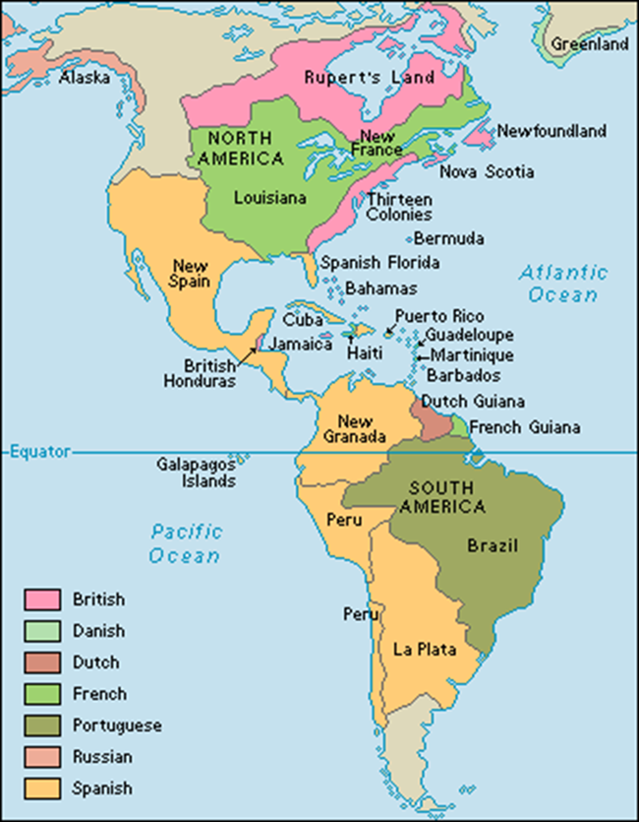
The Consolidation of Latin America 1830-1920

Slide 2
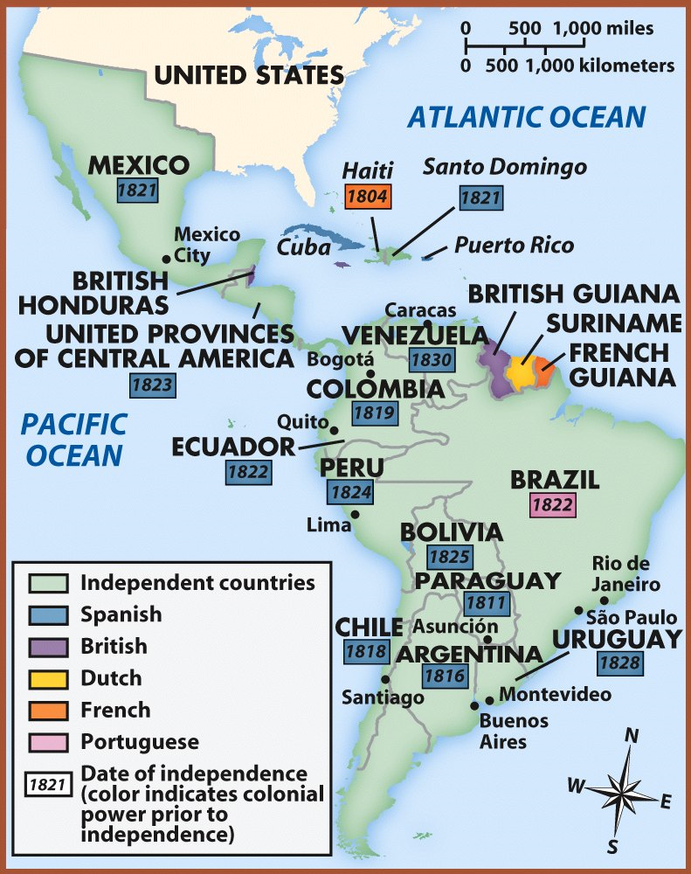
Introduction
19th century - European imperialism swallowed up much of Southeast Asia, India, Africa, and the Pacific
Three areas escaped the imperialist : East Asia, Russia, and the Middle East
More surprisingly, Latin America, one of the earliest European colonial ventures, successfully cast off European political control and gained independence
Early 19th century

Slide 3
Latin American leaders in the 19th century shared Western political views
Virtues of progress
Reform
Representational and constitutional government
Private property rights
Latin American leaders faced problems
Colonial heritage
Little tradition of participatory government
Highly centralized colonial state created dependence on central authority and resentment
Class and regional interests divided new nations
Wealth unequally distributed
Rise of European industrial capitalism created an economic situation that put new nations in a weak and dependent position

Slide 4
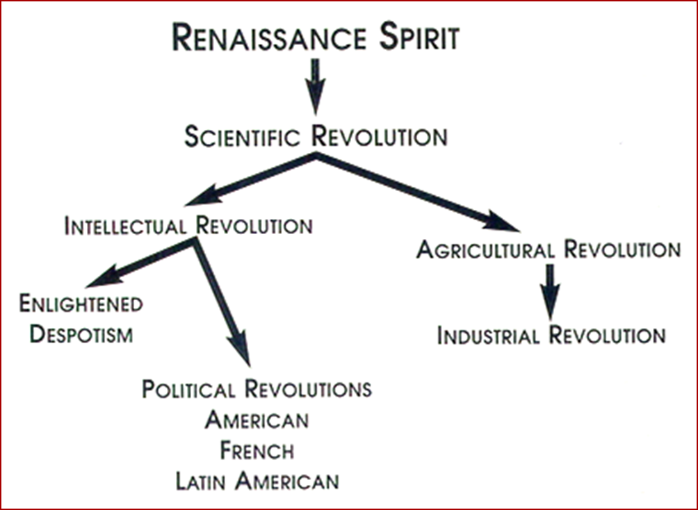
Causes of political change
Late 18th and early 19th centuries – Latin American leaders were moved by the same ideas as those seeking political change elsewhere in the Atlantic world

Slide 5
Causes of Latin American Revolutions
Enlightenment Ideas → writings of John Locke, Voltaire, & Jean Rousseau; Thomas Jefferson and Thomas Paine.

Slide 6
1. Enlightenment Ideas
Laws of nature [NATURAL LAWS] govern natural science and human society.
Give people rights → life, liberty, property!
Make fair societies based on reason possible.
Challenged the theory of “Divine Right” monarchy.

Slide 7
Causes of Latin American Revolutions
2. Creole discontent at being left out of government jobs and trade concessions
Creole elites could not support rejecting the church’s authority or the social leveling implied by the Declaration of Rights of Man

Slide 8
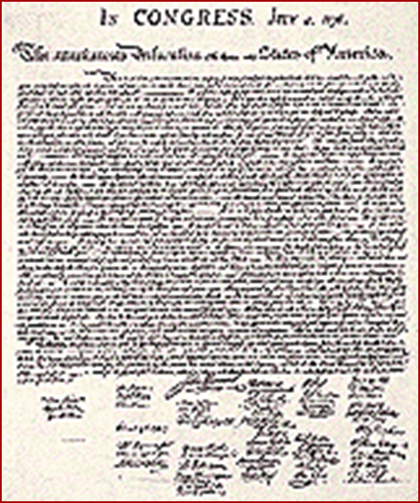
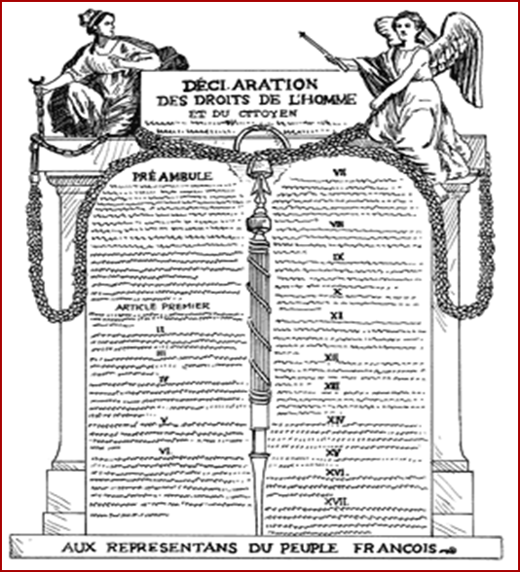
3. Inspiration of American and French Revolutions

Slide 9
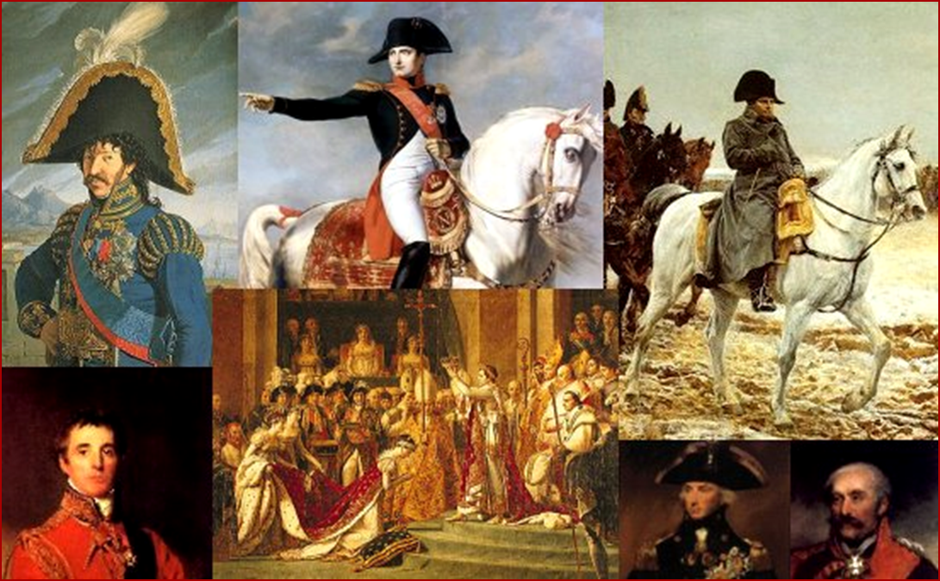
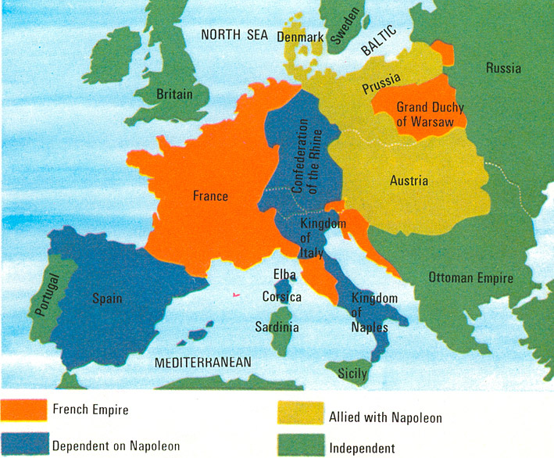
4. Preoccupation of Spain & Portugal in fighting the Napoleonic Wars.

Slide 10
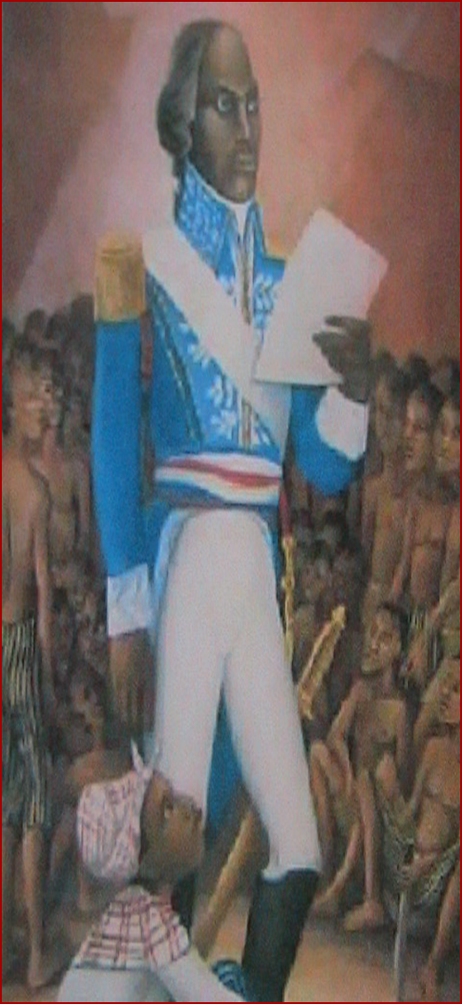
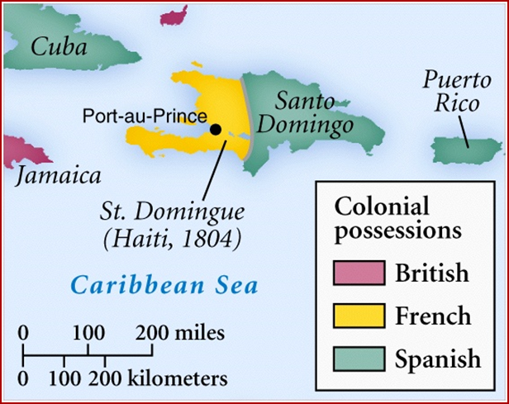
1804 – Touissant L’Overture led a revolution in Haiti
Overthrew French rule
Was the first all black independent nation
For Latin American elites, Haiti was an example to be avoided
The threat of general social disorder and of slaves becoming their own masters so frightened them that they became even more unwilling to risk political change
Cuba and Puerto Rico were among the last of Spain’s colonies to gain independence
For slaves and free people of color, Haiti became a symbol of freedom and hope

Slide 11
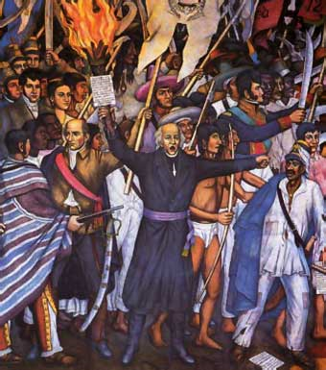
Mexico
1810 - Rebellion in Mexico began by Father Miguel de Hidalgo, who called on the support of mestizos and Indians
Won early battles, but eventually lost support of Creoles (feared social rebellion)
Captured and executed

Slide 12
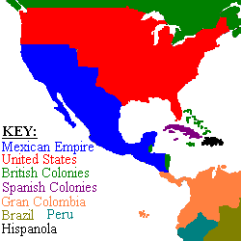
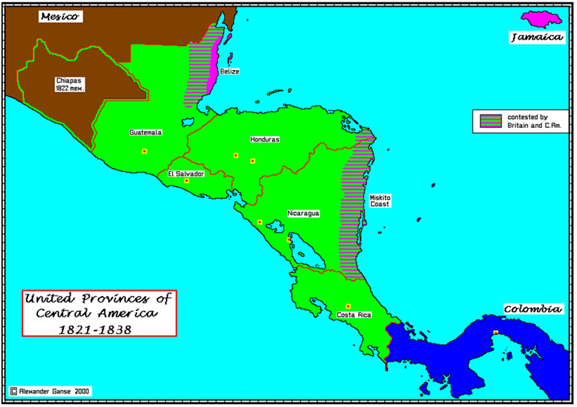
1820 – events in Spain weakened the king and the central government
Creoles in Mexico were willing to move toward independence
1821 - Augustin de Iturbide
Creole military officer
seized Mexico City and proclaimed himself emperor
Mexico quickly abandons monarchy, becomes a Republic, but remained unstable
Military coups, financial failures, foreign intervention, and political turmoil
Central America was briefly attached to the Mexican Empire, which collapsed in 1824
After attempting union until 1838, split apart into independent states
Geographical barriers and cultural differences

Slide 13
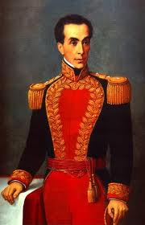
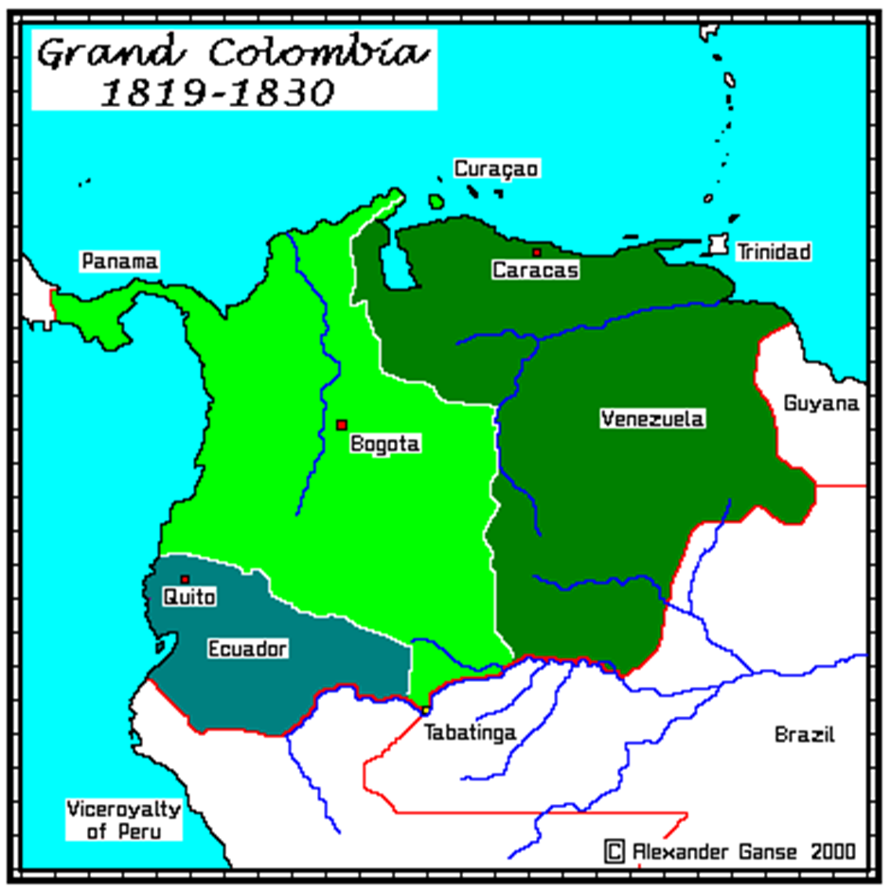
South America
Simon Bolivar emerged as the leader of the revolutionary forces in northern South America
Wealthy Creole officer
Military skill
Passion for independence
1817-1822- Defeated Spanish forces in Venezuela, Colombia, and Ecuador to form the new nation of Gran Colombia
Broke up due to political and regional differences

Slide 14
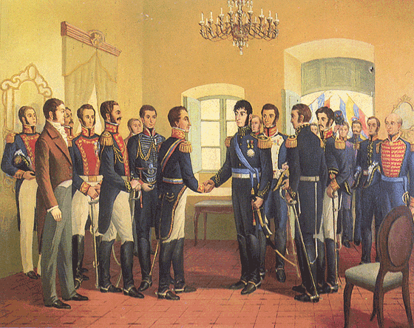
Simón Bolivar Meets José de San Martin

Slide 15
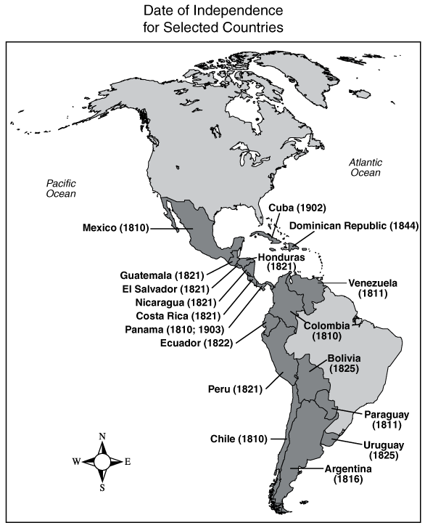
In southern South America, the revolutionary leader was Jose de San Martin
By 1824 - San Martin had defeated the Spanish forces in Argentina, Chile, and Peru
All of Spanish South America had won independence by 1825

Slide 16
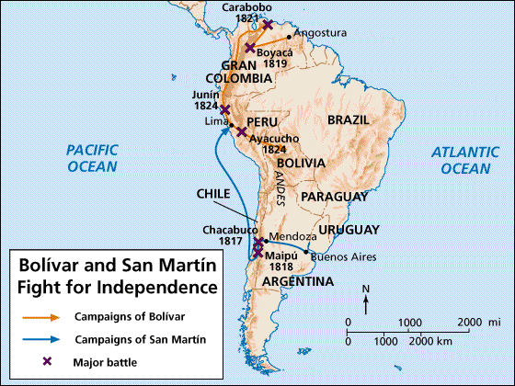
Bolivar & San Martin Fight for Independence!

Slide 17
Brazilian Independence
End of 18th century – Brazil had grown in population and economic importance
Growth of European demand for colonial products
Sugar, cotton, cacao contributed to the growth of slave population
Late 1700s - “Men established in goods and property were unwilling to risk political change”
1807 - Napoleonic invasions –
Portuguese royal family and court fled to Brazil
Brazil = Portugal
1822 – Dom Pedro I claimed independence from Portugal and becomes constitutional Emperor of Brazil

Slide 18
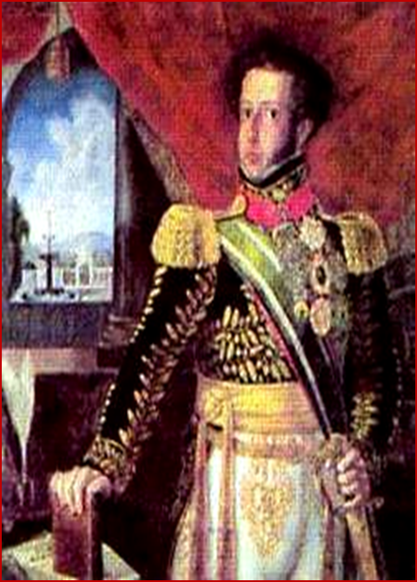
1807 - 1820
The Portuguese King, Dom Joao VI, lived in Brazil and rule his empire from their
Rio de Janeiro turned into a capital city
Public library and botanical gardens
Printing presses used in colony for first time
Schools created
Commerce boomed in newly opened ports
Especially with England
Arrival of many Portuguese bureaucrats and nobles with the court created jealousy and resentment
1820 – defeat of Napoleon in Europe and a liberal revolution in Portugal
King Dom Joao VI sent back to Portugal and left his young son Pedro as his replacement
September 1822 – Dom Pedro I declared Brazilian independence
Became constitution emperor of Brazil
Brazilian independence did not change the existing social organization based on slavery or the political structure

Slide 19
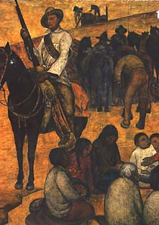
Independence Brought More Poverty
The wars disrupted trade.
Venezuela, Mexico, Columbia
The wars devastated the cities and the countryside.

Slide 20
New Nations, Confront Old and New Problems
1830 – former Spanish and Portuguese colonies had become independent nations
Many of the leaders of independence had shared ideals
Representative government
Careers open to talent
Freedom of commerce and trade
Right to private property
Belief in the individual as the basis of society
Debate over freedom of religion – most leaders wanted Roman Catholicism to be official religion of new states, while others tried to end the exclusion of other faiths
The ideals of the early leaders of independence often were egalitarian
1854 – slavery had been abolished everywhere except Spain’s remaining colonies, Cuba and Puerto Rico, as well as Brazil
Areas where economy was heavily reliant on slavery
Egalitarian sentiments often were tempered by fears that the mass of population was unprepared for self-rule and democracy
Early constitutions – imposed property or literacy restrictions on voters (men)
Women were still subjugated and usually not allowed to hold public office

Slide 21
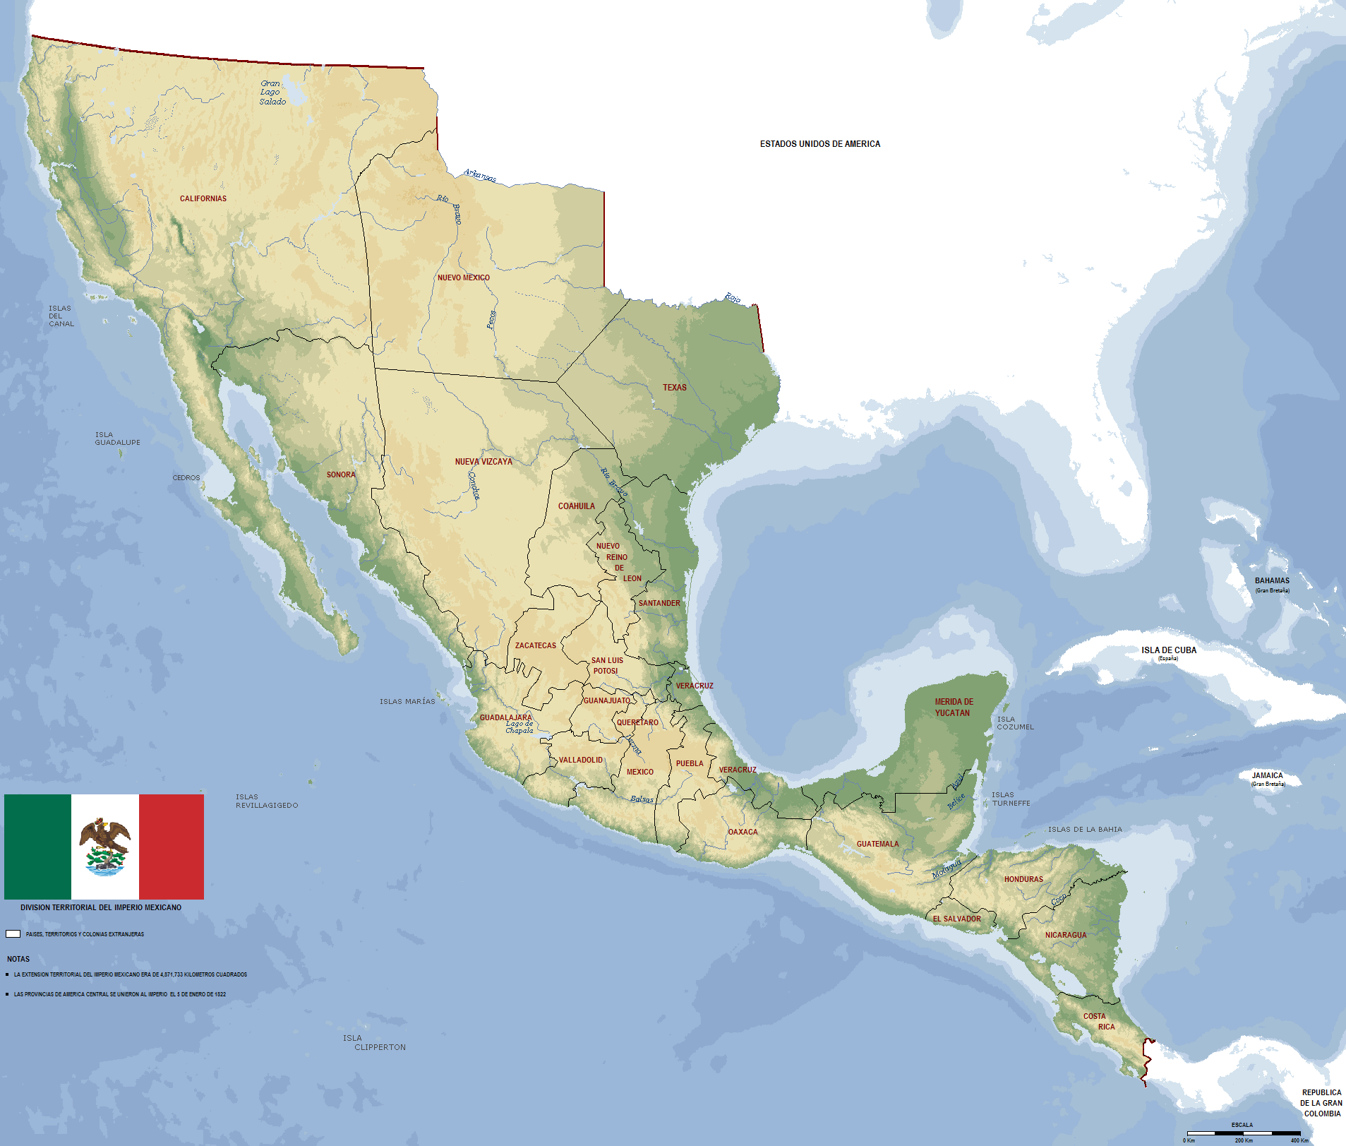
Political Fragmentation
Some of the early leaders for independence had dreamed of creating a unified nation in some form, but things never worked out
Mexico Empire
New Granada
United Provinces of Central America
Most attempts at consolidation and union failed
Enormous geographic barriers
Roads/transportation poor
Regional rivalries
Political divisions
Economic competition

Slide 22
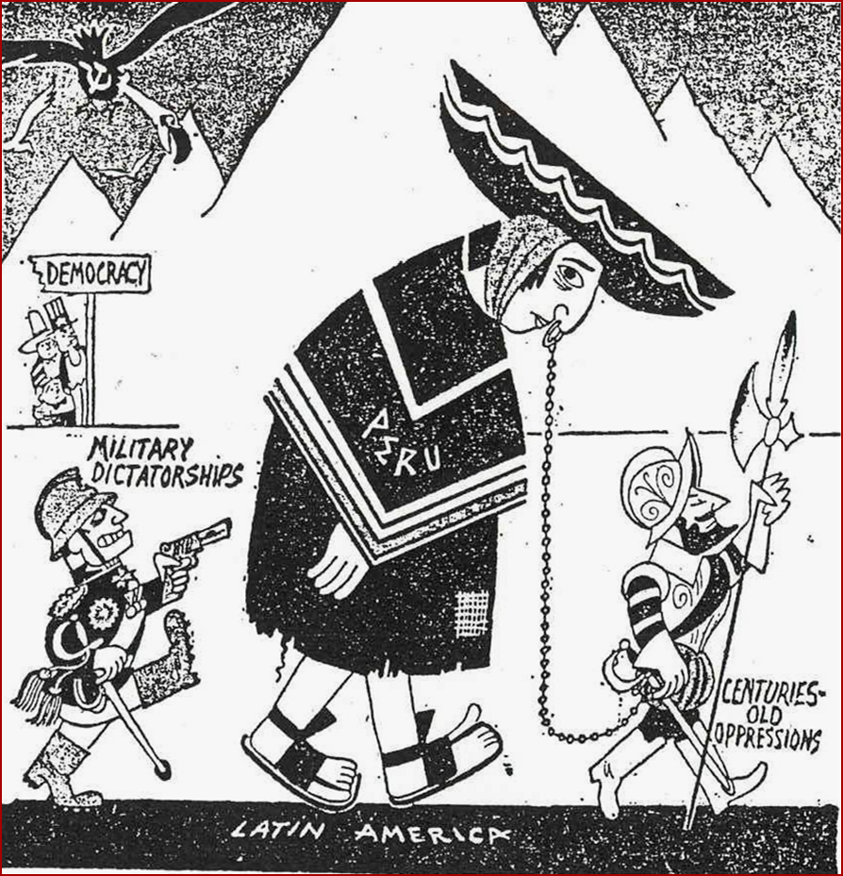
Caudillos, Politics, and the Church
After gaining independence, more than a decade of warfare in places such as Venezuela, Colombia, and Mexico had disrupted the economies and devastated wide areas
Led to the rise of caudillos
Independent leaders who dominated local areas by force
Military dictators
Sometimes seized the national government
Regional or national caudillos usually were interested in power for their own sake
Often defended the interests of regional elites, usually land owners
Some defended the rights of Indians, peasants and the poor, but overthrew governments and took away rights after gaining power

Slide 23
Disagreements over government centralization
Federalists - regional governments to establish policies
Tended to be liberal
Limit the role of the Church in civil affairs, stress rights of the individual
Centrists - wanted powerful, central administrations
Tended to be conservative
Keep Catholic Iberian heritage alive
Constitutions and leadership came and went swiftly
Political turmoil and insecurity in much of Latin America in first 50 years after gaining independence

Slide 24
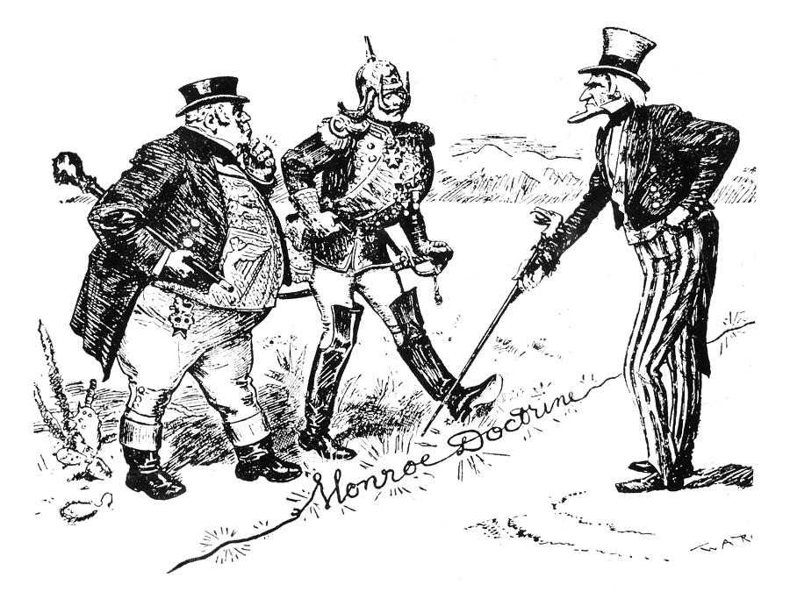
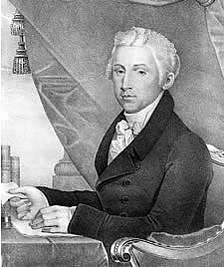
Latin American Economies and World Markets (1820-1870)
New nations sought diplomatic recognition and security
1820s- plans to help Spain recolonize Latin America
1823- Monroe Doctrine– any attempt by a European power to colonize in America would be considered an unfriendly act by the United States

Slide 25
Before 1850 - Little capital had been invested directly in Latin America
Latin American governments now turned to foreign governments and banks for loans
Britain became a major consumer of Latin American products
In return, Britain sold about 5 million pounds worth of manufactured goods to new nations each year
Half to Brazil
1860 - Other countries trade with Latin America (France, United States), but most trade was with Britain
Latin America became increasingly dependent on foreign markets and foreign imports
Reinforced old colonial economic heritage – land was the basis of wealth and prestige

Slide 26
Mid – Century Stagnation
1820-1850: economy of Latin America stagnant
Mining sector slow
Transportation network and port facilities under-developed
Lacked capital for investment for industry
Exception: Cuba (sugar economy)
Still colony of Spain
After 1850 – expansion of European economy created new demands for Latin American products, allowing some Latin American government to address social issues
Brazil – coffee
Argentina – hides and beef
Chile – minerals and grains
Peru – guano (bird droppings)
Allowed government to end Indian tribute and abolish slavery

Slide 27
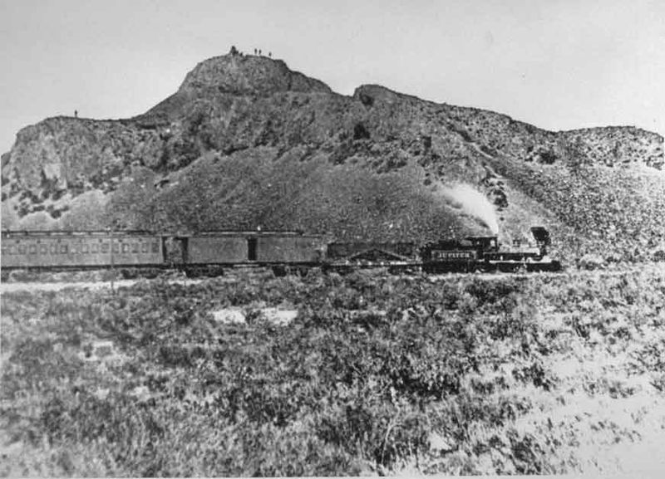
1840s – steamship lines
Improved communication within countries
Opened new possibilities for international commerce
1860s – railroads built
Linked export-producing regions to ports
As levels of exports and governments’ dependence on them increased, Latin America’s vulnerability to the world economy increased
United States gets a cold, Mexico gets phenomena

Slide 28
Economic Resurgence and Liberal Politics
Late 1800s – liberals returned to power in many places in Latin America and began to transform their nations
Caused by Industrial Revolution and Imperialism
The ideological basis of the new liberal surge was changing as the result of the industrial revolution and the age of imperialism
French philosopher Auguste Comte – positivism
Stressed observation and a scientific approach to the problems of society
Application of science to industry created new demands for Latin American products
Copper, rubber, wheat, sugar, and coffee

Slide 29
1820-1880: population of Latin America doubled
More than 43 million
After 1850 – economies grew rapidly
Economic growth and progress were costly
Land owners increase land holdings, peasants lose
Church lands were seized in Mexico
Expansion of exports: Colombia, Argentina, Brazil
Desire for capitalism from Latin American leaders
Post 1860 – liberal leaders
Inspired by England, France, United States
Stressed progress, education, and free competition within a secular society
Distrustful of the masses
“ideas out of place”
Prevented progress that many leaders had desired

Slide 30
Mexico: Instability and Foreign Intervention
Mexican constitutional Republic established in 1824
Influenced by France, United States and Spain
Federalism; guaranteed civil rights
Constitution did not address nation’s continuing social problems
Maldistribution of land
Status of Indians (did not recognize them)
Problems of education
Vast numbers of poor people
Political struggle between conservative centralists and liberal federalists
1832-1835 – Valentin Gomez Farias
Liberal
Social and economic reforms
Attacked church
Led to violent reaction and lose of power

Slide 31
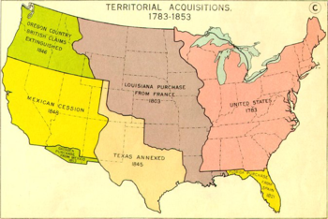
1835, Antonio Lopez de Santa Anna
Military dictator
Typical caudillo, autocratic leader
Mexico’s instability and financial difficulties made it a target for foreign intervention
1845- Annexation of Texas
Failure to suppress the Texas independence movement led to the United States' annexation of the region
Manifest destiny

Slide 32
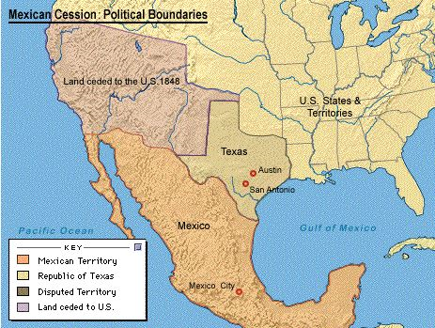
Mexican-American War (1846)
Santa Anna returned from exile to lead Mexican forces
1848 – Mexico forced to sign the Treaty of Guadalupe-Hidalgo
United States acquired half of Mexico territory (5% of pop)

Slide 33
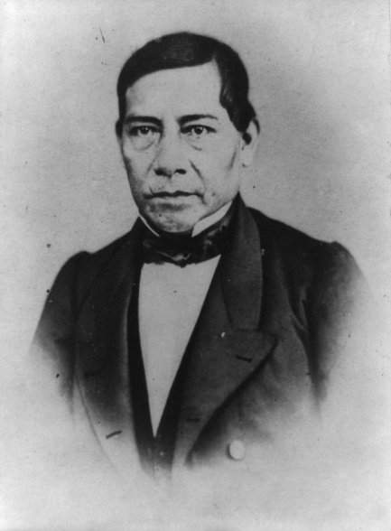
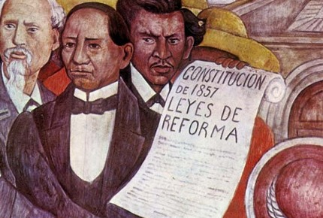
Benito Juarez replaces Santa Anna
liberal
Reduction of military and church privileges
1854 - La Reforma is not successful
Goal : create a nation of small independent farmers
Land that was supposed to be sold to Indians was bought up by speculators or wealthy hacendados/land owners
1910 – half of Mexico’s rural population was landless
1862 – Conservatives convinced France to overthrew the republic and placed Maximilian von Habsburg on the throne as emperor
Good intentions, but ineffective
Juarez rejected idea of a foreign prince ruling Mexico
1867 - Mexican liberals returned to power under Benito Juarez
Administration increasing autocratic

Slide 34
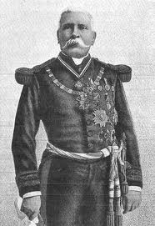
1876-1910: Porfirio Diaz, was elected president of the Mexican republic
Created rapid economic growth
Encouraged foreign investment
Built up the nation's infrastructure
Initiated industrialization
Virtual Dictator
Suppressed all political opposition
In 1910, popular dissatisfaction with Díaz's regime resulted in the Mexican Revolution

Slide 35
Argentina: The Port and the Nation
1820s – In Buenos Aires, the liberals gained control
Instituted a series of broad reforms in education, finance, agriculture, and immigration
Included a program of public land sales, which stimulated the growth of cattle ranches and the power of the rancher class
The secular and progressive programs of the Argentine liberals were similar to the program of Gomez Farias in Mexico
Produced a similar negative reaction from conservatives and the church, especially when church lands were confiscated and freedom of religion legislated

Slide 36
1862 – Argentine Republic
Entered into a period of prosperity and growth under a series of liberal presidents
Programs similar to Reforma in Mexico
Between 1862-1890: able and intelligent presidents initiated a wide series of political reforms and economic measures designed to bring progress to Argentina
Political stability made investment more attractive to foreign banks and merchants
Expansion of Argentine economy created prosperity
Increased exports of beef, hides, and wool
Foreign trade in 1890 was five times as great as it had been in 1860
Population tripled to more than 3 million as the agricultural expansion, high wages, and opportunities for mobility attracted large number of European immigrants
With increased revenues, the government imitated reforms in education, transportation
Often turned to foreign models and foreign investors
Increased feeling of national unity

Slide 37
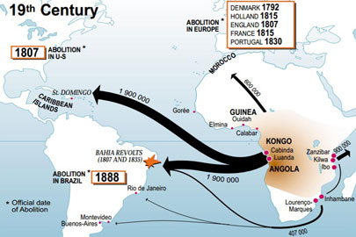
The Brazilian Empire
1822 – Brazil gained independence from Portugal
1824 – Established a liberal constitution issued by Dom Pedro I
1831- Dom Pedro I was forced to abdicate in favor of his young son, Pedro (Dom Pedro II)
Brazil society – slavery, large landholdings, export economy
The Brazilian economy was revolutionized by the emergence of coffee as an export crop
1860 – coffee made up 60% of exports
Slavery was intensified as a source of coercive labor
1.4 million Africans imported in the last 50 years of the trans-Atlantic slave trade
1888 - Slavery abolished in Brazil

Slide 38
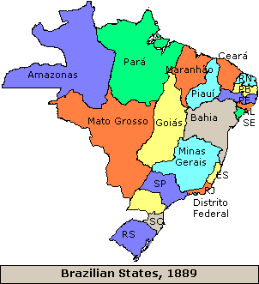
After 1850 – considerable growth and prosperity in Brazil
Improved infrastructure
Railroads, steamships, telegraph
Foreign companies invested in these projects as well as banking
European immigration to Brazil
Italy and Portugal
1850-1875: more than 300,000 immigrations arrived in Brazil
More than 2/3 worked in coffee trees of south Brazil
The monarchy did not long survive the abolition of slavery
1889 – A Republic was established

Slide 39
Old Patterns of Gender, Class, and Race
19th century – time of great change and transformation in Latin America, but effects were not felt equally by all classes or groups in society
Women gained little ground in society
Participated actively in independence movements
Expected to be wives and mothers
Could not vote
Could not participate in government
Could not be lawyers or even testify in court
Once married, could not work or enter into contracts, or control their own estates without permission from their husbands
Lower class women had more economic freedom
Controlling local markets
More personal freedom than elite women under constraints of powerful families
Legal terms were about the same, and material terms much, much worse
By 1870 – women more important to workforce

Slide 40
By 1842- Mexico City required boys and girls aged 7 to 15 to attend school
Public schools appeared throughout Latin America
Minimal impact
Literacy rates remained low
Most teachers were women, giving them new opportunities
New nations legally ended the old society of castes in which legal status and definition depended on color and ethnicity
Reality – much of the system continued
Stigma of skin color and former slave status created barriers to advancement
Indians continued to labor under poor conditions and suffer effects of government failures
Mexico, Bolivia, and Peru

Slide 41
The Great Boom: 1880-1920
Between 1880-1920: Latin America (like areas of Asia and Africa) experienced a tremendous spurt of economic growth
Stimulated by the increasing demand in industrializing Europe and USA for raw materials, foodstuffs, and specialized tropical crops
Mexico and Argentina
Latin America was prepared for export led economic expansion
Liberal ideology
Individual freedoms, open market, limited government intervention in economic system

Slide 42
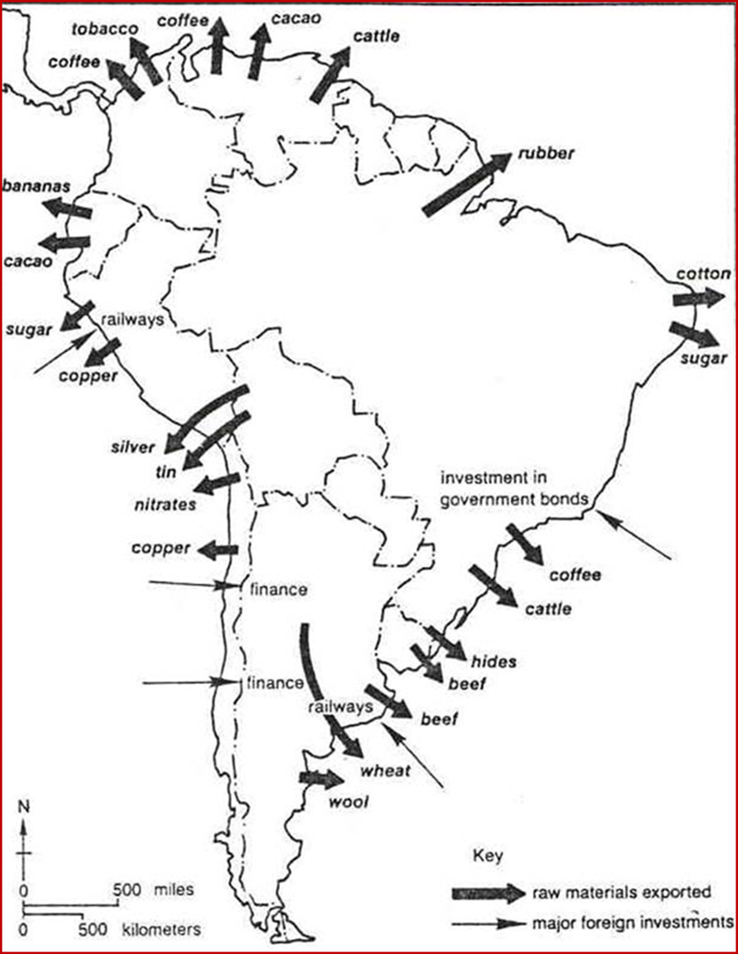
Latin American economies led by exports
Central America – bananas and coffee
Cuba – tobacco and sugar
Brazil – rubber and coffee
Mexico – henequen (fiber for making rope), copper, and silver
Argentina – wool, wheat, and beef
Chile – copper
In this era of strong demand and good prices, these nations made high profits
Allowed for large imports of foreign goods, and funds to beautify cities and other government projects
Still… economic success depended on conditions outside the region
Economies vulnerable and dependent

Slide 43
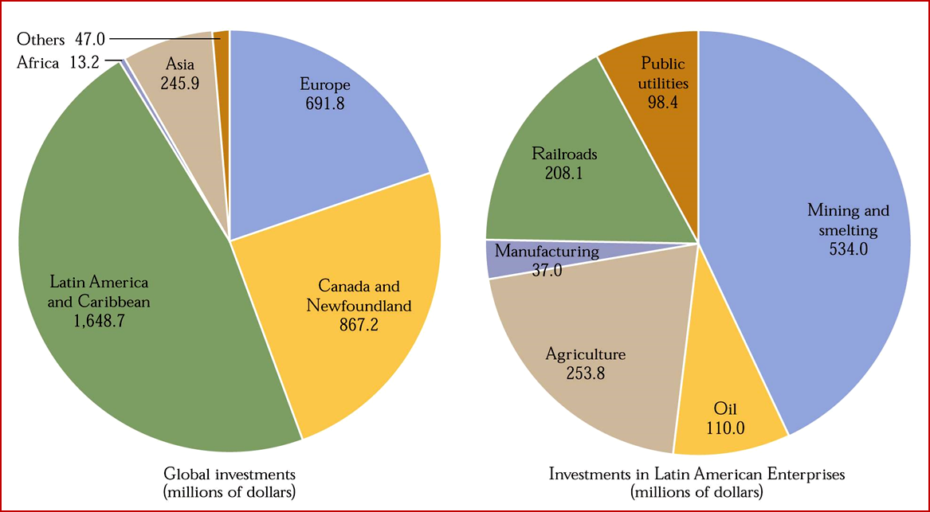
1870-1890: Latin American trade increased by 50%
Attracted the interest of foreign investors eager for high returns on their capital
British, French, German, and North American businesses and entrepreneurs invested in mining, railroads, public utilities, and banking
More than half the foreign investments in Latin America were British
Foreign investments provided Latin America with needed capital and services but tended to place key industries, transportation facilities, and services in foreign hands
Constrained Latin American governments in their social, commercial, and diplomatic policies
1914 - U.S. investments

Slide 44
Mexico and Argentina : Examples of Economic Transformation
In Mexico, the Liberal triumph of Juarez had set the stage for economic growth and constitutional government
1876 – Porfirio Diaz elected President; dominates politics for 35 years
Suppressed regional rebellions and imposed a strong centralized government
Financed by foreign capital, the railroad system grew rapidly
Provided a new way to integrate Mexican regional economies, move goods to ports for exports, and allow movement of government troops to keep order
Industrialization takes place
Foreign investment encouraged in mining, transportation, and financial policies changed to promote investments
United States increased investments to 1 billion pesos in 1911

Slide 45
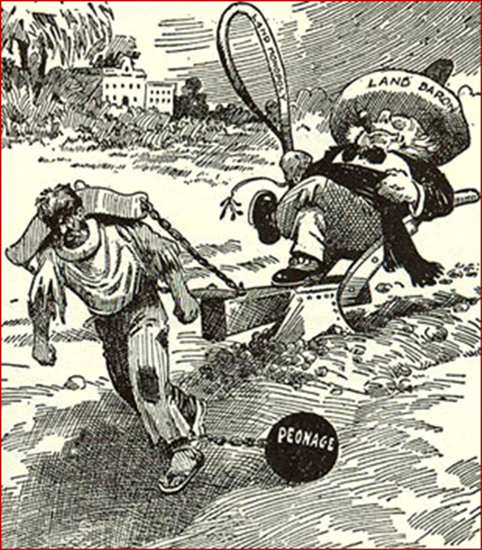
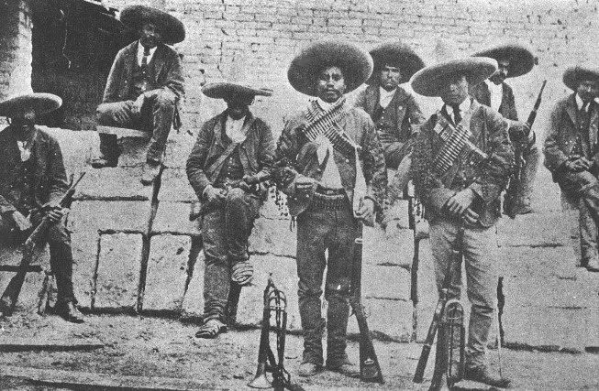
Growth was often bought at the expense of Mexico’s large rural peasantry and its growing urban and working classes
Largely native, few immigrants (unlike Argentina and Brazil)
Led to an unstable situation
Strikes and labor unrest increased particularly among railroad workers, miners, and textile workers
A national police force (the Rurales) maintained order
Political bosses linked to the Diaz regime in Mexico City delivered the votes in rigged elections
1910 – 10 year civil war, the Mexican Revolution

Slide 46
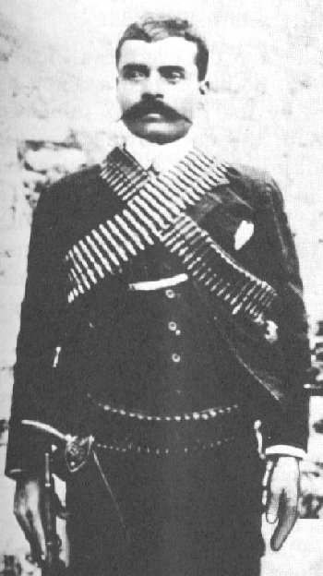
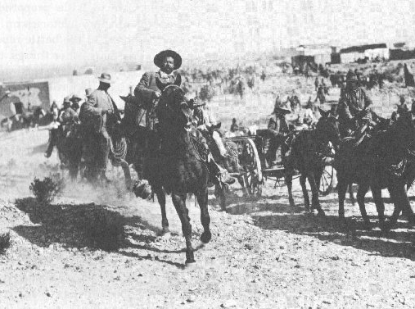
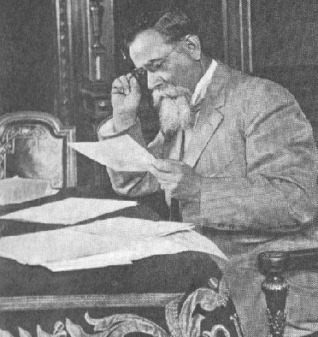
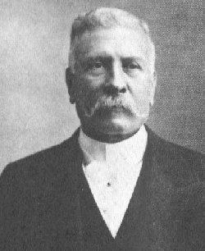
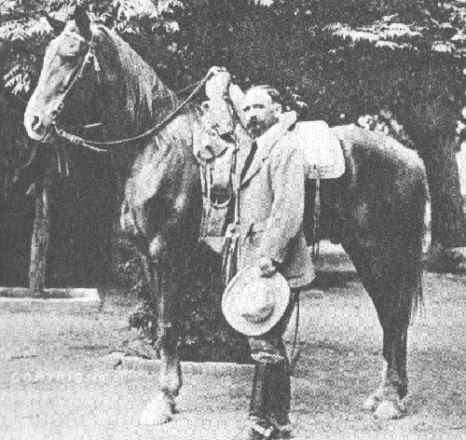
Mexican Revolutionaries
Emiliano Zapata
Pancho Villa
Venustiano Carranza
Francisco I Madero
Porfirio Diaz

Slide 47
Technological changes contributed to Argentine prosperity
Refrigerated ships allowed fresh beef to be sent directly to Europe
Labor was provided by a flood of immigrants
3.5 million immigrants between 1857 and 1930
Italians, Germans, Russians, and Jews Europeanized Argentina (this did not happen in Mexico)

Slide 48
United States Involvement in Latin America
After its Civil War, the United States began to take a more direct and active interest in the politics and economies of Latin America
Commerce and investments began to expand rapidly
American industry was seeking new markets and raw materials
growing population of the United States created a demand for Latin American products

Slide 49
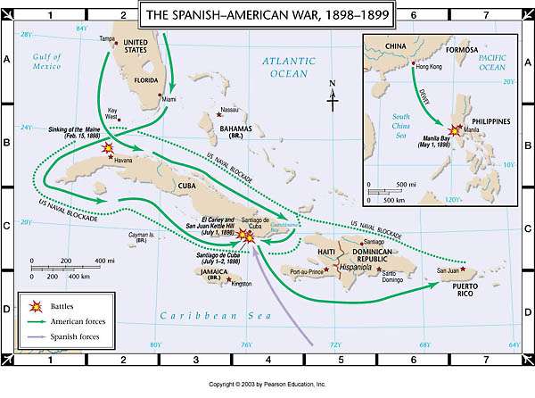
Spanish-American War
Centered on Cuba and Puerto Rico, Spain's last colonies in the Americas
Opened the door to direct U.S. involvement in the Caribbean

Slide 50
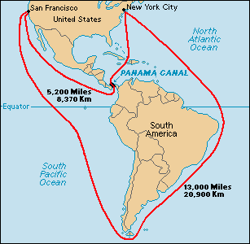
United States builds Panama Canal, which opened in 1908
Shorten route between Atlantic and Pacific
Symbol of technological and industrial strength of the US

Slide 51
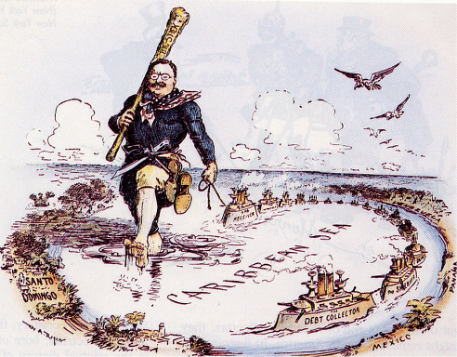
“Big Stick” Foreign Policy

Slide 52
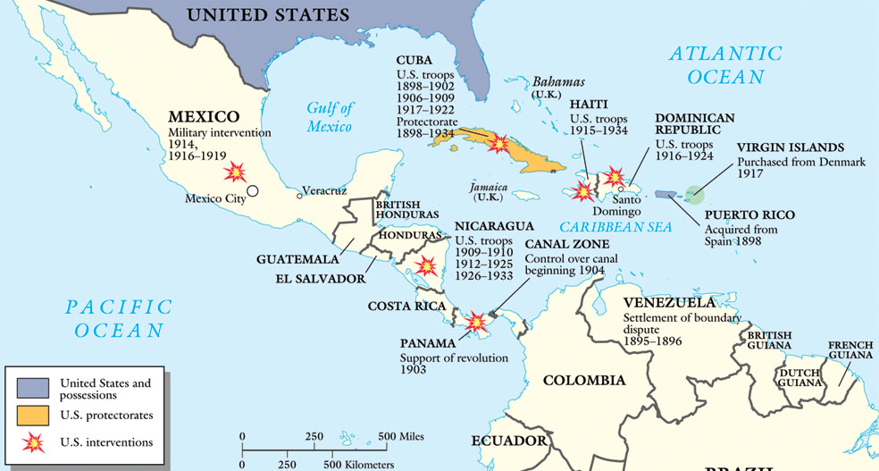
The Caribbean: An “American Lake”

