Slide 1
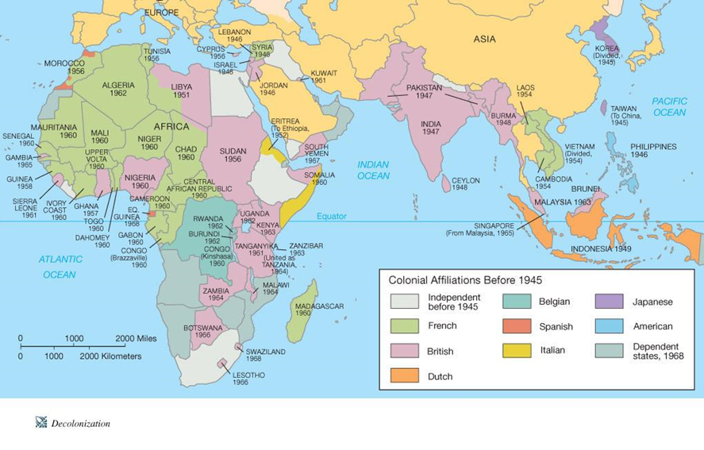
Africa and Asia in the Era of Independence
Chapter 34

Slide 2
Introduction
Once the European colonizers had withdrawn and independence has been won, Western-educated nationalists leaders were faced with many challenges
Building viable nations and prosperous societies for peoples disoriented and deprived by decades of colonial rule
Fragile political systems
Underdeveloped economies
Deep divisions between the different ethnic and religious groups
Concessions made to departing colonizers
Nature of the international economy which heavily favored industrialized nations

Slide 3
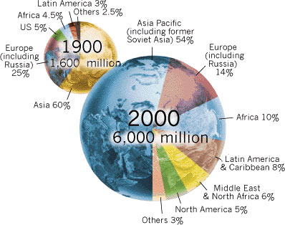
Population increase and efforts to create economic growth had detrimental effects on the already damaged environments of the newly independent nations
Loggers and land-hungry farmers cut and burned large amounts of rainforests throughout much of Africa and Asia
The developing areas could not afford expensive antipollution devices
Polluted air, water, and soil in the decades after independence

Slide 4
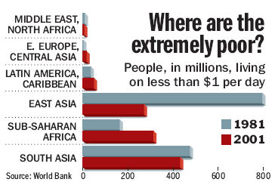
Widespread social unrest in Asia and Africa after independence was caused by
Increasing poverty
Official corruption
Growing concern for the breakdown of traditional culture and social values
Many Western-educated nationalist leaders in Asia and Africa were replaced by military commanders
Assumed dictatorial powers
Forcibly silenced critics
Suppressed interethnic and religious rivalries

Slide 5
The Challenges of Independence
The nationalist movements that won independence for most of the peoples of Africa and Asia usually involved some degree of mass mobilization
Peasants and working class townspeople
Little power in government beyond their village
Drawn into political contests that toppled empires and established new nations
Nationalist groups promised them jobs, civil rights, and equality once independence was won

Slide 6
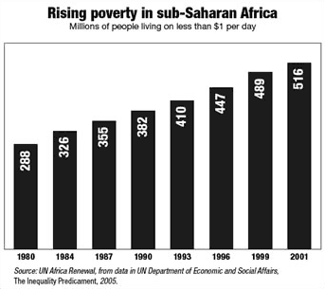
Post-independence realities in almost all new African nations
Nationalist leaders found it impossible to fulfill the expectations they had promised their followers
Goods and services were unequally distributed, leaving some people rich and great majority poor
Not enough resources to take care of everybody, even if it was possible to distribute them equally

Slide 7
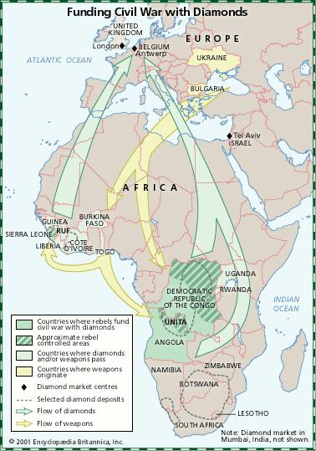
When promises from the nationalists failed to materialize, personal rivalries and long-standing divisions between different classes and ethnic groups, which had been muted by the resurfaced or intensified
Became dominant features of political life
Produced political instability
Consumed resources that might have been devoted to economic development
Stopped measures designed to build more sustainable and prosperous states
Caused African and Asian politicians to neglect problems
Soaring population increases
Uncontrolled urban growth
Rural landlessness
Environmental deterioration

Slide 8
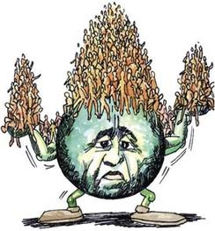
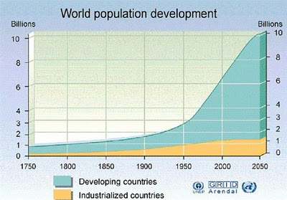
The Population Bomb
The nationalist leaders who led the colonized peoples of Africa and Asia to independence had firmly committed themselves to promoting rapid economic development once colonial restraints were removed
Saw their nations following the path of industrialization that had brought national prosperity and international power to much of western Europe and the United States
The most formidable and persistent barrier was the spiraling population increases

Slide 9
Factors for population increases in already densely populated areas of Asia and Africa
Food crops, mostly from the New World
Dramatic population growth in China, India, and Java
Helped sustain high levels of population in west Africa, despite heavy losses from slave trade
Colonial rule
Ended local warfare which caused the spread of epidemic diseases and famine
New railroad and steamship links established by the colonizers reduced regional famines
Death rates declined, but birth rates remained the same
Improved hygiene and medical treatment
Efforts to eradicate tropical diseases, as well as global scourges such as smallpox
Improved sewage systems
Purified drinking water

Slide 10
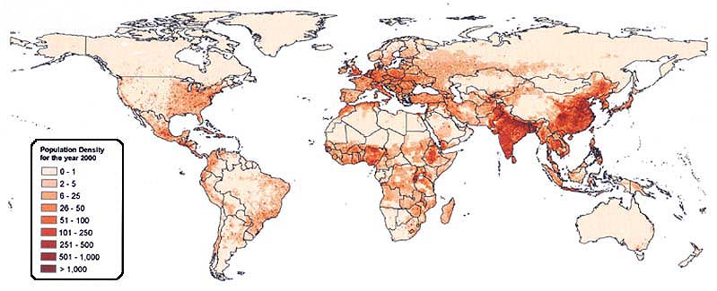
Nearly all leaders of the emerging nations headed societies in which population was increasing at unprecedented levels, which created problems
Lacked factories to employ the exploding population that moved to cities from rural areas
Lacked technology to produce the necessities of life for more and more people
Difficult to draw food and mineral resources from the rest of the world to feed growing population
Any gains in economic productivity were swallowed up quickly by the population explosion
Resistance to birth control efforts aimed at controlling population growth
Linked to deeply entrenched social patterns and religious beliefs
In Africa, children are seen as necessary additions to family
In India, sons are essential for continuing the patrilineal family line
In recent times, many leaders have begun to reassess their attitudes toward birth control

Slide 11
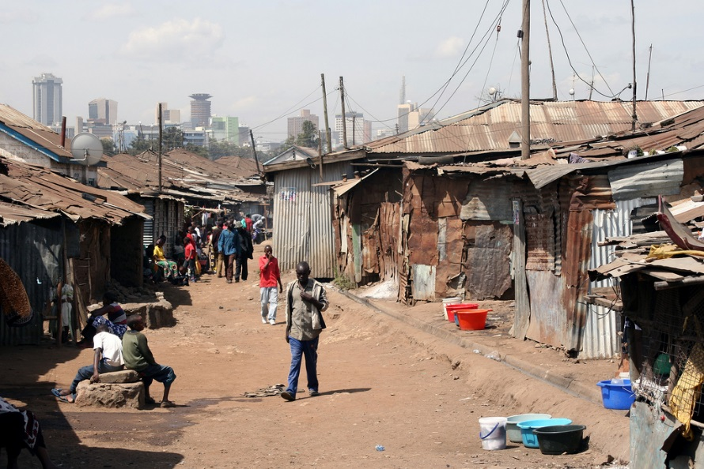
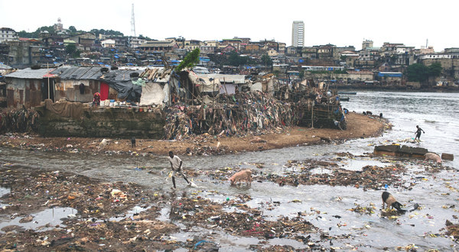
Parasitic Cities and Endangered Ecosystems
Postcolonial – mass migrations to urban areas in most African and Asian countries
Ambitious youths and rural poor crowded into port centers and capital cities in search of jobs
Most African and Asian cities were often dead ends for migrants from rural areas
Lacked the rapidly expanding industrial sectors found in the West
Few jobs
Heavy competition
Wages low for most workers
Heavily dependent for on food and resources drawn from their own countryside or abroad
Development of slums
Lacked electricity, running water, or basic sewage facilities
Growing numbers of underemployed or unemployed migrants
Turned to street vending, begging, or petty crime to survive

Slide 12
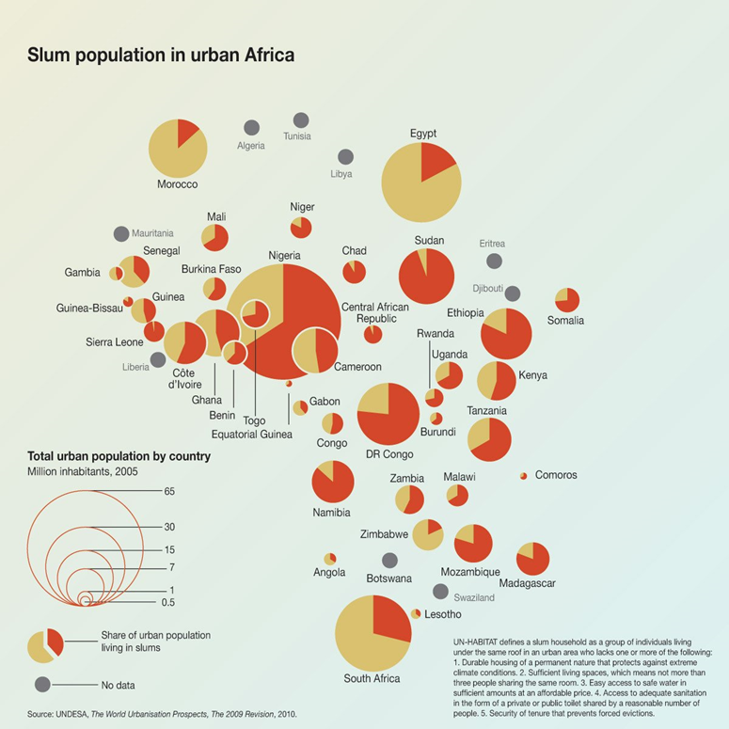

Slide 13
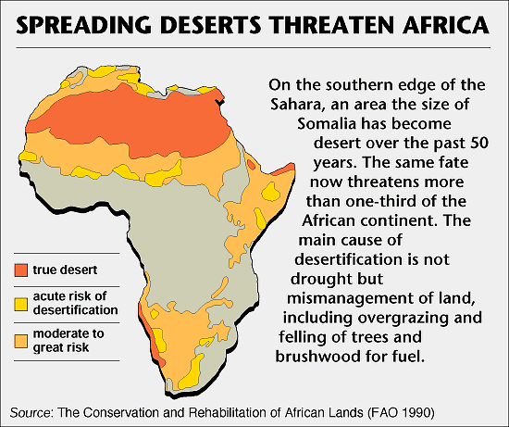
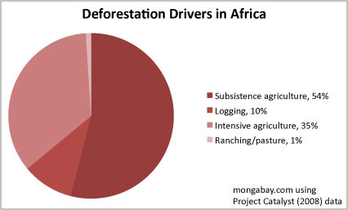
Overpopulation in the decades after Asian and African independence has created environmental problems
Peasant villagers cut trees (deforestation) for fuel or clear land for farming and livestock grazing (overgrazing)
Caused soil depletion and desertification
Environmental degradation intensified by industrial pollution from both developed countries and emerging nations themselves
African and Asian nations cannot afford antipollution technology

Slide 14
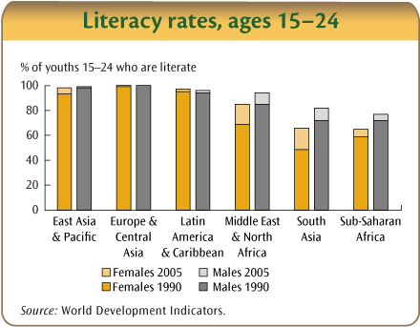
Women's Subordination and the Nature of Feminist Struggles in the Postcolonial Era
Although constitutions guaranteed civil and legal rights for women, in practice these rights were often ignored
Suffrage, political posts and social/economic equality all still suffer in Asian and African nations
Men generally dominate political life – become elected officials and government administrators
Women often do not vote or echo their husband’s preferred candidate
Expectations for early marriage and large families (the norm) hinders educational and career opportunities
Often, African and Asian women have little or no education/resources to exercise legal rights
Most Asian and African women continue to be dominated by male family members, are much more limited than men in their career opportunities, and are likely to be less well fed, educated, and healthy than men as comparable social levels

Slide 15
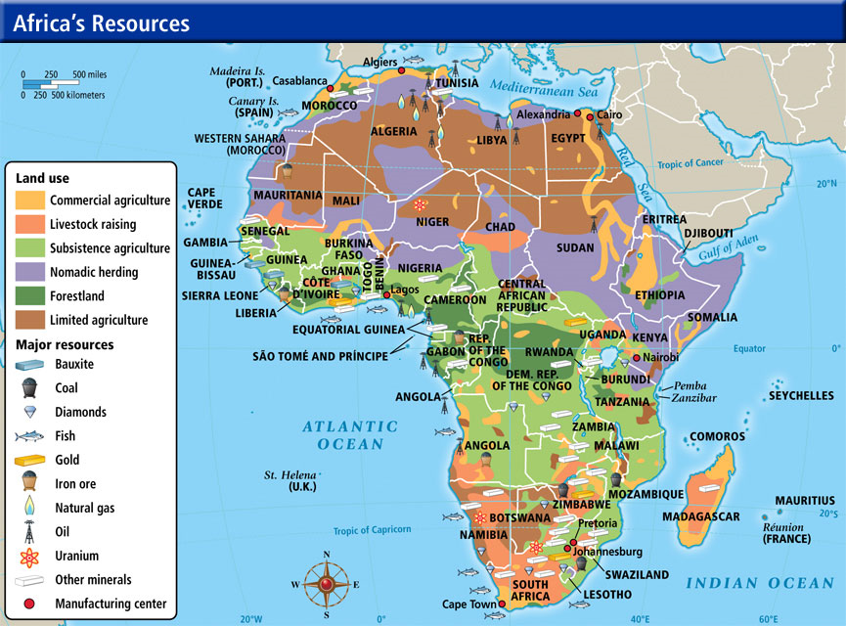
African and Asian nations have had trouble industrializing
Needed money to buy machines and hire the technical experts essential to industrialization
Little tax money left after bureaucrats paid and public works/education funded
Relied on export production to finance industrialization
Food crops – cocoa, palm oil, coffee, jute, and hemp
Industrial raw materials – copper, bauxite, and oil
High demand in industrialized economies of Europe, North America, Japan
Price fluctuations have created problems for African and Asian governments

Slide 16
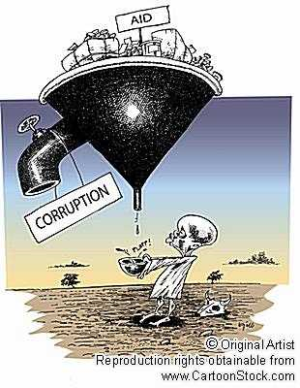
Reasons why many emerging African and Asian nations have failed to develop
Neocolonialism - use of economic, political, and cultural pressures to influence other countries, especially former dependencies
Failures in government policy of African and Asian leaders
Members of the educated classes dominated political and business life, using their positions to enrich themselves and relatives
Widespread corruption
Government import of luxury goods, such as automobiles, televisions sets, radios for the minority elite
Tax revenues could have been used to develop country
Lack of social reforms
Land redistribution
Lack of investment funds
Turned to international organizations, such as the World Band and International Monetary Fund, or rival industrial nations
Loans have come with strings attached which have hurt emerging nations

Slide 17
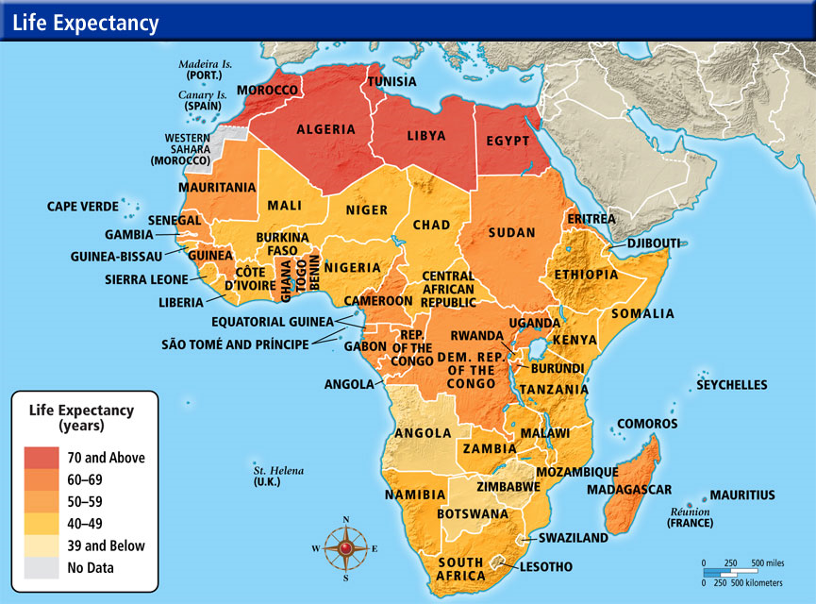
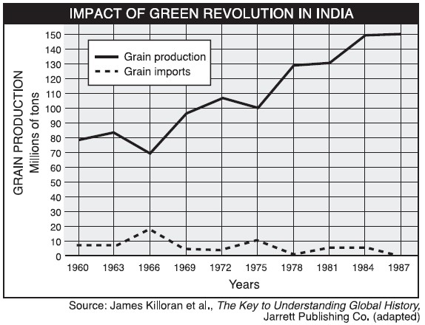
Paths to Economic Growth and Social Justice
African and Asian leaders have had trouble developing their nations
Increases in standards of living for only a minority of population
Green Revolution has made countries more dependent on irrigation, oil-based fertilizers and more vulnerable to plant disease
Redistribution of wealth has failed
Poor government planning
Bloated bureaucracies
Insufficient resources

Slide 18
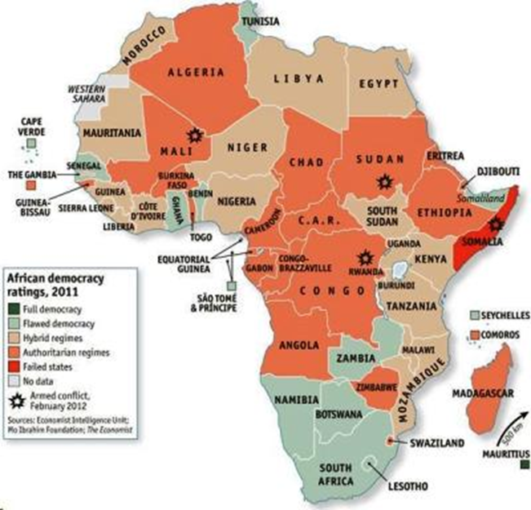
After independence, many African and Asian leaders of the new nations became more authoritarian
Approach disguised by calculated, charismatic appeals for support from the disenfranchised masses

Slide 19
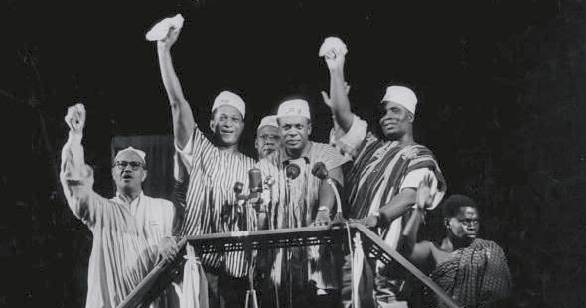
Kwame Nkrumah
Leader of Ghana’s independence movement
1957 – first prime minister of Ghana
After assuming power, he became to initiate programs (education, industrialization) to benefit the people, but they failed
Challenged by rival political parties
Leftist leaning won support from the Soviet Union but frightened away Western powers
Price of cocoa, Ghana’s largest export crop, began to fall sharply after independence

Slide 20
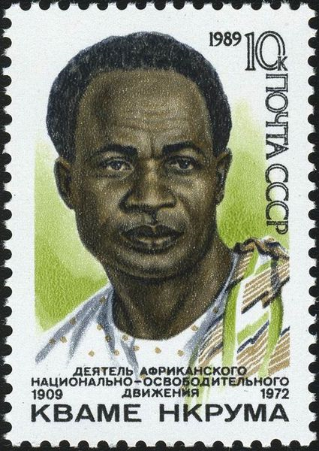
Nkrumah’s response to the failure of his programs was increasingly dictatorial
Early 1960s – forcibly crushed all political opposition by banning rival parties and jailing other political leaders
His suppression of all opposition and his growing ties to the Communist party, coupled with the rapid deterioration of the Ghanaian economy, increased the number of his enemies
1966 – overthrown by a military coup
Postage stamp from Soviet Union celebrating the 80th anniversary of his birth

Slide 21
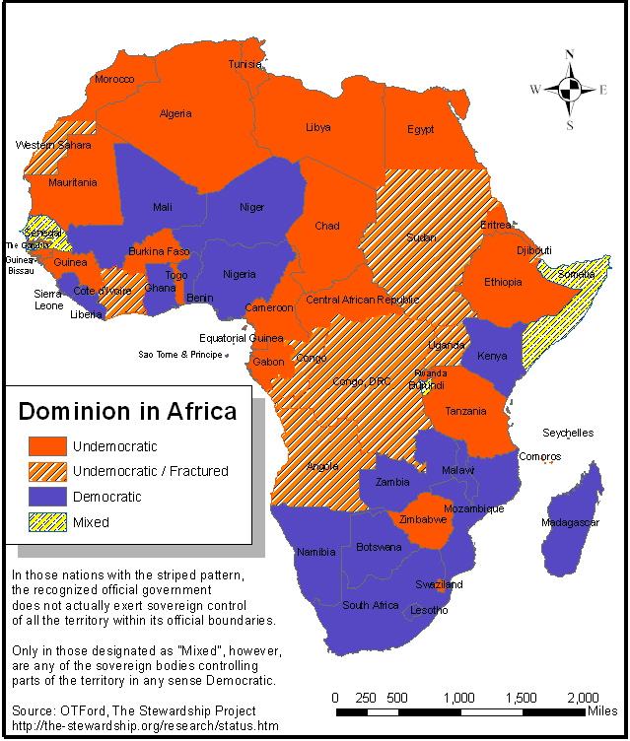
Military Responses: Dictatorships and Revolutions
Some civilian run governments in Asia and Africa
India, Ivory Coast, Kenya, Zambia, and Zimbabwe
Most Asian and African countries have been or are now governed by military regimes
Military possess a monopoly on force
Civilian political parties banned
Varying degrees of repression and authoritarian control
Uganda, Burma (now Myanmar), and Zaire
Civil liberties taken away
No attempt to reduce social inequities or improve living standards
Regimes existed mainly to enrich military leaders and their allies
Notorious for official corruption
Imprison, torture, or eliminate political opponents
Diverted a high proportion of their nations’ meager resources on military hardware
Use military conflicts with neighboring regimes to divert attention from the failure of their domestic policies

Slide 22
Egypt
Mid-1930s – won their independence from Britain except for the lingering British presence in the Suez Canal zone
Self-centered civilian politicians and the corrupt khedival regime had done little to improve the standard of living of the Egyptian masses, leading to the emergence of revolutionary forces
Free Officers movement
Evolved from a secret organization established in the Egyptian army
Egyptian rather than Turco-Egyptian descent
Secret Revolutionary Command Council studied conditions in the country and prepared to seize power through revolution
Muslim Brotherhood
1928 – founded by Hasan al-Banna
Held contempt for the wealthy minority of Egyptians and Europeans who flourished while most Egyptians lived in poverty
Early on, focus was on a program of social uplift and sweeping reforms
Promotion of trade unions
Building medical clinics
Education of women
Land reform
Overtime, focus was on establishing militant youth organizations and paramilitary assassination squads
Members of the brotherhood continued to expand its influence in the early 1950s among both middle-class youths and the impoverished masses

Slide 23
Mass anger with a discredited Khedival regime
1948 – Egypt defeated in the first Arab-Israeli War
1952 – Egypt defeated in a clash with Britain over British occupation of the Suez Canal zone
July 1952 – an almost bloodless military coup toppled the corrupt khedive regime
1952- Nasser and Free Officer come to power
Egyptians ruled themselves for the first time since the 6th century B.C.E.
All political parties disbanded, including the Muslim Brotherhood
Used dictatorial powers to carry out social and economic reforms
Land reform
Limits placed on how much land an individual could own
Excess lands were seized and redistributed to landless peasants
State-financed education through the college level was made available to Egyptians
Government became Egypt’s main employer
1980 – 30% of Egypt’s work force was on the government payroll
State subsided used to lower the price of basic food staples
Wheat and cooking oil
State-controlled industry
Modeled after the Five-Year Plans of the Soviet Union
Placed stiff restrictions on foreign investment
Foreign properties seized and redistributed to Egyptian investors
Interventionist foreign policy
Stressed the struggle to destroy the newly established Israeli state
1956 – rallied international opinion to finally oust the British and their French allies from the Suez Canal zone

Slide 24
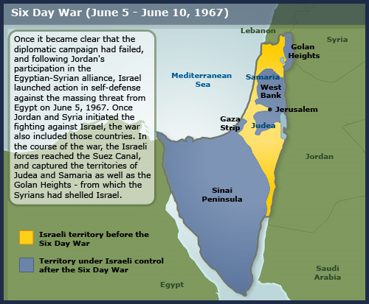
Many of Nasser’s policies failed
Land reform efforts were frustrated by bureaucratic corruption and the clever strategies devised by the landlord class to hold on to their estates
State development plans lacked proper funding and failed because of mismanagement and miscalculations
Aswan High Dam
Interfered with the flow of the Nile which resulted in increasing numbers of parasites that cause blindness
Led to a decline in the fertility of farmlands in the lower Nile delta
Continuing population growth canceled out additional cultivable lands the dam produced
Foreign investment funds from the West, which Egypt desperately needed, were gone
Soviet Union could only provide military assistance
1960s – heavy costs of mostly failed foreign policy
1967 – Six-Day War with Israel

Slide 25
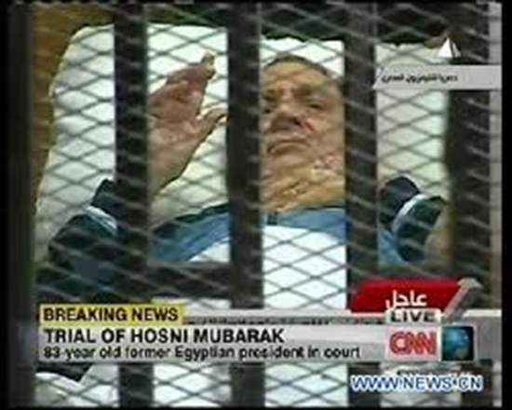
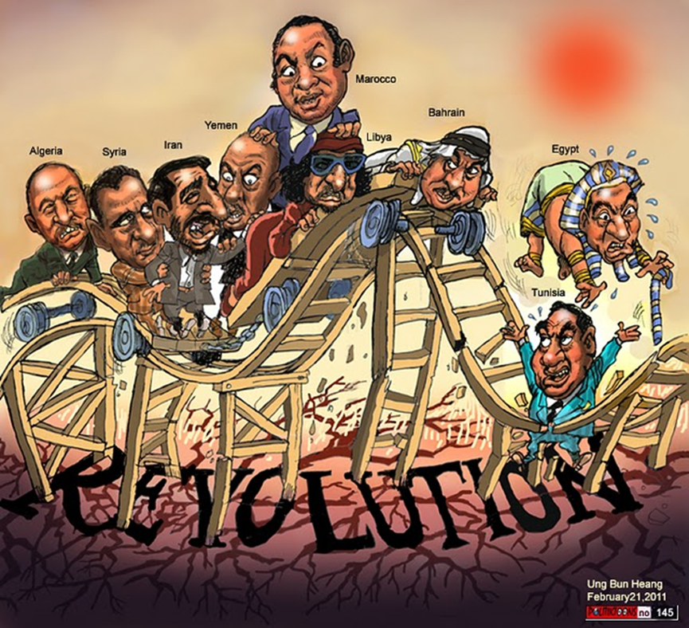
Anwar Sadat
Nasser’s successor
Favored private rather than state initiatives
Middle class became a powerful force
After fighting the Israelis to a stalemate in 1973, he moved to end the costly confrontation with Israel as well as Egypt’s support for revolutionary movements in the Arab world
Expelled Russians and opened Egypt to aid and investment from the United States and western Europe
Shift in direction was continued by his successor, Hosni Mubarak
Alarming population increases combined with corruption of its bloated bureaucracy
2011 – Mubarak imprisoned in the Arab Spring and has since died

Slide 26
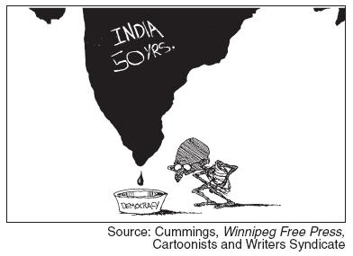
India after independence from Great Britain
Preserved civilian rule
Military has consistently defended secular democracy against religious extremism and other possible authoritarian trends
Overpopulation
Leaders such as Jawaharlal Nehru and his allies in Congress party committed to social reform, economic development, civil rights and democracy
World’s largest functioning democracy
Opposition parties have controlled many state and local governments, and remain active in national parliament
Outspoken press
Free elections
Pushed state intervention in some areas, but also allowed foreign investment
Industrial and agrarian growth has generated the revenue for the Indian government to promote literacy, village planning, family planning, and village electrification

Slide 27
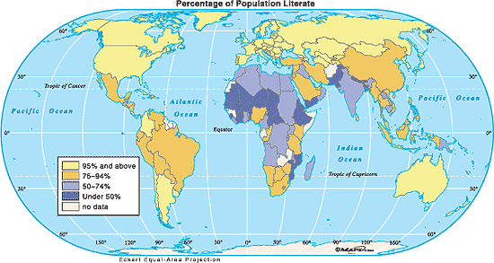
Problems in India after independence
Corruption and self-serving politicians
Population growth has offset economic gains
Not enough resources to raise the living standards of most Indians
50% of India’s people have gained little from the development plans and economic growth
Social reform has been slow in most areas
Wealthy landlords, who supported the nationalist drive for independence, continued dominating the mass of tenants and landless laborers
Green Revolution
Greatly favored cultivators with the resources to invest in new seeds and fertilizer
Increased the gap between rich and poor people over much of rural India
Literacy rates remained well below that of China
Large proportion of population malnourished

Slide 28
Iran: Religious Revivalism and the Rejection of the West
Similarities between Ayatollah Khomeini Revolution of 1979 in Iran to the Mahdi of Sudan in the 1880s
Emphasized religious purification and the rejoining of religion and politics
Wanted to return to the “golden age” of the prophet Muhammad
Aimed at toppling Western-backed governments
Mahdists’ – Anglo-Egyptian presence in the Sudan
Khomeini – autocratic Iranian shah and the Pahlavi dynasty
Promised to rescue the Islamic faithful from imperialist Westerners and from corrupt and heretical leaders within the Muslim world
Promised their followers magical protection and instant paradise if they died while fighting the holy war against the heretics and infidels
Wanted to defend and restore the true beliefs, traditions, and institutions of Islamic civilization
Sought to spread their revolutions to surrounding areas

Slide 29
Shah of Iran
Leader of Iran before the Iranian Revolution of 1789
Modernized Iran with Iran’s considerable oil wealth
Tried to impose economic development and social change by government directives
Alienated the great mass of the Iranian people in the process
His dictatorial and repressive regime deeply offended the emerging middle classes
Neglected Islamic worship and religious institutions
Enraged the ayatollahs, or religious experts
Alienated the mullahs, or local prayer leaders and mosque attendants, who guided the religious and personal lives of the great majority of the Iranian population
Pro-West
Showed favoritism to foreign investors
Placed a handful of rich Iranian entrepreneurs with personal connection to high ranking government jobs
Failed land reform
Alienated the land-owning classes without doing anything to improve the condition of the rural poor
Neglected the military
1978 – crisis begins and military not prepared
Refused to fire on growing crowds that demonstrated for the shah’s removal and the return of Khomeini
Defeated in the Iranian Revolution

Slide 30
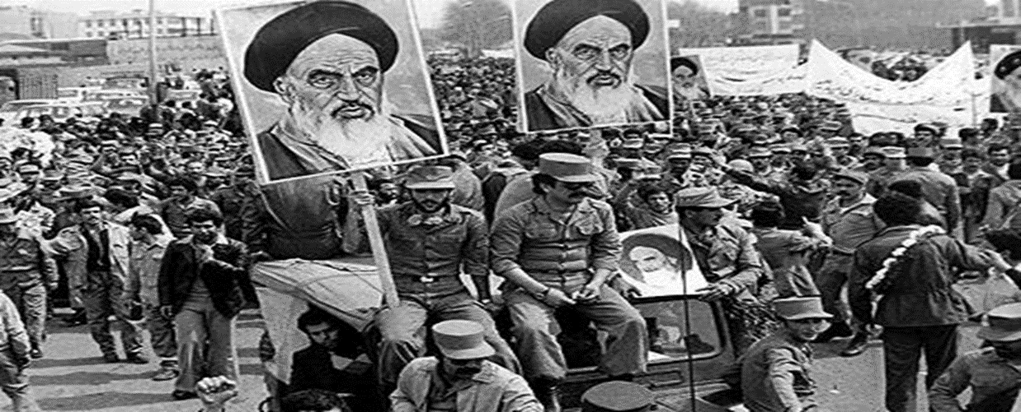
Ayatollah Khomeini came to power after Iranian Revolution
Constitutional and leftist parties allied to the revolutionary movement were brutally repressed
Moderate leaders replaced by radical religious figures eager to obey Khomeini’s every command
Secular influences in law and government were replaced by strict Islamic legal codes
Punishments including the amputation of limbs for theft and stoning for women caught in adultery
Veiling became obligatory for all women
Career prospects for women of the educated middle class limited drastically

Slide 31
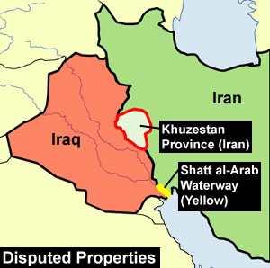
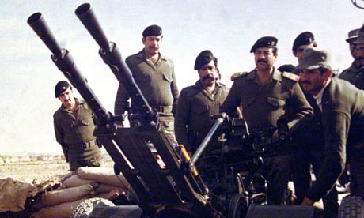
1980-1988 : Iran-Iraq War
Aka - First Gulf War
Saddam Hussein, dictator of Iraq, wanted to annex Iran’s western, oil-rich provinces
Take advantage of Iran’s ongoing civil war
Khomeini was determined to destroy Saddam Hussein and punish the Iraqis
Refusal to negotiate peace cause heavy losses and massive suffering to the Iranian people
Hundreds of thousands of poorly armed and half-trained Iranian conscripts, including tends of thousands of untrained and nearly weaponless boys, died
Advantages for Iraq
Iran had an aging military and few allies
Iraq had a more modern military and the support of oil-rich neighbors that were fearful that Khomeini’s revolution might spread to their own countries
1988 – Khomeini agreed to humiliating armistice
Iran in shambles
Shortages in food, fuel, and other necessities of life were widespread

Slide 32
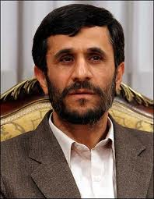
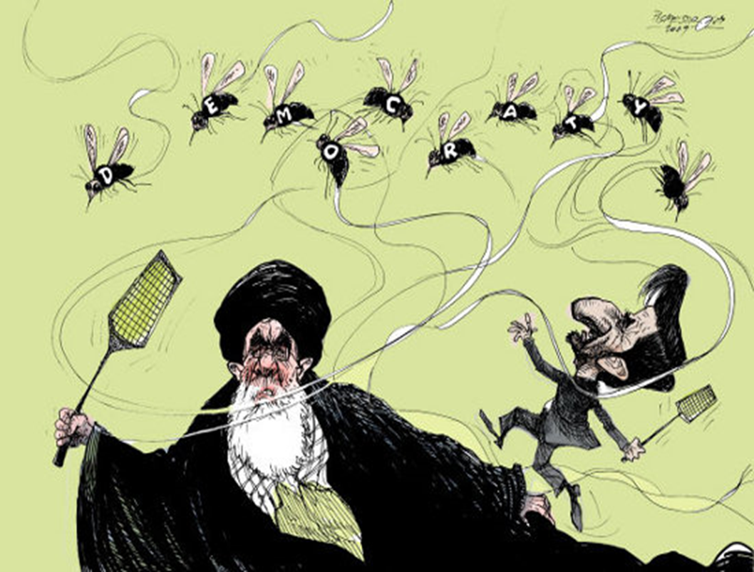
Iran – U.S. Relations
Mahmoud Ahmadinejad continued the strict Shia Islamic traditions in Iran
His policies of nuclear proliferation and anti west commentary make him a continued adversary of the United States and West
Having acquired their strict theocracy through revolution they now strike down any opposition or demonstrations

Slide 33
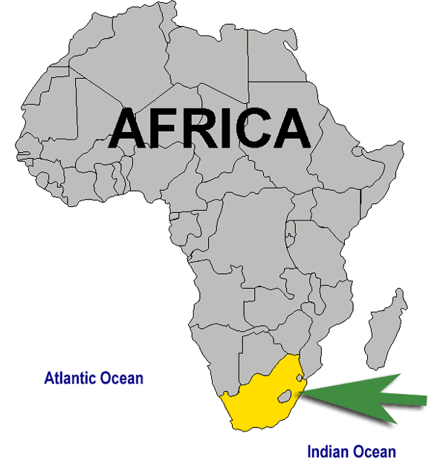
South Africa: The Apartheid State and Its Demise
South Africa
Since 1940s – white settlers, primarily Dutch-descended Afrikaners, had solidified their internal control of the country under the leadership of the Nationalist party
1960s – Nationalists won complete independence from Great Britain
Blacks, who made up the majority of South Africans, were not allowed to vote
1970s – by far the largest, most populous, richest, and most strategic area where most of the population had yet to be liberated from colonial domination

Slide 34
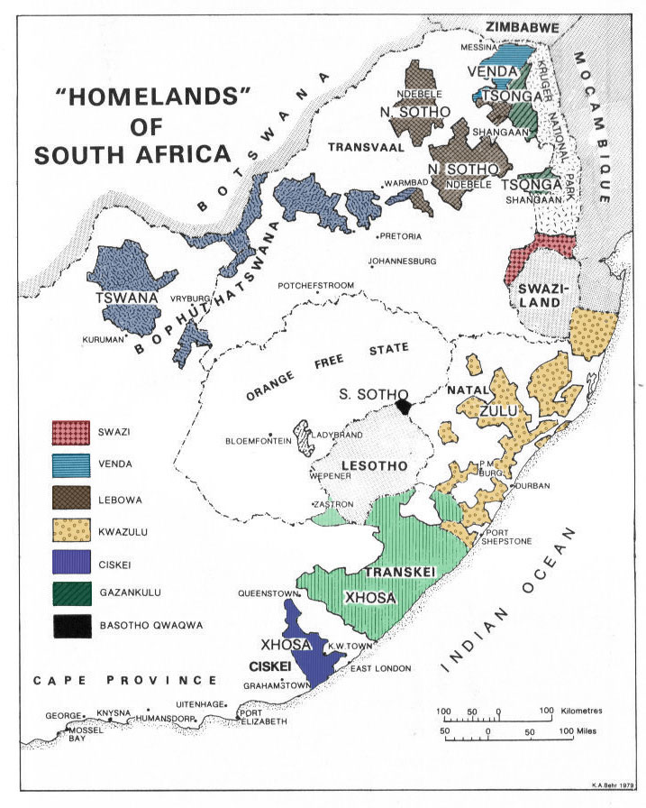
Apartheid
System created by Afrikaners to institutionalize white supremacy and white minority rule
Created a monopoly of political power and economic dominance for the white minority
Imposed extreme segregation on all races of South Africa in all aspects of life
Separate and deliberately unequal facilities established for different racial groups
Recreation, education, housing, work, and medical care
Dating and sexual intercourse across racial lines strictly prohibited
High-paying jobs reserved for white workers
Nonwhite were required to carry passes that listed the parts of South Africa where they were allowed to work and live
Nonwhites routinely thrown in jail for noncompliance
Development of homelands
Left the black African majority with a small portion of the worst land
over-populated and poverty-stricken
Provided white minority cheap labor for their mines, factories, and farms
Dominated all aspects of South African life until 1990s

Slide 35
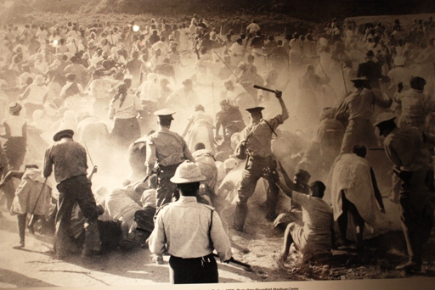
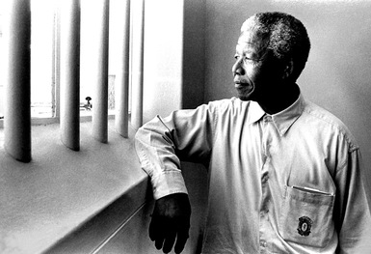
To maintain the apartheid system
White minority built a police state
Government spent a large portion of the federal budget on a well-trained military
Until the late 1980s – government prohibited all forms of black protest and brutally repressed even nonviolent resistance
Black organizations such as the African National Congress were declared illegal
African leaders such as Nelson Mandela were shipped off to maximum-security prisons

Slide 36
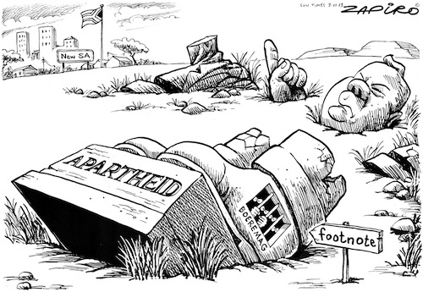
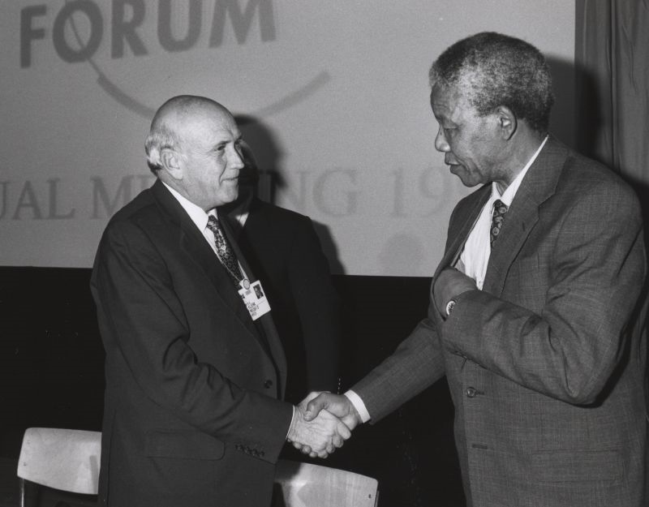
Late 1980s – apartheid system in decline
International boycott greatly weakened the South African economy
High cost of the South African army
Wars in neighboring Namibia and Angola
Struggles against the black liberation movements
F.W. De Klerk
Moderate Afrikaner leader
Pushed for reforms that began to dismantle the system of apartheid
1990 – released Nelson Mandela from prison
1994 – Election in South Africa
All adult South Africans could vote
Brought to power the African National Congress party, led by Nelson Mandela

