Slide 1
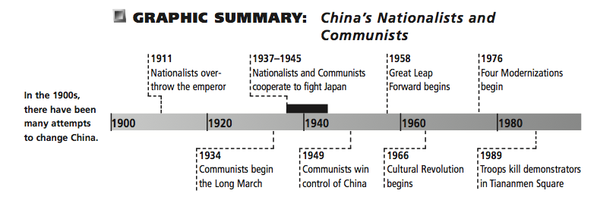
War and Revolution in China and Vietnam
Chapter 35
LAST POWERPOINT!!!

Slide 2
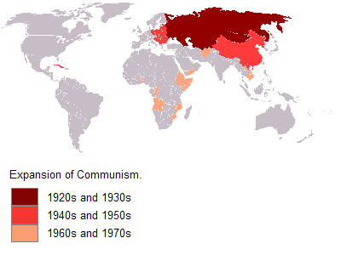
Introduction
China and Vietnam share many experiences with developing nations such as experiences with:
  imperialism
  lower standards of living
  overpopulation
  ecological destruction
China and Vietnam chose to abandon the traditional Confucian culture in favor of communist revolution

Slide 3
THE STRUGGLE FOR CHINA
1912 – After the fall of Qing dynasty
  Military commanders (warlords) dominated Chinese politics for the next three decades
    Warlords formed alliances
      Protect their own territories
      Crush neighbors and annex their lands
  Merchants and bankers of coastal cities (Shanghai and Canton) made up a second power center in post-Manchu China
  Students and teachers, as well as independent intellectuals played critical roles in shaping new ideologies to rebuild Chinese civilizations
    Defenseless

Slide 4
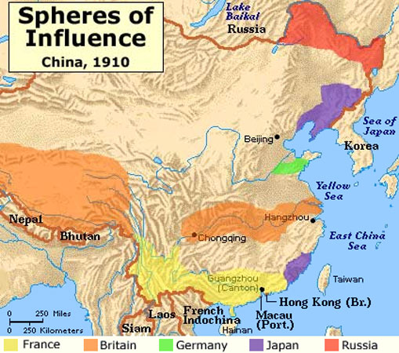
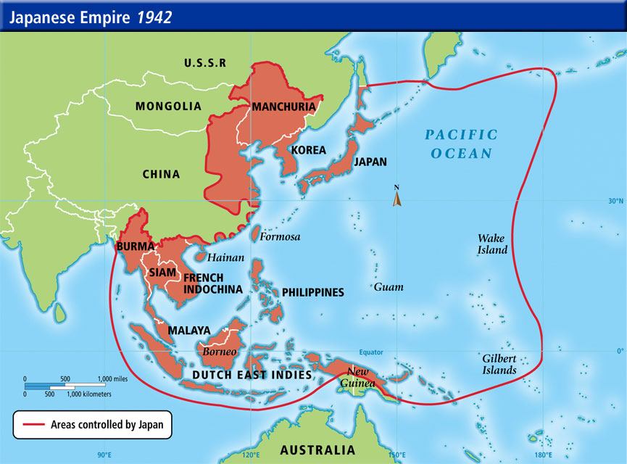
China was further complicated by the continuing intervention of Western powers eager to profit from China’s divisions and weakness
  Overshadowed by Japan
    From mid-1980s until 1945, Japanese were a major factor in the long and bloody contest for control of China

Slide 5
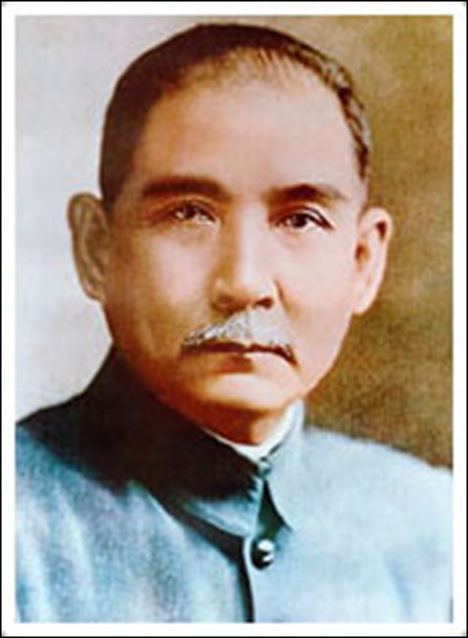
The May Fourth Movement and the Rise of the Marxist Alternative
  Sun Yat-sen
    Leader of the Revolutionary Alliance that had opposed the Qing in 1911
    1911 - Elected president, but warlords continued to dominate China
    Set up a parliament modeled after those in Europe
      Had little effect on warlord dominated China
    1912 – Realizing his lack of power, resigned the acting presidency in favor of the northern warlord Yuan Shikai

Slide 6
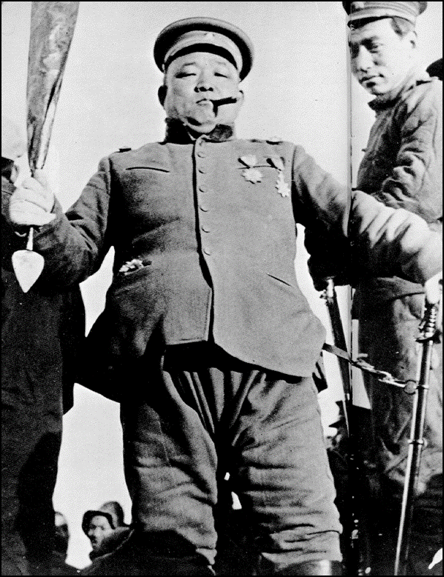
  1912 - Yuan Shikai takes control of China
    Most powerful of the northern warlords
    Appeared to have the best chance to unify China under a single government
    Took foreign loans to build up his military forces and buy out most of the bureaucrats in the capital at Beijing
      Put down attempts to be overthrown by Sun and other leaders of the Revolutionary Alliance
    1915 – plans to become Emperor failed
      Rivalry with other warlords
      Republican nationalists such as Sun caused problems
      Growing influence of Japan in China

Slide 7
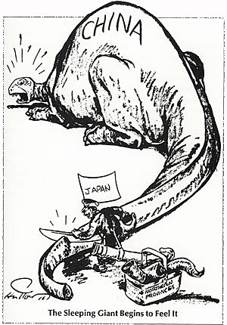
Japan
  Entered WWI on the side of Entente powers (Western allied)
  Seized German-held islands in the Pacific
  Occupied the Germans’ concessionary areas in China
  1915 – Presented Yuan’s government with Twenty-One Demands
    Would have reduced China to the status of a dependent protectorate
    Yuan was indecisive in response
      1916 – forced to resign; free-for all power struggle between remaining warlords for control of China
  1919 – Treaty of Versailles
    Japan managed to solidify its hold on northern China by winning control of the former German concession in the peace negotiations

Slide 8
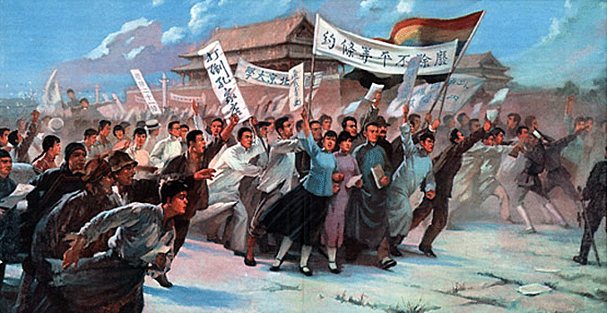
1919 - May Fourth movement
  Students and nationalist politicians organized mass demonstrations in many Chinese cities
  Demonstrations began a prolonged period of protest against Japanese
  Expanded from marches and petitions to strikes and mass boycotts of Japanese goods
  Initially aimed a transforming China into a liberal democracy
  Called for the abandonment of Confucianism in favor of Western ideals
    Democracy
    Liberation of women
    Simplification of the Chinese scripts to promote mass literacy
    Promotion of Western-style individualism

Slide 9
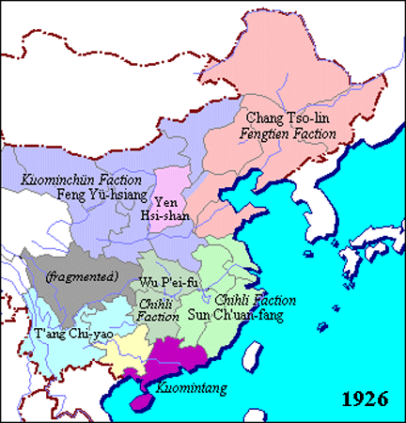
Civil liberties and democratic elections were meaningless in a China that was ruled by warlords
  Tens of millions of peasants were malnourished or dying of starvations
  Chinese intellectuals, students, and some nationalist politicians turn to more radical solutions
    1920s – rise of Communism within the Chinese nationalist movement
      Russian Revolution made Chinese aware of Marxism
Map of Warlords

Slide 10
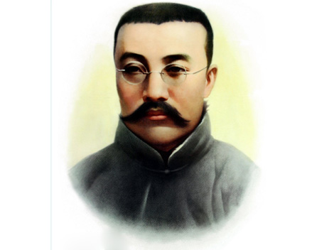
Li Dazhao
  Most influential of the thinkers who called for a reworking of Marxist ideology to fit China’s situation
  Saw peasants, rather than the urban workers, as the leaders of revolutionary change
  Argued that all of China had been exploited by the bourgeois, the industrialized West
    Chinese as a whole needed to unite and rise up against their exploiters

Slide 11
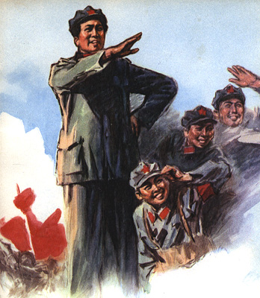
Mao Zedong
  Student of Li Dazhao
  Angered by what he thought was China’s betrayal by imperialist powers
  Hostile to merchants and commerce, which appeared to dominate West
  Deeply committed to social reform and social welfare
  Believed in an authoritarian state
1921 – Communist Party formed and Mao would later become one of the main communist leaders

Slide 12
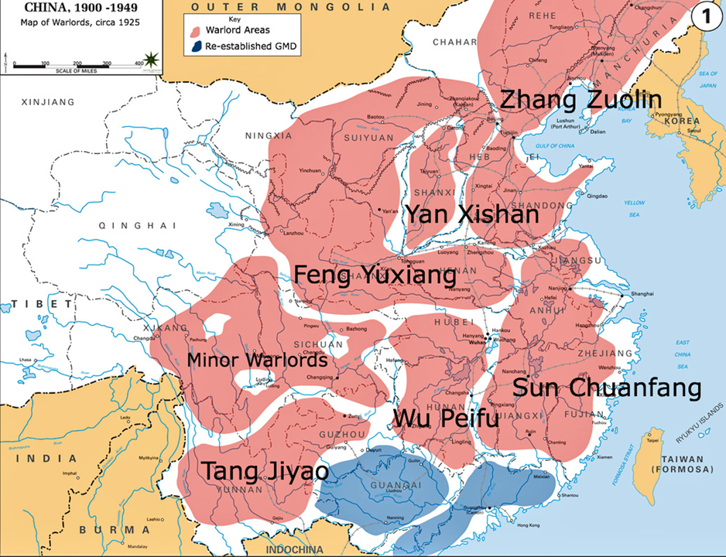
The Seizure of Power by the Guomindang, or Nationalist Party
  1919 – Nationalist party, aka Guomindang
    Rival Communist Party for control
    Sun Yat-sen – head of the party from 1911 until his death in 1925
    Began to militarize in order to drive out the warlords
    Stressed the need to unify China under a strong central government
    Wanted to bring the imperialist intruders under control
    Introduced social reforms aimed to alleviate the poverty of the peasants and the oppressive working conditions of laborers in China’s cities
    Welcomed advisors and material assistance from the newly formed Soviet Union
      Bolsheviks encouraged the Chinese Communist party to join with the larger and richer Nationalist party in a common struggle to seize power

Slide 13
  While the Nationalists were engaged in political and military organization, China was deteriorating
    Failed to implement most of the domestic programs they proposed (including land reform)
    Laborers worked for little pay and lived in terrible conditions
    Corrupt warlords and bureaucrats, including those allied to the Nationalist party, colluded with the landlords to extract taxes and labor from the peasants
    Big landlords and rich peasants amassed great landholdings, which they rented out at exorbitant rates to the peasants
      Peasants took to banditry
    Millions of peasants died
      Swept away by floods
      Famine
      Disease
      Killed by local warlords army

Slide 14
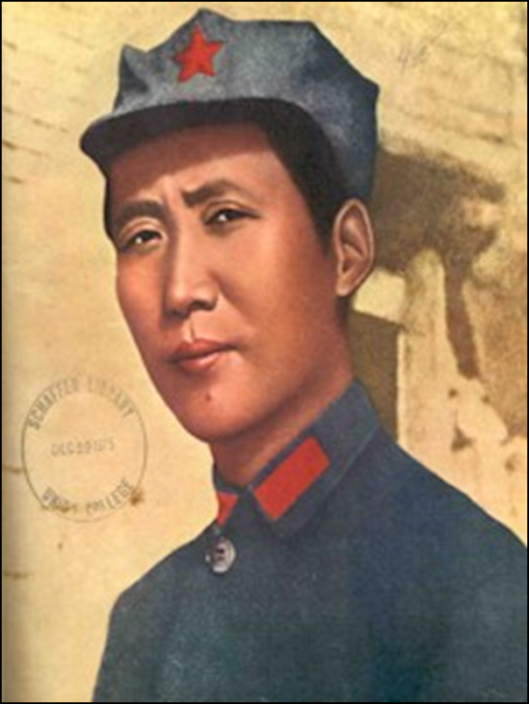
Mao and the Peasant Option
  Mao Zedong
    Came from a peasant background
    Influenced by Marxist thinkers
      Li Dazhao
    Rebelled against his father’s exploitation of the tenants and laborers who worked the family fields
    Late 1920s – Chiang Kai-shek and the Nationalist party leaders drive to destroy all communists paved the way for Mao’s rise to leadership

Slide 15
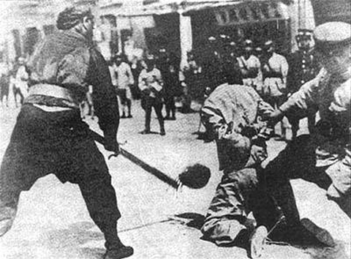
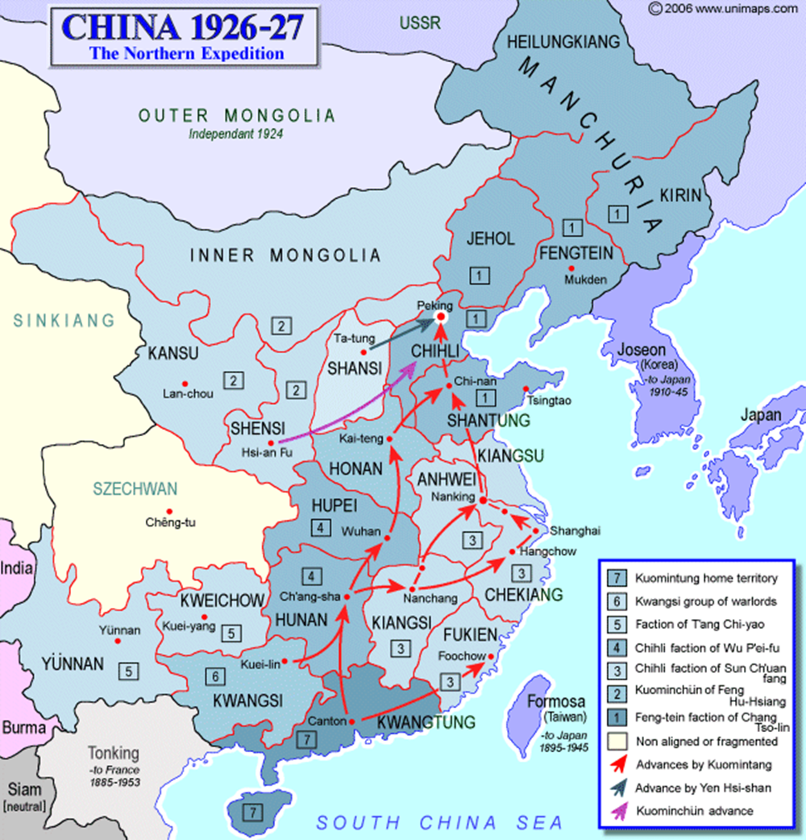
Chiang Kai-shek
  1925 – leader of the Nationalist party after the death of Sun Yat-sen
  After winning over or eliminating the military warlords in the Canton area, he marched north with his newly created armies
  Chiang ruthlessly eliminated his political rivals and civil war broke out between the Nationalists and the Communists in China
    Took over the Yangtze River valley and Shanghai
      In Shanghai, his soldiers beheaded communist supporters throughout the city
    Captured the capital at Beijing and the rest of the Yellow River basin
    1947 – civil war ends with Communist victory

Slide 16
Reaction Versus Revolution and the Communist Victory
  Nationalists received help and support from
    The richest and most powerful social groups in China
      Urban businesspeople and merchants, most intellectuals, most university students, rural landlords and the military
    Chinese bureaucrats and police throughout China
    Peasants
      Willing to wait and see if the nationalists would act to alleviate their problems
    The U.S. for being against communists
    Soviet Union
      Stalin had emerged as the unchallenged dictator of a totalitarian state
        Perhaps preferred a weak China led by Nationalists

Slide 17
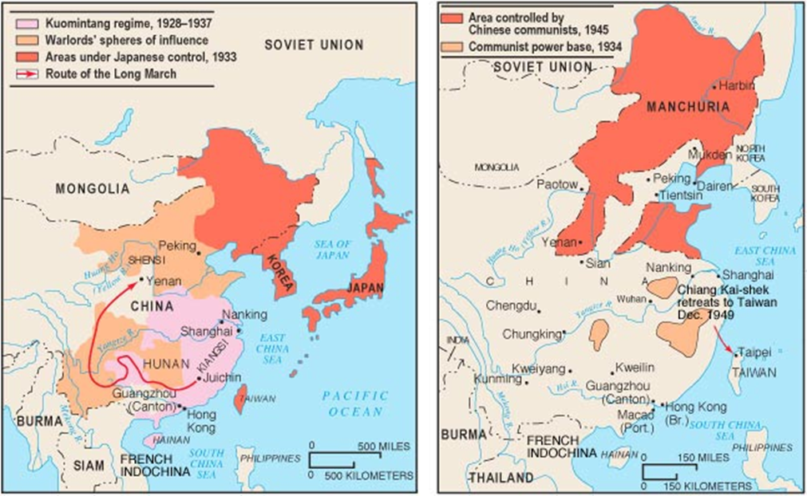
Late 1920s – center of communist operations came to be the south central province of Hunan
  Mao and what was left of the communist leadership focused on land reform and improving life in China’s tens of thousands of impoverished villages

Slide 18
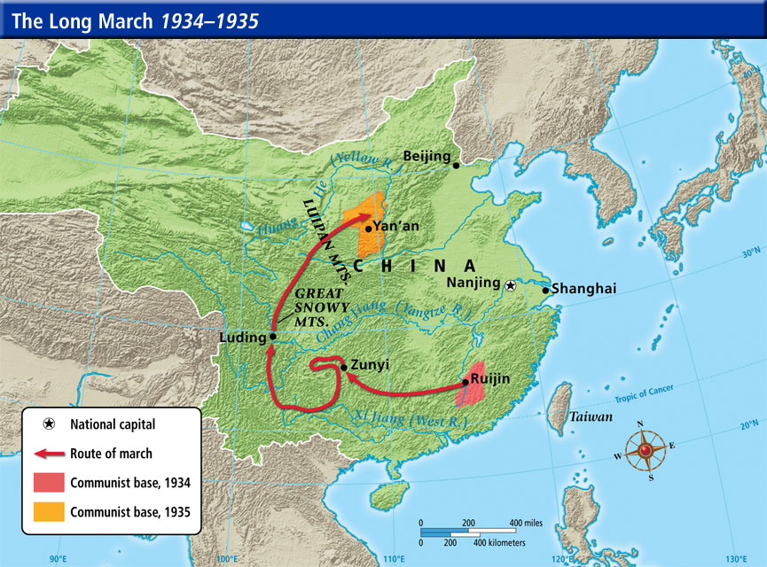
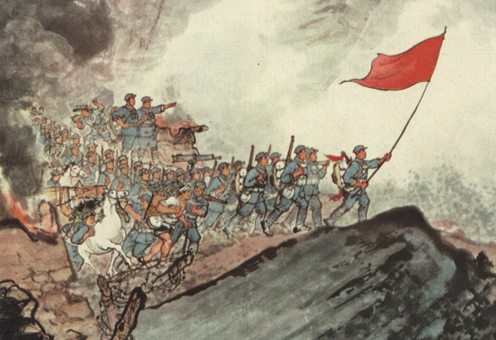
Long March
  Mao led more than 90,000 Communist party loyalists out of Hunan
  Traveled across thousands of miles of the most difficult terrain in China to Shaanxi in northwestern China
    Shaanxi would become the center of the communist movement in China until the mid-1940s
  Mao and only about 20,000 followers managed to survive trip
  Firmly established Mao as the head of the Chinese Communist party

Slide 19
1937 – Japan invaded China
  Chiang wanted to continue the struggle against the communists, but reluctantly formed a military alliance with the communists
  Until 1945 – war against Japan took priority over the civil war in the contest for control of China
  Brought massive suffering to the Chinese people
  Advantageous for the Chinese Communist party
    Weakened the nationalist rivals
      Japanese invaders captured much of the Chinese coast, where the cities were the centers of business and commercial backers of the Nationalists
        Lowered their standing in the eyes of the Chinese people
      Chiang’s military forces pummeled by the superior air, land, and sea forces of the Japanese
      Suspension of Nationalists extermination campaigns against the Communists
    Communist guerilla warfare proved more effective against Japanese
      Extend their control over large areas of north China

Slide 20
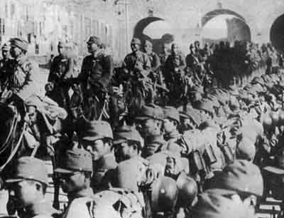
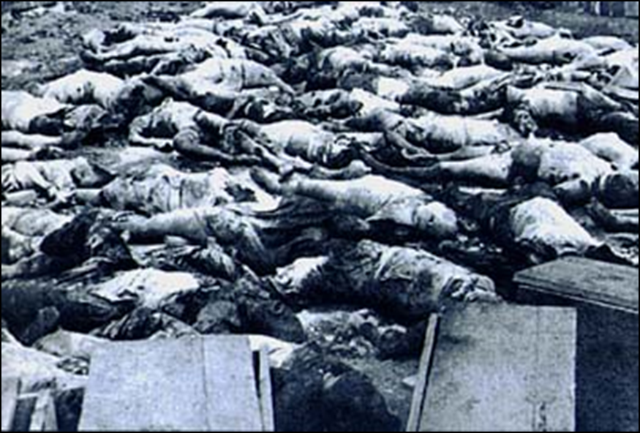
December 9, 1937-Japanese soldiers march into Nanking
Victims of the Japanese bombing of Shanghai

Slide 21
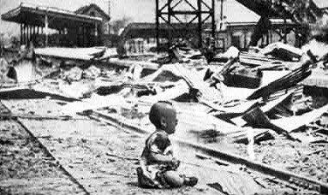
The Japanese Invasion

Slide 22
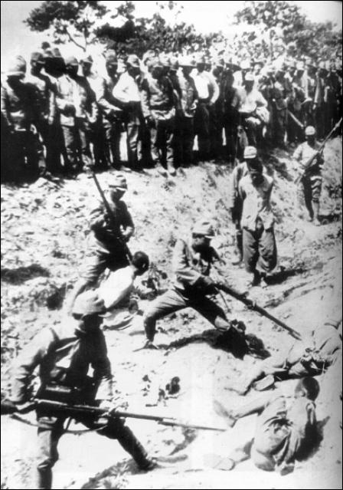
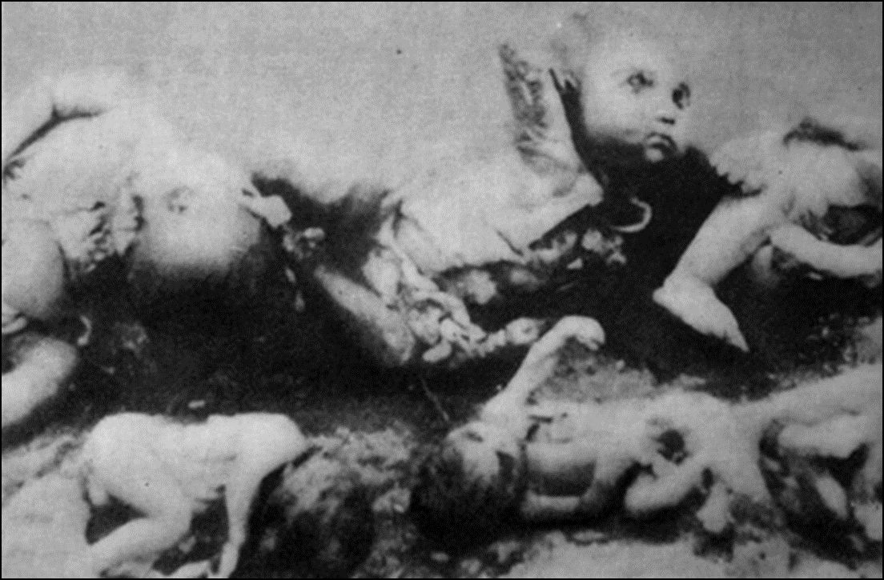
Japanese Bayonet

Slide 23
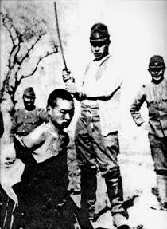
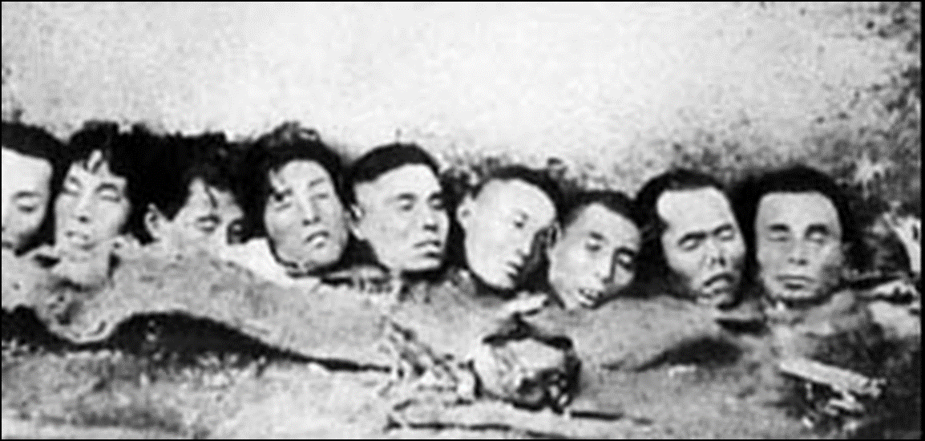
Public beheadings

Slide 24

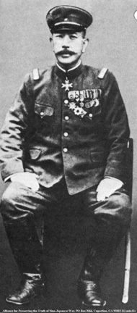
UNIT 731: Bio-Chemical Warfare

Slide 25
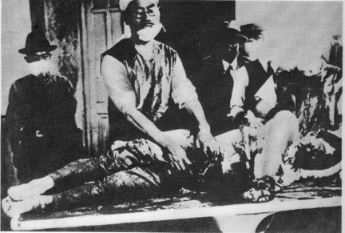
UNIT 731: Live Human Dissections

Slide 26
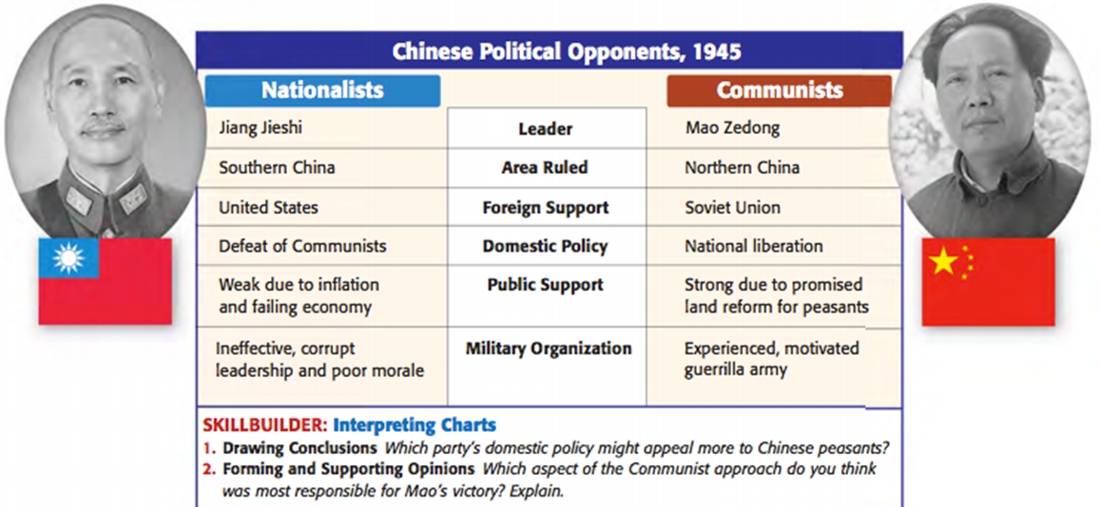
By the end of World War II
  Nationalists controlled mainly the cities in the north
  Balance of power within China shifting in the Communists’ favor
    Won support of most of China’s intellectuals and many of the students who had earlier supported the Nationalists

Slide 27
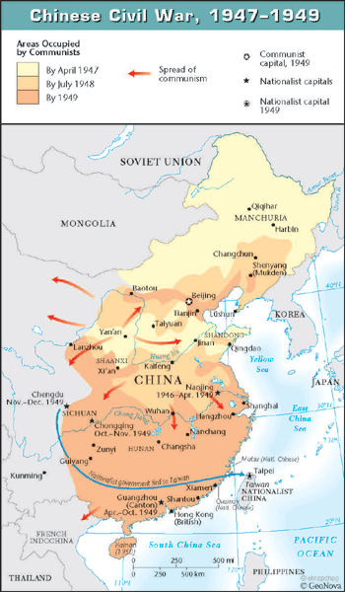
1945 – 1949 : Civil war in China
  Communists vs Nationalists
  Chiang and what was left of his armies fled to Taiwan
  Mao proclaimed the establishment of The People’s Republic of China in Beijing

Slide 28
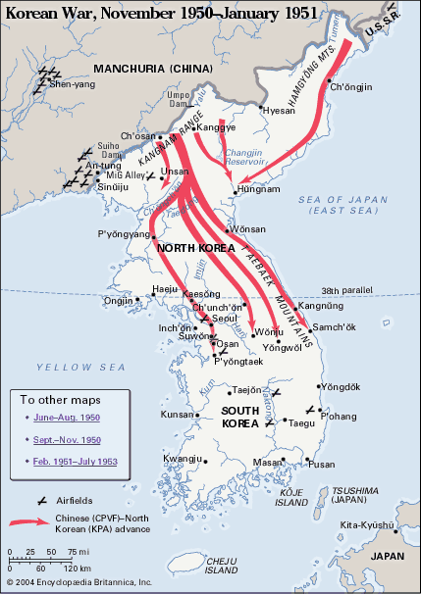
Mao’s China and Beyond
Although deep social divisions remained, the Chinese faced far less serious splits between different religion and ethnic groups than most other new nations of Africa and Asia
  Common history and cultural development created a sense of identity and a tradition of political unity
1950s – Chinese intervened military in the Korean War
  Forced United States out of North Korea and to settle for a stalemate and a lasting division on the peninsula

Slide 29
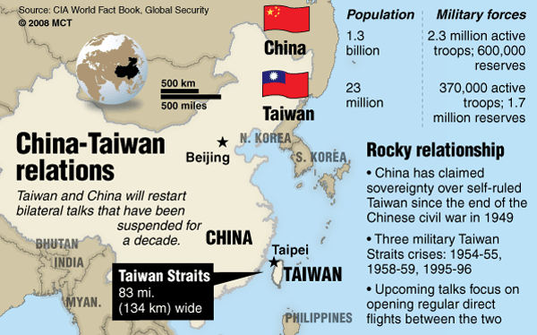
The Communist party in China
  Periodically threatened to invade the nationalists’ refuge on Taiwan
  Played an increasingly important role in the liberation struggle of the Vietnamese to the south
  Late 1950s – end of collaboration with the Soviet Union
    Border disputes, focusing on territories the Russians had seized during the period of Qing decline
    Chinese refusal to be number two to Russia
  1960 - China demonstrated its international strength in defeating India in a brief border war and exploding a nuclear device

Slide 30
Planning for Economic Growth and Social Justice
  Between 1950 and 1952, the landlord class in China was eliminated and the government redistributed land to peasants
    3 million members of landlord class executed
    China became a land of peasant smallholders
  Communist planners saw rapid industrialization, not peasant farmers, as the key to successful development
  1953 – five-year plan
    Government turned to urban workers as the hope for a new China
    State drew resources from the countryside to finance industrial growth
    Advances made in industrialization, particularly in steel
    Unacceptable consequences to Mao
      Bureaucrats greatly increased their power and influence
      An urban-based privileged class of technocrats began to develop

Slide 31
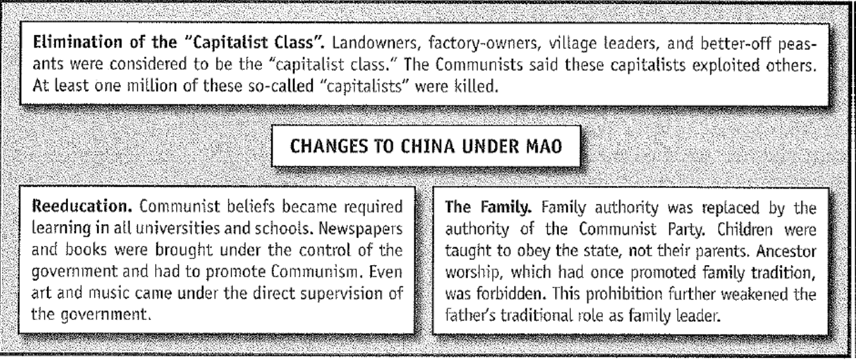
Mao
  Had deep hostility toward elitism, which he associated with the discredited Confucian system
  Distrusted intellectuals, disliked specialization, and favored the peasants rather than the workers as the driving force of the revolution
  1955 - Introduced the Mass Line approach
    Formation of agricultural cooperatives
    Cooperatives became farming collectives that soon accounted for more than 90% of China’s peasant population
  1957 – Encouraged professors, artists, and other intellectuals to speak out on communist rule
    Led to angry protest and criticism of communist policies
      Communist party responded with prison sentences and banishment to hard labor on the collectives

Slide 32
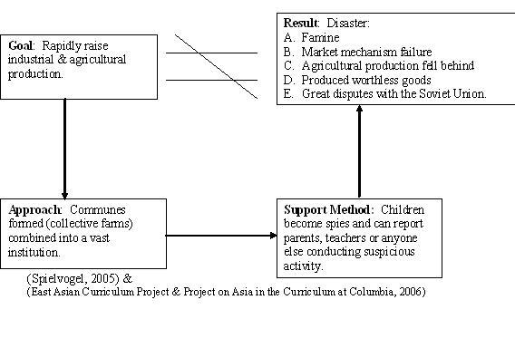
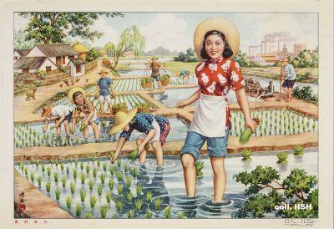
The Great Leap Backward
1958 – The Great Leap Forward
  Revitalize the weakening revolution by restoring its mass, rural base
  Rapid collectivization through the development of communes
    Self-reliant peasant living areas
    Property held in common
    All aspects of the lives of commune members were controlled by commune leaders
  Rather than plants located in cities, industrialization would be pushed through small-scale projects integrated in peasant communes
    Aimed at producing tractors, cement for irrigation projects, and other manufactures needed by the peasantry

Slide 33
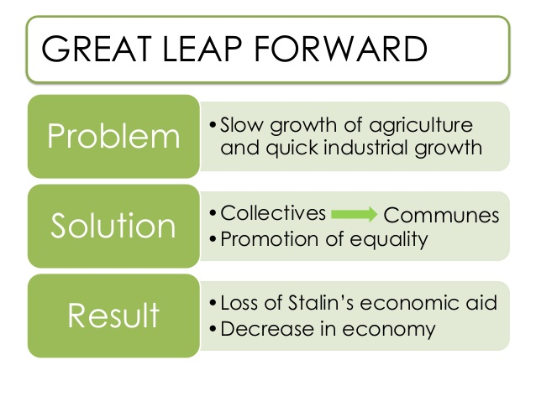
  Within months, all indicators suggested programs were leading to economic disaster
    Peasant resistance to collectivization
    Abuses of commune leaders
    Low output of the backyard factories
    Worst famine of the communist era spread across China
    China forced to import large amounts of grain to feed its people

Slide 34
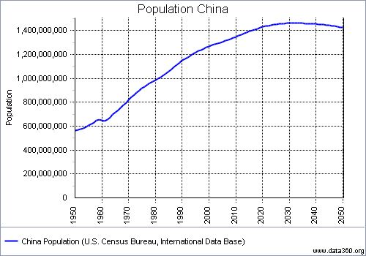
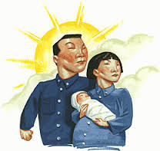
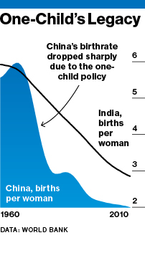
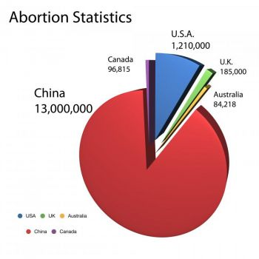
In the face of environmental degradation and overcrowding that this leap in population produced, Communist party ideologues knew something had to be done to curb the birth rate
  Mid 1960s – government launched a nationwide family planning campaign
    Urban couples – 2 children limit
    Rural couples – 1 child limit
  Early 1970s – revised to two children for either urban or rural couples
  1980s – only one child per family allowed
    Pressure on women to have abortions

Slide 35
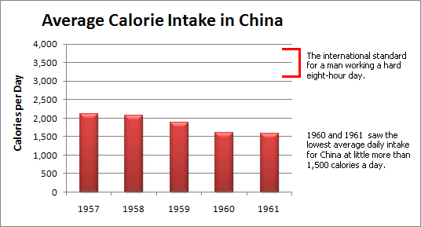
By 1960 – clear that the Great Leap must be ended and a new course of development be adopted
  Mao lost his position as State Chairman
  Rise of pragmatists, including Deng Xiaoping

Slide 36
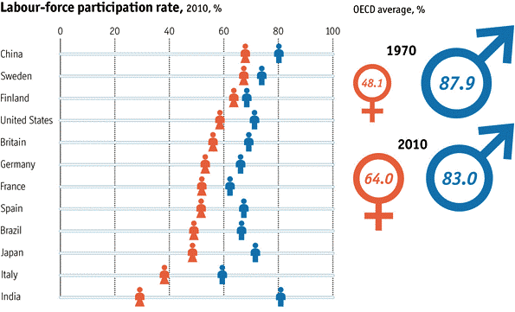
"Women Hold Up Half of the Heavens"
  The failure of the Nationalists to support women's rights led many women to embrace the Communists
    Used women as teachers, laborers, and even soldiers
    Brought full legal equality to Chinese women and entry into the work force
    Women were still expected to fulfill traditional roles as wives and mothers within their households

Slide 37
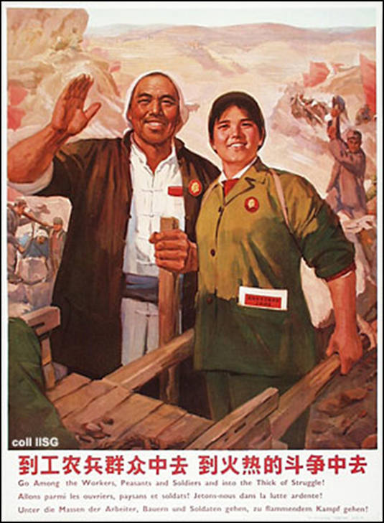
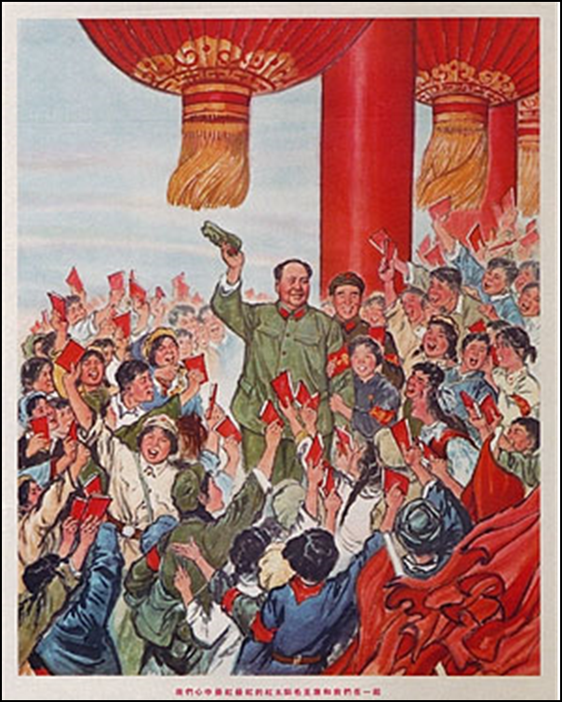
Mao's Last Campaign and the Fall of the Gang of Four
  In 1965, Mao launched the Cultural Revolution
    Concerned about the loss of enthusiasm for Communism by party officials inside China
    Cover up mistakes of Great Leap Forward
    Attacked capitalists
    Led to shortages of food and goods
    Mao closed China’s universities and schools and invited eleven million students to gather in Beijing as Red Guards
      Attacked writers, scientists, doctors, professors, factory managers and party officials that looked down on the common people and for abandoning Communist ideas
        As many as one million killed
        Those not killed or imprisoned forced to do manual labor on rural communes so they could understand Chinese peasantry
      “little red books” served as the blueprint for revolution

Slide 38
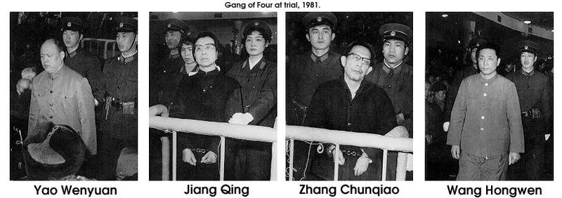
Gang of Four
  Name given to a political faction of four Chinese political party officials
  Included Mao’s wife, Jiang Qing
  Fought for increasingly contested power on behalf of the aging Mao
  1976 – lost control to the pragmatists that had aligned themselves with military leaders
    Gang of four were arrested and imprisoned for life

Slide 39
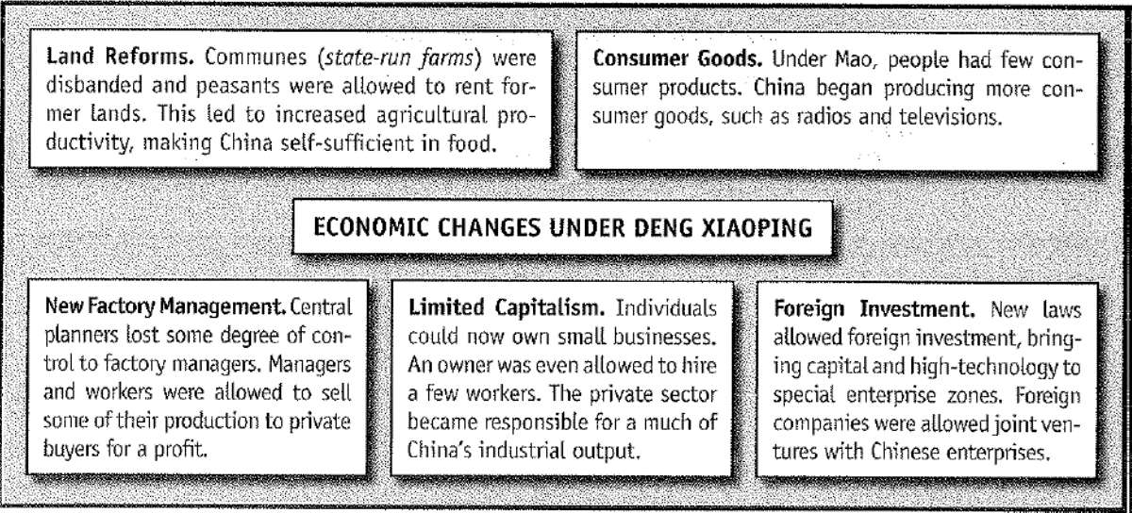
  Late 20th century – pragmatists ascended to power, led by Deng Xiaoping
    Opened China to Western influences and capitalist development
      Farming communes replaced by private peasant production for the market
      Private enterprise in industry
    Still… no democracy
    Increase in standard of living, although relative poverty is still common
      Improvements in education, health care, housing, working conditions, availability of food

Slide 40
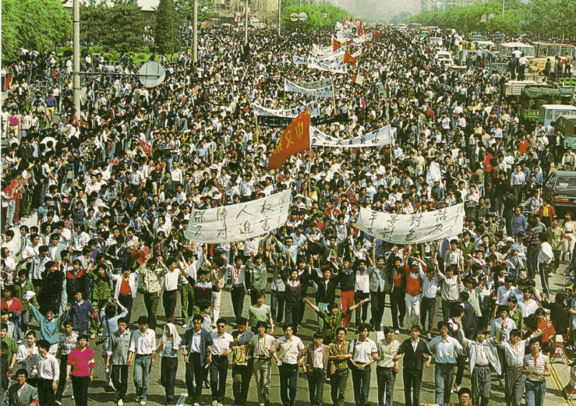
Tiananmen Square, 1989
More democracy!

Slide 41
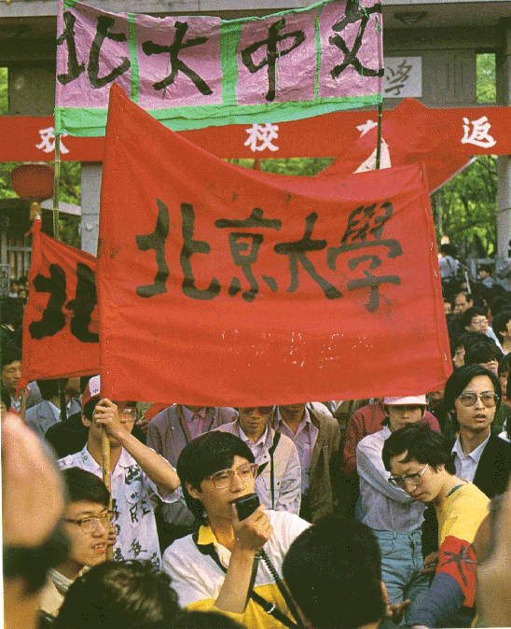
Tiananmen Square, 1989
Student activist, Wang Dan, Beijing University

Slide 42
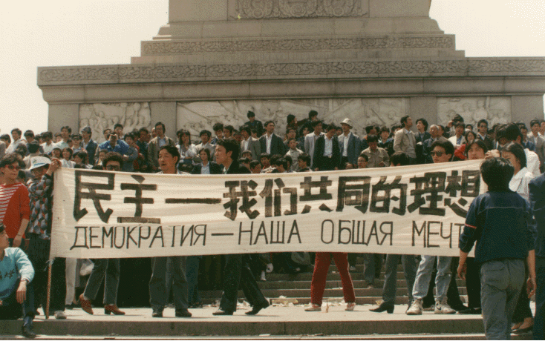
Tiananmen Square, 1989
Democracy—Our Common Ideal!

Slide 43
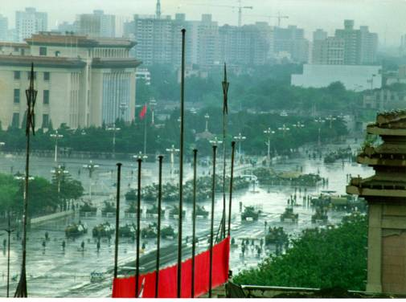
Tiananmen Square, 1989
The Government Clamps Down

Slide 44
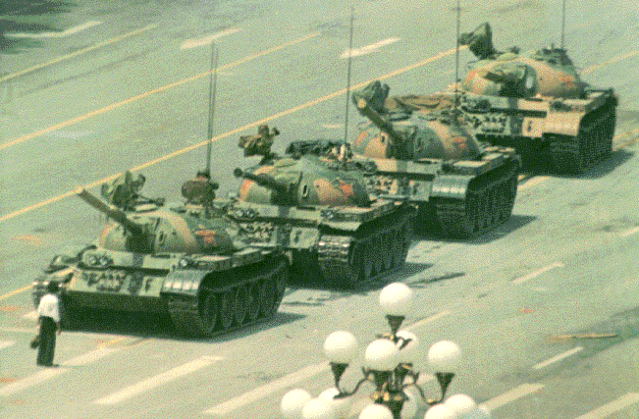
Tiananmen Square, 1989
One Lone Man’s Protest

Slide 45

Tiananmen Square, 1989
The Massacre: The People’s Army Moves In

Slide 46

Tiananmen Square, 1989
The Massacre: A Human Body Crushed by an Army Tank

Slide 47

Tiananmen Square, 1989
The Army Looks for Dissidents

Slide 48

Tiananmen Square, 1989
Student Leaders Are Arrested

Slide 49

Tiananmen Square, 1989
Chinese Students Mourn the Dead

Slide 50

Tiananmen Square, 1989
The Reestablishment of Order

Slide 51

What’s the Message Here?

Slide 52
Colonialism and Revolution in Vietnam

Slide 53
Introduction
  Like the Chinese, exposure to imperialism caused the Vietnamese to abandon Confucian elements of their culture.
  When the Tayson Rebellion in southern Vietnam toppled the Nguyen dynasty in the 1770s, the French Bishop of Adran chose to support the surviving member of the Nguyen house, Nguyen Anh and successfully regained control
  By the 1890s, the French had reduced the Nguyen to the status of puppet rulers
  French exploitation devastated the peasantry of northern Vietnam

Slide 54
Vietnamese Nationalism: Bourgeois Dead Ends and Communist Survival
  The failure of the Nguyen dynasty to free itself of French influence discredited the Confucian regime
  By the 1920s, Nationalists attempts at peaceful protests had failed, leaving only a revolutionary option.
    A series of failed revolutions and French repression virtually destroyed the Vietnamese Nationalist party.

Slide 55
Vietnamese Nationalism: Bourgeois Dead Ends and Communist Survival
  In the late 1920s, the leader of the Communists was Nguyen Ai Quoc, later known as Ho Chi Minh.
  The party shifted from dependence on urban workers to a peasant-led revolution in the 1930s.
  Again, failed attempts at revolution smashed much of the party

Slide 56
The War of Liberation Against the French
  As the Japanese were defeated, they immediately carried out social and economic reforms within the regions they controlled.
  By 1945, the Viet Minh controlled the northern capital of Hanoi and proclaimed an independent Vietnam
  After the war in 1954, an international conference at Geneva conceded the Viet Minh control of the northern portions of the country and elections would take place in the south

Slide 57
The War of Liberation Against the United States
  The U.S. selected Ngo Dinh Diem, a nationalist leader, to create a new government in southern Vietnam.
  Diem attempted to crush Communist in southern Vietnam, while the northern Vietnamese government attempted to ship men and arms to the south.
  The U.S. continued to escalate support but were unable to crush the Communists.
  As the government in the south began to fall apart, the U.S. withdrew from the war in 1975.
  The Communists reunited Vietnam for the first time in more than a century.

Slide 58

Early Protests of Diem’s Government
Self-Emolation by a Buddhist Monk

Slide 59
U.S. Troop
Deployments
in Vietnam

Slide 60


Slide 61
After Victory: The Struggle to Rebuild Vietnam
  The heads of the party in Vietnam expended much effort in eliminating enemies and attempted to maintain a strongly central govt.
  In the 1980s, the government began to liberalize the economy and to permit investment from the West and industrialized nations of Asia
  Vietnamese relations with the United States have recently improved

Slide 62

The Air War:
A Napalm Attack

Slide 63



Who Is the
Enemy?

Slide 64

Impact of the Vietnam War
Johnson announces (March, 1968):
…I shall not seek, and I will not accept, the nomination of my party for another term as your President.

Slide 65


Anti-War
Demonstrations
Columbia University
1967

Slide 66









Slide 67

Hell no, we won’t go!

Slide 68


Anti-War Demonstrations
Student Protestors
at Univ. of CA
in Berkeley, 1968
Democratic Convention in Chicago, 1968

Slide 69

“Hanoi Jane”
Jane Fonda: Traitor?

Slide 70

Anti-War Demonstrations
May 4, 1970
4 students
shot dead.
11 students
wounded
Jackson State
University
May 10, 1970
2 dead; 12
wounded
Kent State University

Slide 71


Slide 72
Conclusion: Revolutions and Civilization in China and Vietnam
Both China and Vietnam have undergone revolutionary transformations in the twentieth century
New governments eliminated much of the traditional elite.
The Confucian system of education was supplanted by public education programs
Women's status has improved
Marxism replaced Confucianism as the guiding orthodoxy.
Both societies continue to harbor suspicions about commercial classes.
Political philosophy continues to stress the duty of the government to rule for the benefit of the people.
Both nations continue to stress harmony and secularism.

Slide 73

And
in the End….
Ho Chi Minh:
If we have to fight, we
will fight. You will kill
ten of our men and we will kill one of yours, and in the end it will be you who tires of it.

