Slide 1
Chapter 26
Civilizations in Crisis: The Ottoman Empire, the Arab Heartlands, and Qing China

Slide 2
1644 – Manchu nomads conquer China; Qing dynasty rules
1644-1772: Reign of Kangxi emperor in China
1727 – first printing press in Ottoman Empire
1736-1799: Reign of the Qianlong emperor in China
1768-1774: Disastrous Ottoman war with Russia
1772 – Safavid dynasty falls in Persia
1789-1807: Reign of Ottoman Sultan Selim III
1798 – British embassy to Qianlong emperor in China; French invasion of Egypt; Napoleon defeats Egypt’s Mameluk rulers

Slide 3
1805-1849: Reign of Muhammad Ali in Egypt
1807-1839: Reign of Ottoman Sultan Mahmud II
1826 – Ottoman Janissary corps destroyed
1834 – Postal system established in Ottoman Empire
1838 – Ottoman treaty with British removing trade restrictions in the empire
1839-1841: Opium War in China
1839-1876: Tanzimat reforms in the Ottoman Empire
1850-1864: Taiping rebellion in China
1854-1856: Crimean War
1856-1860: Anglo-French war against China
1866- First railway begun in Ottoman Empire
1869 – Opening of Suez Canal
1870 – Ottoman legal code reformed

Slide 4
1876 – Ottoman Empire Constitution
1876 – 1908: Reign of Ottoman Sultan Abdul Hamid
1877 – Treaty of San Stefano; Ottomans driven from most of the Balkans
1882 – British invasion and occupation of Egypt; failed revolt led by Orabi in Egypt
1883 – Mahdist victory over British-led Egyptian expeditionary force at Shakyan
1889 – Young Turks established in Paris
1898 – British-Egyptian army defeats the Mahdist army of Omdurman
1898-1901: Boxer Rebellion in China; 100 days of Reform in China
1908 – Young Turks seize power in Istanbul

Slide 5
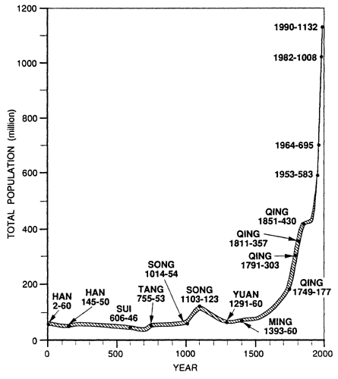
Early 18th century – China under Manchu control
  China enjoying another early dynastic period of growth and prosperity
  China’s population growing steadily, and trade and agricultural production were high
  European traders (“barbarians”) were confined to the ports of Macao and Canton on China’s south coast
  Qing emperor had severely reduced missionary activities in China

Slide 6
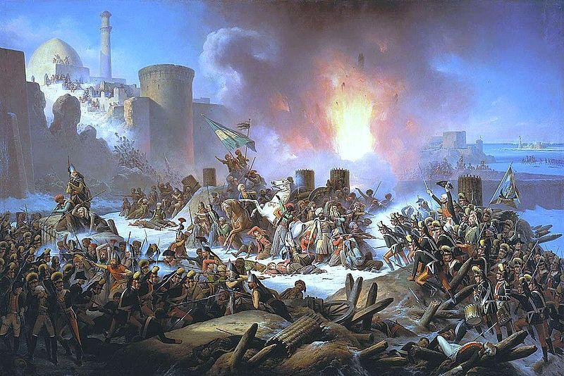
Early 18th century - Ming Dynasty going well, Ottoman Empire in decline
  Many breaking away from Ottoman Empire…
    West – Austrian Hasburgs
    North – Russia
    North Africa – Muslim kingdoms
    Middle East – imperial governors and local notables grew more and more independent of the ruling Sultan in Istanbul (formerly Constantinople)
Led to… political, economic, and social problems
  Inflation rampant
  European imports destroying Ottoman handicraft industries
  Social tensions, crime, and rebellion occurred in some areas
Ottoman troops desperately attempt to halt advancing Russians during the Siege of Ochakov in 1788.

Slide 7
19th century – European powers threw China into a prolonged crisis
Chinese civilization more vulnerable than the Islamic world
Ottomans began to find new sources of leadership and to introduce reforms on the basis of Western precedents
  Late 19th century – new leaders emerged in Ottoman Empire who were able to overthrow sultanate and begin process of nation-making
China – overpopulation, administrative problems, and massive rebellions hurt China from within, while European gunboats and armies broke down outer defenses
  As old China died, its leaders struggled to find a new and viable system to put in its place
  1898-1949: – foreign invasion, revolution, and social and economic breakdown produced massive suffering

Slide 8
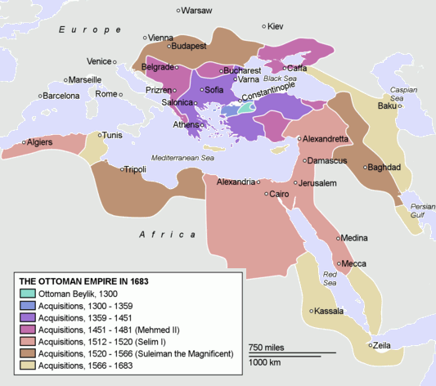

Slide 9
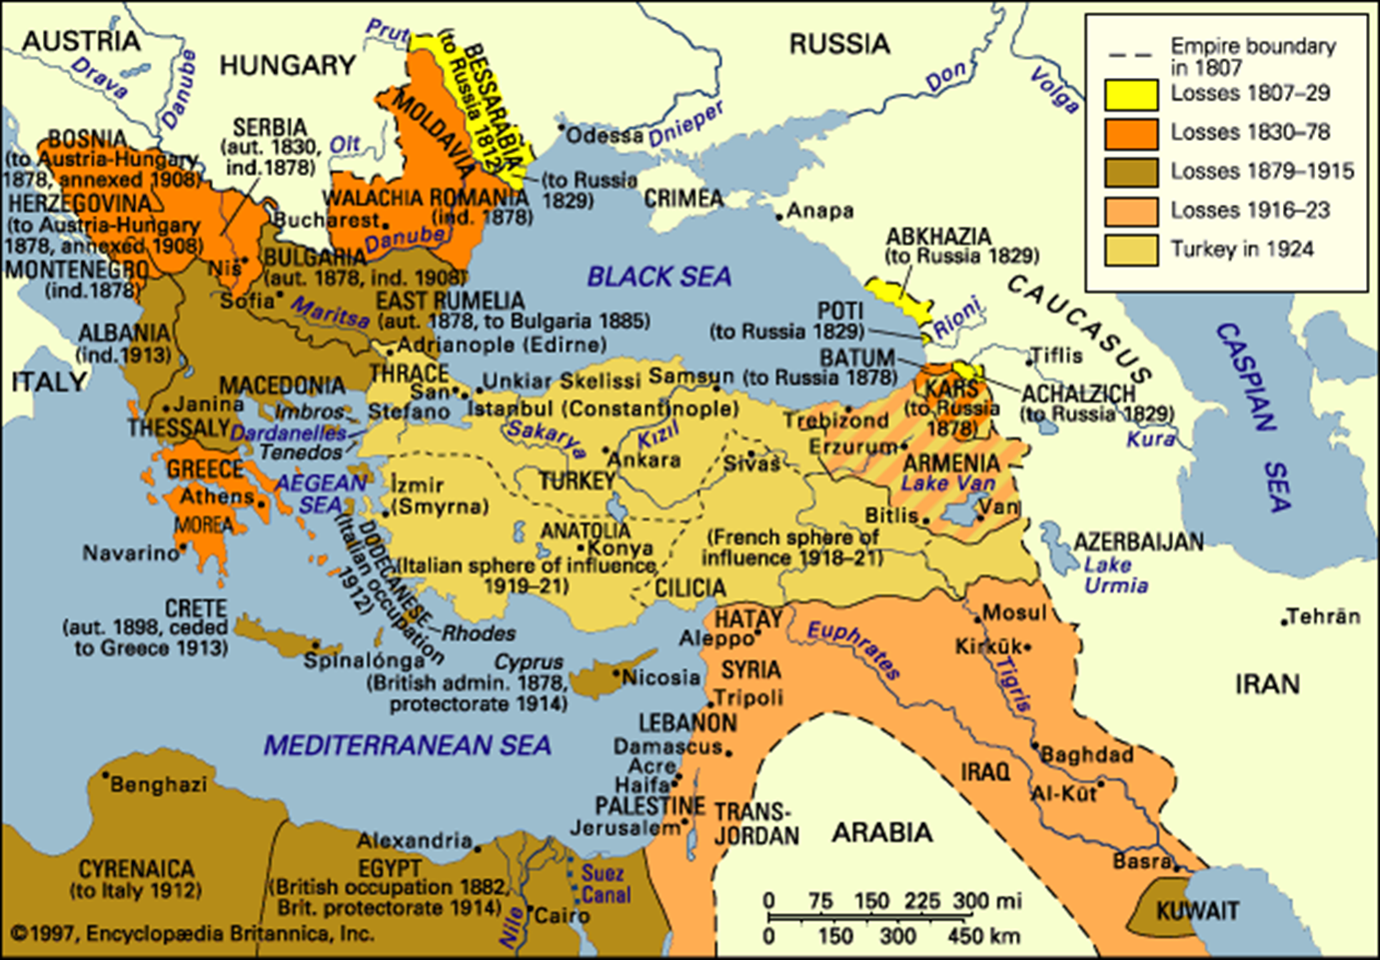
From Empire to Nation: Ottoman Treat and the Birth of Turkey
18th Century – weakened by internal strife, the Ottomans were unable to prevent their European rivals from taking their territory
Late 18th century – Ottoman rulers and committed reformers make changes
  Slows the decline of empire and advance of European powers

Slide 10
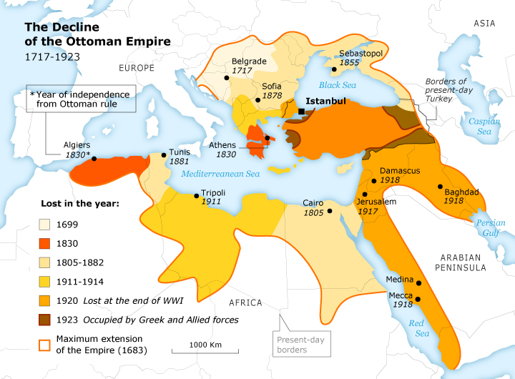
Causes of Ottoman crisis
  Succession of weak rulers, with Sultan on top
  Inept sultans opened the way for power struggles
  Rival ministers, religious experts, Janissaries
  Weakened control over the population and resources it claimed to rule
  Provincial officials work with local land owners to cheat taxes due to Sultan
    Hurt already hard pressed peasants
  18th and early 19th centuries - Position of artisan workers in town deteriorated because of competition from imported manufactures from Europe
    Led to urban riots
  Ottoman economic dependence on European political rivals increasing

Slide 11
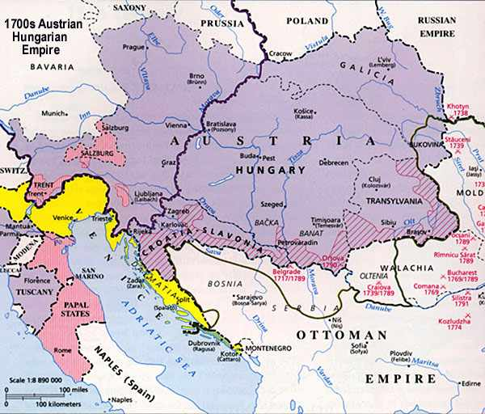
Early 1700s – Austrian Habsburg dynasty was main beneficiary of Ottoman decline
  Ottomans pushed out of Hungary and northern Balkans
Late 1700s – Russian Empire (strengthened by Peter the Great’s forced Westernization) became main threat to Ottomans’ survival
  Russians took lands in the Caucasus and Crimea
1830 – Greeks regain independence after centuries of Ottoman rule
1867 – Serbia gains freedom
1870s – Ottomans driven out of nearly the whole Balkans ; Most of European provinces were eliminated from empire

Slide 12
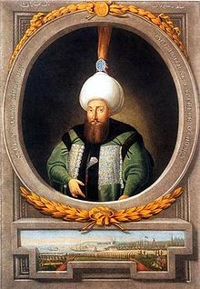
Reform and Survival
Ottoman Empire survived into 20th century
  Divisions between European powers
  British concern to prevent Russians from controlling Istanbul
    Might threaten British naval dominance in Mediterranean
  Reforms from within initiated by sultans and advisors
    Increased tensions within the ruling elite
Sultan Selim III (1789-1807)
  Reform efforts tried to improve administrative efficiencies and building a new army
  1807 – killed by Janissaries
    Janissaries – dominant force in the Ottoman military

Slide 13
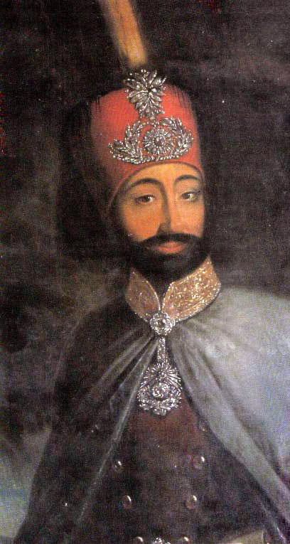
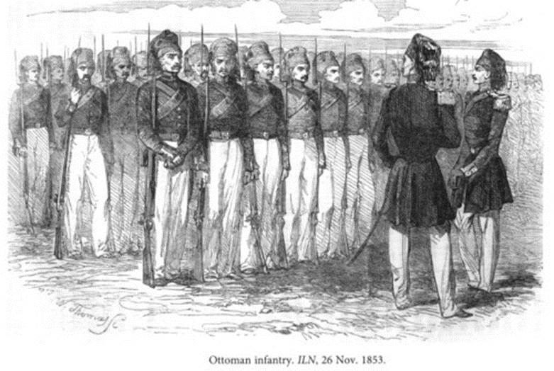
Sultan Mahmud II
  Creates a well-trained new army
    Ends the Janissaries
  Patterned reform program on Western precedents
  Established diplomatic corps on Western lines and exchanged ambassadors with European powers
  Westernized the army

Slide 14
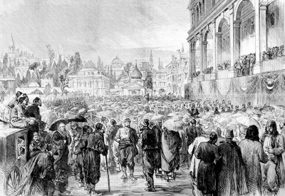
Tanzimat reforms (1839-1876)
  University education Westernized
  Training in European sciences and mathematics
  1830s - State-run postal and telegraph systems
  1860s - Railways
  Newspapers
  1876 - Constitution based heavily on European models
    Improved position of minority religious groups
  Few improvements in position of women until 1908
Proclamation of Constitution

Slide 15
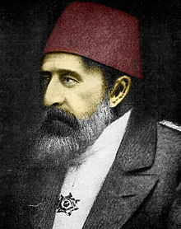
Repression and Revolt
Reforms did improve Ottomans’ ability to fend off/deflect assaults of foreign aggressors
Western-educated bureaucrats, military officers, and professionals came to view sultanate as barrier to even more reforms
1878-1908: Ottoman Sultan Abdul Hamid responds to threat of Westernized population
  Authoritarian absolutism
  Nullified constitution
  Restricted civil liberties (freedom of press)
  Deprived Westernized elite groups power
  Dissidents imprisoned, tortured, or killed
However… continued to push Westernization in certain areas
  Military (European arms and techniques)
  Railways (Berlin to Baghdad)
  Telegraph lines
  Education and judicial reforms
1908 -Bloodless coup ends reign of Abdul Hamid

Slide 16
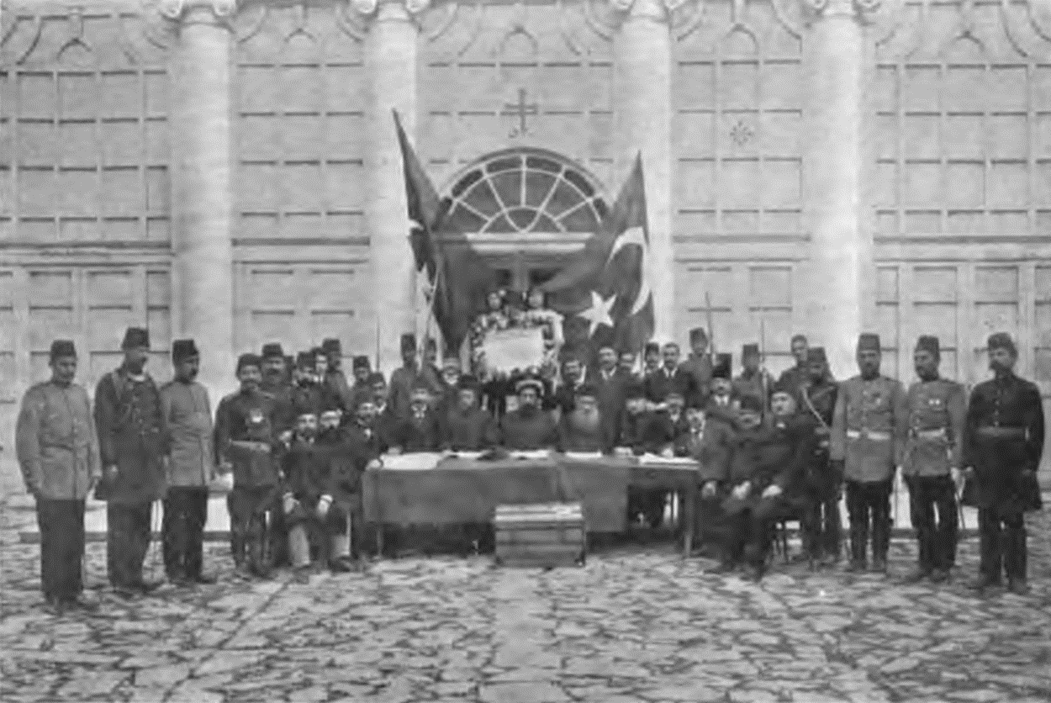
1908 – Young Turks come to power
  Turkish intellectuals
  Restore 1876 constitution
  Freedom of press restored
  Promised reforms in education, administration, and status of women
  Sultan retained as political figurehead and highest religious authority in Islam

Slide 17
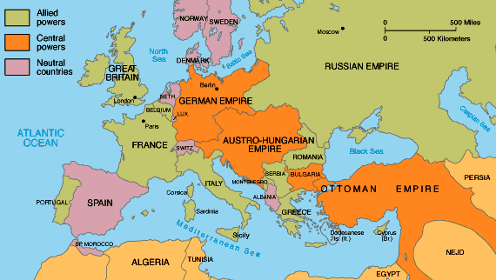
Young Turks managed to stave off collapse of empire by achieving military victories and playing the hostile European powers against each other
Arabs eventually resist rule of Young Turks
  Arabs subjugation, Young Turks massive state control
1914- Turkish entry in WWI (siding with Germany) will lead to the end of Ottoman Empire

Slide 18
Western Intrusions and the Crisis in the Arab Islamic Heartlands
Islamic thinkers debated the best way to reverse the decline and drive back Europeans
  Return to Islamic past
  Large-scale adoption of Western ways
  Combine the two approached
Muhammad Ali (Egypt)
  Preserve old state and society while mixing elements of Western culture
Religious leaders (Mahdi of Sudan)
  Lead jihads (holy wars) against advancing Europeans

Slide 19
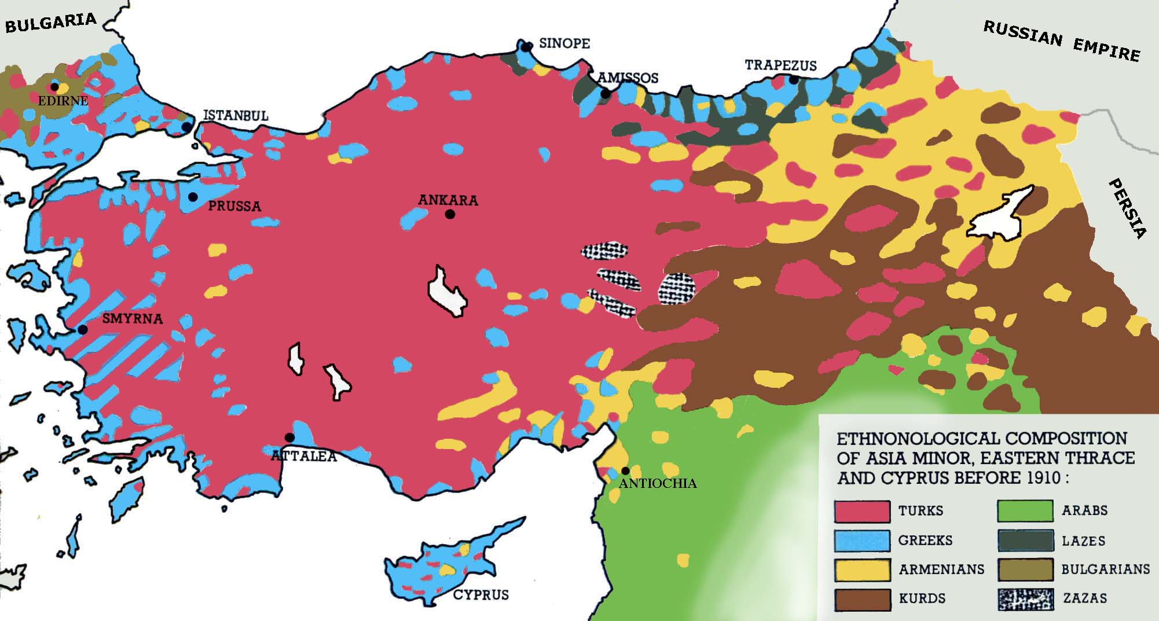
By early 1800s – Arabs of the Fertile Crescent, Egypt, coastal Arabia, and North Africa had lived for centuries under Ottoman-Turkish rule
  Although fellow Muslims, Arabs resented Turkish domination
As Ottoman Empire weakened, the Arabs became vulnerable to aggressive European powers
  Sense of crisis among Islamic faithful
  Europeans capture of Indonesia archipelago, India, Algeria
Islamic world had been displaced by the West as the leading civilization
  From scientific inquiry to monumental architecture

Slide 20
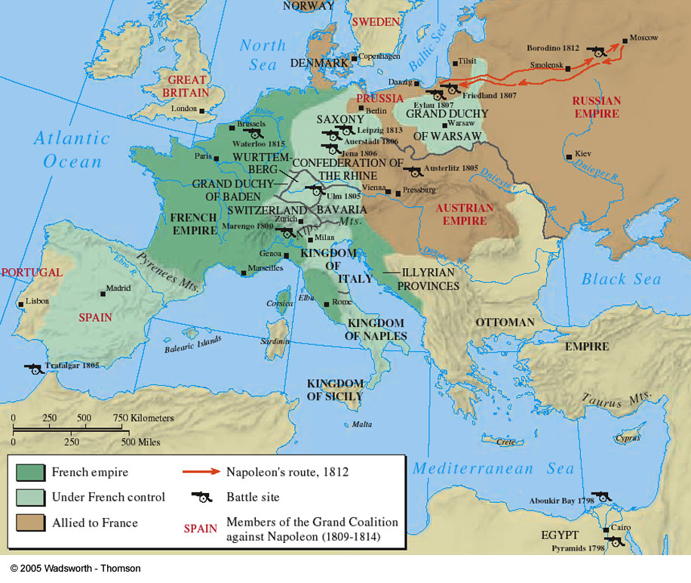
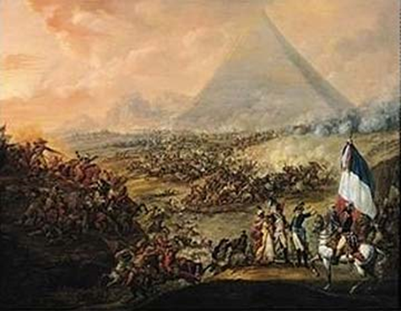
Muhammad Ali and the Failure of Westernization in Egypt
1798 – Napoleon invades Egypt
  Prelude to destroying British Empire in India
  Battle between France and Mamluk cavalry was easy victory for French
    Disciplined firepower vs. medieval armor and spears
  Revealed how vulnerable Muslim core areas were to European aggression and how far Muslims had fallen behind the Europeans in capacity to wage war
  1798 – British push French back
    Egypt was spared European conquest because of British, not Egypt’s Muslim defenders
    French withdraws from Egypt (1801)

Slide 21
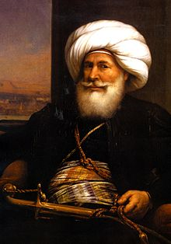
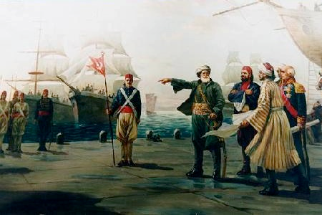
Muhammad Ali emerged as ruler of Egypt (founder of modern Egypt)
  Impressed by weapons and discipline of French armies
    Built up-to-date European-style military force
    Introduced Western-style conscription among Egyptian peasantry
    Imported Western arms
    Put together most effective fighting force in Middle East

Slide 22
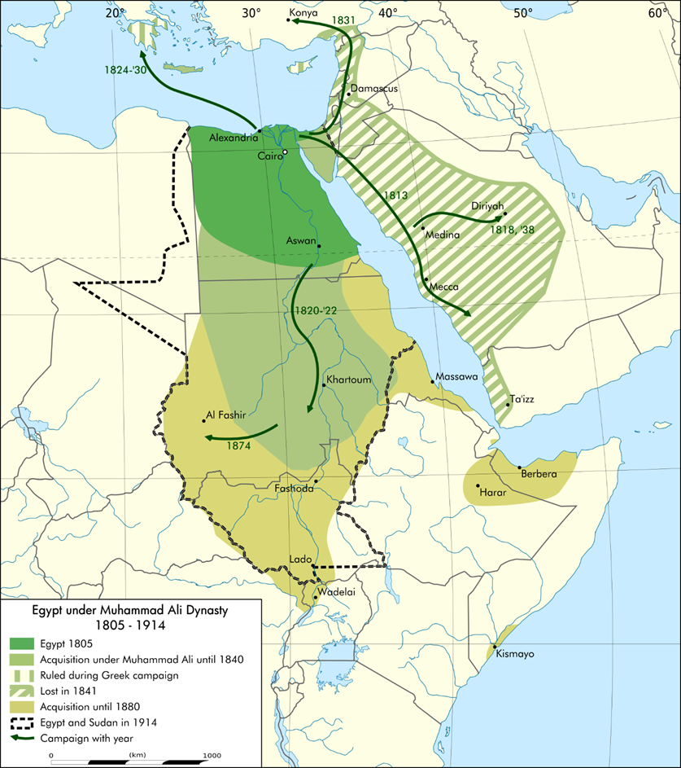
  Successfully invaded Syria, and threatened Istanbul multiple times
  Ordered Egyptian peasantry to increase production of cotton, hemp, indigo (in growing demand in industrial Europe)
  Failed to build industrial sector (competition from Western-manufactured goods)
  Allied with powerful rural landlords (ayan) to control peasantry
  Took peasants’ produce to pay for rising costs of military establishment
    Further impoverished already hard-pressed rural population

Slide 23
Bankruptcy, European Intervention, and Strategies of Resistance
Muhammad Ali’s successors hurt efforts to reform and revitalize Egyptian society
  Cotton production increased and landlord class grew rich, while great majority of peasants went hungry
  Great expansion of cotton production at expense of food grains and other crops (dependent on a single export)
  Education advances benefited only elite
  Revenues Khedives (descendants of Ali) collected wasted
    Palace life
    Wasteful military campaigns on Sudanic peoples along upper Nile
  Mid 19th century - Growing indebtedness to European financers
    Wanted access to Egypt’s cheap cotton and to build a canal

Slide 24
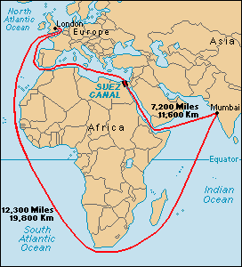
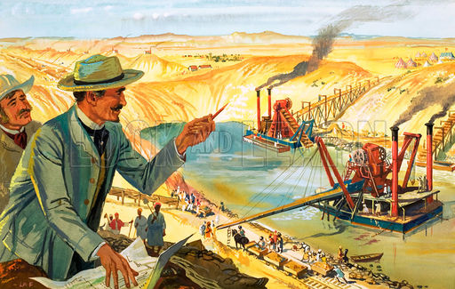
1869 – Suez Canal
  Connected Mediterranean and Red Sea
  Transformed Egypt into one of the most strategic places on Earth
  Vital commercial and military link between European powers and their colonial empires in Asia and East Africa
Muslims debate over how to stop the Europeans
  Jihad
  Learn from Europeans (science and math)
Mounting debts of Khedival regime and strategic importance of canal gave European powers (Britain and France) a growing stake in the stability and accessibility of Egypt

Slide 25
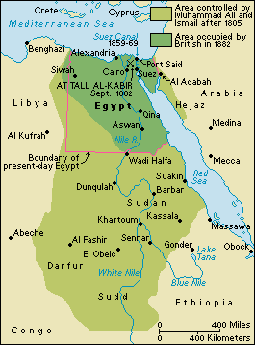
1882 – Britain helps Egyptians defeat revolt led by Orabi
  Orabi – led mutiny in Egyptian army
Although Egypt not formally colonized, British intervention began decades of dominance by British consuls and British advisors to high-ranking Egyptian administrators
  Khedives became mere puppets
  British officials controlled Egypt’s finances and foreign affairs
Direct European control of Islamic heartlands had begun

Slide 26
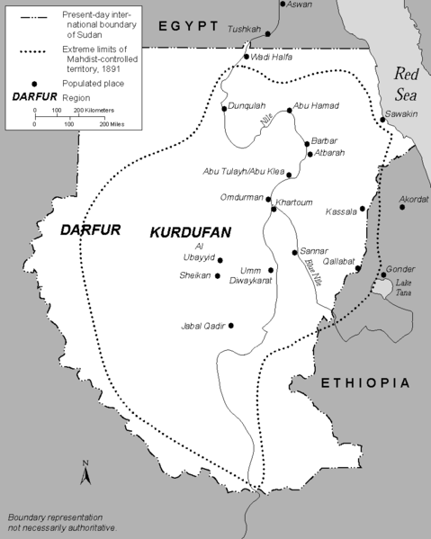
Jihad: The Mahdist Revolt in the Sudan
  Resistance to Egyptian and British influence was focused by Muhammad Achmad
    Head of a Sufi brotherhood in the Sudan
  Taking the title of Mahdi he claimed descent from Muhammad and declared a jihad
    Eliminate foreign influences on Islam and restore purity

Slide 27
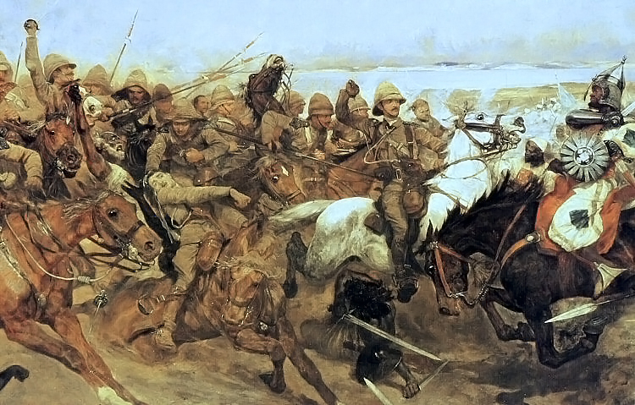
  The military forces of the Mahdi enjoyed military success against the Egyptians until his death
  New leaders of the Sudanese insurgence were not nearly as powerful and a British expedition defeated the Mahdist army
    British extended their power along the Nile

Slide 28
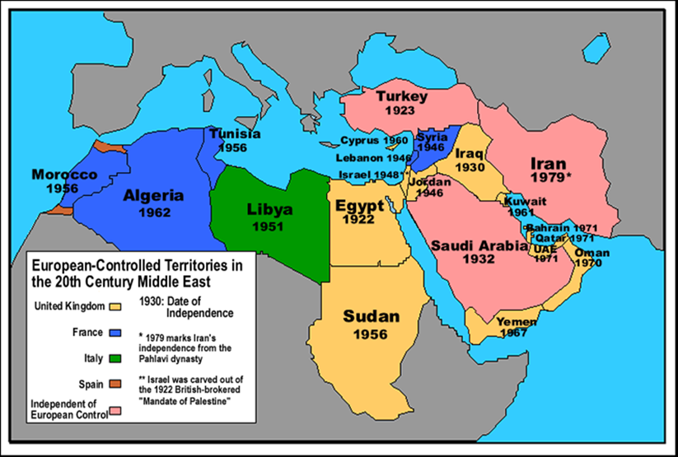
Retreat and Anxiety: Islam Imperiled
19th century – severe reverses for the people of Islamic world
  Outflanked and out-fought by old European rivals
  Many Islamic leaders became puppets of European overlords
  Islamic lands passed under rule of colonial rulers
Islamic civilization was by no means defeated
  But its continued viability clearly was threatened by Europeans, which had become master of the world

Slide 29
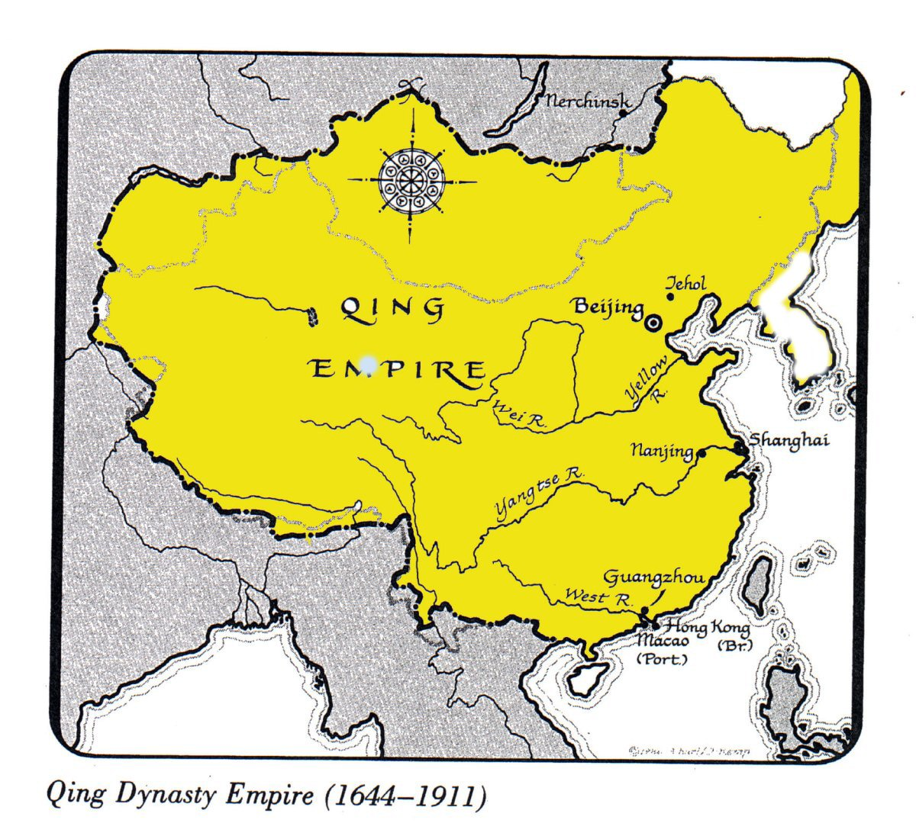
The Last Dynasty: Rise and Fall of Qing Empire
More than a century of strong rule by the Manchus and a high degree of social stability
End of 18th century -rampant official corruption, severe economic dislocation, and social unrest by the end of 18th century
19th century – Western powers (led by British) took advantage of weaknesses to force open China’s markets, humiliate its military defenders, and reduce its Qing rulers to little more than puppets

Slide 30
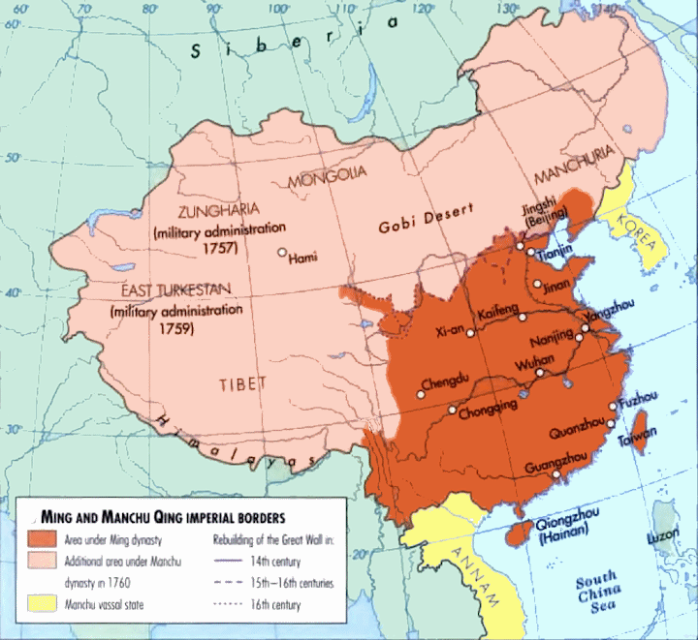
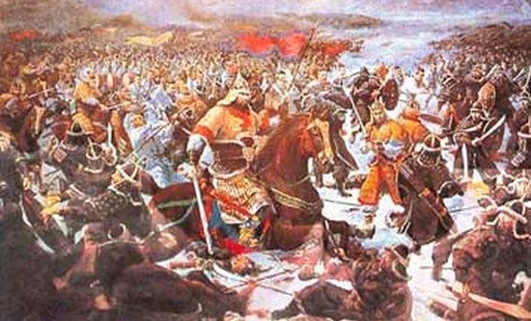
North of Great Wall and before the takeover of China, Manchu elite adopted Chinese ways
  Bureaucracy organized along Chinese lines
  Chinese court ceremonies
  Chinese scholar-officials found lucrative employment
Weakness of declining Ming regime, not Manchus’ own strength, gave Manchus an opportunity to seize control of China
Manchu armies forced submission by nomadic peoples far to the west and compelled tribute from Kingdoms to the South (Vietnam and Burma)
Qing ruled an area larger than any previous Chinese dynasty (exception – Tang)

Slide 31
Manchus retained much of the political system of their Ming predecessors (ethnic Chinese made up majority of subjects)
  Confucian rituals
  Scholar-gentry officials serving under Ming remained in office
    Imperial bureaucracy - Manchu/ethnic Chinese
    Regional/local bureaucracy – ethnic Chinese
  Pardoned many who resisted Manchu conquest
  Patrons of Chinese art
    Manchu rulers employed thousands of scholars to compile encyclopedias of Chinese learning
  Retained the civil service exam
  Manchu emperors – Sons of Heaven
However… reduced the tax exemptions and privileges of the scholar-gentry class

Slide 32
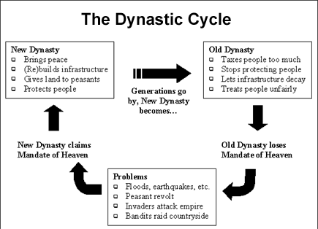
Economy and Society in Early Centuries of Qing Rule
Manchu retained long nurtured values such as respect for rank and acceptance of hierarchy in Chinese society
  Old over young, male over female, scholar-bureaucrat over commoner
  Extended family remained core unit of social order
  Lives of women at all social levels remained centered on household
Manchus alleviated rural distress and unrest after last years of Ming rule
  Taxes and state labor demands lowered
  Tax-free land offered to those willing to cultivate
  Canals, roadways and extending irrigation works repaired

Slide 33
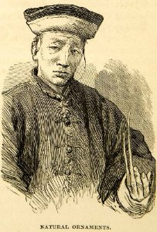
However… the gap between the rural gentry and ordinary peasants and laborers increased
  Many men of the gentry class let their nails grow long to demonstrate that they did not have to engage in physical labor
First century of Manchu rule - Commercial and urban expansion (began in Song era) gained new strength
End of 18th century – state and mercantile classes profited from influx of silver to pay for exports
  Tea, porcelain, silk
Chinese merchants freed from restrictions against overseas travel setup in late Ming
  Profits from overseas trade gave rise to a wealthy new group of merchants (compradors) specializing in import-export trade
    19th century – Compradors major links between China and outside world

Slide 34
Rot from Within Bureaucratic Breakdown and Social Disintegration
Late 18th century – Qing in decline
  Massive corruption in exam system
    Cheating, favoritism
    Sons of high officials often were ensured a place in the ever-growing bureaucracy
    Examiners could be bribed to approve weak credentials or look the other way when candidates consulted cheat sheets
    Wealthy saw positions in bureaucracy as means of influencing local officials and judges and enhancing family fortunes
    Less and less concern was expressed for the effects of bureaucratic decisions on peasantry and urban laborers

Slide 35
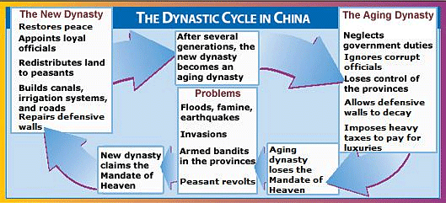
Qing in decline…
  Revenues for state projects are now used to enrich individual families
    Example: funds needed to maintain armies and public works declined sharply and filled the pockets of individuals
  Food shortages and landlord demands caused mass migrations
  Vagabond bands clogged roads, and beggars crowded the city streets.
  Banditry became major problem
  Food crops from the Americas (corn and potatoes) had created massive increase in population
    Chinese social and economic systems could not sustain such a large population

Slide 36
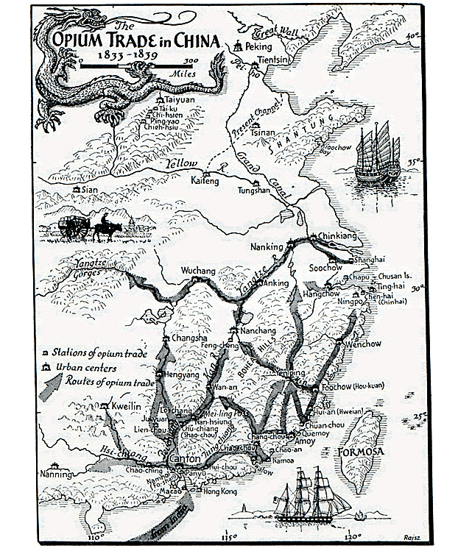
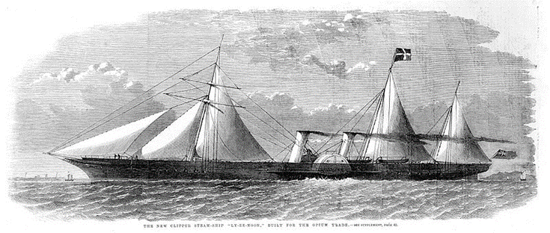
Barbarians at the South Gates: The Opium War and After
Scientific and industrial revolutions allowed Britain to compensate for their smaller numbers with better organization and superior technology
For centuries, British merchants had eagerly exported silks, fine porcelains, tea, and other products from the Chinese Empire
British forced to trade growing amounts of silver (China didn’t want European stuff)
Britain unhappy with unfavorable terms of trade
  Turn to opium (high demand in China)
Above: British steamship built for Opium trade

Slide 37
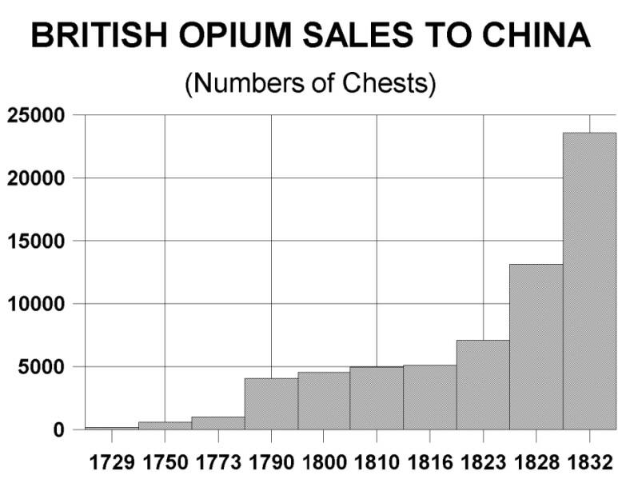
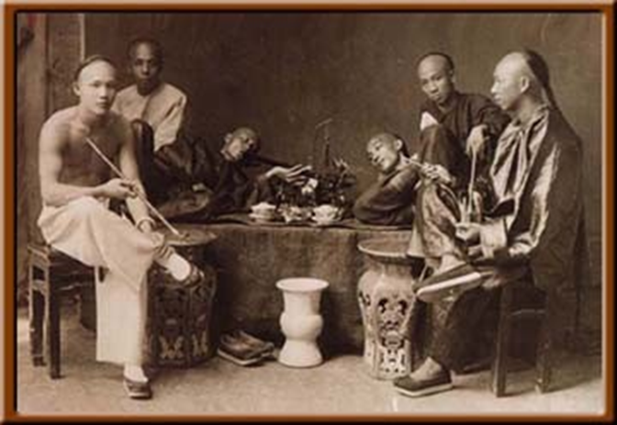
Chinese soon realized that opium traffic was a major threat to their economy and social order
  Within years, China loses their favorable balance of trade
  Silver begins to flow in large quantities OUT of country
    As sources of capital for public works and trade expansion decreased, agricultural productivity stagnated or declined, and unemployment spread
Wealthy Chinese squandered increasing amounts of China’s wealth to support opium habits
Strung-out officials neglected their administrative responsibilities, the sons of prominent scholar-gentry families lost their ambition, and laborers and peasants abandoned their work for pleasures of opium

Slide 38
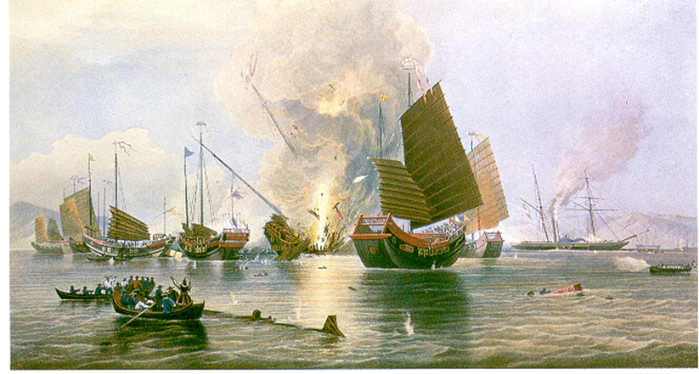
Early 18th century – Qing emperors had issued edicts forbidding opium traffic, but little was done to enforce
British ordered the Chinese to stop their anti-opium campaign or risk military intervention
1839 – Opium War
  War junks no match for British gunboats

Slide 39
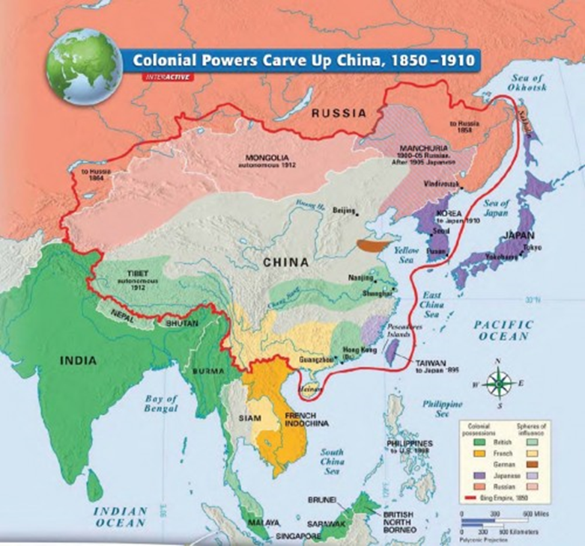
British victory in Opium War allowed the European powers to force China to open trade and diplomatic exchanges
  Hong Kong established as additional center of British commerce
  1890 – more than 90 ports available to European and American traders
  Britain, France, Germany, and Russia actually leased certain ports and their hinterlands.
  Mid 19th century – China’s foreign trade and customs overseen by British officials
    Ensured that European nationals had favored access to China’s markets and no protective tariffs were established by Chinese

Slide 40
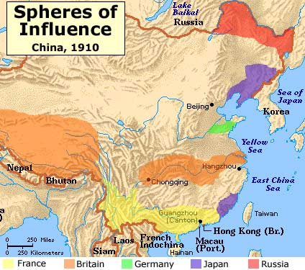
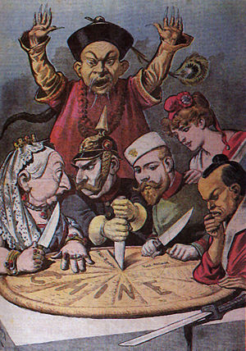

Slide 41
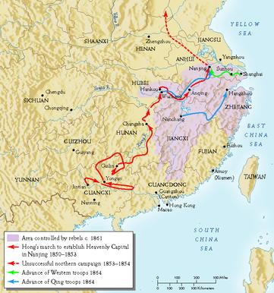
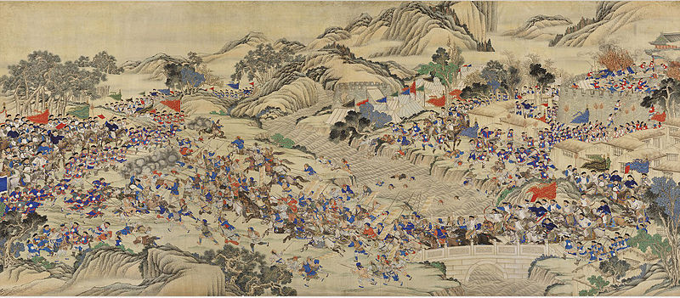
A Civilization at Risk: Rebellion and Failed Reforms
China’s defeat in the Opium war contributed to a building crisis that threatened not just the Qing dynasty but Chinese civilization as a whole
Taiping rebellion (Hong Xiuquan) – increased the problems in Chinese society, drained resources of ruling dynasty
  Posed a serious alternative not only to the Qing dynasty but to Confucian civilization
  Offered sweeping programs for social reform, land redistribution, and liberation of women
  Attacked traditional Confucian elite
    Attack on the scholar-gentry was one of the main causes of Taiping’s ultimate defeat

Slide 42
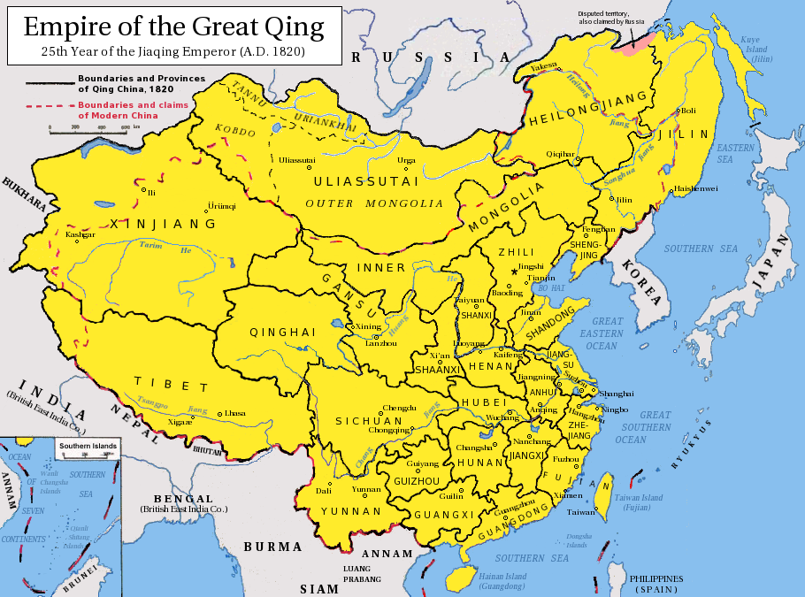
Late 19th century – provincial leaders most responsible for China’s self-strengthening movement
  Challenged the West
  Encouraged Western investment in railways and factories in areas they governed
  Modernized their armies
  Manchus had trouble controlling them
Manchu rulers would stubbornly resisted the far reaching reforms that were the only hope of saving the regime, and Chinese civilization

Slide 43
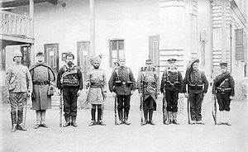
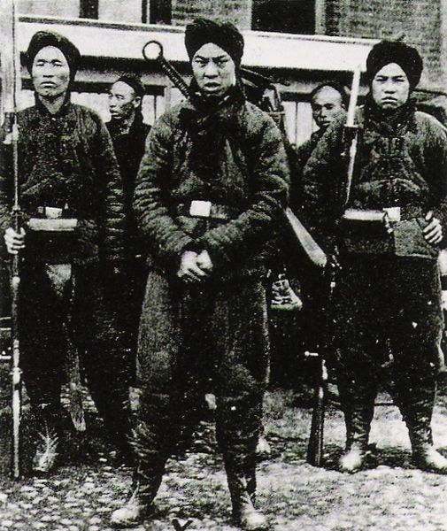
Boxer Rebellion (1898) – Group of Chinese try to remove European influence in China
  1901- Imperialist powers intervene
  Failure of rebellion led to even greater control over China’s internal affairs by the Europeans
Above: troops of the Eight nations alliance in 1900.
Left to right: Britain, United States, Australian, British India,
Germany, France, Austria-Hungary, Italy, Japan

Slide 44
The Fall of the Qing
End of 19th century – sons of some of scholar-gentry and especially of the merchants in the port cities were becoming more and more involved in secret society operations aimed at overthrowing the regime
Wanted to get rid of Manchus, and also…
  Pass power to Western-educated, reformist leaders who would build a new, strong nation-state in China
    Patterned after the West
  Desperately needed social programs to relieve the misery of peasants and urban workers
Revolutionaries – drew heavily on the West for ideas and organization models
  Still… rising middle classes didn’t want imperialist powers in Chinese affairs
    Condemned Manchus for failing to control foreigners
February 1912 – last emperor of China (Puyi) was overthrown, and one of the more powerful provincial lords was asked to establish a republican government in China

Slide 45
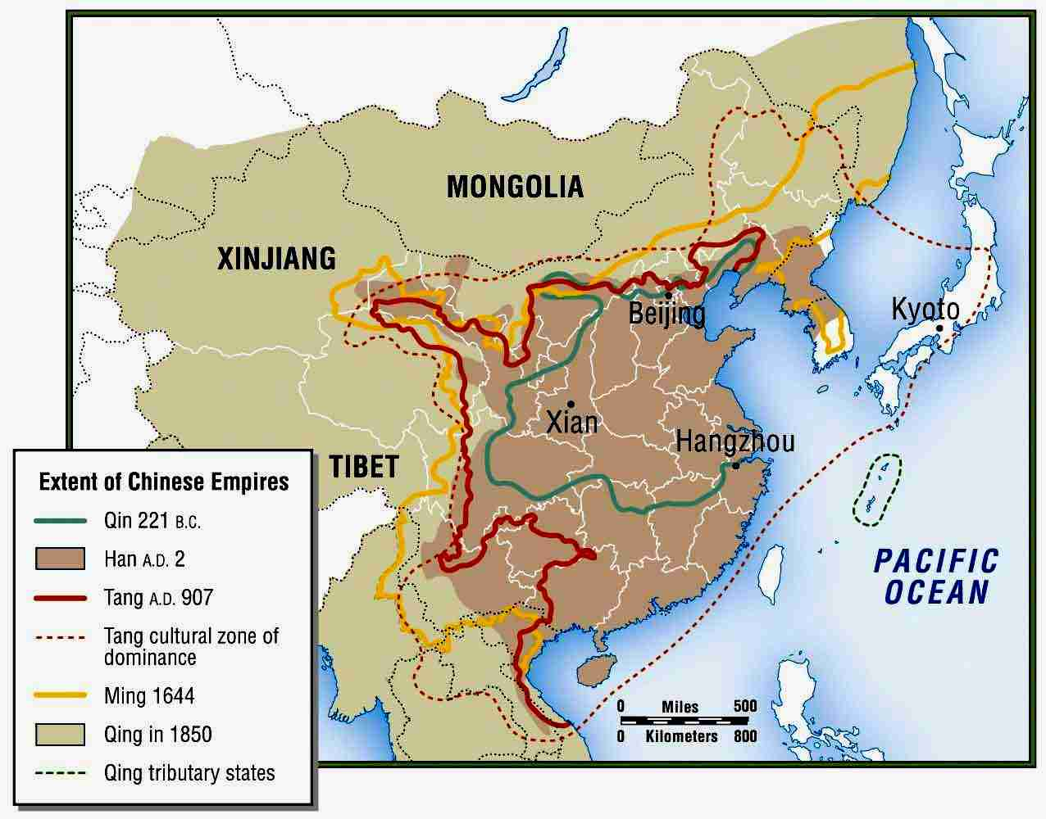
The End of a Civilization?
  Even prior to their abdication, the Qing had abandoned the Confucian examination system as inappropriate to the problems of the government
    Signaled the end of patterns of civilization in China

