Slide 1
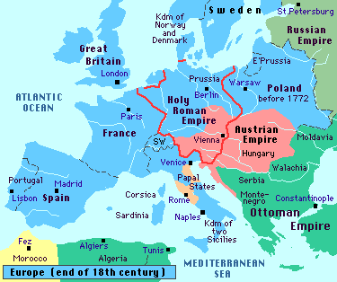
Chapter 23
The Industrialization of the West, 1760-1914

Slide 2
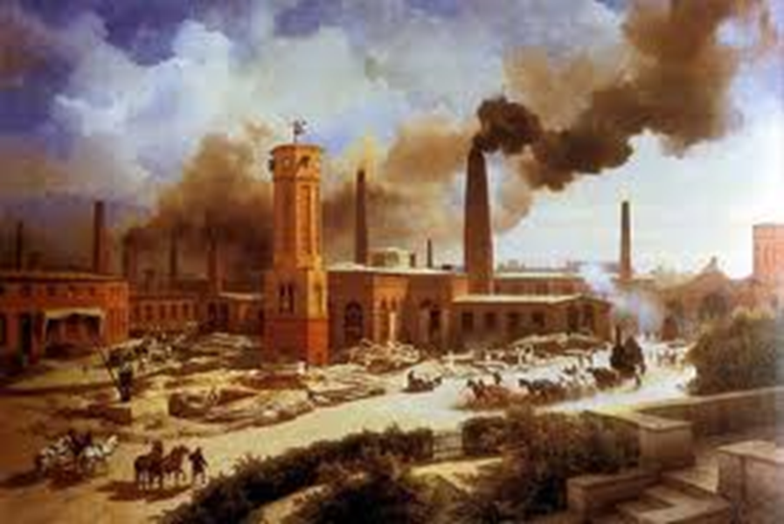
1760 – almost entirely monarchies; largely agricultural
1914 – many monarchies overthrown, replaced by powerful parliaments (voting systems); industrialized, urban populations
  Greatest change to West – industrialization
    Creation of new technological and economic structures

Slide 3
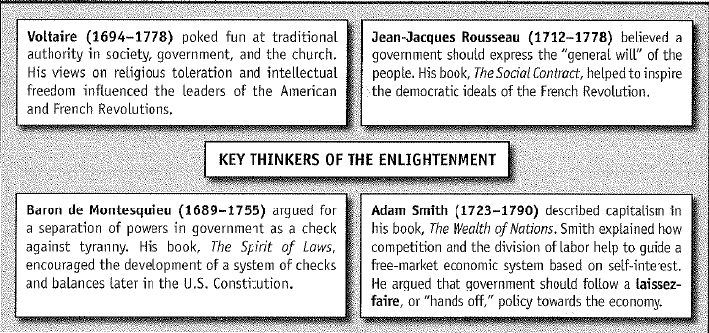
Intellectual Challenge and Population Pressure
  The Enlightenment thinkers
    Challenged regimes that failed to enact reforms
      Religious freedom
      End aristocratic privilege
    Jean-Jacques Rousseau – government based on a general will, plea for democratic voting
    Encouraged economic and technical change and policies that would promote industry

Slide 4
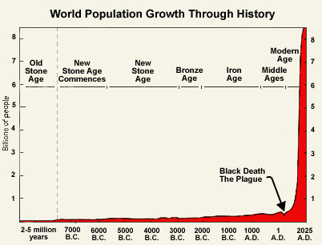
  1730 – dramatic population increase created instability
    improved nutrition (growing use of potato)
    lower rate of infant mortality
    Better border policing by the efficient nation-state governments
    Reduced number of disease-bearing animals
    Became harder for anyone who was not an aristocrat to gain a high post in church or state
    Many driven into working class with no chance of inheriting property
      Work in agriculture and manufacturing

Slide 5
  18th century – population growth promoted rapid expansion of domestic manufacturing in Western Europe and the United States (by 1800)
    Proto-industrialization - Hundreds of thousands of people became full-time or part-time producers of textile and metal products, working from home
  Social patterns changed in response to new economic conditions
    Villagers began to dress more urban
    Premarital sex increased
    Parental authority declined among groups with little or no property
    Young people began looking for jobs on their own

Slide 6
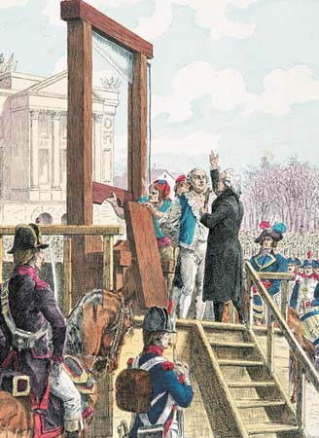
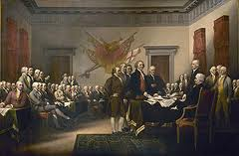
  American and French Revolutions
The Tide of Revolution, 1789-1830

Slide 7
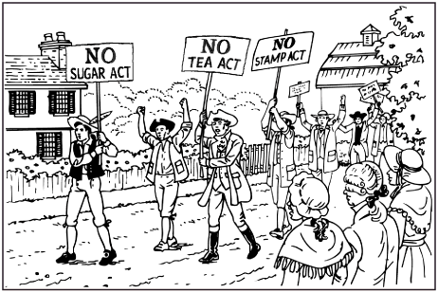
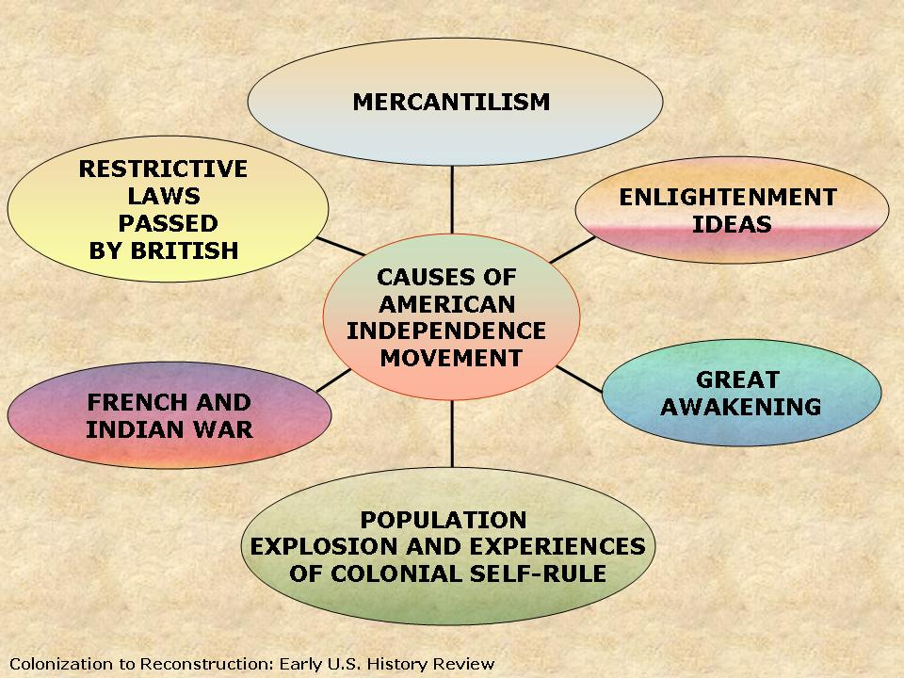
The American Revolution
  1775 – Britain’s Atlantic colonies rebelled in a war for Independence
    1763 – new taxes on the colonies
      1765 – Stamp Act: imposing tax on documents and pamphlets
      “No taxation without representation”
    Limitations placed on development of the western frontier
    Desire to overthrow existing colonial government

Slide 8
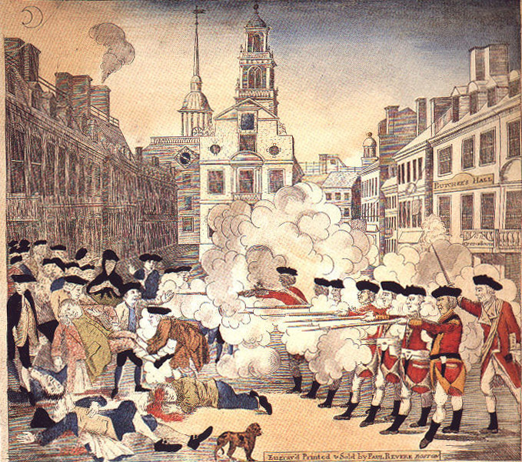

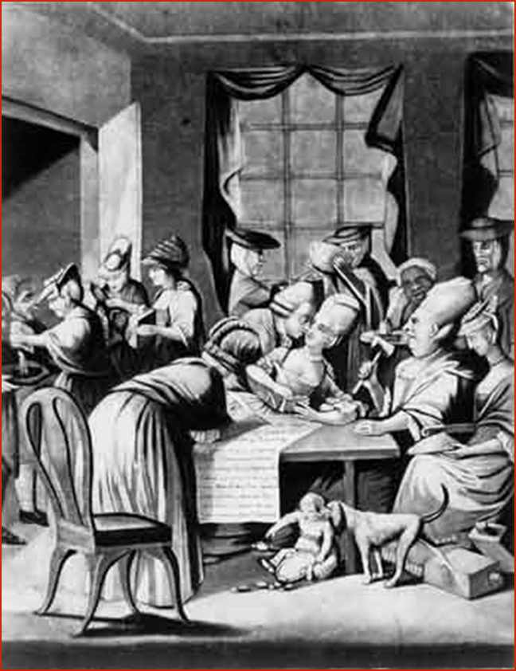

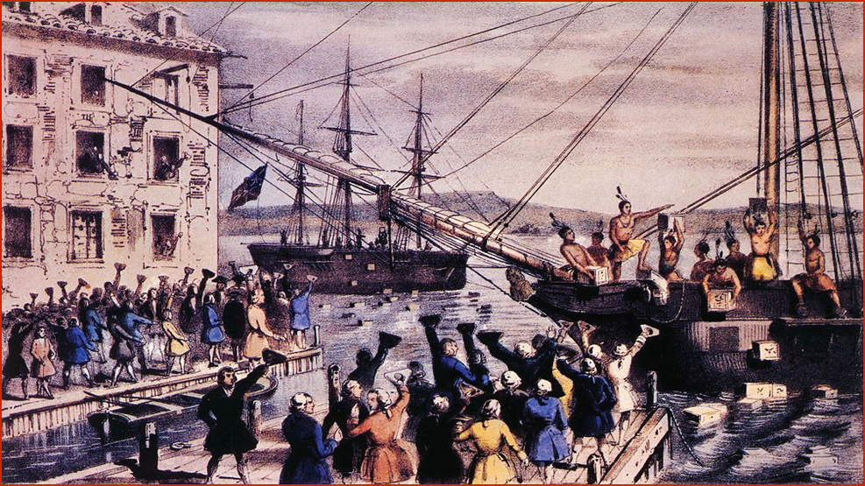
The Boston Massacre (March 5,1770)

Slide 9
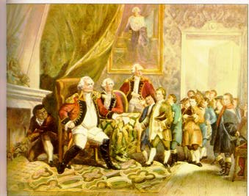
The Coercive or Intolerable
Acts (1774)
1. Port Bill
2. Government Act
3. New Quartering
Act
Lord North
4. Administration of
Justice Act

Slide 10
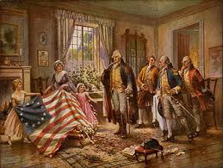
First Continental Congress (1774)
55 delegates from 12 colonies
Agenda: How to respond to the Coercive Acts & the Quebec Act?
1 vote per colony represented

Slide 11
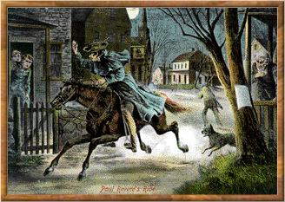
The British Are Coming . . .
Paul Revere & William Dawes make their midnight ride to warn the Minutemen of approaching British soldiers.

Slide 12

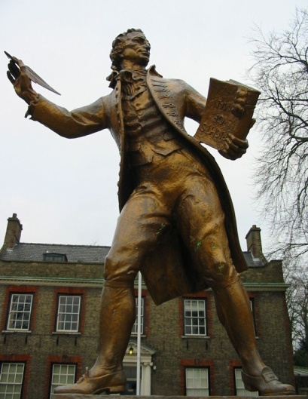
Thomas Paine: Common Sense
January 1776, Common Sense was published
New perspective of blaming the monarchy instead of parliament for seizing power from the people

Slide 13
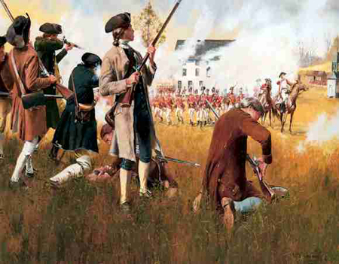
The Shot Heard ’Round the World!
FIRST BATTLE - Lexington & Concord April 18,1775

Slide 14
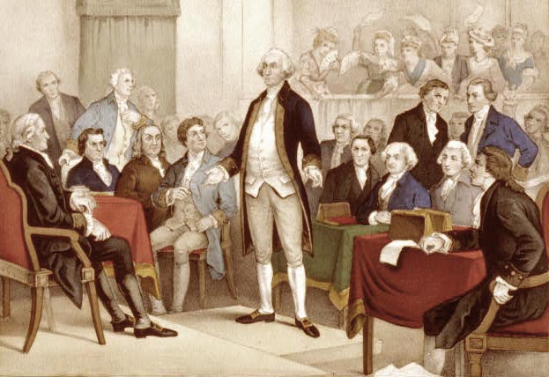
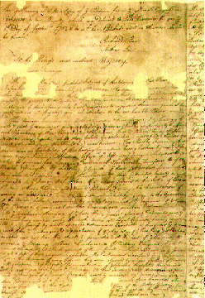
The Second Continental Congress (1775)
Formed an army called the Continental Army
George Washington was elected Commander in Chief
Approved the Declaration of Independence

Slide 15
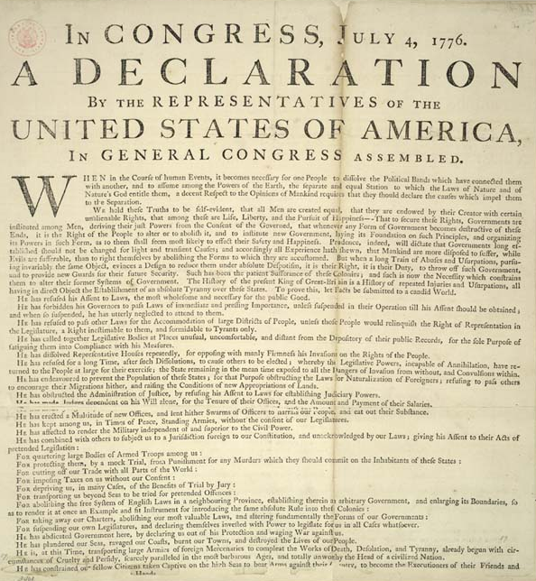
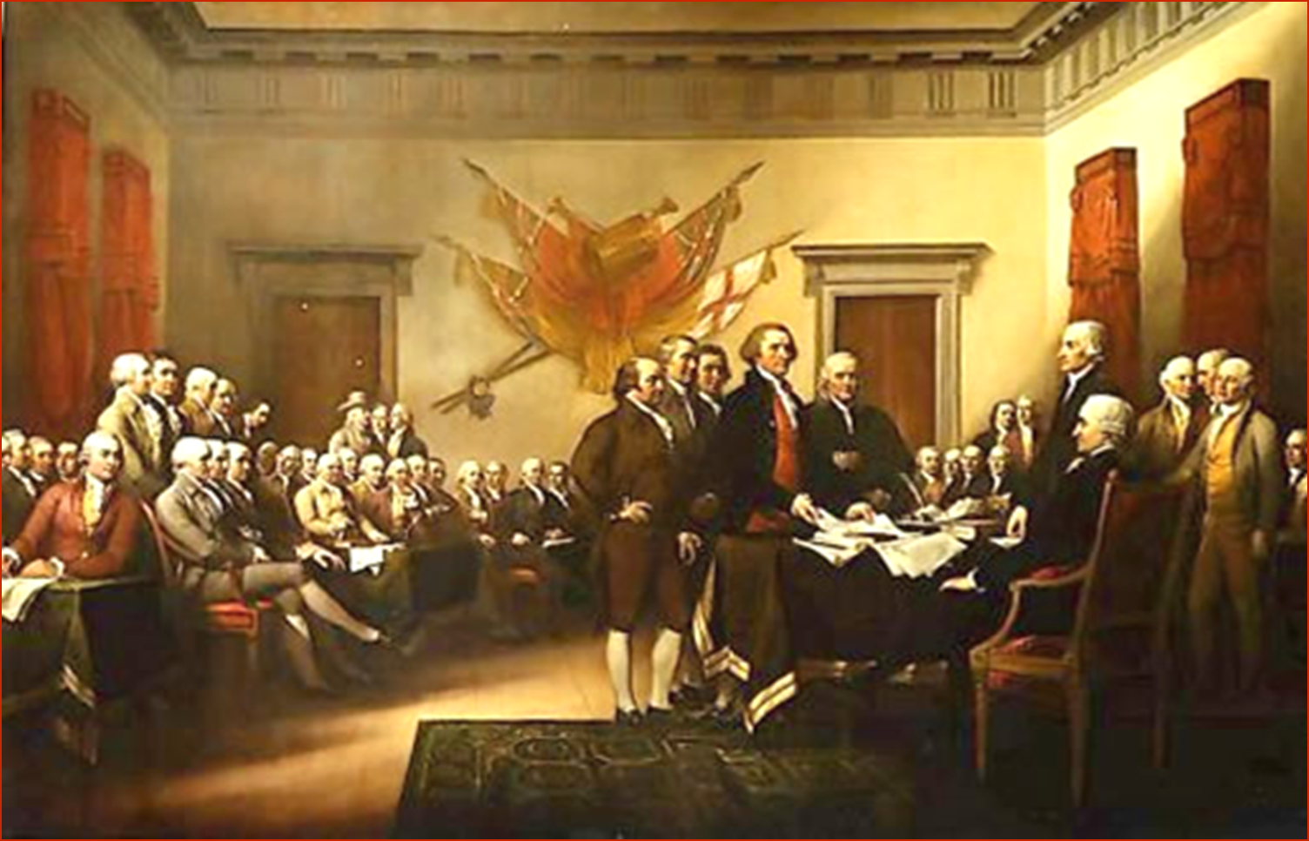
Declaration of Independence (1776)
On July 4, 1776 the Second Continental Congress approved the Declaration of Independence
A political document that declared the colonies to be “free and independent states absolved from all allegiance to the British Crown”

Slide 16
The American Revolution
  Following the Declaration of Independence of 1776, colonists set up a provisional government and proceeded to fight a war against British forces
  After forcing the British to come to terms, the colonists established a new constitutional structure in 1789 based on Enlightenment principles
    Checks and balances
    Formal guarantees of individual liberties
    Voting rights (limited)
    Slavery remained

Slide 17
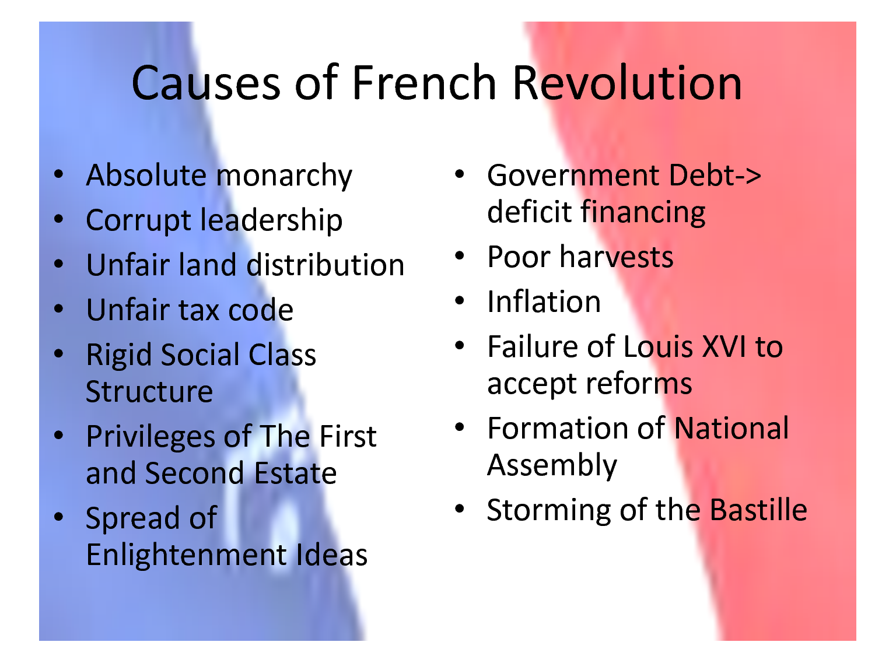
The French Revolution

Slide 18
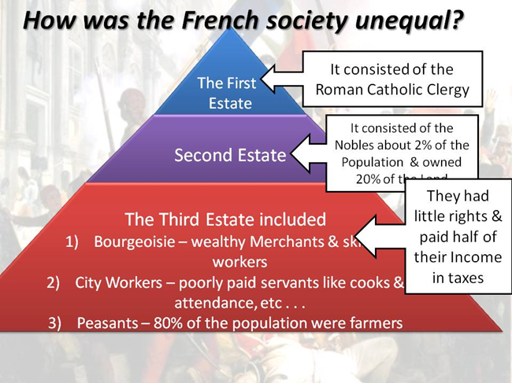
Causes of the French Revolution (1789)
French Social Division – 3 Classes
  First Estate: the clergy (priests & Church officials)
  Second Estate: nobility who had special privileges like tax exemption & collecting feudal dues. Nobles served as officers in military and held high positions at court
  Third Estate: largest of the 3 estates; common people; included bourgeoisie – middle classes of merchants, professionals, store owners, urban workers, peasantry

Slide 19
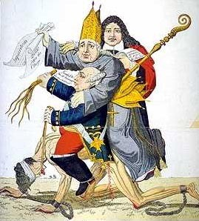
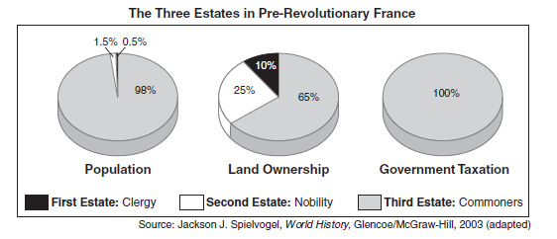

Slide 20
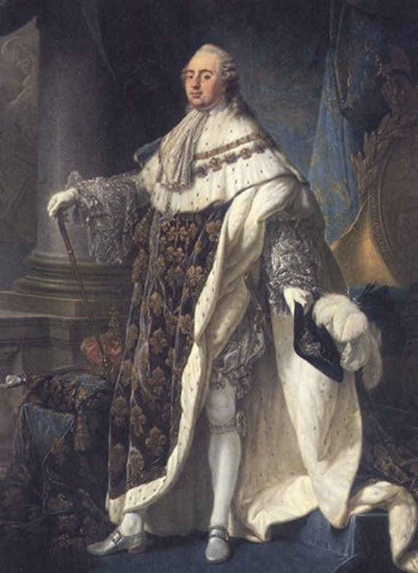
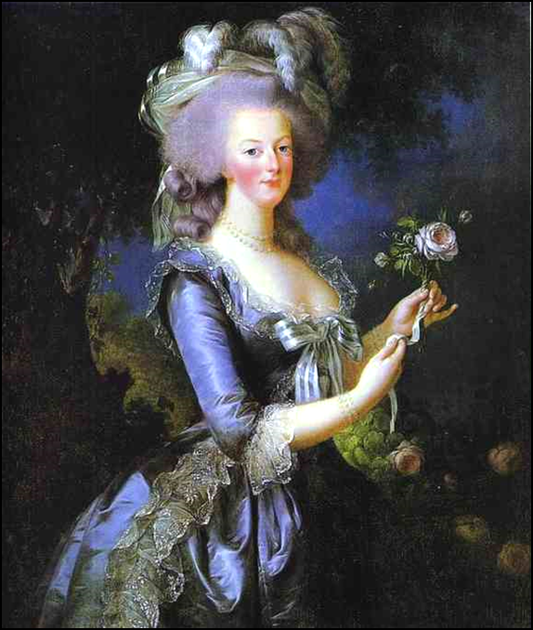
Crisis in France in 1789
  Reformers seeking change along Enlightenment lines attacked the inefficiency and autocracy of the French monarchy
    Limit powers of Catholic church, aristocracy, and monarchy
  Resistance to the government arose in all levels of French society
    Cries for reform were met with adamant resistance on the part of the monarchy and the French nobility
    Peasants wanted fuller freedom from landlords’ demands
The French Monarchy:
1775 - 1793
Marie Antoinette & Louis XVI

Slide 21
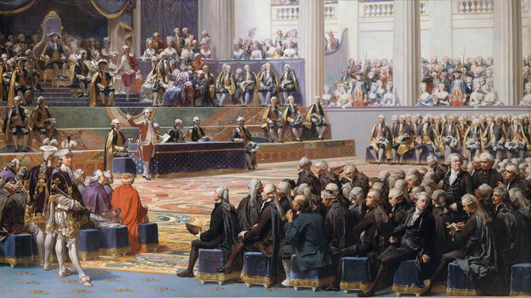
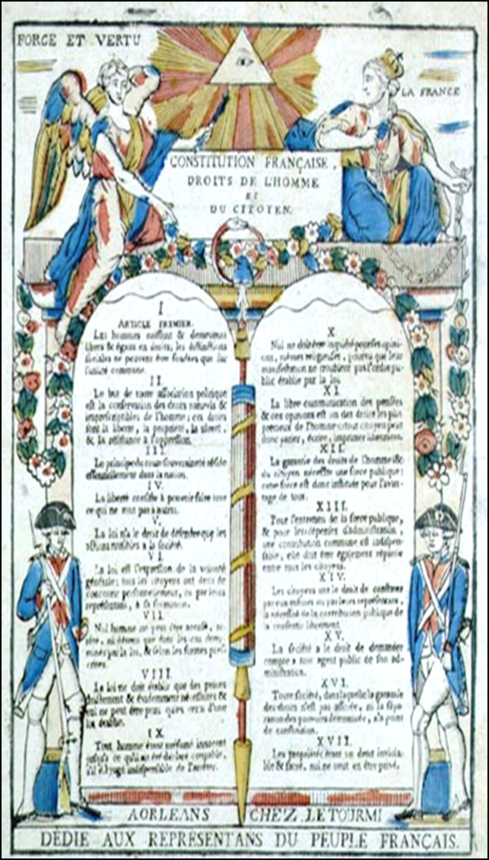
  In 1789, Louis XVI called a meeting of the French Estates General to consider tax reform, but reformers seized control of the meeting
  August 17, 1789- Reformers issued the Declaration of the Rights of Man
    Guaranteed freedom of expression
    Like the Declaration of Independence, law enacted natural rights to “liberty, property, security, and resistance to oppression”

Slide 22
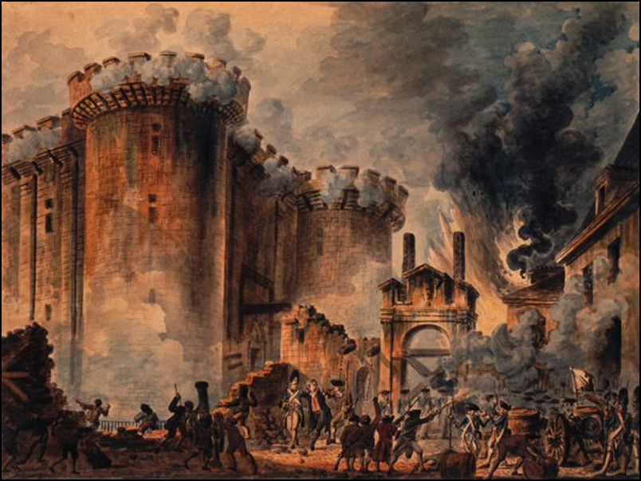
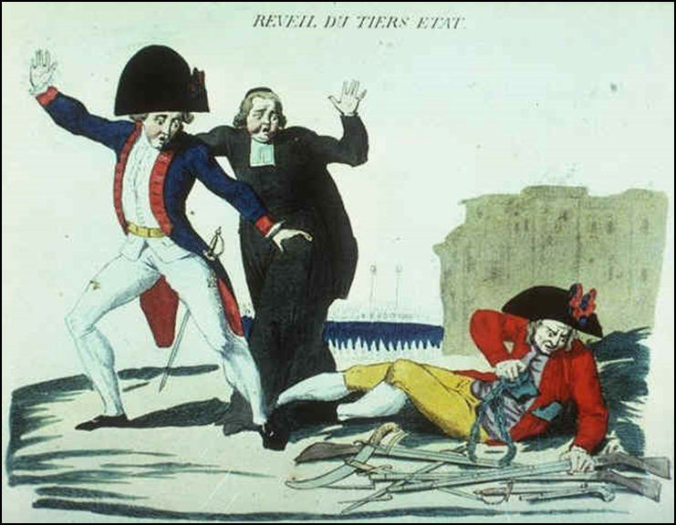
  July 14 1789 – Popular riot at a prison, the Bastille
    Symbol of revolution
  Peasants seized manorial records and many landed estates
    Proclamation issued abolishing manorialism, giving peasants clear title to much land and establishing equality under the law
  A new constitution created
    established individual rights
    assaulted the position of the Church
    granted limited voting rights to the adult male population
    Strong parliament was set up
      Limited power for King
    Males with property could vote
      About half of population
“Liberty, Equality, and Fraternity”

Slide 23
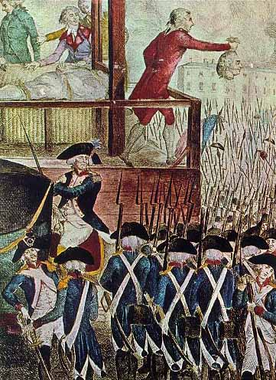
The French Revolution: Radical and Authoritarian Phases
  1792- The initial push for reform began to turn more radical
    Early reforms provoked massive opposition in the name of church and aristocracy
    Civil war broke out in several parts of France
  Pressures led to a takeover by radical leaders
    Abolished the monarchy
    Decapitated the King using a guillotine
      Enlightenment – provide more humane execution
    Reign of Terror – killed thousands of opponents
      Nobles, priests, and suspected traitors
      40,000 killed
      Started by Committee of Public Safety
      Followed Rousseau’s idea of using force to achieve goal

Slide 24
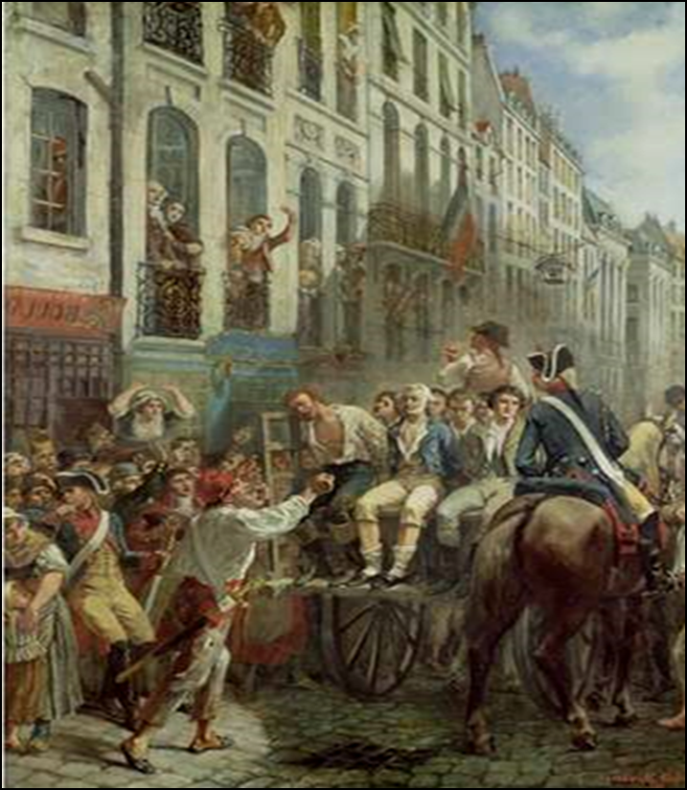
The leader of the radical phase was Maximilien Robespirre
  1792 - Headed the prosecution of the King
  Took over the leadership of government
  Sponsored the Reign of Terror
  Centralized government
  1794 – arrested and guillotined

Slide 25
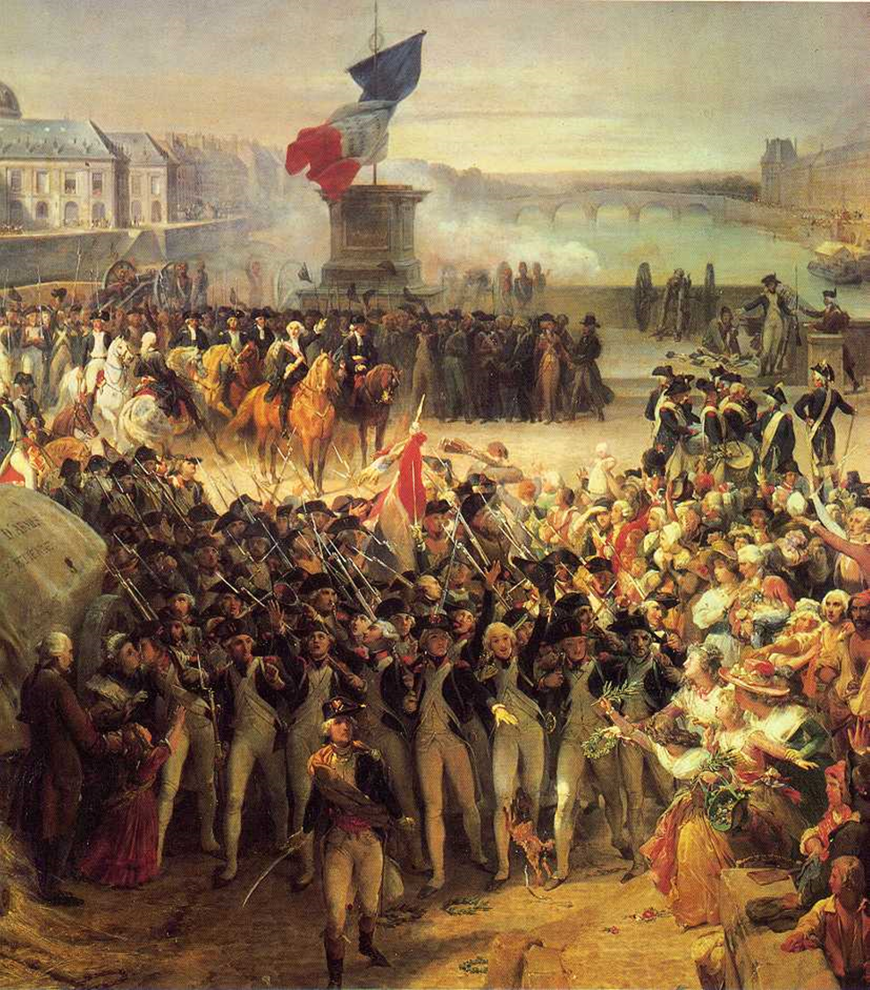
Robespierre and his colleagues pushed the revolution further
  New constitution proclaimed universal adult male suffrage
    Never fully put into practice
  Proclaimed universal military conscription
  Revolutionary armies began to win major success
    Drove out France’s enemies
    Acquired new territory in the Low Countries, Italy, and Germany
      Spread revolutionary gains further
  New sprit of nationalism
    French people felt an active loyalty to the new regime

Slide 26
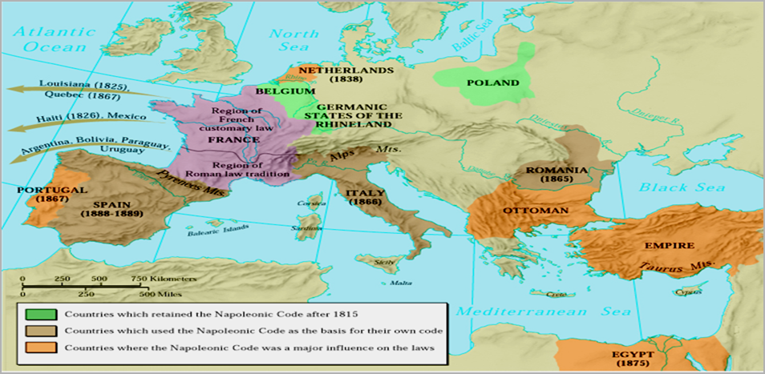
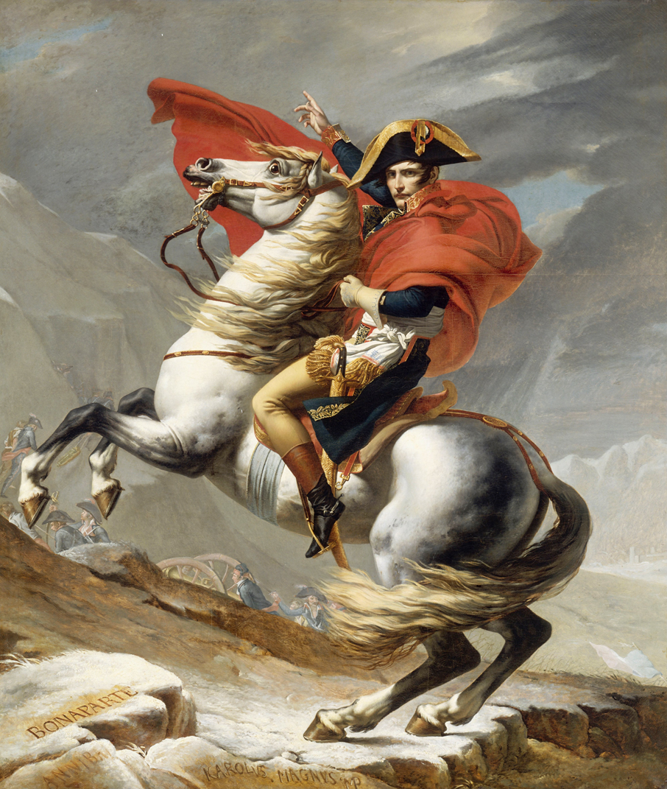
Napoleon Bonaparte
  1799 – led the final phase of the revolution
  Leading general
  Converted the revolutionary republic to an authoritarian empire
  Greatly reduced the power of parliament
  Established a police system which limited freedom of expression
  Enacted religious freedom
  Napoleonic Code
    Law code
    Equality for men, not women
  Developed a centralized system of secondary schools and universities to train bureaucrats

Slide 27
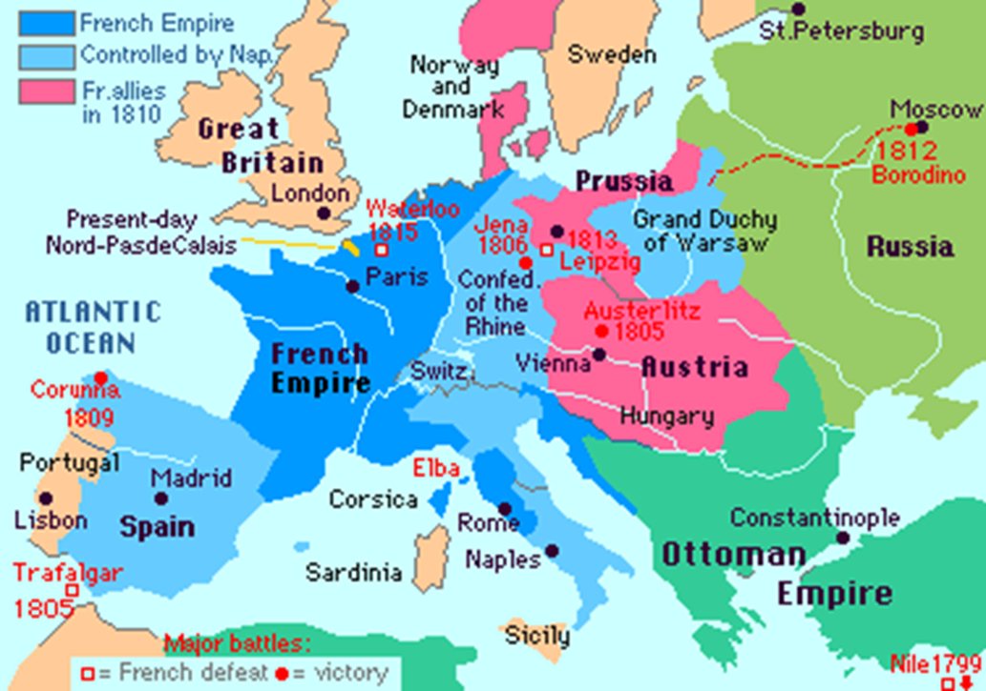
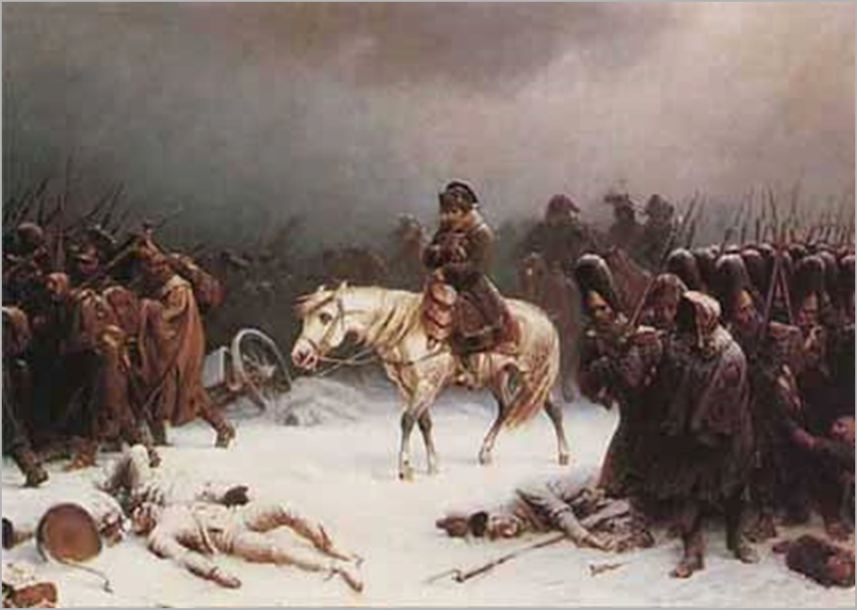
Napoleon devoted most of his attention to expansion abroad
  A series of wars brought France against all of Europe’s major powers, including Russia
  1812 – French empire directly held or controlled as satellite kingdoms most of western Europe
    Spread key revolutionary legislation throughout western Europe
      Idea of equality under the law and the attack of privileged institutions such as aristocracy, church, and craft guilds
  1812 – Attempt to invade Russia failed
    French armies perished in the cold Russian winter

Slide 28
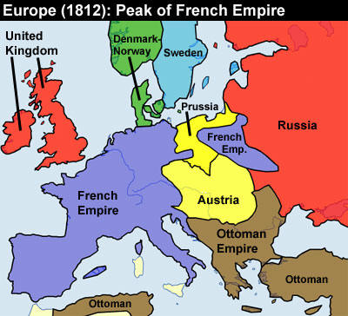

Slide 29
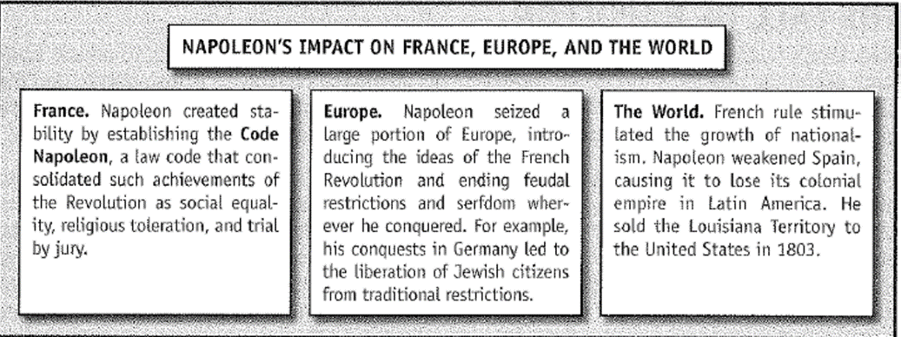
The revolution and Napoleon encouraged popular nationalism outside of France as well as within
  French invasion made many people more conscious of loyalty to their own nations
  Popular resistance to Napoleon played a role in the final French defeat
    Spain, Germany

Slide 31
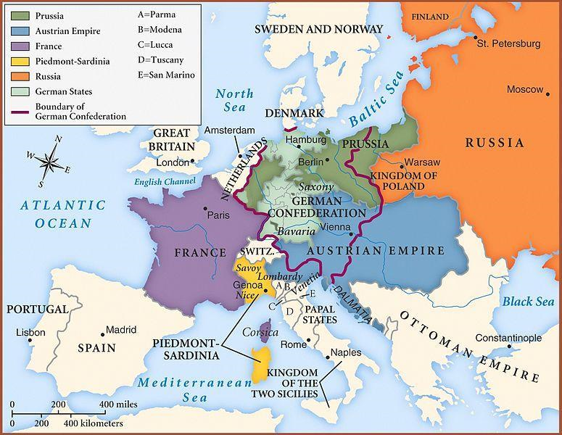
A Conservative Settlement and the Revolutionary Legacy
1815 – Congress of Vienna
  Meeting between the allies who defeated Napoleon
  Wanted a peace settlement that would make further revolution impossible
  Did not try to punish France too sternly
    Wanted to restore European balance of power
  Britain gained new colonial territories
    Confirmed its lead in the scramble for empire in the wider world
  Russia maintained its hold over most of Poland
  Territorial adjustments kept Europe fairly stable for the next half century

Slide 32
Political movements arose to challenge conservatism
  Liberals
    Focused on political structure
    Looked for way to limit government interference in individual life
    Urged representation of propertied people in government
    Pushed the importance of constitutional rule and protection for freedoms of religion, press, and assembly
    Represented the growing middle class
    Economic reforms
    Better education
    Promotion of industrial growth
  Radicals
    Accepted the importance of most liberal demands
    Wanted wider voting rights (democracy)
    Urged some social reforms in the interest of lower classes
    Attacked private property in the name of equality and an end to capitalist exploitation of workers

Slide 33
1820s-1830s: Revolutions and political changes occurred throughout Western Europe and the United States
  1820 – Greek Revolution
    Revolts involved a nationalist Greek revolution against Ottoman rule
    Key to gradually dismantling the Ottoman Empire in the Balkans
  1830 – Another French Revolution
    Installed a different king and a somewhat more liberal monarchy
  Uprisings occurred in Italy and Germany
    Minimal impact
  1830 – Belgian Revolution
    Produced a liberal regime and a newly independent nation
  1820s – United States
    Key state granted universal adult male suffrage (except for slaves)
  1832 – Britain signed the Reform Bill of 1832
    Gave the parliamentary vote to most middle-class men
  1830s – regimes in France, Britain, Belgium, the United States, and several other countries had parliamentary governments, some guarantees for individual rights, religious freedom not only for various Christian groups but also for Jews, and a voting system ranging from democratic (for men) to upper middle class

Slide 34
THE INDUSTRIAL REVOLUTION

Slide 35
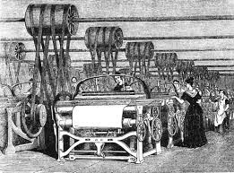
TURNING POINT in History
During the Industrial Revolution, Europe saw a shift from an economy based on farming and handicrafts to an economy based on manufacturing by machines in factories
Coal-powered engines replaced people and animals as key sources of energy
  Spindles (wrapped fiber automatically into thread), sugar refining, printing

Slide 36

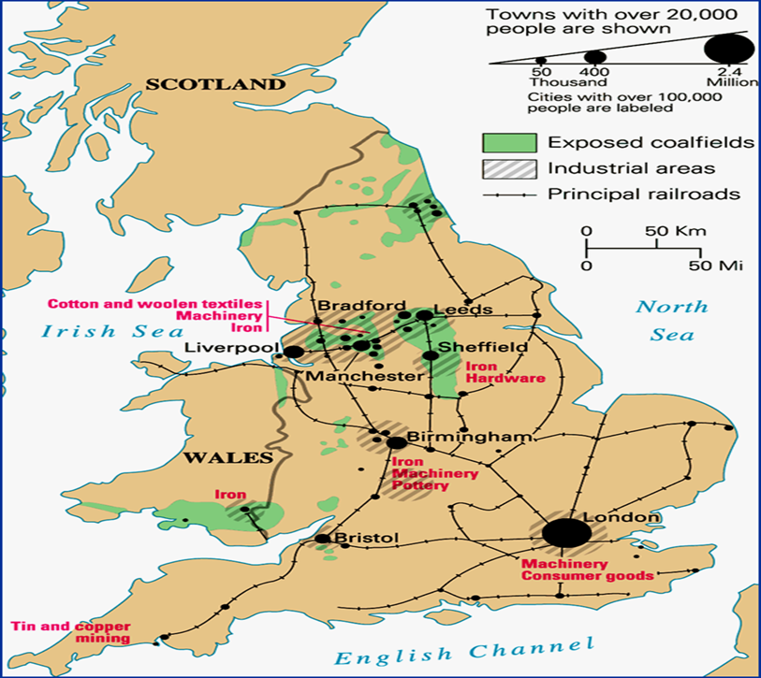
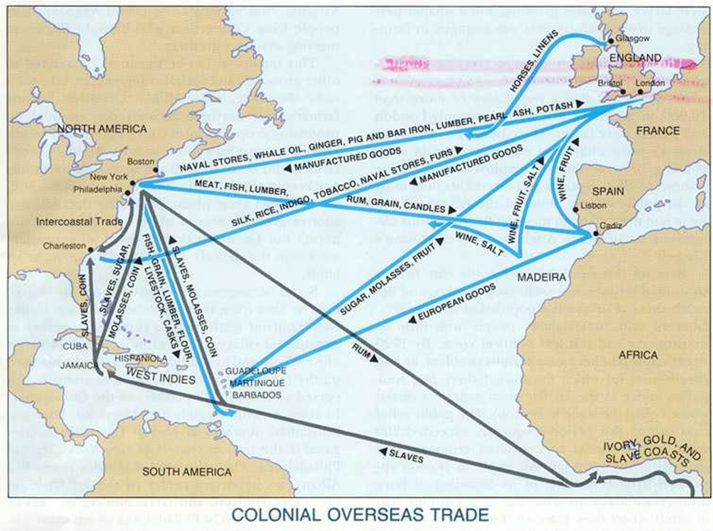
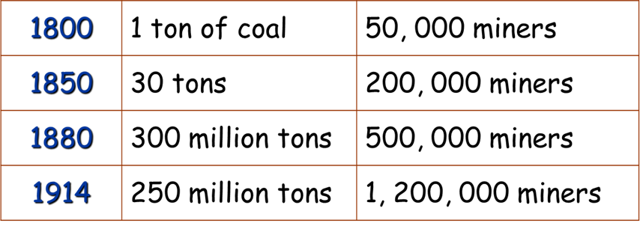
British Industrial Revolution
  Favorable natural resources (coal, rivers)
  Population pressure forced innovations
  Government support of industrialization
  Supply of markets throughout British Empire

Slide 37
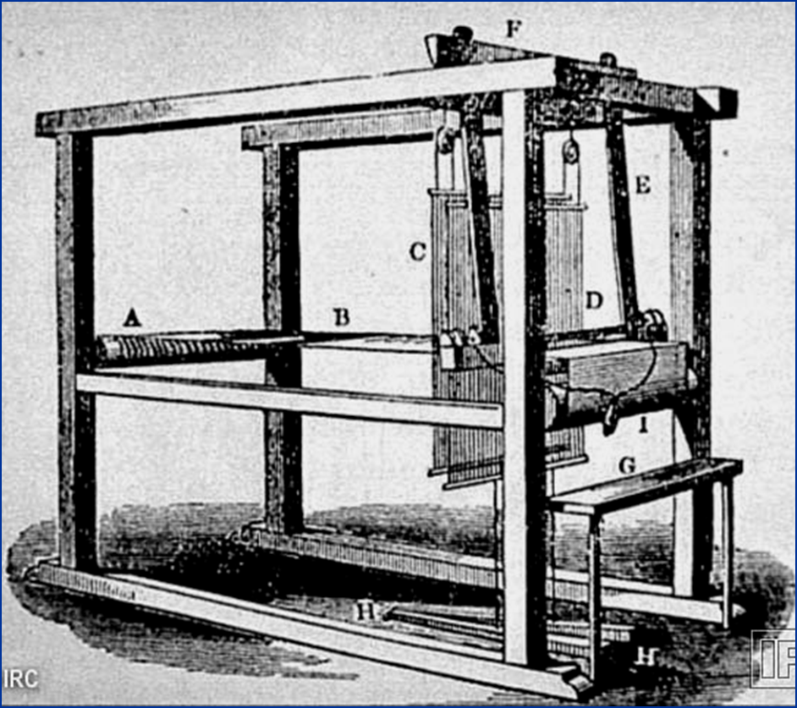
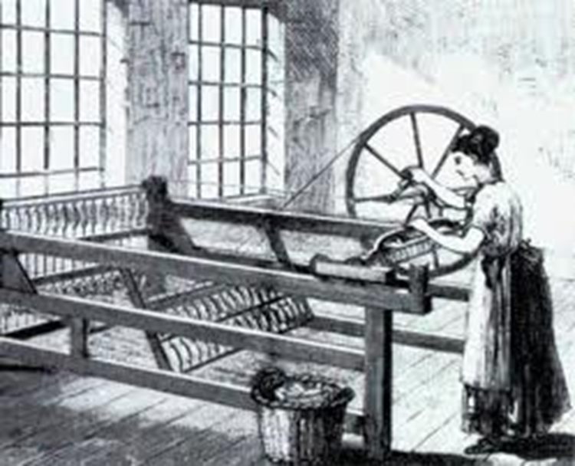
Origins of Industrialization, 1770-1840
18th century – key inventions developed in Britain
  Automatic machinery in textiles
John Kay’s “Flying Shuttle – made weaving faster and more efficient; increased demand of thread to make cloth
Spinning Jenny – 1764; used a single wheel to control several spindles at a time; larger quantities of threads could be made quickly and inexpensively

Slide 38
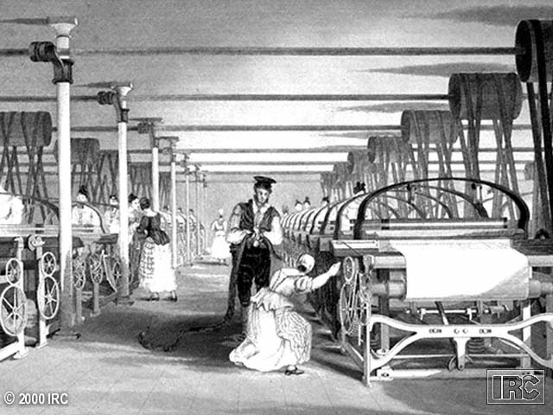
The Power Loom
Made it possible for weavers of cloth to catch up to spinning of thread
Created jobs and brought workers to work in factories near streams and rivers

Slide 39
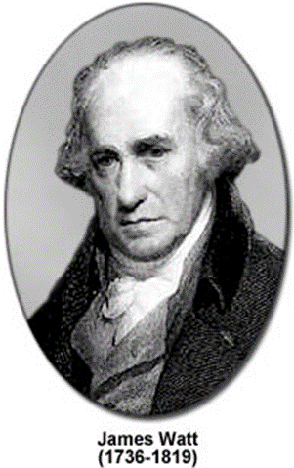
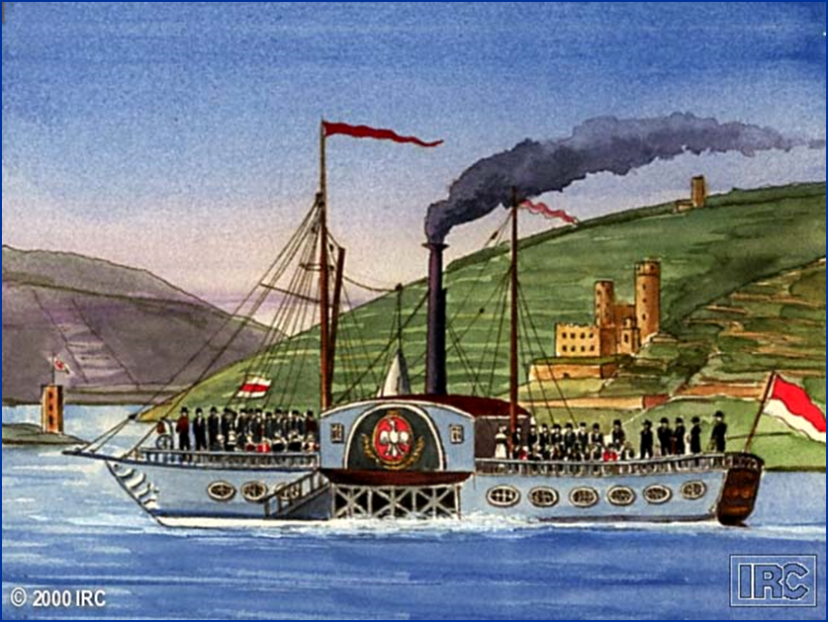
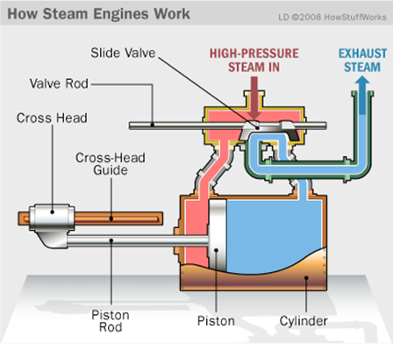

1770s – Scottish artisan James Watt devised a steam engine that could be used for production
  Created separate chambers for the steam to get hot and to cool down
  Factories no longer dependent on water to power their machines
  Steam power could now be used to spin and weave cotton

Slide 40



Early 19th century - Technological change was applied quickly to transportation and communication
  More goods to be moved and more distant markets to contact
  Telegraph, steam shipping, and railway provided faster movement of information and goods

Slide 41



The Industrial Revolution depended on improvements in agriculture
  Growth of cities required a large food supply
  Improved equipment and seeds
  Growing use of fertilizers

Slide 42

Inventions of the Industrial Revolution

Slide 43

  Industrialization involved a shift in the organization of labor and the emergence of the factory system with its specialization of tasks and greater discipline
    Separated work from home

Slide 44

The Spread of Industry
Western nations quickly saw the need to imitate
  Belgium, Germany, France, United States
French revolutionary laws helped spread industrialization
  Destroyed local restrictions on trade
  protected private property
  abolished artisan guilds that had often tried to defend older production techniques

Slide 45


The Disruptions of Industrial Life
  Huge movements of people from countryside to city
  Crowded cities were hellholes for many new residents
    Health conditions were bad
    Packed housing
    Inadequate sanitation
    Crime increased
    Work became unpleasant for many people
      Separated from family
      Harsh labor conditions
      Constraints on traditions of popular leisure
    Women, traditionally active partners to merchants, now withdrew from formal jobs
      Gained new roles in caring for children and home

Slide 46




  Workers responded to new conditions, in some cases with outright resistance, but failed to slow the pace of technological change
    Long working hours (12-16 hour shifts)
    No minimum wage
    No safety regulation or training
    Inhalation of chemicals
    Pollution

Slide 47


19^{c} Bourgeoisie:
The Industrial Nouveau Riche

Slide 48

Stereotype of the Factory Owner

Slide 49

“Upstairs”/“Downstairs” Life

Slide 50

The Revolutions of 1848
1840s – the impacts of political revolution and industrial transformation were beginning to merge
  Western governments encouraged railway development
    United States government gave large land grants to promote a national rail system
  All governments began to organize technical fairs and to promote engineering and science education
    A more literate work force would be more productive
  Governments focused on improving city conditions
    New sew systems
    Housing regulation
    Formal urban police forces

Slide 51

A final, extraordinary way of revolutions in 1848 and 1849 brought protest to a head
  Key lower-class groups turned to political protest as a means of compensating for industrial change
    Chartist movement – Artisans and workers in Britain generated a new movement to gain the vote in the 1830s and 1840s

Slide 52

February 1848 – French monarchy was once against expelled, this time permanently
  Democratic republic was established briefly
  Urban artisans pressed for serious social reform and government supported jobs for the unemployed
  Women schoolteachers agitated for the vote and other women rights
  Social demands were far wider than those of the 1789 revolution

Slide 53

Major revolts occurred in Germany, Austria, and Hungary
  Revolutionaries devised liberal constitutions to modify conservative monarchies
  Artisans pressed for social reforms that would restrain industrialization
  Peasants sought a complete end to manorialism
  Element of nationalism

Slide 54

The revolutionary fires burned only briefly
  Social demands of artisans and some factory workers were put down quickly
    Opposed by conservatives and middle-class liberals
  Democracy persisted in France, but a nephew of Napoleon soon replaced the liberal republic with an authoritarian empire that lasted until 1870
  Peasant demands were met, and serfdom was fully abolished throughout western Europe
    No longer profitable for nobles
“Galician slaughter” – Peasants killed over 1,000 noblemen and destroyed 500 manors in 1846 ; mainly on Polish lands

Slide 55

The substantial failure of the revolutions of 1848 drew the revolutionary era in Europe to a close
  Taught many liberals and working-class leaders that revolution was too risky
    Gradual methods should be used instead
  Improved transportation reduced the chance of food crisis
    Traditional trigger for revolution in Western history
  By 1850 – industrial class structure had come to dominate
    With industrialization, social structure came to rest less of privilege and birth and more on money
    Old alliances that had produced the revolutions were now dissolved

Slide 56

The Consolidation of the Industrial Order, 1850-1914
City growth continued in west
  Britain – 50 percent living in cities
  First time in human history more than a minority of a population lived in cities
City governments began to address problems growth had created
  Sanitation improved
  Death rates fall below birth rates (first time in urban history)
  Parks, museums
  Effective regulation of food and housing facilities
  Efficient police forces
    Crime rates stabilize or even drop

Slide 57
Adjustments to Industrial Life
Family life adjusted to industrialization in Western society
  Low birth rates and low death rates
  Children now seen as a source of emotional satisfaction and parental responsibility, not as workers contributing to family income
  1850 – Material conditions improved
    1900 – 2/3 of Western population enjoyed conditions above the subsistence level
    People could afford new amenities such as newspapers and family outings
  Diet and housing improved
  Health got better
  1880 – 1920 : revolution in children’s health
    Better hygiene during childbirth and better parental care
    Infant mortality rate - from 33% to 10%

Slide 58



  1880s: Louis Pasteur's - discovery of germs as agents of disease
    Result in sanitary regulations and procedures by doctors and other health care specialists
    Reduced the deaths of women at childbirth
      Women began to outlive men by a noticeable margin

Slide 59

1890s – labor movements among industrial workers
  Massive strike movements by miners, metalworkers, and others from United States to Germany
  Labor leaders fought work conditions and political repression
  Trade union movement stressed the massed power of workers

Slide 60
Political Trends and the Rise of New Nations
After 1850 – Many Western leaders worked to reduce the need for political revolution
  Liberals decided that revolution was too risky and became more willing to compromise
  Conservatives strove to develop reforms that would save elements of the old regime, including power for the landed aristocracy and monarchy
Britain
  1867 – voting extended to working class
Prussia
  Prime minister Otto von Bismarck worked with a parliament to extend voting rights to all men
Germany
  1871- Prussia joined Germany to form the German Empire
    1871 – created a national parliament
      Lower house – universal male suffrage
      Upper house – favored conservative state governments

Slide 61

1861-1865: American Civil War
  Resolved the dispute over sectional rights between the North and South
  Brought an end to slavery
1870 – France overthrew its short lived echo of the Napoleonic Empire
  Established a conservative republic
    Votes for all men
    Reduction of church power
    Expansion of education
    No major social reform
By 1914 – almost all Western nations had parliamentary systems
  Usually democracies of some sort
  Religious and other freedoms widely protected

Slide 62

The Social Questions and New Government Functions
After 1870- Government functions expanded throughout Western world
  Introduction of civil service examinations to test applicants on the basis of talent rather than connections or birth alone
  Government expanded the regulatory powers of the growing bureaucracy
    Inspecting factory safety
    Health of prostitutes
    Regulation of hospitals
    Personal travel
      Passports and border controls
  Schooling expanded
    Generally compulsory up to age 12
    By 1900 – 95% of all adults in western Europe and the United States could read
England

Slide 63

Governments also began to introduce wider welfare measures
  Advent of socialism
  Replaced or supplemented traditional groups such as churches and families
  Germany began providing social insurance to assist in cases of accident, illness, and old age
  Britain added measures to aid the unemployed
  Early welfare programs were limited, but showed a major extension of government power

Slide 64

After 1848 – Karl Marx promoted a more aggressive form of socialism
  Predicated on the inevitability of class conflict
  Believed that modern political systems would be shaped by the resolution of the class struggle between the upper and lower class
  Told workers that low wages were exploitive and unjust
    Urged the need for violent action
  Socialist parties developed as strong political alternatives in German, France and Austria, but were less successful initially in Britain and the United States
  A transitional social state between the overthrow of capitalism and the realization of communism

Slide 65

By 1900 – feminist movements
  Sought various legal and economic gains for women
    Equal access to professions and higher education
    Right to vote
  Won support from middle-class women
  By 1914 – Several American states and Scandinavian countries extended vote to women
  After 1918 – women receive right to vote in Britain, Germany, and the entire United States

Slide 66
Cultural Transformations
During 19th century – Western culture changed dramatically
  Growing emphasis on consumers introduced new values and leisure forms
  Science increased its hold but generated a new, complex view of nature
  New artistic movements demonstrated innovation and impulsiveness

Slide 67

Emphasis on Consumption and Leisure
After 1850
  Better wages and the reduction of work hours gave ordinary people new opportunities
  Alongside the working class grew a large white-collared labor force
    Secretaries, clerks, and salespeople
    Served the growing bureaucracies of big business and the state
  Factories could now produce such high quantities of goods that popular consumption had to be encouraged to keep pace with production
    Widespread advertising developed
    Product crazes emerged
    Bicycle fad in 1880s

Slide 68

Mass leisure culture began to emerge
  Popular newspapers with bold headline and compelling human interest stories
    Millions of subscribers in the Industrial west
    Crime, imperialist exploits, sports, and comics
  Popular theater soared
    Comedy routines and musical revues drew thousands of patrons to music halls
    After 1900 – motion pictures
  Vacation trips became common
  Late 19th century – rise of team sports
    Soccer, American football, and baseball surged into new prominence at both amateur and professional levels

Slide 69



Advances in Scientific Knowledge
Although new churches were built as cities grew, and missionary activity reached new heights outside the Western world, the churches no longer served as centers for the most creative intellectual life
Charles Darwin
  Evolutionary theory
  Argued that all living species had evolved into their present form through the ability to adapt in a struggle for survival
    Survival of the fittest
  Clashed with traditional Christian beliefs that God had fashioned humankind as part of initial creation
Albert Einstein
  Theory of relativity
Sigmund Freud
  Social sciences
  He and other leading economists tried to explain business cycles and the causes of poverty

Slide 70

Western Settler Societies
Industrial Revolution prompted a major expansion of the West’s power in the world
  Could produce far more processed goods than ever before
    Needed markets, new raw materials and agricultural products
  Military advantage
    Repeating rifle and machine gun
  Steamships could navigate previously impassable river systems
  Move western guns inland
  European nations competed for new colonies as part of their nationalistic rivalry, businesspeople sought new chances for profit, and missionaries sought opportunities for conversion
    Europe’s empires would spread through Africa, southeast Asia, and parts of China and the Middle East

Slide 71
Diplomatic Tensions and
World War I
  The unification of Germany upset the balance of power established in Europe after the Napoleonic wars.
  Germany's emergence set off rounds of diplomacy that resulted in new alliances.
  Competition between nations over colonies tested the ability of the alliance system to maintain the peace.

Slide 72

The New Alliance System
  By 1907, two alliance systems structured the diplomatic relations of Europe.
    Germany, Austria-Hungary, and Italy formed the Triple Alliance
    France, Britain, and Russia made up the Triple Entente
  All parties began to construct more powerful militaries to offset perceived gains among their rivals. Each alliance system was dependent on the status of a weak member.

Slide 73
NATIONALISM
  Patriotic feeling, principles, or efforts for your country
    (extreme nationalism is feeling superiority over countries)
  PRIDE IN YOUR COUNTRY

