Slide 1
Ch. 29 The West in the 20th Century

Slide 2
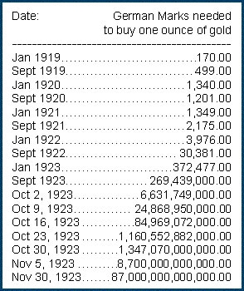
The Disarray in the West, 1914-1945
World War I quickly shattered the confidence many Europeans felt at the turn of the century
Damaged European economy
Hurt diplomatic relations between Western states
Hurt political systems in many Western states
Had a devastating material and psychological impact on the European combatants

Slide 3
The Roaring 20's
A period of apparent peace reduced internal political tensions in Europe during the early 1920s
Germany refused to accept its new eastern boundaries, but did promise peace
Industrialization boomed on the back of growing consumer demand
More in the United States than in Europe
Cultural creativity during the 1920s resulted in new artistic styles and the growing popularity of the moving picture
Many changes for women, particularly in the middle class
Women pushed out of labor force at end of WWI
Right to vote in United States, Britain, and Germany
New leisure habits and less restrictive fashions
Mass consumption standards rose
Radios, automobile, household appliances

Slide 4
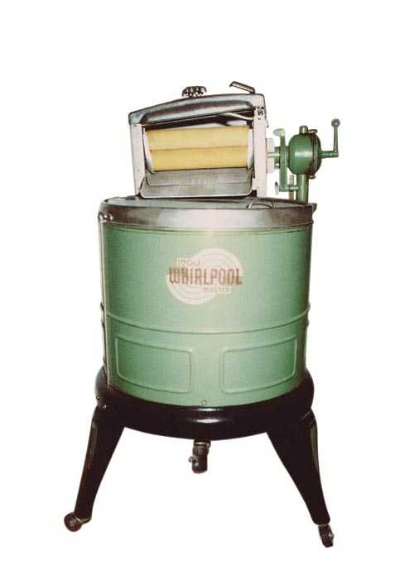
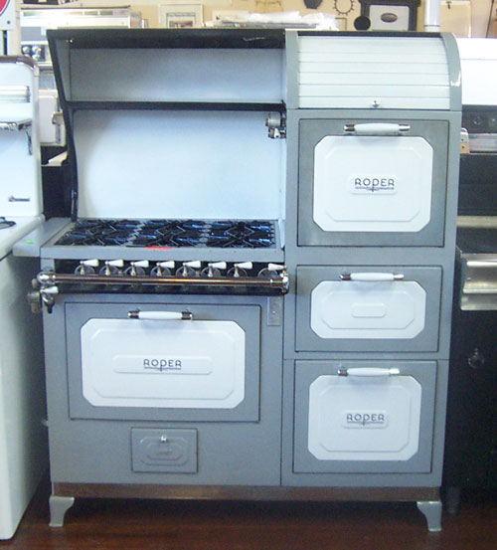
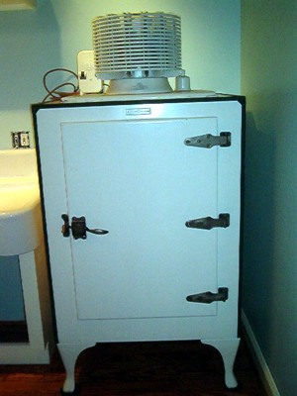
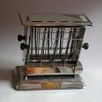
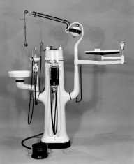
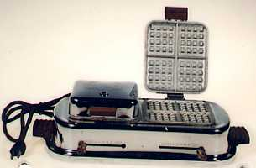
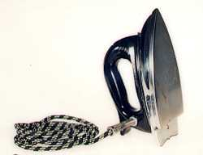
Consumer Economy

Slide 5
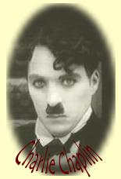
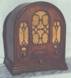
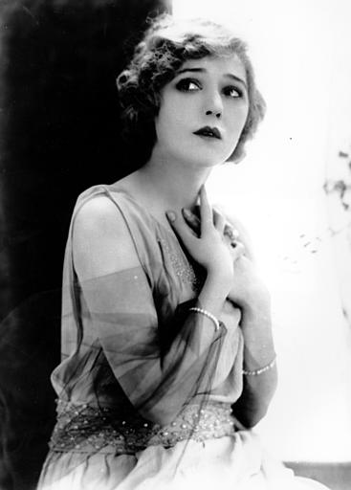
Culture of the Roaring 20’s
Radio
KDKA Pittsburgh
GE, Westinghouse,& RCA form NBC
Silent Movies
Charlie Chaplin
“Talkies”
The Jazz Singer
Starring Al Jolson
Mary Pickford
“America’s Sweetheart”

Slide 6
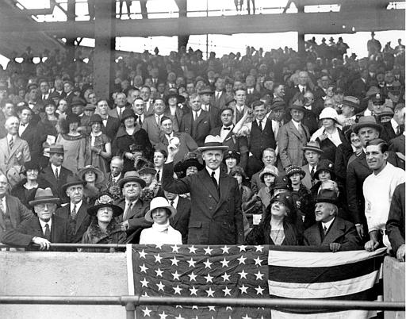
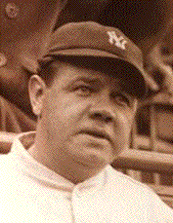
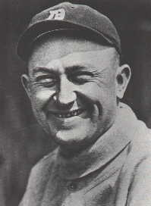
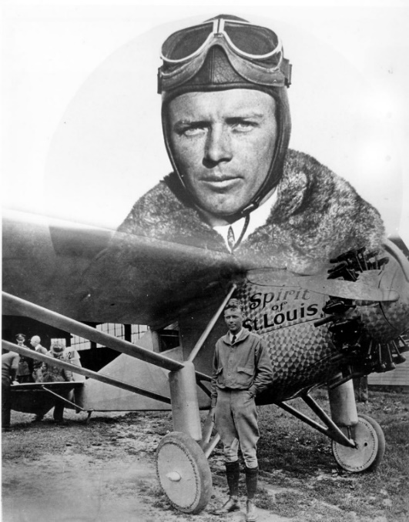
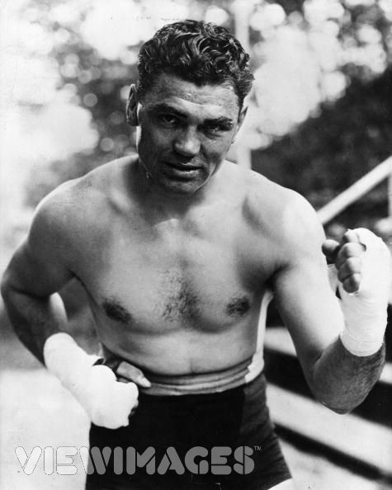
Celebrities
Babe Ruth &Ty Cobb
Charles Lindbergh
The Spirit of St. Louis
Jack Dempsey

Slide 7
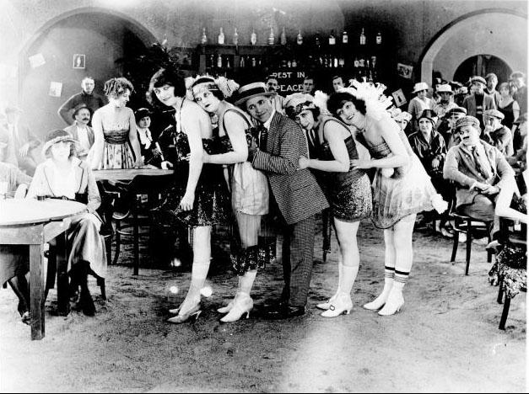
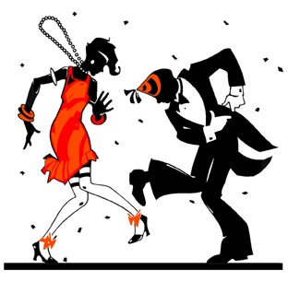
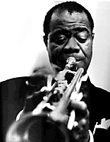
The 20’s is The Jazz Age
The Flappers
make up
cigarettes
short skirts
Writers
F. Scott Fitzgerald
Ernest Hemingway
Musicians
Louis Armstrong
Duke Ellington

Slide 8
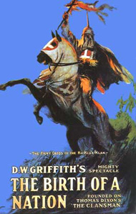
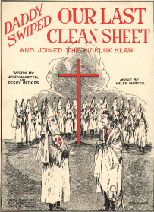
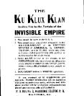
The Ku Klux Klan
Great increase
In power
Anti-black
Anti-immigrant
Anti-Semitic
Anti-Catholic
Anti-women’s suffrage
Anti-bootleggers

Slide 9
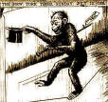
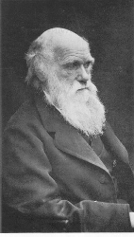
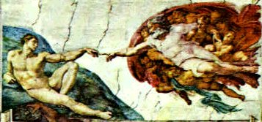
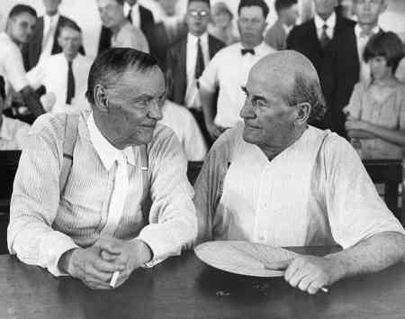
Scopes “Monkey” Trial
Evolution vs. Creationism
Science vs. Religion
Famous Lawyers
Dayton, Tennessee
John Scopes
High School Biology teacher

Slide 10
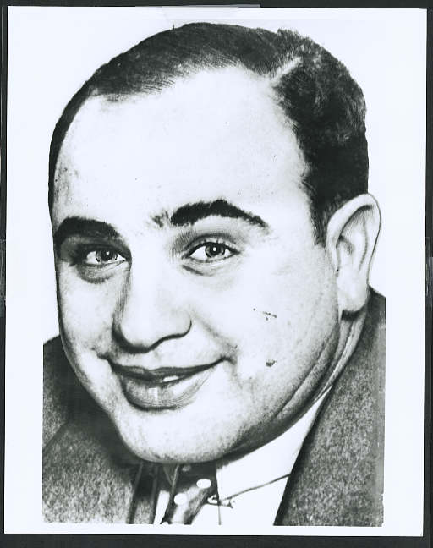
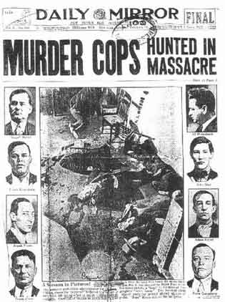
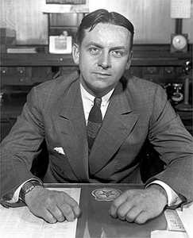
Prohibition
18th Amendment
Volstead Act
Gangsters
untouchables
Al Capone

Slide 11
The Impact of the Depression
With the onset of the Great Depression in 1929, Western governments raised national tariffs
Tried to keep out the goods of other countries
Worsened the international economy and weakened sales for everyone
Political radicalism once again became a popular solution to government inadequacy in dealing with depression
Communism – Stalin
Fascism – Hitler/Mussolini

Slide 12
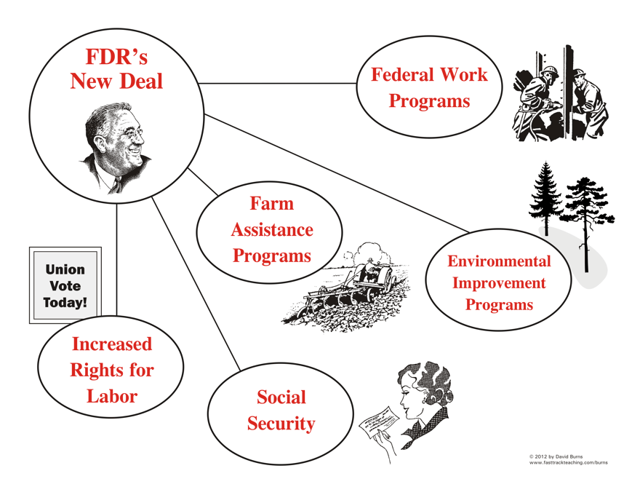
In Scandinavia and the United States, governments chose to intervene more actively in the economy with generally positive results
Advent of welfare state
New Deal (1933) in the United States
Social Security – provided assistance to the unemployed and retirees
Older people began to expect less economic support from their families and more from the state
Huge public works
Increased the power of the state

Slide 13
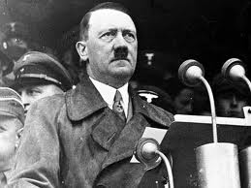
The Challenge of Fascism
In Germany, the treaty arrangements after WWI and the depression were contributing factors to the rise of a fascist regime
Characteristics of Fascism
Attacked parliamentary democracy and the corruption and class conflict of Western capitalism
Strong state ruled by a powerful leader who would revive the nation’s forces through vigorous foreign and military policy
Vaguely promised social reforms to alleviate class resentments
Attacked trade unions and socialist/communist parties which pleased landlords and business groups
Extreme nationalism, believing their nation was superior to others
The rise of Adolf Hitler in Germany made fascism a major force
Middle- class and conservative groups were drawn to Hitler's assault against socialism and communism and accepted his condemnation of the Jews
Hitler repeated the need for unity and hopeless weakness of parliamentary politics
State should provide guidance, for it was greater than the sum of individual interests
Strong leader
Promised a glorious foreign policy to undo the wrongs of the Versailles treaty
Represented a hope for effective action against the depression

Slide 14
1933 – Hitler made arrangements with other political leaders for his rise to power legally; quickly dismantled parliamentary government (Weimar Republic) and established a totalitarian state
Government would exercise direct control over nearly all the activities of its subjects
Eliminated all oppositional parties
Put Nazis in control of military/bureaucracy
Gestapo – secret police
Arrested hundreds of thousands of political opponents
Labor unions replaced by government-sponsored institutions
Attempted to appease low-paid workers by offering full employment and welfare
Attacked modern art, challenged scientific education
Propaganda
Extreme nationalism was combined with his genocidal hatred of the Jews (anti-Semitic)
Blamed Jews for various personal misfortunes
socialism, excessive capitalism
Forced Jews to wear special emblems, property attacked and seized, and millions sent to concentration camps
1940 – eliminate the Jews
Hitler's constitutional revisions were intended to create the necessary war machine that would catapult Germany into control of Europe
1939 – WWII begins

Slide 15
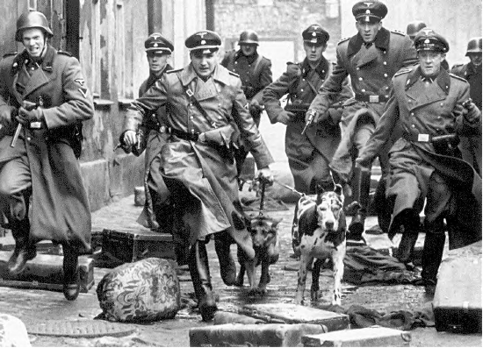
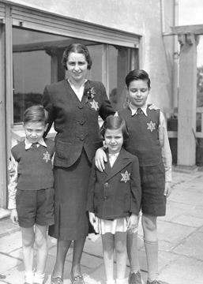
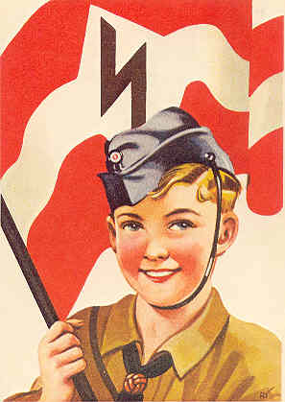
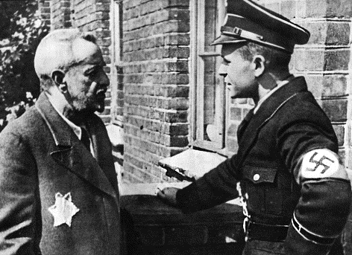

Slide 16
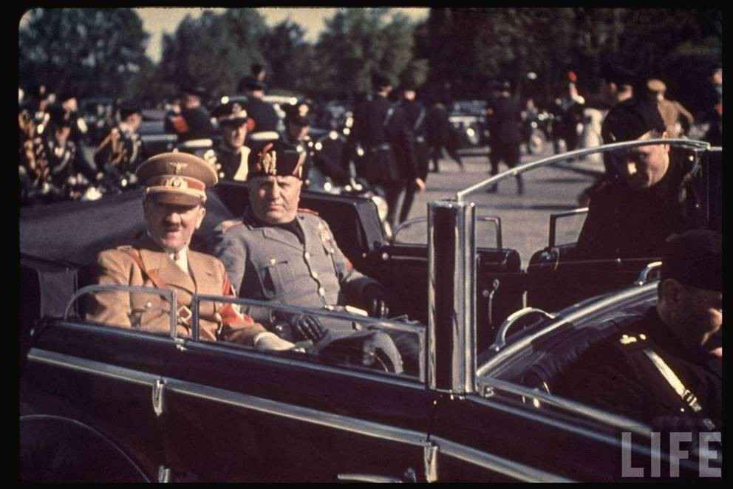

Slide 17
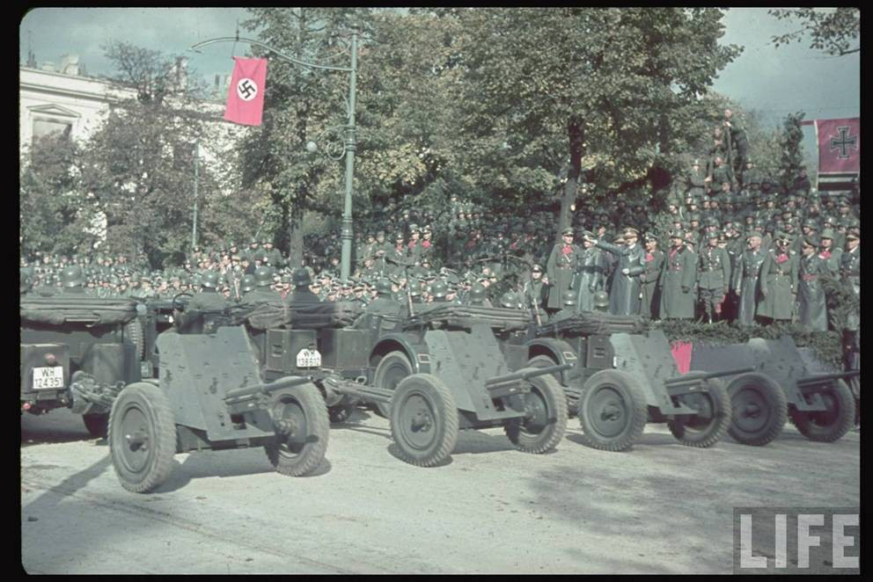

Slide 18
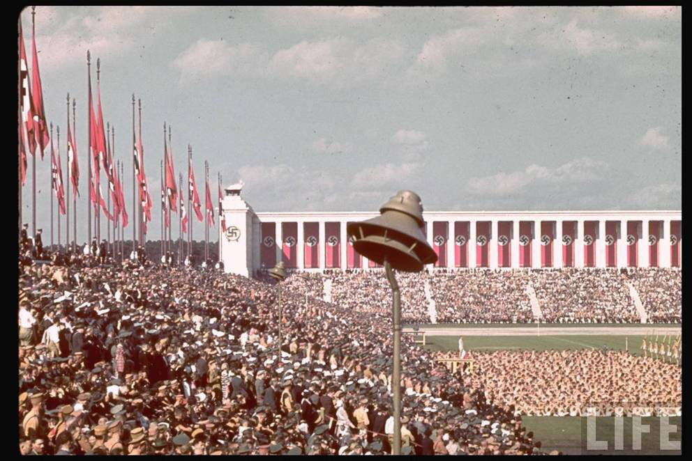

Slide 19
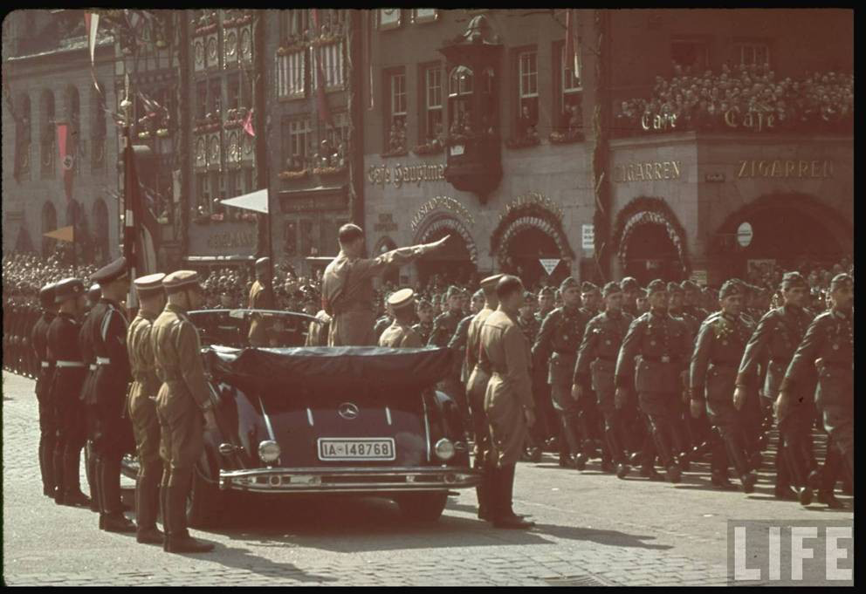

Slide 20
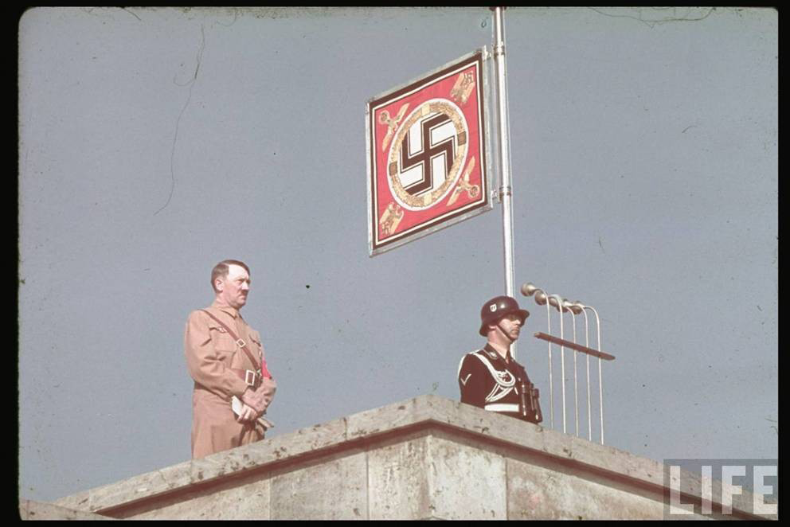

Slide 21
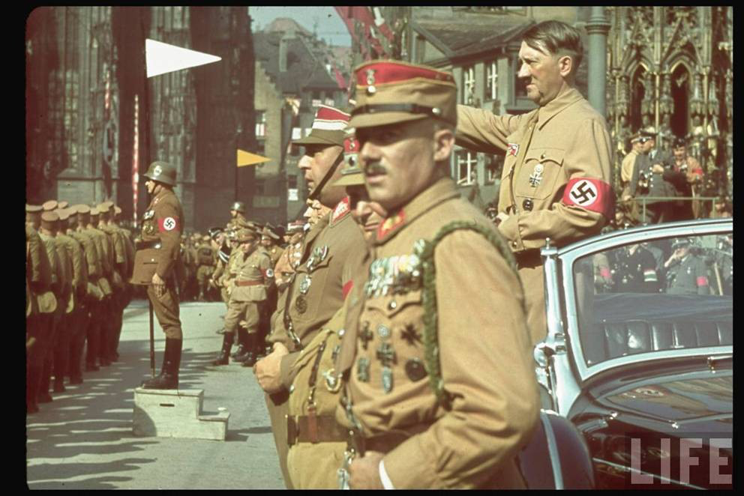

Slide 22
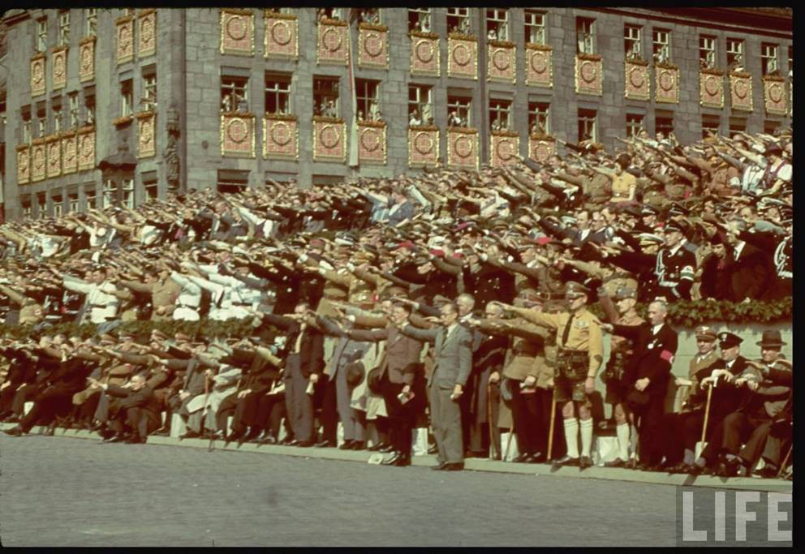

Slide 23
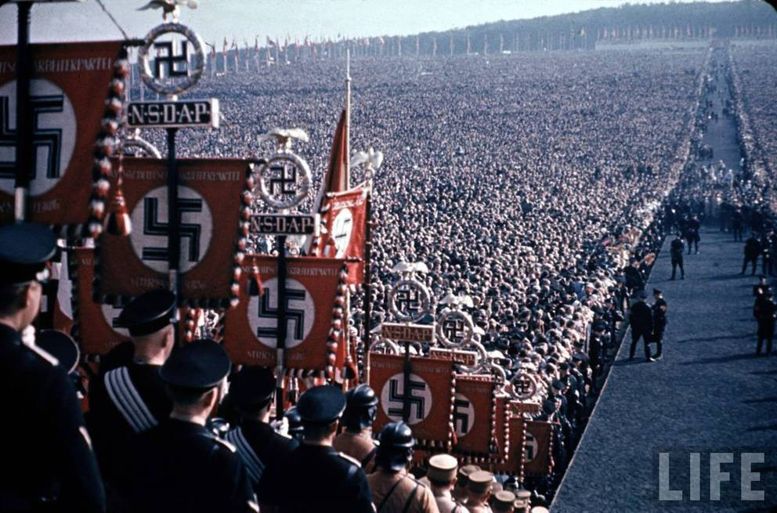

Slide 24
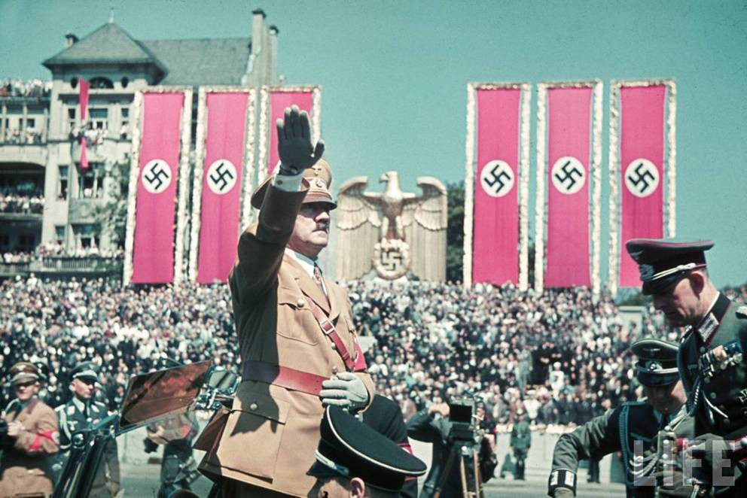

Slide 25
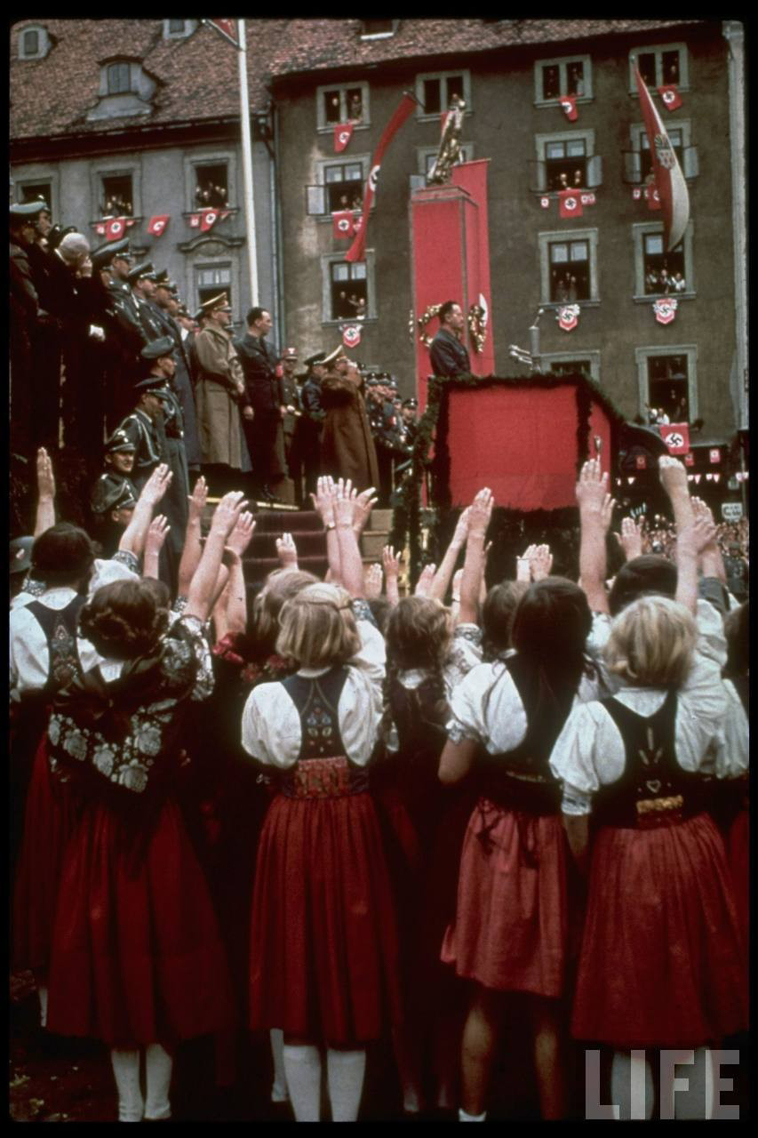

Slide 26
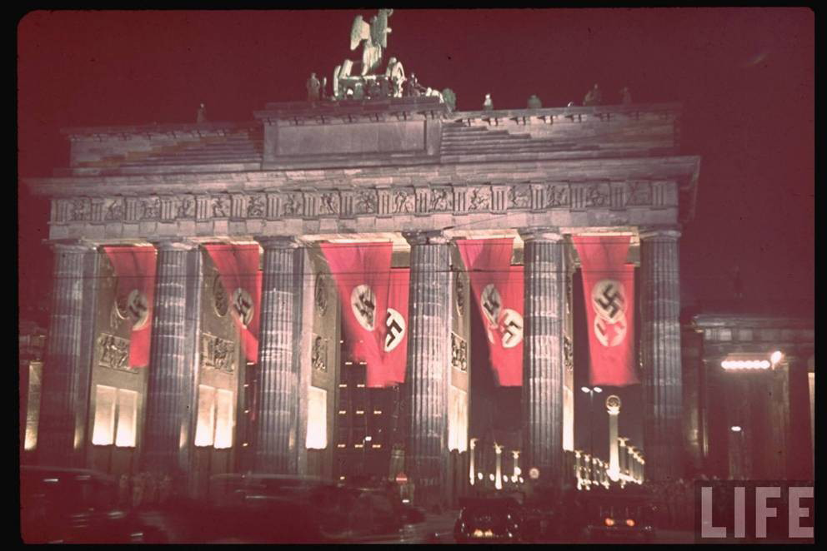

Slide 27
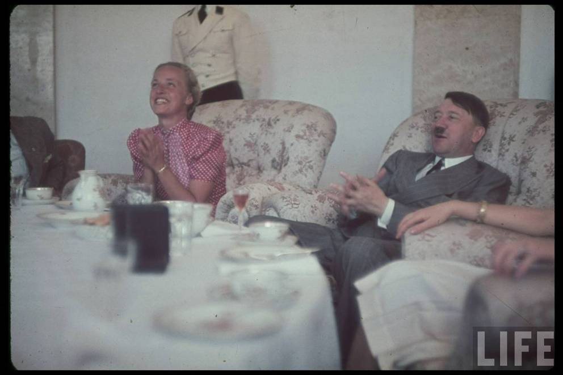

Slide 28
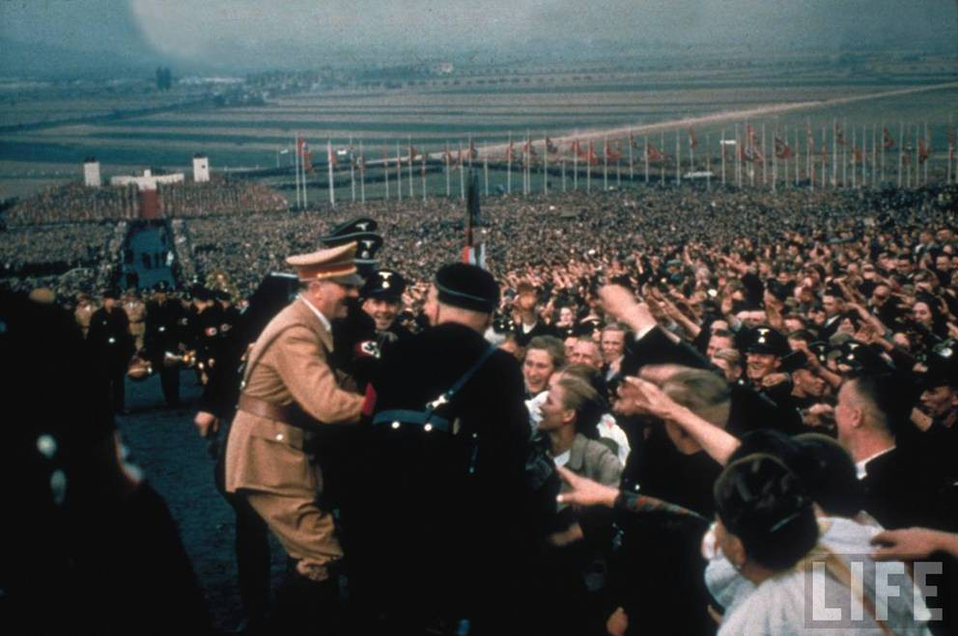

Slide 29
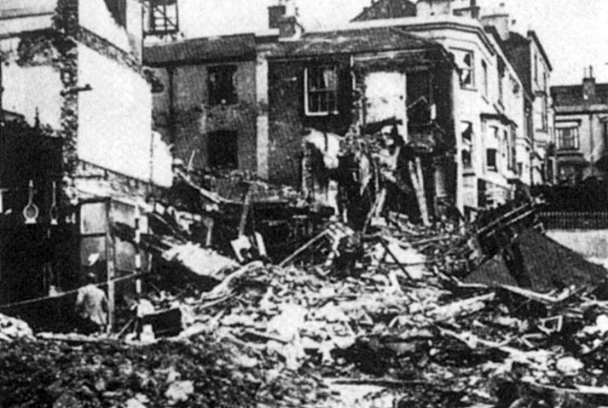
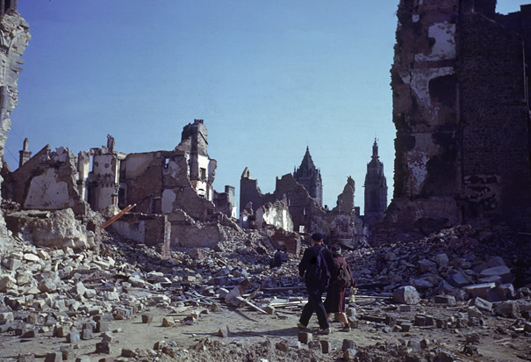
After World War II: International Setting for the West
WWII left western Europe in shambles
Physical destruction of housing and transportations
Downed bridges
Broken rail lines complicated food shipments
Many people ill-fed and unable to work at full efficiency

Slide 30
Europe and Its Colonies
It became obvious to European powers after World War II that colonies could only be maintained at great expense
Not worth the cost
In most cases, the European nations provided more peaceful transitions to colonial independence.
Exception – French in Vietnam and Algeria
Despite abandoning direct colonial control, Western economic influence in the former colonies of Africa and Asia remained strong.

Slide 31
The Cold War
The cold war linked the U.S. with Western Europe and other allies against the Soviet Union and the communist allies.
The U.S. pushed for higher European military expenditures and German rearmament
The Soviet Union, through its support for European communist movements and perceived aggressive position, also influenced European policy
France and Italy

Slide 33
Most Western European nations were content to rely on U.S. military intervention against the possibility of Soviet invasion
Great Britain and France developed small nuclear capabilities, but they could not afford the massive stockpiles and rockets of the two superpowers
European nations kept their military budget modest compared to Soviet Union and United States
The United States increased its budgetary commitment to nuclear armament.
The dominance of the United States as the primary Western European ally brought the U.S. into closer relationships with Canada, New Zealand, and Australia

Slide 34
The Spread of Liberal Democracy
In politics, defeat in war greatly discredited fascism and other rightist movements that had opposed parliamentary democracy
Leftist groups, including the strong communist movements were committed to democratic politics

Slide 35
Defeated Germany was divided
Federal Republic of Germany (West Germany) -Controlled by France, Britain, and the United States
German Democratic Republic (East Germany) – Controlled by Soviet Union

Slide 36
Following World War II, most European countries created new constitutions
Effective parliaments
Universal suffrage
1970s - Western Europe’s movement toward more consistent democracy was extended
Spain and Portugal shifted from authoritarian, semifascists constitutions to democratic, parliamentary systems

Slide 37
The Welfare State
The movement of democracy created a welfare state
Shift leftward of the political spectrum helped explain the new activism of the state in economic policy and welfare issues
Need for new programs to reduce the impact of economic inequality and to reward lower classes for their loyalty
1948 – Western Europe: nature of the modern welfare-state had been established
Unemployment insurance
Medical care supported by state-funded insurance (nationalized healthcare)
State run medical facilities
Family assistance payments to families with several children
1950s – ¼ of British population was housed in structures built and run by government

Slide 38
1960s – United States: Lyndon Johnson’s Great Society Programs

Slide 39
After WWII - An increased government role in economic planning
Regulations in banking, industry, agriculture
welfare
nationalized some industry sectors outright

Slide 40
Political Stability and the Question Marks
Post-World War II decades –
Welfare states and economic planning reduced political protest
Europeans seemed to accept the state’s new social and economic role
Political power shifted between moderate conservative and reformist socialist parties
1960s – campus unrest in Western societies
American universities – protest of the Vietnam War
Europe and United States – young people targeted materialism in society

Slide 41
1970s – new wave of feminism and environmentalist movements
Green movement signaled a new political tone, hostile to uncontrolled economic growth

Slide 42
1970s – economic growth slowed
British Conservative Party (Margaret Thatcher) and United State Republican Party (Ronald Reagan)
Worked to cut welfare and housing expenses
Promote free enterprise
1990s – British Labor Party (Tony Blair) and United States President (Bill Clinton)
Pragmatic versions of welfare state that focused more on economic growth than social protections

Slide 43
The Diplomatic Context
1947 – Marshall Plan
Gave billions of dollars in financial aid to Western European governments to rebuild their war-torn economies
Goals: build future trading partners for the United States and to help Europeans fight communism
Additional diplomatic reform
NATO

Slide 44
NATO – North Atlantic Treaty Organization
Established in 1949
The United States, Canada, and ten Western European countries
Goal: protect Western Europe from Communist aggressions
United States pledged to defend Western Europe with its nuclear weapons
Warsaw Pact
Created in 1955
Soviet Union and Eastern European allies

Slide 45
1958 – European Economic Community (European Union)
Started by West Germany, France, Italy, Belgium, Luxembourg, and the Netherlands
Set up a single economic currency
Tariffs reduced between member nations
Common tariff policy set for the outside world
Free movement of labor and investment encouraged
Bureaucracy and court system established

Slide 46
Economic Expansion
Significant economic growth after an agonizing time of postwar rebuilding
1950s – Western Europe had entered a new economic phase
Agricultural production and productivity increased because of new equipment and seeds (aided by technocrats)
Retooled industries poured out textiles and metallurgical products
Expensive consumer products (automobiles and appliances) supported rapidly growing factories

Slide 47
Overall growth in gross national product surpassed rates of any extended period since start of Industrial Revolution
By1950s
Germany – 6 percent annual growth
France – 8 percent annual growth
Italy – 11 percent annual growth
Scandinavian and Britain – 4 percent annual growth

Slide 48
These growth rates depended on rapid technological change
Europe’s rising food production was achieved with a steadily shrinking agricultural labor force
1950s – growth of industrial work force (factory expansion)
1960s – rising production, but fewer industrial workers
Instead… workers move into service jobs
Teachers, clerks, medical personnel, insurance and bank workers, and performers and other leisure industry personnel, bureaucratic jobs

Slide 49
1950s and 1960s - High rates of economic growth also ensured low unemployment rates
Britain – 4 percent
France and Germany – 2 to 3 percent
United States

Slide 50
Between 1960 and 1973 – per capita disposable income rose
United States, France, Germany, Denmark, Scandinavia, Switzerland
New spending money rapidly translated into huge increases in purchase of durable consumer goods
Shopping malls and supermarkets

Slide 51
Many immigrant workers suffered very low wages and unstable employment
“guest workers” from Turkey, north Africa, Pakistan, and West Indies were residentially segregated and victims of discrimination by employers and police
Racism continued to be an important factor in Western society

Slide 52
After 1970 – slowing economic growth
1973 - oil-producing states of the Middle East cut their production and raised prices
1979 – oil crises
Led to a severe recession throughout Western society
High rates of unemployment

Slide 53
Society and Culture
1950s - The West became the first example of an advanced industrial society and both the United States and western Europe played key roles in this change.
Developed countries

Slide 54
Postindustrial Social Structure
There remained discrepancies in class wealth
Gap between rich and the poor
Middle class had more abundant leisure opportunities than most workers
Immigrants supplied much of unskilled labor
Social mobility exist
Education, hard work
Increased crime rates and racial disturbances reflected continued social tensions

Slide 55
Most people in the labor force were in service sectors, not industrial production

Slide 56
The Women's Revolution
There were many changes to the family structure in Western Europe and the United States after WWII
Family leisure activities expanded
Extended family contacts were facilitated by telephones and automobiles
More years of schooling
Authority of parents declined
For women
More factory and clerical jobs
Number of working women (especially married) rose steadily
1970s – 44% of the labor force
Full equality not achieved

Slide 57
New rights for women
Right to vote
Gains in higher education
Family rights improved
Access to divorce increased
Abortion law eased
1960 – contraceptive pill
Pressures to readjust family roles, women working outside the family context, and growing legal freedom for women caused men and women alike to turn more readily to divorce
1961 – 9% of British marriages ended in divorce
1965 – 16% of British marriages ended in divorce
1970s – 1/3 of British marriages ended in divorce
Growing divorce rate produced an increase in female poverty

Slide 58
Western Culture: Creativity and Uncertainty
After 1920 – scientific research continued to be dominated by Western culture
Growing science faculties commanded greater prestige in expanding universities
Individual scientists made striking discoveries
Researchers cranked out more specific findings than scientists had ever before produced

Slide 59
1930s – physicists began to experiment with bombarding basic matter with neutrons, or particles that carry no electric charge
World War II – development of atomic bomb
After WWII -
Improved telescopes, atom smashers, and then lasers and space satellites
Complex mathematical theories facilitated by the theory of relativity
Astronomers made progress in identifying additional galaxies and other phenomena in space
Atomic bomb mushroom clouds over Hiroshima (left) and Nagasaki (right)

Slide 60
Breakthroughs in biology involved primarily genetics
1950s – British and American scientists discovered the double-helix pattern of deoxyribonucleic acid (DNA)
Advanced the understanding of how genetic information is transmitted and how it can be altered
James Watson and Francis Crick (right), co-originators of the double-helix model, with Maclyn McCarty (left).

Slide 61
Biologists produced major improvements in health care
Starting in 1928 - New drugs (penicillin) revolutionized the treatment of common diseases, and immunization virtually eliminated scourges such as diphtheria
By 1970s – host of industries that used scientific principles to produce new medicines, seeds, and pesticides
Use of genetics to clone complex animals
1997 – sheep was cloned in Scotland
Raised new ethical issues and human capacity to reshape natural processes
Dolly

Slide 62
1920s onward – advances in social sciences
British economist John Keynes (Keynesian Economics)
Emphasized the importance of government spending to compensate for loss of purchasing power during a depression
American New Deal
European planners

Slide 63
Painters became increasingly nonrepresentational
Cubist movement (Pablo Picasso) rendered familiar objects as geometric shapes
Modern Art – moved even further from normal perceptions, stressing purely geometrical design or wild swirls of color
Musical composition involved the use of dissonance and experimentation with new scales
Electronic instrumentation
In literature, the novel remained dominant
Turned toward exploring moods and personalities

Slide 64
20th century – cultural themes in West were largely secular
Regular church attendance fell, attracting only 5 percent of British population by 1970s
In the United States, religion maintained a greater hold, and both church attendance and popular belief remained at higher levels than elsewhere in Western society

