Slide 1
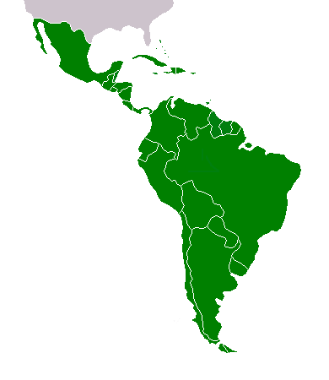
Latin America: Revolution and Reaction in the 20th Century

Slide 2
Introduction
Having received their independence earlier than other colonized nations, Latin American countries tended to look towards Western social and political structures
Latin American elites led their nations into closer ties with the growing international capitalist economy
Investments often came from Europe and the USA
Economies continued to concentrate of exports
Economic dependence continued
Vulnerable to changes in world financial system
Latin America continued its 19th century emphasis on agrarian and mineral production
Industrial sector in some places
Workers’ organization began to emerge as a political force
Immigration to some countries
Urban growth
Despite numerous revolutions, institutions and social patterns have proven resistant to change

Slide 3
The Mexican Revolution and the Great War
1910-1920: Mexican Revolution
10 year civil war
Caused primarily by internal forces
Influenced by the Great War (World War I)
Latin American nations avoid direct participation
Reduced Latin American imports from Europe and exports to Europe
Forced Latin America to rely on themselves
United States emerged as dominant foreign power in the region
Replaced Great Britain

Slide 5
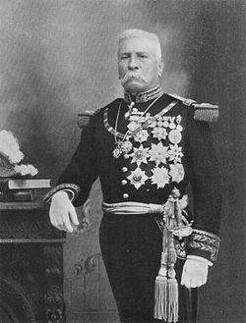
Mexico's Upheaval
Porfirio Diaz
Served 7 terms as President of Mexico
1876-1911
Created economic prosperity
Not for peasants, Indians, and laborers
Turned much of Mexico's economy over to foreigners
Foreign concessions in mining, railroads, and other sectors of economy
90% of Mexico did not belong to Mexicans
Political corruption
Imprisoned or exiled political opponents
Hacienda system dominated by a small elite
Government took repressive measures against workers, peasants, and Indians who opposed the loss of their lands or the unbearable working conditions

Slide 6
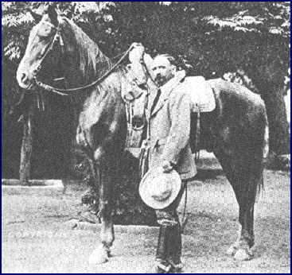
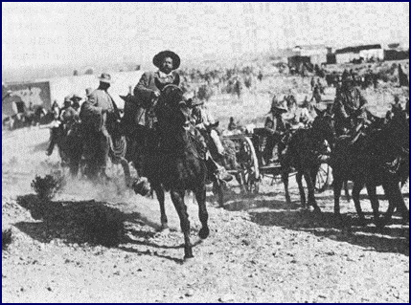
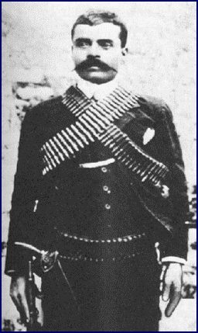
1910 – Francisco Madero challenged Diaz
Madero arrested, rigged election put Diaz back into power
When Madero was released from prison, he called for a revolt, leading to the Mexican Revolution
Coalition of forces drove Diaz out of power
In the north, Pancho Villa organized resistance
Farmers, railroaders, and cowboys
In Morelos, Emiliano Zapata rallied Indians and peasants for land reform
“Tierra y Libertad”

Slide 7
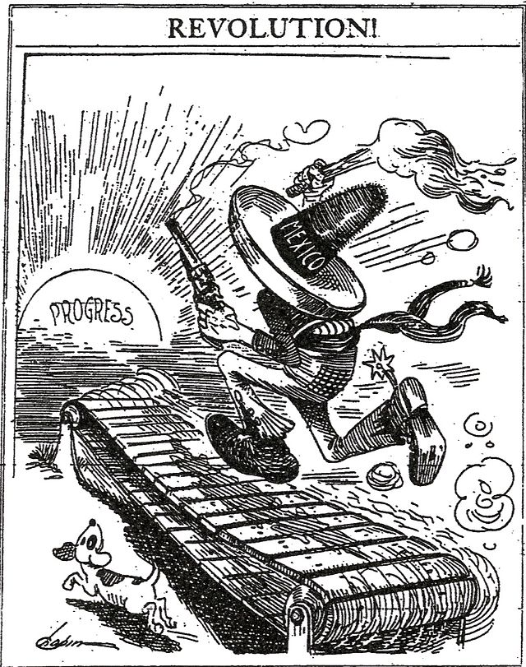
With Diaz out of power, Madero took over
Moderate programs did not resolve Mexico’s continuing social problems
1913 - Military coup removed Madero from government, later assassinated
General Victoriano Huerta
Attempted to restore the Diaz-type dictatorship
Supported by large land owners, the army, and foreign companies
1914 – forced from power by Villa, Zapata, and other middle-class political opponents
The new leaders fought over the nature of the new regime
Violence continued
1915- General Alvaro Obregon emerged as the new ruler
Attempted to resuscitate Mexico's economy

Slide 8
1917 - Mexican Constitution of 1917
Promised land and educational reform
1934-1940: President Lazaro Cardenas
Land reform - More than 40 million acres of land distributed in the form of ejidos, or communal holdings
Educational reform – extensive program of primary education, especially in rural areas
Limited foreign ownership of Mexican industry/resources
Guaranteed rights of workers
Limited the Church's ownership of land
1920 – civil war had ended
Obregon elected President, followed by a series of presidents from the new revolutionary elite
Revolution devastated the country
1.5 million dead
Major industries destroyed
Ranching and farming disrupted

Slide 9
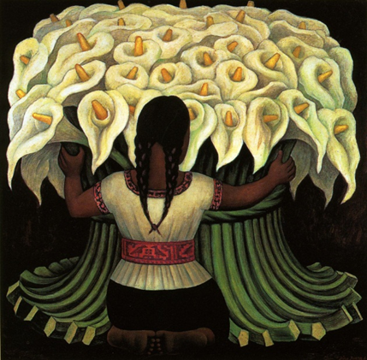
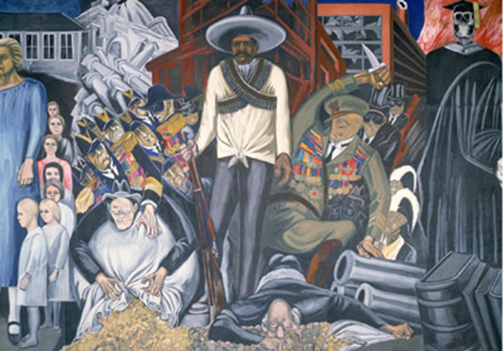
Culture and Politics in Postrevolutionary Mexico
After the Revolution, Mexico attempted to “Indianize” the nation
Secular schools
Emphasized nationalism
Glorified Indian heritage
Denounced Western capitalism
Artists - Diego Rivera and Jose Clemente Orozco
Decorated public buildings and painted murals that glorified the Indian past of Mexico
Popular literature and music celebrated the heroes of the revolution
The Church opposed increasing secularism within Mexican society
1920s - The Cristero movement
Combined conservative peasants with politicians and the Church in an attempt to halt secularization

Slide 10
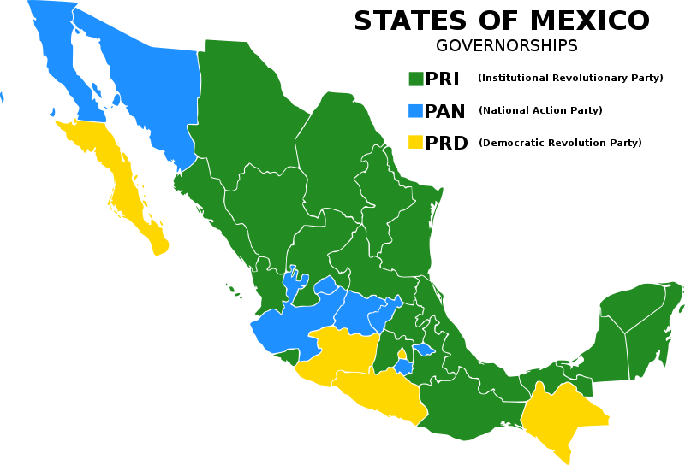
1934 – President Cardenas
Nationalized its petroleum industry in a state-run monopoly
PEMEX
Considered a declaration of economic independence
Symbolized the nationalistic basis of many of the revolution’s goals
Party of the Institutionalized Revolution (PRI)
Revolutionary leaders hoped to control the new regime by creating a one-party system
Incorporated labor, peasant, military, and middle-class sectors
Although technically a democracy, the PRI dominated Mexican politics from the 1920s until 2000 when Vicente Fox (PAN) won the election
As of 2010

Slide 11
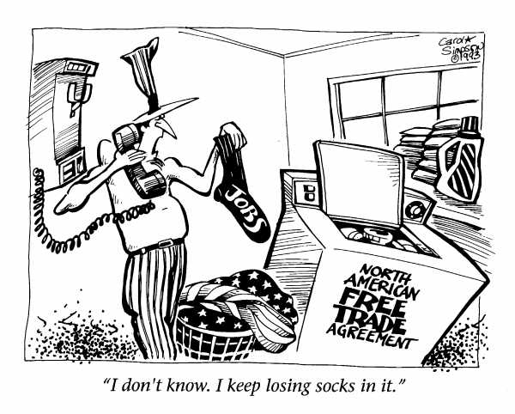
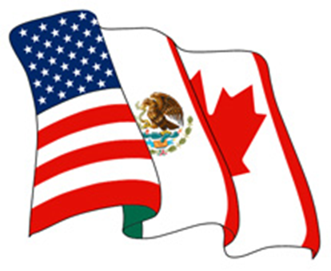
1990s – North American Free Trade Agreement (NAFTA)
PRI government hoped expanding the economy would offer new hope to the nation
Opposed by U.S. labor groups
Feared job losses and lower wages of Mexican workers

Slide 12
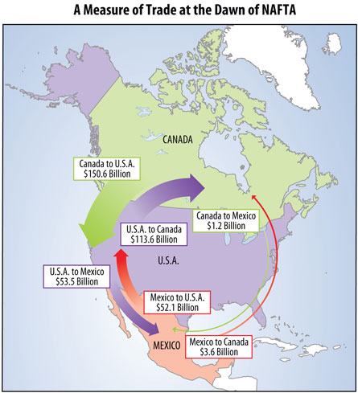

Slide 13
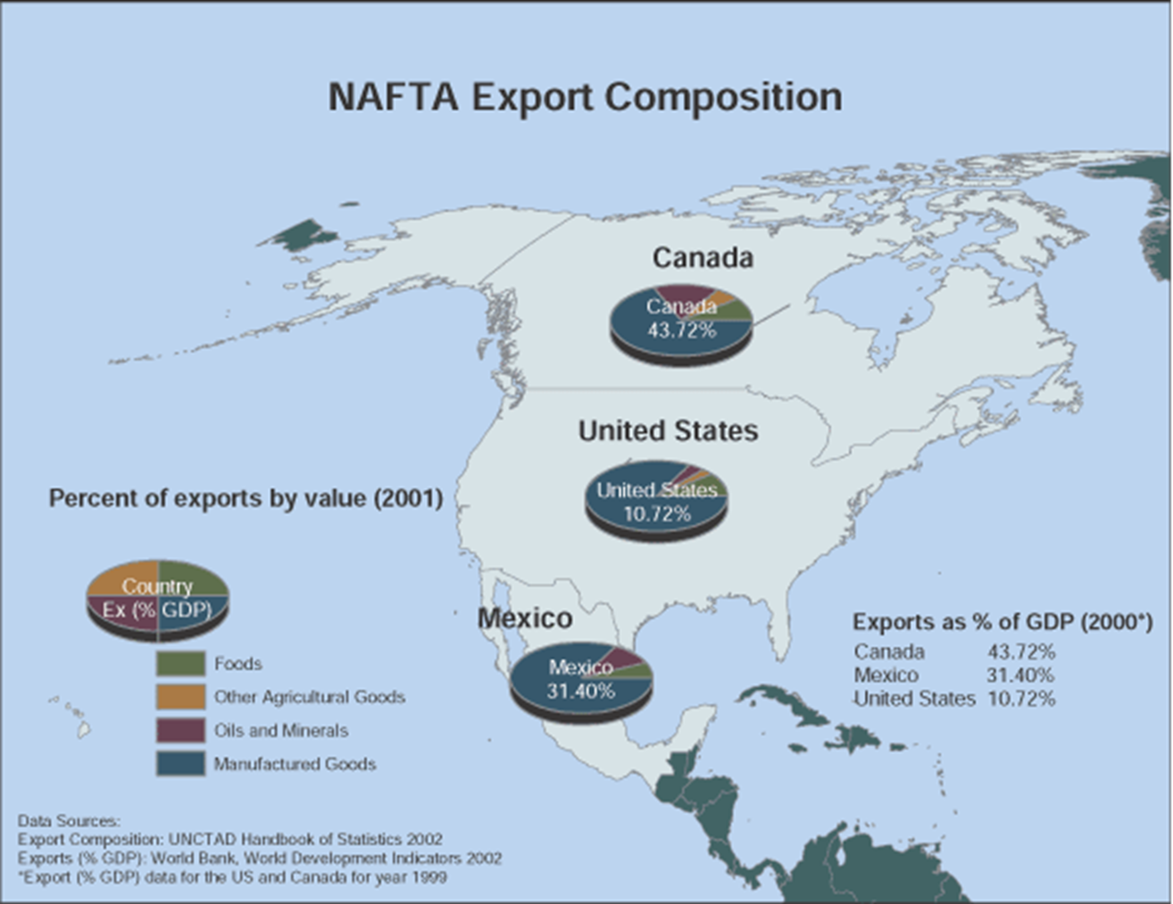

Slide 14
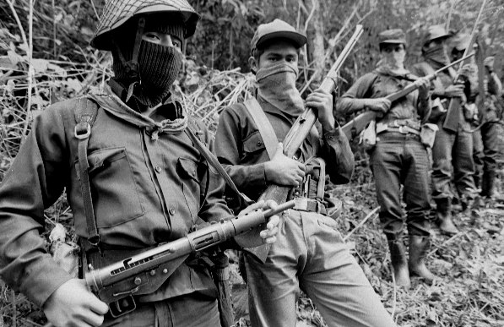
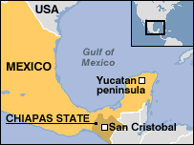
January 1994 – guerilla movement in heavily Indian state of Chiapas
Young rebels (Zapatistas) sought to improve conditions
Demanded work, land, housing, food, health care, and education for indigenous population of Chiapas
2,000 poorly armed, masked men and women captured four towns
Mexican government suppressed the rebels, and entered into negotiations

Slide 15
Economic Changes and New Political Actors
Late 19th century – early 20th century: economic boom across Latin America
Each nation had its specialized crop or set of exports
Colombia, Brazil, Costa Rica – coffee
Bolivia, Chile, Peru – minerals
Ecuador, Central America – bananas
Cuba – sugar
As long as European demand remained high, groups in control of these exports profited greatly
Latin America dependent on foreign economies

Slide 16
During World War I, Latin America experienced economic growth
Import substitution industrialization
Had to produce for themselves some of what they had formerly imported, such as textiles
Latin America still suffered from a lack of capital, limited markets, and low technological levels
Immediate effects on Latin America after World War I
Inflation
Wages declined
Population growth
Immigration into Argentina, Brazil, and other countries with a temperate climate
Political unrest
Rapid urban growth
Created a series of social problems that reflected the transformation of Latin America from agrarian to industrializing societies
Lima, Montevideo, Quito, and Mexico City
Dominated economic and political resources of their countries

Slide 17
Labor and the Middle Class
Rising importance of urban labor and growth of urban middle class led to changes in the political structure of some Latin American nations
Argentina, Chile, and Brazil went from traditional land-owning oligarchy to a political system that gave powers to growing middle class

Slide 18
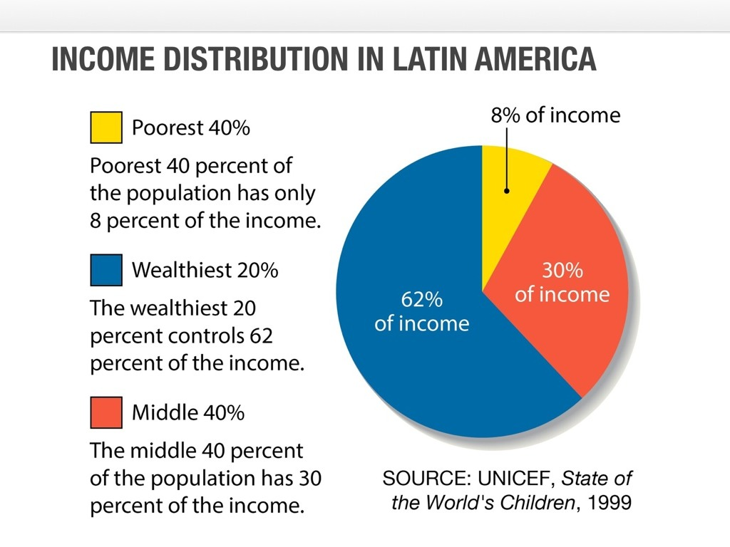
Growing sense of class conflict developed in Latin America (similar to Western Europe)
Railroad, dock, and mining workers often were among most radical and the first to organize and usually met with government force
Governments had to consider organized labor as a force to be confronted or accommodated
Most workers in Latin America, unlike western Europe, were still agrarian and not organized

Slide 19
Ideology and Social Reform
1920s-1930s: liberalism had failed
Middle class emerged in politics, but had to share party with traditional oligarchy or military
Large segments of population were landless and uneducated
Increasing industrialization did not dissolve old class boundaries
Public education and other liberal programs failed to produce social mobility
Movements for social reform spread rapidly in Brazil, Argentina, Chile, and Uruguay.
Many criticized the failure of liberal regimes
Latin America should find its own solutions, and not import ideas from Europe
Socialism and communism appeared in Latin America, especially after Russian Revolution of 1917

Slide 20
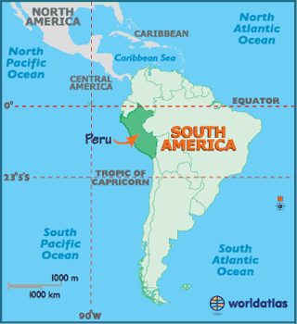
Populist Politics: The Case of Peru
Characteristics of Peru
Primarily Indian population
Export economy
Nitrates and agricultural products
Infrastructure built with foreign investment
Elites profited greatly from economic advancement
Many peasants landless
Rampant government corruption

Slide 21
1924 – Victor Raul Haya de la Torre created the American Popular Revolutionary Alliance (APRA)
Influenced by the Mexican Revolution, social, nationalism, and some aspects of Mussolini's fascism
Gained wide support
Anti-imperialists
Those in favor of nationalizing lands and basic industry
Middle-class/proletariats
APRA represented the new populist political parties in Latin American that began to gain mass support among workers, small farmers, and urban sectors
Gained broad support from urban masses and rural peasants
Often led by politicians from the military or the elites
Emphasis on personal charisma of the leader, direct appeals to the masses, and political mobilization of the people

Slide 22
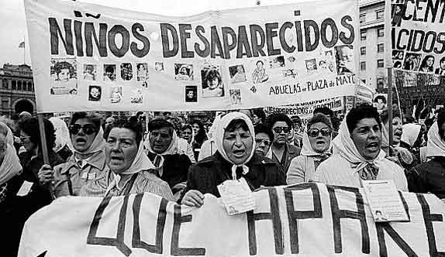
The Great Crash and Latin American Responses
Latin American economy and infrastructure collapsed during the global depression
Internal weakness of liberal regimes and economic dependency
Foreign investments stopped
Purchases of region’s products declined
High unemployment
Within three years of the depression, military coups removed liberal governments in 12 Latin American countries
Liberal governments replaced with various adaptations of socialism, corporatism, and Italian/German fascism
By 1930s - Most governments wished to bring an end to capitalism and to appeal to a broader segment of the population for support

Slide 23
Promises of Social Reform
1930s – new regimes with a new concern with social problems characterized much of Latin America
Mexico – President Cardenas (1934-1940)
Land reform – 40 million acres of land distributed
State oil monopoly
Expanded rural education
Cuba – leaders of a nationalist revolution in 1933 aimed at social reform

Slide 24
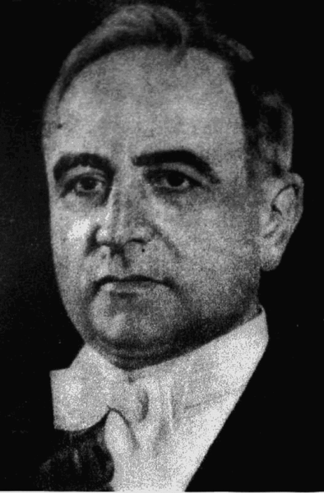
The Vargas Regime in Brazil
Brazilian economy, based on coffee exports, collapsed in the 1929 crash
1929 – President Getulio Vargas
Promised liberal reforms and elimination of the worst abuses of the old system
Launched a new kind of centralized political program, imposing federal administrators over the state governments
Little open opposition to government allowed
State organized many aspects of economy
1935 – held off attempted coups by the communists
1937 – held off attempted coups by the green-shirted fascist “integralists”

Slide 25
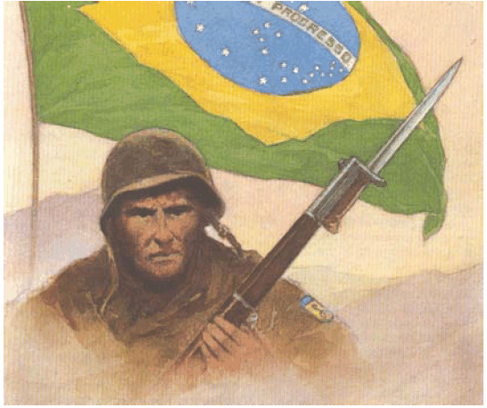
1937 - With support of the military, Vargas imposed a new constitution
Established the Estado Novo (New State)
Based on ideas from Mussolini’s Italy
Imposed an authoritarian regime within the context of nationalism and economic reforms
Limited immigration
Eliminated political parties opposed to the government
Marked the beginning of Vargas’ dictatorship
Despite authoritarian sympathies, Vargas joined the Allies in WWII
Supplied bases to the United States
Sent troops to fight against the Axis powers in Italy
In return, Brazil obtained arms, financial support for industrial development, and trade advantages

Slide 26
Argentina: Populism, Peron and the Military
1920s – Argentina was something of an abnormality in Latin America
1920s – middle-class Radical party held power
1929 – lost power when the economy collapsed
A military coup backed by a strange coalition of nationalists, fascists, and socialists seized power, hoping to return Argentina to the golden days of the great export boom of the 1890s
Coup failed
Argentina became more dependent as foreign investments increased and markets for Argentine products declined
1943 – military group once again in power
Nationalists who wanted to industrialize and modernize Argentina and make it the dominant power of South America

Slide 27
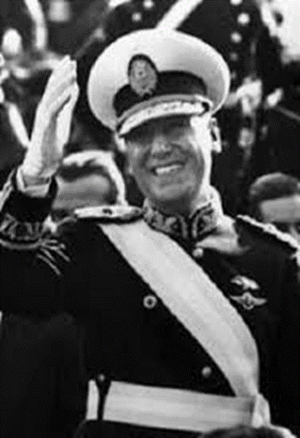
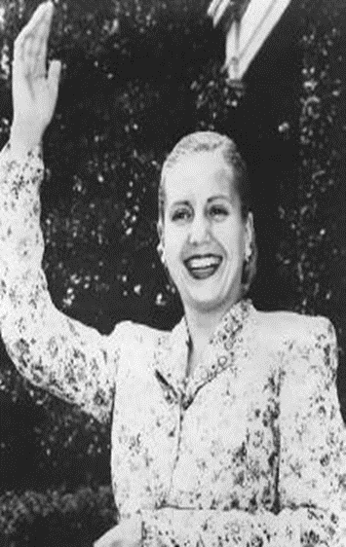
Colonel Juan D. Peron
Using his position in the Ministry of Labor, he appealed to workers
Raised their salaries, improved their benefits, and generally supported their demands
Gained popular support, aided by his wife, Eva Duarte, known as Evita
Became a popular figure and public spokesperson for Peron among the lower classes
1947 – elected President of Argentina
Populist government
Formed an alliance between the workers, industrialists, and military
Like Vargas, learned the effectiveness of radio, the press, and public speeches for mobilizing public support
Depended on his personal charisma and on repression of opponents to maintain his rule
Nationalized the foreign-owned railroads and telephone companies, as well as the petroleum resources

Slide 28
1947 – Argentina’s economy worsened
Peron’s regime had problems holding the interests of the various components of the coalition together
Democratic opposition – complained about Peron’s control of the press and violation of civil liberties
Industrialists – disliked the strength of labor organizations
Military – worried that Person would arm the workers, and they feared Peron would being to cut back on the military’s gains
1955 – anti-Peron military officers drove him into exile
Peronist party was banned
A succession of military-supported civilian governments tried to resolve the nation’s economic problems and its continued political instability
Mass of urban workers and the strong Peronist unions continued to fight for his programs
1973 – Peron and his new wife, Isabel, returned to Argentina
Won the presidential election in that year, she as vice president
1974 – Peron died
Argentina slid once more into a military dictatorship

Slide 29
Radical Options in the 1950s
1940s – pressure for change across the political spectrum
Desire to improve social and economic conditions
General agreement that development and economic strength were the keys to a better future
Throughout Latin America, the failures of democratization, economic development, and social reforms led to consideration of radical and revolutionary solutions
Many revolutions successful initially, but unable to sustain changes long-term
1952 – Revolution in Bolivia
By late 1950, 90% of land owned by 6 % of population
Mines were nationalized and some land redistributed,
1964 - army was back in power and governments remained more interested in order than reform

Slide 30
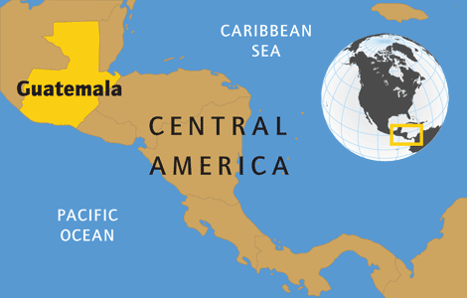
Guatemala: Reform and United States Intervention
Guatemala
Predominantly Indian nation
Mainly illiterate
Poor health conditions and high mortality rates
Land and wealth distributed very unequally
Economy depended on exports of coffee and bananas
1944 – Juan Jose Arevalo elected president
Reformer
Created a new constitution
Land reform
Improvement in the rights and conditions of rural and industrial workers
Income tax
Educational reforms

Slide 31
1951 – Colonel Jacobo Arbenz elected President of Guatemala
Radical nationalist program
Against foreign economic interests and the landholding oligarchy
Announced programs to improve or nationalize the transportation network, the hydroelectric system, and other areas of the economy
United Fruit Company
U.S. owned company operating in Guatemala since 1900
Acquired extensive properties in Guatemala
Controlled transportation and shipping facilities
1953 – under considerable pressure from the United Fruit Company, the United States denounced the changes and began to impose economic and diplomatic restrictions on Guatemala

Slide 32
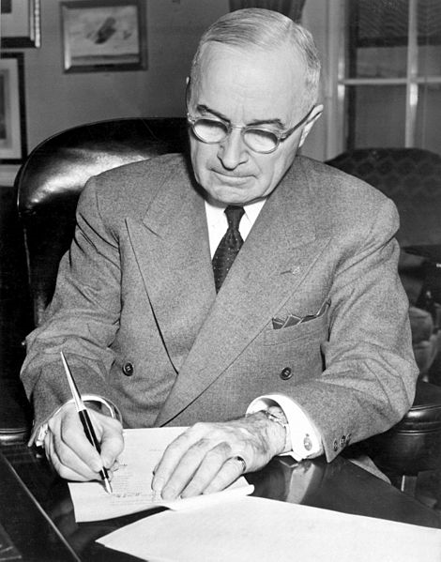
1954 – the United States Central Intelligence Agency organized a military force and invaded Guatemala
Arbenz government was replaced with a pro-American regime
Reversed the land reform and negotiated a settlement favorable to United Fruit
Reforms stopped
Guatemala continued to have a low standard of living
Especially Indian population
Many military coups failed and violence/political stability remained
Operation PBFORTUNE: President Harry Truman authorized the CIA to effect a Guatemalan coup d’état in 1951

Slide 33
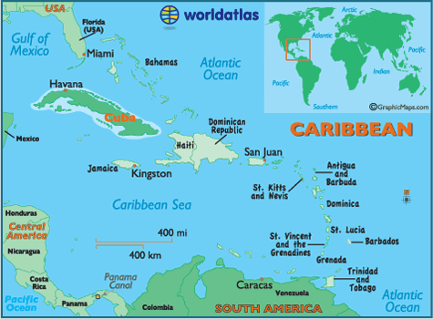
The Cuban Revolution: Socialism in the Caribbean
Cuba
Population of 6 million
Most were descendants of Spaniards and African slaves who had been imported to produce sugar and tobacco
Working and living conditions were poor
Cuban politics and economy were rarely free of American interests
1940s-1950s: high level of American investments
1950s – ¾ of Cuban imports came from U.S.

Slide 34
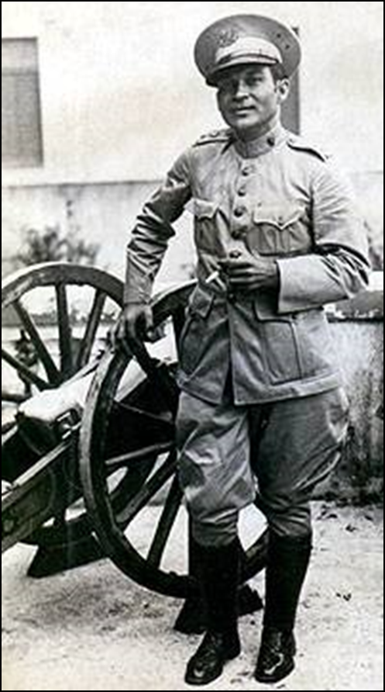
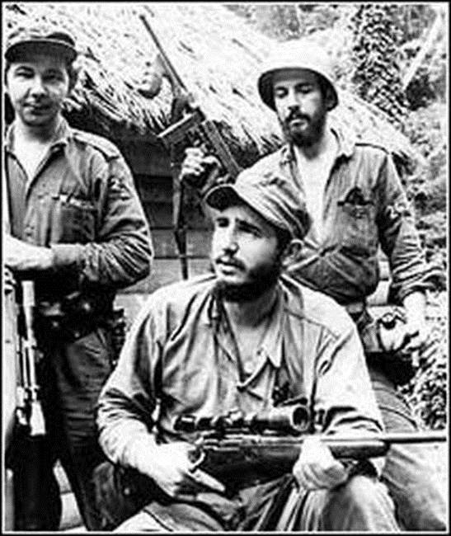
1934-1944: Fulgencio Batista ruled Cuba
Authoritarian reformer
1940 – democratic constitution
Promised major changes, nationalization of natural resources, full employment, and land reform
Massive corruption in programs of reform
Fidel Castro
Passionate critic of the Batista government
July 26, 1953 – Castro led an unsuccessful rebellion against the Batista government
Released from prison, Castro fled to exile in Mexico where, with the aid of Ernesto “Che” Guevara, a militant Argentine revolutionary, gathered a small military force
1958 – the “26th of July Movement”
Castro gained support from students, labor organizations, and rural workers against Batista’s army
Batista driven from power, rebels took over

Slide 35
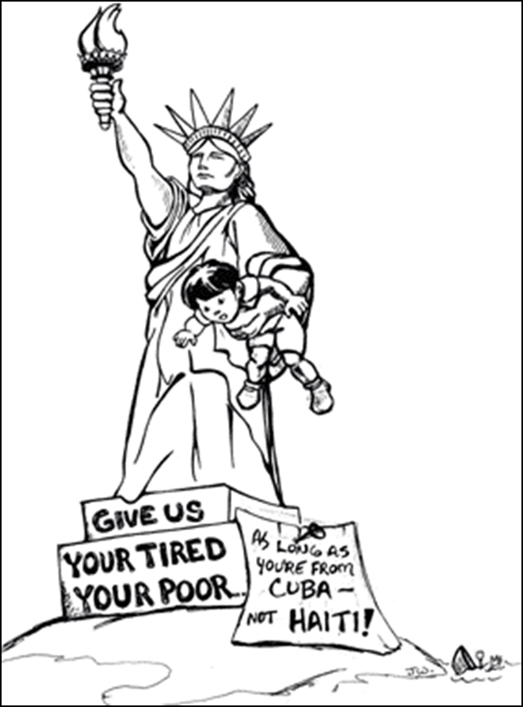
Now in power, Castro launched a program of sweeping reforms
Foreign properties were seized by government
Farms were collectivized
A centralized socialist economy put into place
Nationalist and anti-imperialist foreign policy
Depended on the financial support and arms of the Soviet Union
1960s – failed effort to industrialize
Cuba turned against to its ability to produce sugar
Education, health, and housing improved
Achievements accompanied by severe restrictions of basic freedoms

Slide 36
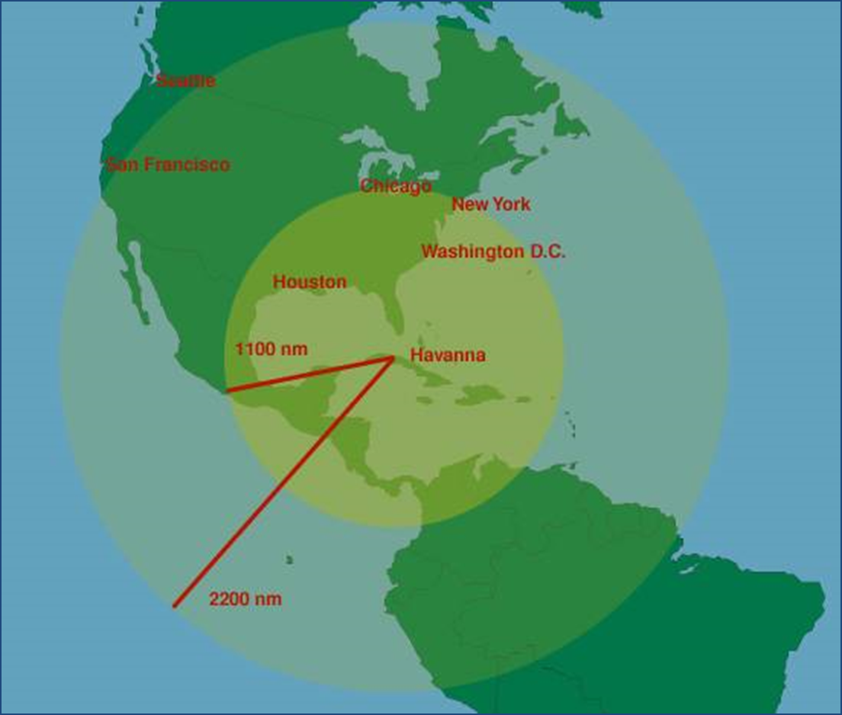
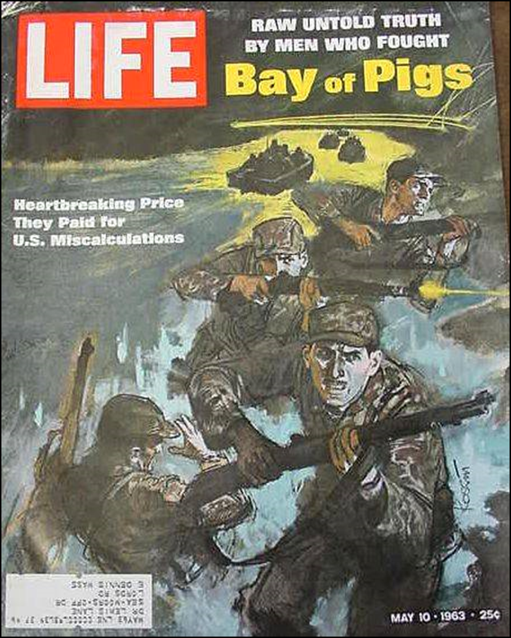
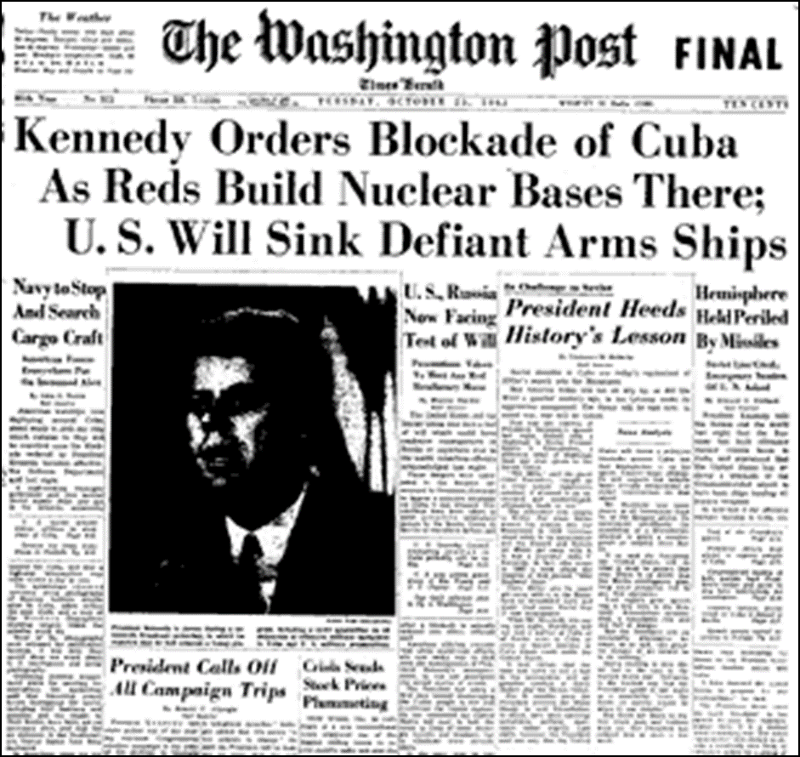
1961 – relations with the United States terminated
Bay of Pigs – failed U.S. sponsored invasion by Cuban exiles and embargo on trade with Cuba
Led to the Cuban Missile Crisis
Soviet Union placed nuclear missiles on the harbors of Cuba

Slide 37
The Search for Reform and the Military Option
1950s
How could the traditional patterns of inequality and international dependency be overcome?
What was the best path to the future?
Possible answers
Political stability, forced if necessary, to promote capitalist economic growth
One party system in Mexico
The Church should provide guidance
Chile and Venezuela – Christian Democratic parties
1970s – liberation theology
Combined Catholic theology and socialist principles in an effort to improved conditions for the poor

Slide 38
Out of the Barracks: Soldiers Take Power
19th century – military forces in Latin American have been involved in politics (caudillos)
Over time, military became more professionalized
True representatives of nation
Best equipped to solve nations’ problems, even if it meant sacrificing the democratic process
Military coups, often with the compliance of the United States, overthrew governments
Brazil (1964), Argentina (1966), Chile (1973), Uruguay (1973), and Peru (1968).
Military governments were authoritarian regimes
A President, controlled by the military, formulated and applied policies through a bureaucracy
Political repression and torture to silence critics
Limited political freedom
Military economic policies sought to crush labor movements, develop new industrial strength, and promote building of the infrastructure.

Slide 39
The New Democratic Trend
Mid 1980s – military had begun to return government to civilian politicians
Pressures of containing opponents wore heavily on military leaders
Economic problems (high debt, low standards of living, inflation)
Fear of communism had diminished
Despite problems, democratization of political systems continued in the 1990s
1983 – Free elections in Argentina
1989 – Brazil restored democratic government

Slide 40
Last decades of century - Problems in Latin America
Massive debt threated the economic stability of Latin American countries
Large foreign loans (1970s) for the purpose of development, sometimes for unnecessary projects
High rates of inflation
Reduction in government spending
International commerce in drugs
Criminal activity and powerful international cartels
Government corruption

Slide 41
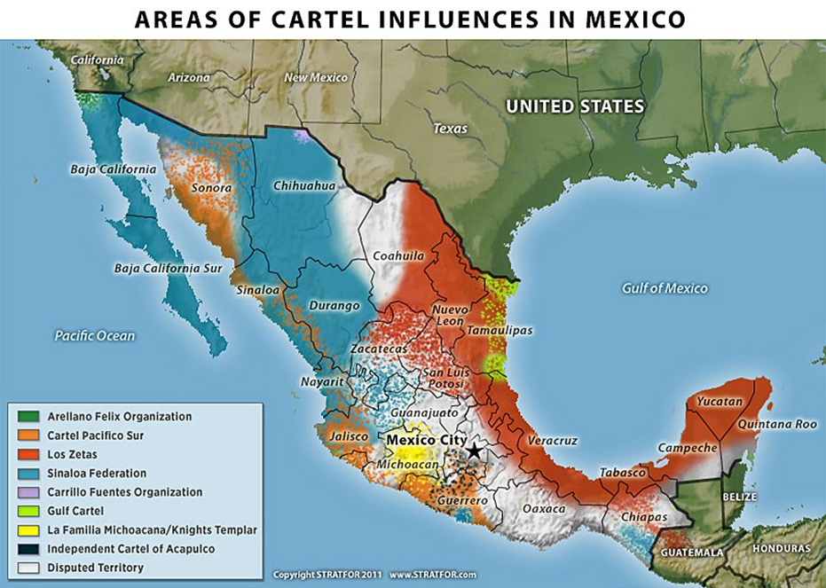

Slide 42
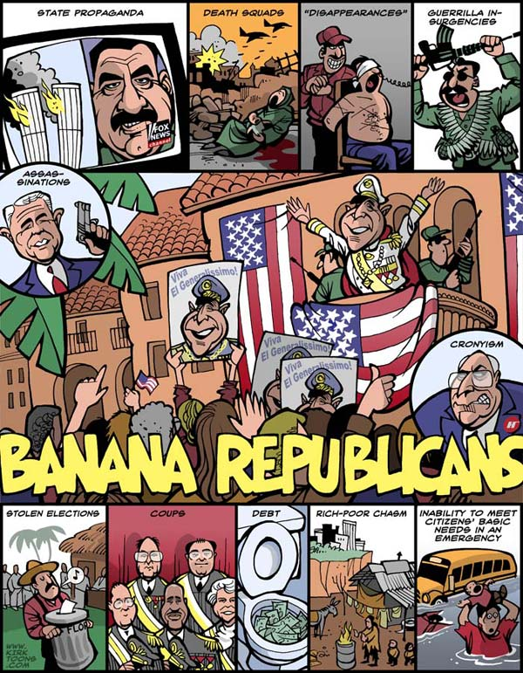
The United States and Latin America: Continuing Presence
After WWI, the United States dominated the Western Hemisphere
The U.S. intervened directly whenever it believed its interests to be threatened
More than 30 interventions before 1933
Haiti, Nicaragua, the Dominican Republic, Mexico, and Cuba
Central America
High level of investment by U.S. corporations
Banana Republics - establishment of puppet governments
Often dictatorships friendly to the United States

Slide 43
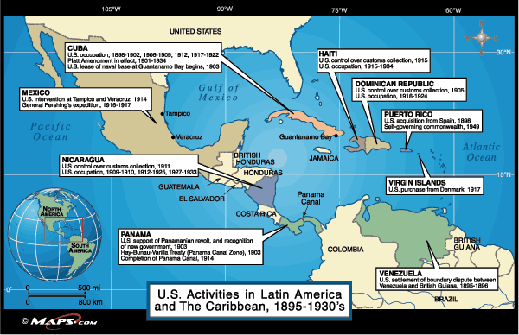

Slide 44
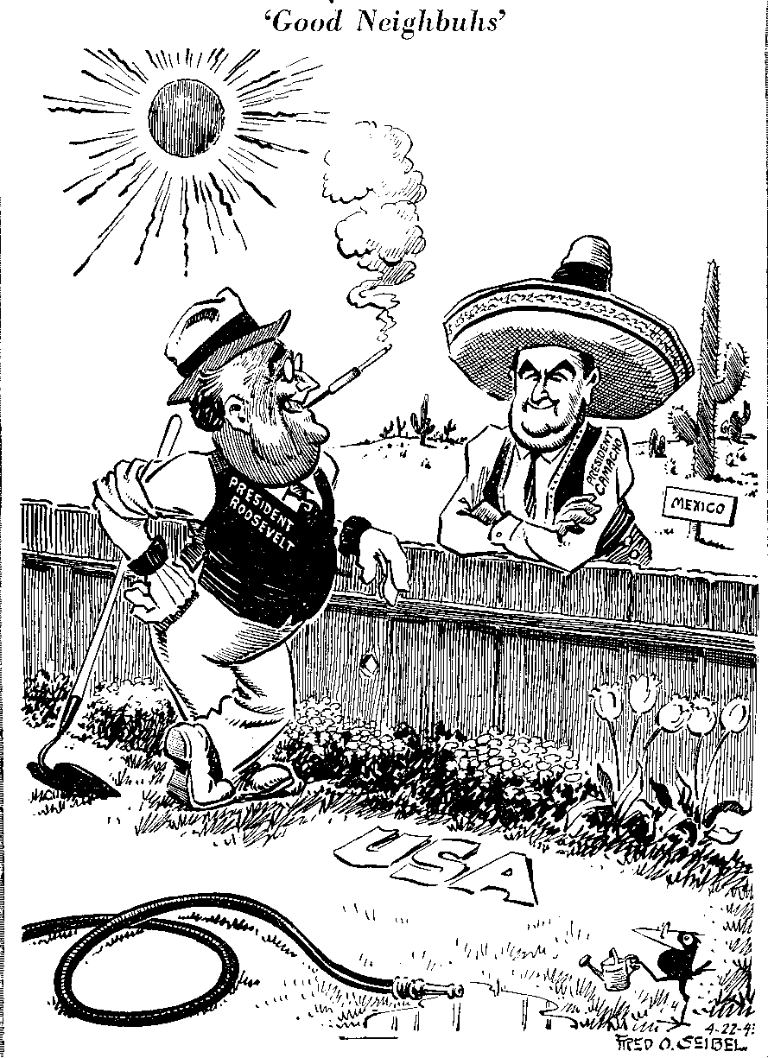
1933 – United States introduced the Good Neighbor Policy (FDR)
Promised to deal more fairly with Latin America and stop direct interventions
1961 - the U.S. program Alliance for Progress
Attempted to provide economic aid as a means of raising standards of living and reducing radical movements.
$10 billion in aid, little success
1970s – 1980s : U.S. would accept Latin America as it was
Treaty signed with Panama that ceded to that nation eventual control of the Panama Canal

Slide 46
Societies in Search of Change
Social relations changed slowly in Latin America
Inequalities based on ethnicity continued in some places
Women entered the labor force in large numbers but began to gain the right to vote only after 1929
Status closer to women in Western Europe than to those of Asia or Africa
Population growth, urbanization, and migration continued to challenge the regions

Slide 47
Slow Change in Women's Roles
Women in Latin America
After WWI – continued to live under inequalities in the workplace and in politics
1940s-1950s: most Latin American countries allow women to vote
Did not guarantee political rights or the ability to have their specific issues heard
Males excluded women from political life out of fear that their traditional associations with organized religion would make them conservative
In response, women formed organizations and suffrage associations
By the 1990s, the position of women in Latin America was closer to the West than other areas of the world
9% of legislators are women

Slide 48
The Movement of People
1950- Latin America and North America both had around 165 million people
1985
North America – 265 million
Latin America – 400 million
Declining mortality and continuing high fertility
Beginning 20th century – immigration to Latin America and internal migration
Internal migration caused by low employment rates and political flight
1920s - Migration from Latin America to the U.S., often illegal, was similar to the movement of workers from southern Europe and Africa to the industrialized nations of Western Europe
Many immigrants fled from political repression.
1970s – 750,000 illegal Mexican migrants a year were crossing border

Slide 49
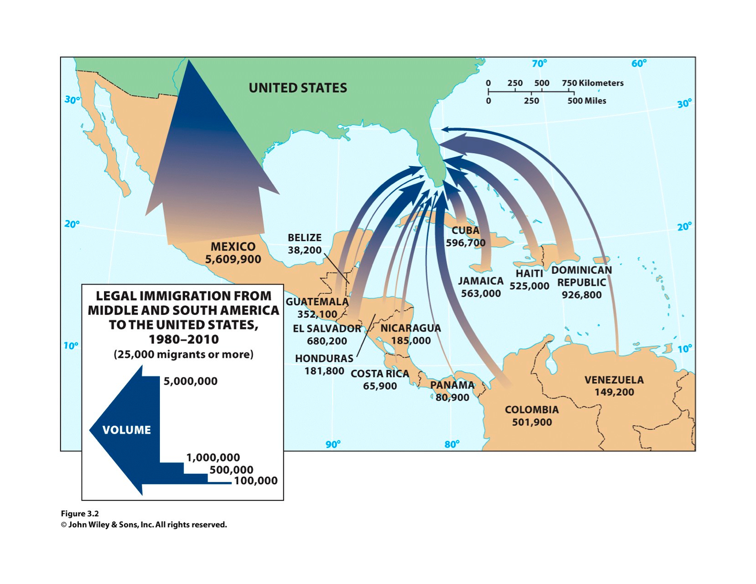

Slide 50
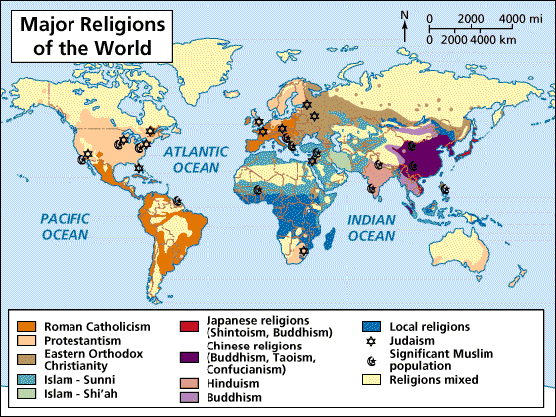
Cultural Reflections of Despair and Hope
Latin America remains predominantly Catholic and Hispanic with mixtures of African and Indian cultures
Indigenous cultures and the plight of the poor are common themes in Latin American art and literature

Slide 51
Conclusion: Struggling Toward the Future
In many ways, Latin American nations of the 20th century have been unable to bring about the fundamental political, social, and economic changes that would have resulted in prosperity and stability
Despite change, however, enormous problems continue to exist

