Slide 1
Decolonization and the Decline of the European World Order
Chapter 33
“An eye for an eye makes the world go blind” - Gandhi
“Be the change you want to see in the world” - Gandhi

Slide 2
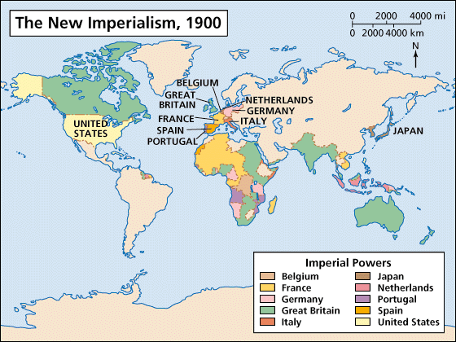
Introduction
18th-19th centuries – European political, economic, and cultural dominance over much of African and Asia
  Leaders in Asia and Africa began to reevaluate what needed to be kept from their own cultures and what western accommodations were to be kept

Slide 3
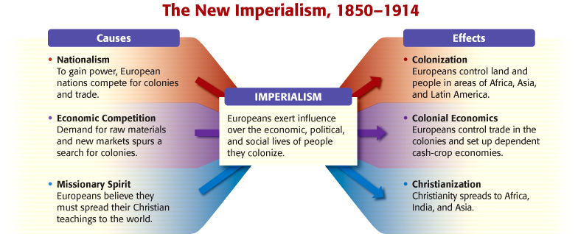

Slide 4

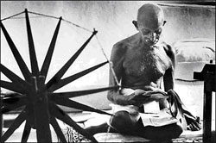
Characteristics of decolonization in Asia and Africa
  Violence sometimes used, particularly in settle colonies
  Nationalists relied mainly on peaceful demonstrations, economic boycotts, and constitutional maneuvers in their struggles for independence
  Mohandas Gandhi (India) and Kwame Nkrumah (Ghana)
    Leaders in the struggle for independence
    Used Europeans’ own principles and values, especially those stressing human dignity and civil rights, against the colonial overlords
    Used indigenous religious beliefs and traditional symbols of legitimacy to rally mass support for their cause

Slide 5
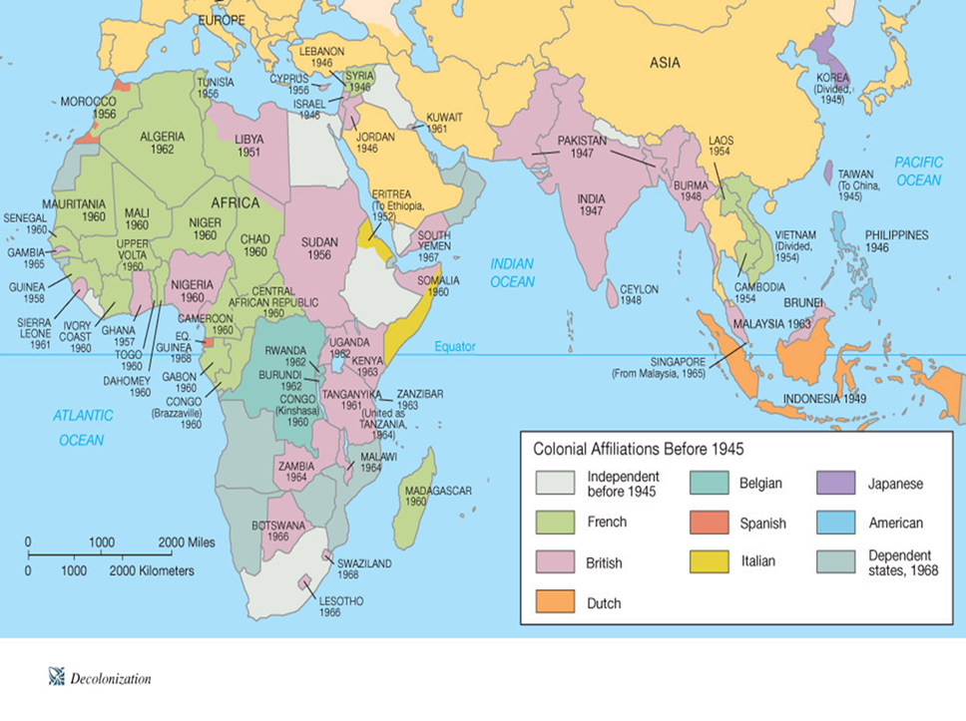
European colonial regimes had been built in collaboration with indigenous elite groups (princes, landlords, and new middles classes) and depended for their survival on these groups, as well as on soldiers and police recruited from colonized peoples
  Europeans vulnerable to growing challenges within colonies

Slide 6
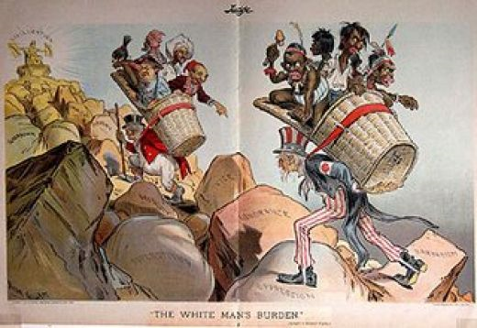
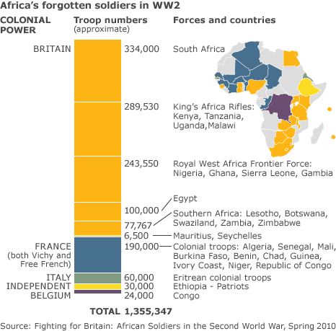
World War I
  Caused doubt on the Europeans’ claims that by virtue of their racial superiority they were the fittest of all peoples to rule the world
Great Depression
  Hit most colonies hard, which gave further strength to the nationalist cause
World War II
  Created problems with the existing European colonial order
  Within decades, most of Africa and Asia had been liberated from European rule

Slide 7
India: The Makings of the Nationalist Challenge to the British Raj
  1885 – creation of the Indian National Congress
    Dominated by Hindus but had Muslim leaders
    Created by regional associations of Western-educated Indians located in major cities
    Had approval from high-ranking British officials
      Forum for educated individuals to make their opinions known through government
      Most early members were loyal to the British rulers
    Primary function of the early party was to present grievances to the British colonial administration
      Most of the issues concerned the Indian elite, not the poor
      Increasing Indian representation in local legislative bodies
      Drain of wealth from subcontinent to Great Britain
      Growing poverty of Indian masses
      Removing barriers to Indian employment in colonial bureaucracy
      British racism
        Poor salaries and limited opportunities for Indians in the colonial administration
    Despite its limited aims, the Congress party did allow the formation of a sense of Indian identity
    Led the Indians to independence and has governed through most of the postcolonial period

Slide 8
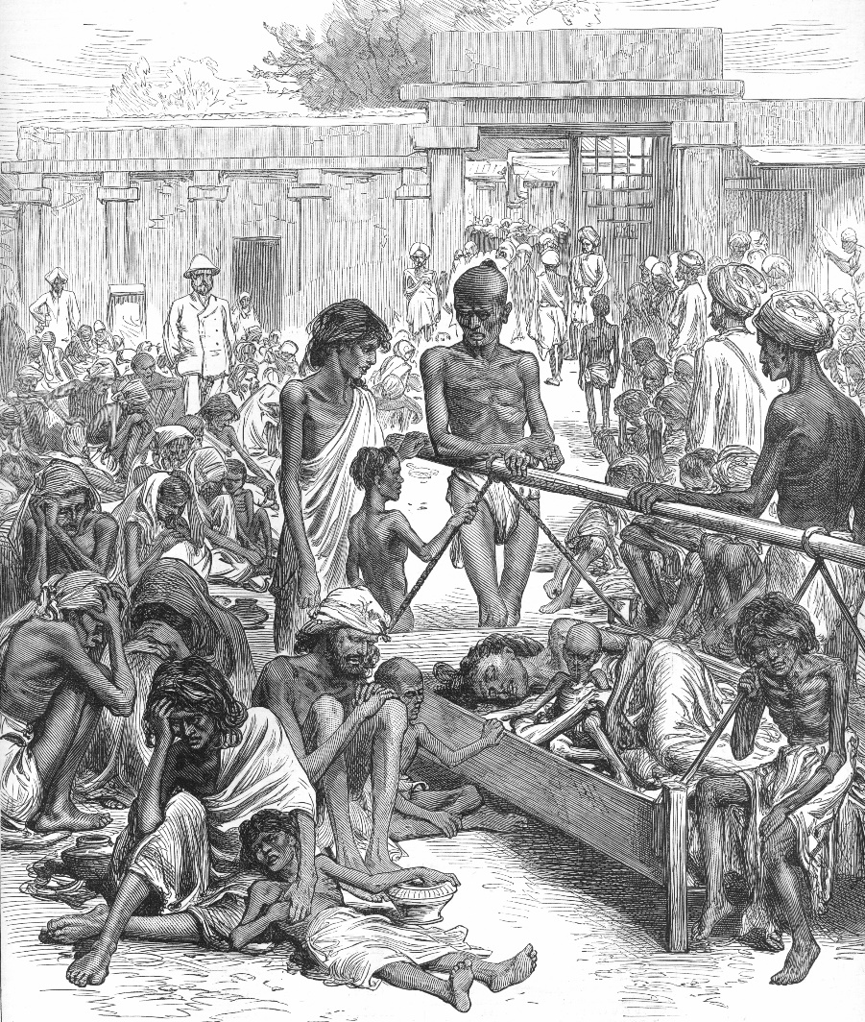
Social Foundations of a Mass Movement
  After a century of British rule of India by the end of 19th century, British economic and social policies helped the Congress party attract a mass following
    Indian businesspeople (many would financial support Congress party) were angered by British favoritism in investment and trade policies
    Indian political leaders stressed the drain of Indian resources under colonial rule
      The colonial army
        Mainly fought wars outside of British Empire
      High-salaried bureaucrats
        Occupied positions that the Indians themselves were qualified to assume
      Public works projects
        Purchase of railway equipment or steel goods from Great Britain
    Problems among the peasantry
      Shortfalls of food supplies
        Shift from the production of food to commercial crops (cotton, jute, and indigo)
        Recurrent famines before World War I
      Landlessness
      Chronic poverty

Slide 9
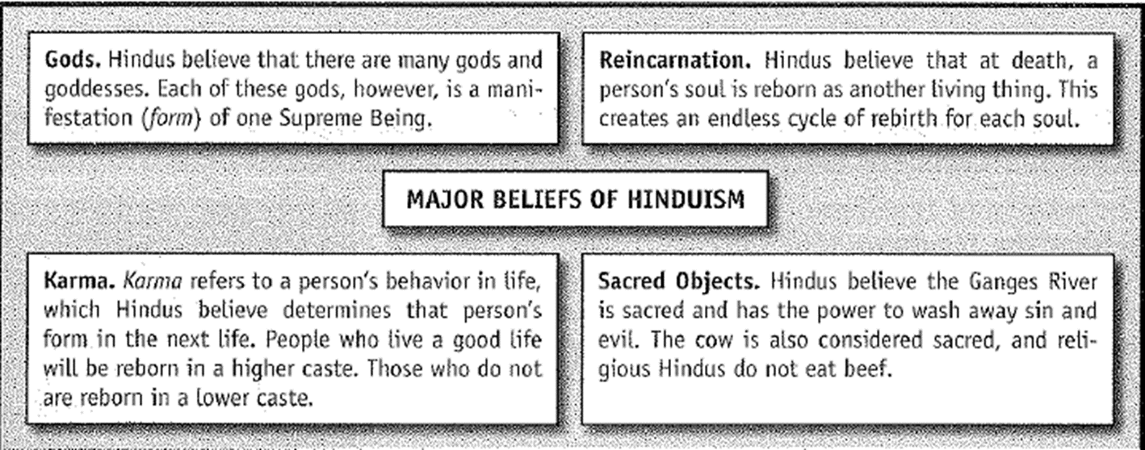
The Rise of Militant Nationalism
  Some of the issues Indian nationalist leaders stressed in their early attempts to build a mass base had great appeal for devout Hindus
    Campaigns to protect cows
    Alienated Muslims
      1/4th of the population of the Indian Empire

Slide 10
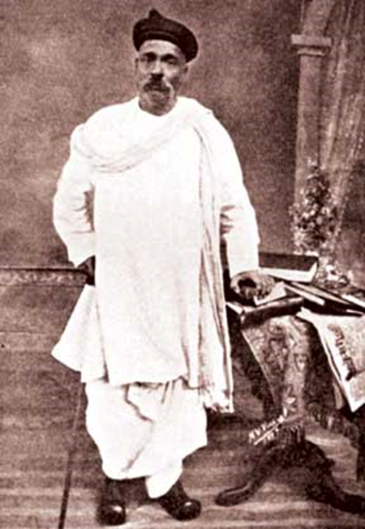
  B. G. Tilak
    First Indian nationalist leader with a genuine mass following
    Believed that because Hindus made up the overwhelming majority of the Indian population, nationalist should be built on appeals to Hindus
      Promoted the restoration and revival of Hinduism
        Opposed women’s education and raising of the very low marriage age for women
    Urged the boycott of British manufactured goods
    Sought to persuade Indians to refuse to serve in colonial administration or military
    Demanded full independence, with no deals or delays
      Threatened violent rebellion if the British failed to comply
        British arrested Tilak and deported him to Burma

Slide 11
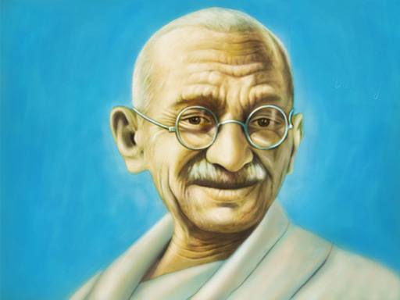
  The other major threat to the British in India before World War I also came from Hindu communalists who advocated the violent overthrow of the colonial regime
    Some Hindus embraced terrorism as a means of ending British rule
    Terrorist groups used secret organizations to targeted British officials and public buildings
    Young revolutionaries also struck at European civilians
    British had substantial resources to crush these violent threats
  Mohandas Gandhi used peaceful schemes for protest against the British rule

Slide 12
Egypt and the Rise of Nationalism in the Middle East
  1882 – Egypt
    Occupied by British and Turkish Khedives
      British - Lord Cromer
        Dominated government policy in Egypt
        Pushed for much-needed economic reforms that reduced the debts of the Khedival regime
        Oversaw sweeping reforms in the bureaucracy
        Supported the construction of irrigation systems and other public works projects
      Changes to Egypt only benefited certain groups, including foreign merchants, the Turco-Egyptian political elite, a small Egyptian bourgeoisie in Cairo, and the ayan (landlords in rural areas)

Slide 13
1890s –
  Newspapers in Arabic (and to a lesser extent French and English) strove to expose the mistakes of the British and the corruption of the Khedival regime
    Attacked the British for their racist arrogance and their monopolization of well-paying positions in the Egyptian bureaucracy
  First nationalist party was formed
1907 – three main alternative political parties
  None could be said to speak for the great majority of Egyptians, who were illiterate, poorly paid, and largely ignored urban laborers and rural farmers
1906 – Dinshawai incident
  Confrontation between the British military and their Egyptian subjects which exemplified the racial arrogance of most of the European colonizers
  Limited number of fatalities
  Spurred support for nationalist agitation across the social boundaries that had so long divided the peoples of Egypt
1913 – Britain issued a constitution with representation in a parliament elected indirectly by men of wealth and influence
  Britain had felt pressure from the Egyptian nationalists
  Suspended constitution during WWI

Slide 14
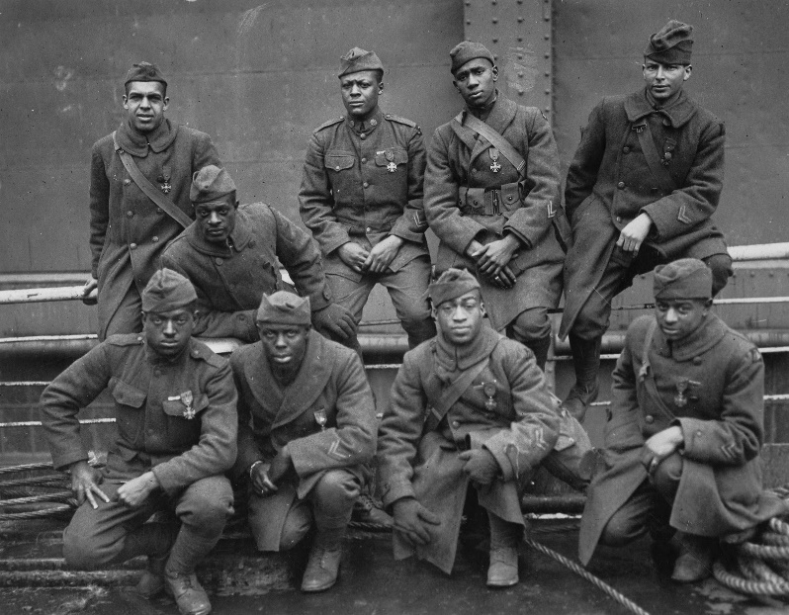
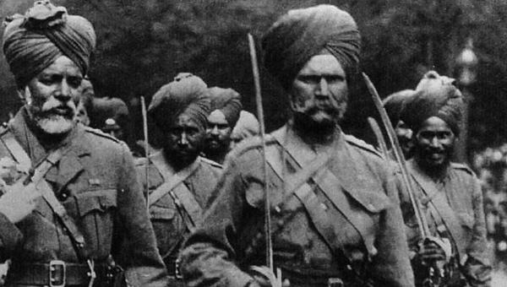
World War I and the Postwar Crisis of the European Empires
Hundreds of thousands of African and Asian soldiers served to meet the needs of their colonial powers on the Western Front, Egypt, Palestine, Mesopotamia, and East Africa
  Supplied food for home populations and important raw materials
    Oil, jute, cotton
British encouraged expansion of industrial production in India to supplement the output of their overextended factories
British and French made many promises about the postwar settlement
  Betrayal of these pledges contributed to many problems after WWI

Slide 15
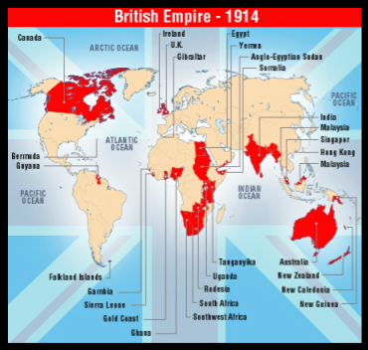
India: Gandhi and the Nationalist Struggle
  The White Dominions (Canada, Australia, and New Zealand) and India within the British Empire played significant roles in WWI
    Quickly declared war on Central Powers and raised armies
    Indian princes offered war loans
    Indian soldiers suffered most from the war effort in east Africa and Middle East
    Nationalist leaders, Gandhi and Tilak, toured India selling war bonds

Slide 16
  WWI created a lot of hardship for the Indian people
    Wartime inflation
    Indian peasants angered at the ceilings set on the price of their market produce, despite rising costs
    Shipping shortages
    Decline in wages
    Famines
  British leaders had promised the Indians that if they continued to support the war effort, India would move steadily to self-government once the conflict was over
    British failed to follow through with promises
  1919 - Montagu-Chelmsford reforms
    Increased powers of Indian legislators and placed much of the provincial administration under their control
  Later in 1919 – Rowlatt Act
    Placed severe restrictions on key Indian civil rights such as freedom of press, causing local protest

Slide 17
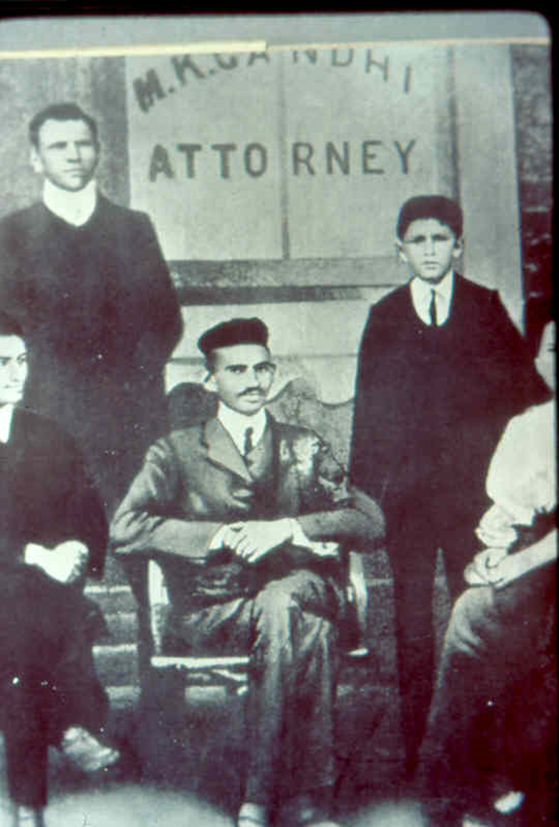
Mohandas Gandhi
  Western-educated lawyer in South Africa
    Witnessed how the white South Africans were treating people of color, including Indians and black Africans
  Became the leader of an all-India campaign against policies of the colonial overlords
    Remarkable appeal to both the masses and the Western-educated nationalist politicians
  Stressed nonviolent but aggressive protest
    Satyagraha - Peaceful boycotts, strikes, noncooperation, and mass demonstrations
      Proved an effective way to weaken British control while limiting opportunities for violent reprisals that would allow the British to make full use of their superior military

Slide 18
The Rise of Communalism and the Beginnings of Political Fragmentation
  Despite Gandhi’s constant stress on religious tolerance and shared harmony, some Muslim leaders mistrusted Gandhi and the Congress party politicians who organized his civil disobedience campaigns
  1906 - The Muslim League
    Rival political party aimed at advancing the causes of Islamic Indians
    1919 – Amritsar massacre catapulted the movement
      219 Indians (many Muslims) were slaughtered by British during a peaceful protest in a city park
    Destroyed the vision of a united India
    Were frustrated with Gandhi's attempt to create a broad-based opposition to British rule
    Mistrusted Gandhi and Congress party who organized civil disobedience campaigns
  On the other side, Hindu extremists were opposed to religious toleration and sharing power with minority religious groups

Slide 19
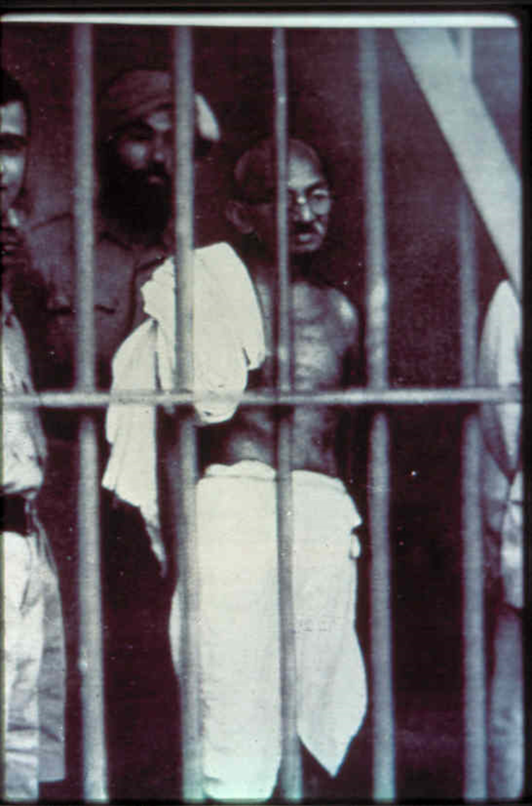
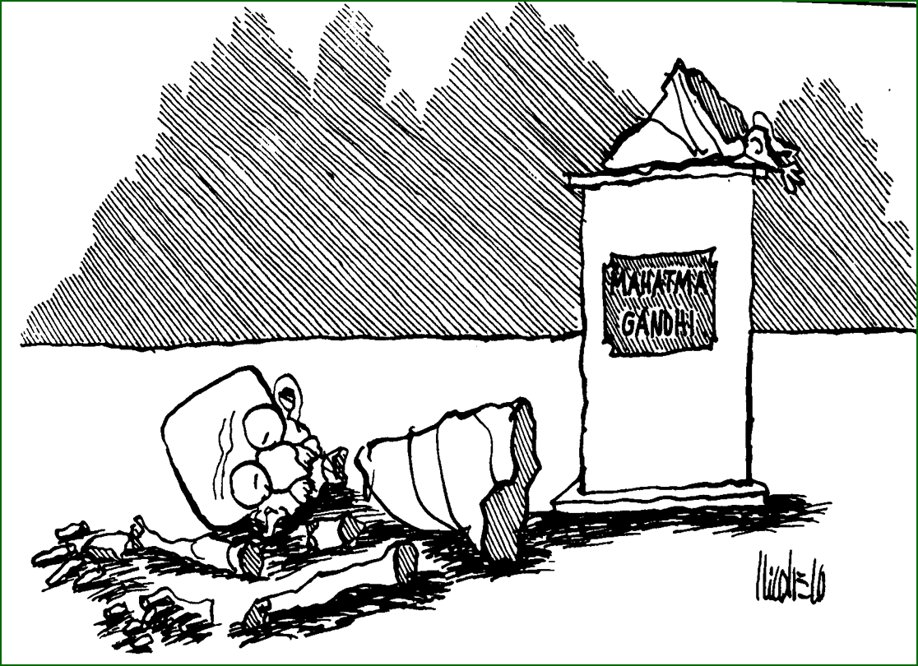
  Gandhi's attempts to repeal the Rowlatt Act revealed the strengths and weaknesses of his movement
    Congress party organizers rallied mass support for boycotts, noncooperation, and civil disobedience
      Initially, put British on the defensive
    But a lack of time and sufficient numbers of trained followers to instruct protesters in the discipline of nonviolent resistance led to violent retaliation from police repression
    Gandhi eventually cancelled the satyagraha against the anti-Rowlatt campaign
      Allowed the British to round up and imprison much of the nationalist leadership, including Nehru and Gandhi

Slide 20
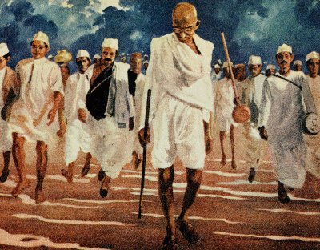
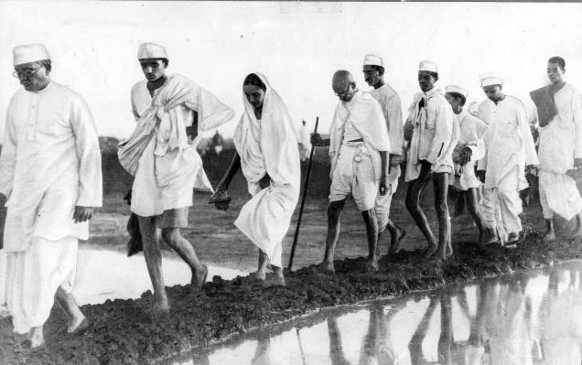
  The depression, led to the revival of mass movements for nationalism and struggle for decolonization
    Sharp fall in price of agricultural products hurt nearly all segments of rural population
  1931 – Salt March
    Gandhi led his followers on a march to the sea to make their own salt from sea water instead of buying the expensive English salt with its extra tax
    Forced the colonial government to eventually make concessions
  1931-1935
    British alternated between mass jailings, forcible repression, and roundtable negotiations with nationalist leaders, especially Gandhi
  1935 – Government of India Act
    The British opened all provincial governments to Indian leaders
    British retained control of central administration

Slide 21
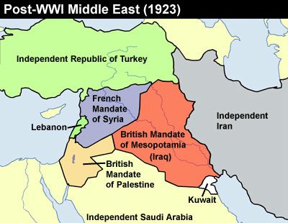
The Middle East: Betrayal and the Growth of Arab Nationalism
  After WWI – resistance to European colonial domination spread to much of the Middle East
    Turkish defeated in WWI
    Arab nationalist in Beirut, Damascus, and Baghdad now threatened by the victorious Entente powers, France and Britain
      Betraying promises to preserve Arab independence, French and British forces occupied much of the Middle East in the years after the war
        League of Nations mandate

Slide 22
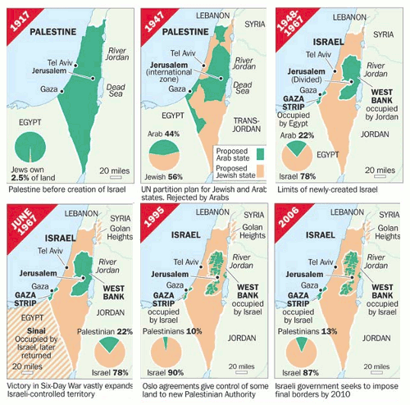
  Zionism is a form of nationalism of Jews and Jewish culture that supports a Jewish nation state in territory defined as the land of Israel
      Anti-Semitism in Eastern European Jewish communities accelerated the creation of Zionist planning for migration to the proposed Middle Eastern homeland
      Zionism and the British takeover of Palestine both seemed to violate assurances to the Arabs of nationalist independence
  1922 – League of Nations Mandate
    Palestine promised by British to both Jewish Zionists and Arabs
  1947 creation of Jewish state of Israel

Slide 23
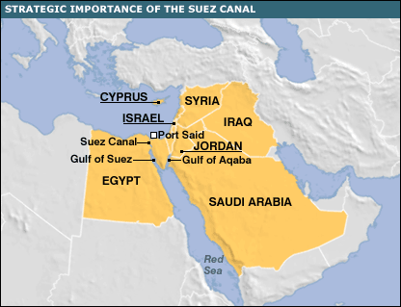
Revolt in Egypt, 1919
  Egypt was already occupied by the British when the war broke out
    Strong anti-colonial struggle in Egypt (especially peasants)
  During the war
    The defense of the Suez Canal was one of Britain’s top priorities
    Declaration of martial law throughout Egypt
    British drained increasingly scarce food supplies
      Led to food shortages
    Forced labor
    Confiscations of peasants draft animals

Slide 24
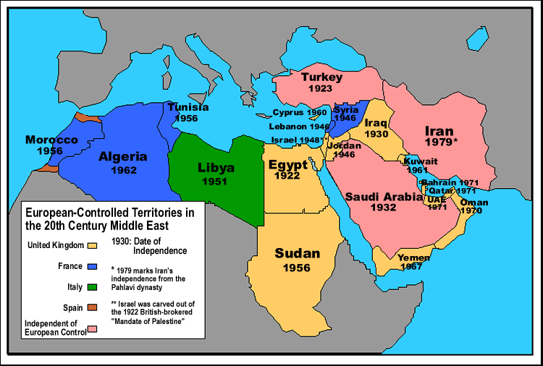
  After World War I
    British refused to allow an Egyptian delegates into the Paris Peace Conference at Versailles
      Most Egyptian leaders resigned from government and called for mass demonstrations
      Student-led riots
    Formation of the Wafd party in Egypt
      Egyptian Nationalist Party
      Provided the nationalists with both a focus for unified action and a mass base
    A British commission recommended that the British begin negotiations for an eventual withdrawal from Egypt
      Years of bargaining followed, eventually leading to Egyptian independence
      1922 – 1936: British withdrawal to the Suez Canal Zone

Slide 25
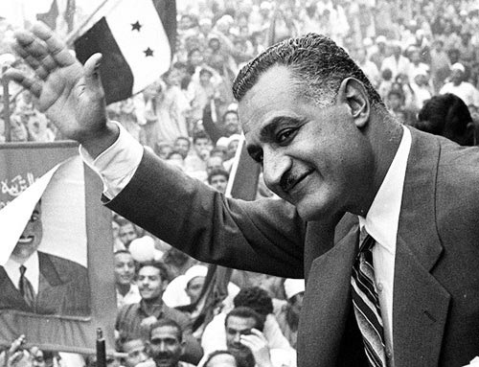
  Although they had achieved a significant degree of political independence, the Wafd party failed to enact significant social or economic reforms
    Did little to relieve increasing misery of Egyptian people
    Used political power as an opportunity to increase their own and their families’ fortunes
    Politicians, merchants, and professionals amassed huge estates worked by landless tenants and laborers
    Land reforms and public works denied
    Decades after independence – social bankruptcy by nationalist political dominance
    70% of Egypt’s cultivable land owned by 6% of population
    98% of peasants illiterate
    Chronic malnutrition
    95% of rural Egyptians suffered from eye diseases
  1952 – military coup and social revolution led by Gamal Abdul Nasser

Slide 26
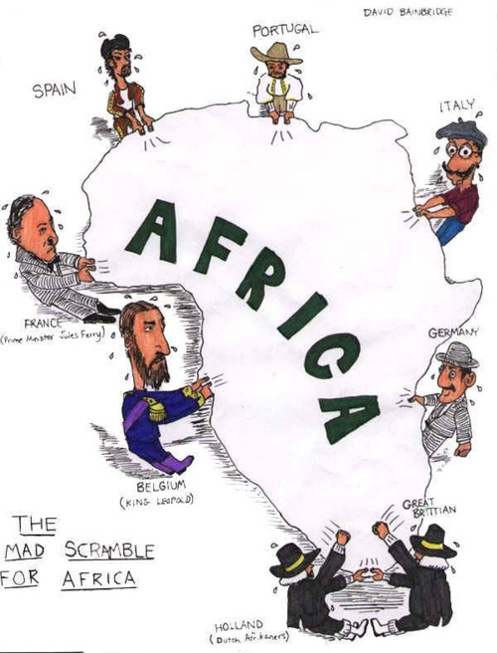
The Beginnings of the Liberation Struggle in Africa
1880s - Scramble for Africa and Berlin Conference
End of 19th century - Precolonial missionary efforts produced small groups of western-educated Africans in west and south-central Africa
  Like counterparts in India, most Western-educated Africans were loyal to British and French overlords during WWI
British and French were able to draw on their African possessions for labor and raw materials throughout WWI
  Took a toll on colonies
  Led to local rebellions
  African merchants and farmers suffered from shipping shortages and the sudden decline in demand for crops such as cocoa
  African villagers were not happy to go hungry so that their crops could feed the armies of the allies

Slide 27
Europeans promised better jobs and public honors to induce young Africans to enlist in armed forces or serve as colonial administrators
  Europeans kept few of these promises
Between WWI and WWII
  Major strikes and riots broke out
  1930s – protest intensified in colonized Africa
    Response to Great Depression
  1920s – 1930s: African elites began organizing
    Most early political organizations were too loosely structured
    Growing recognition by leaders of need to build up a mass base

Slide 28
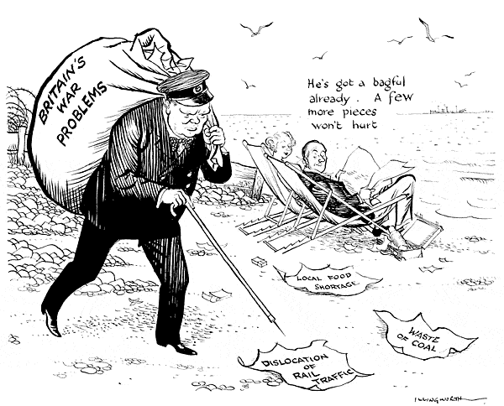
Another Global War and the Collapse of the European World Order
WWII
  The devastation drained the resources of European powers
  Hurt the will of the European people to hold increasingly resistant African and Asian colonies
  Increased power of United States and Soviet Union (both against colonialism)
    Franklin Roosevelt was hostile to colonialism in effort to win Asian and African support for the Allied war effort
      Atlantic Charter of 1941 – Roosevelt persuaded Churchill to include a clause that recognized the “right of all people to choose the form of government under which they live.”
    Soviets provided aid to nationalist campaigns after the war

Slide 29
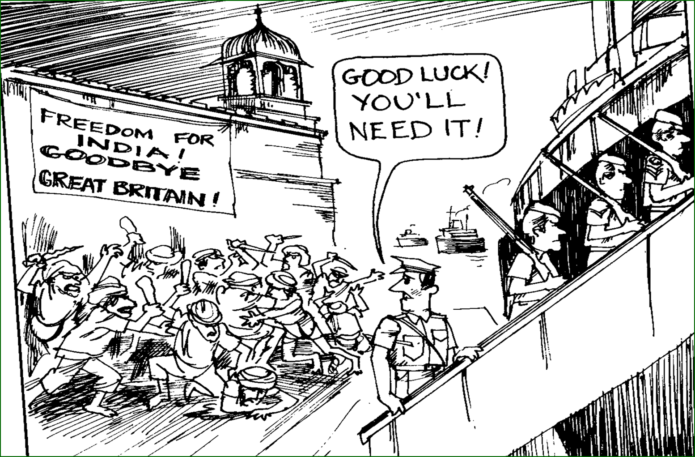
The Winning of Independence in South and Southeast Asia
  1930s – Indian National Congress offered to support the Allies’ war effort if the British would give them significant share of power at the all-India level and commit themselves to Indian independence once the conflict was over
    Rejected both by the viceroy in India and at home by Winston Churchill
  1942 - Quit India movement- Indian resistance to the British government
    British responded with repression and mass arrests (Gandhi, Nehru)
  1945- the new British ministers began negotiations for independence
    The Muslim League insisted on the creation of separate Muslim and Hindu states
    Fearing a possible sectarian bloodbath, Congress party leaders agreed to split India

Slide 30
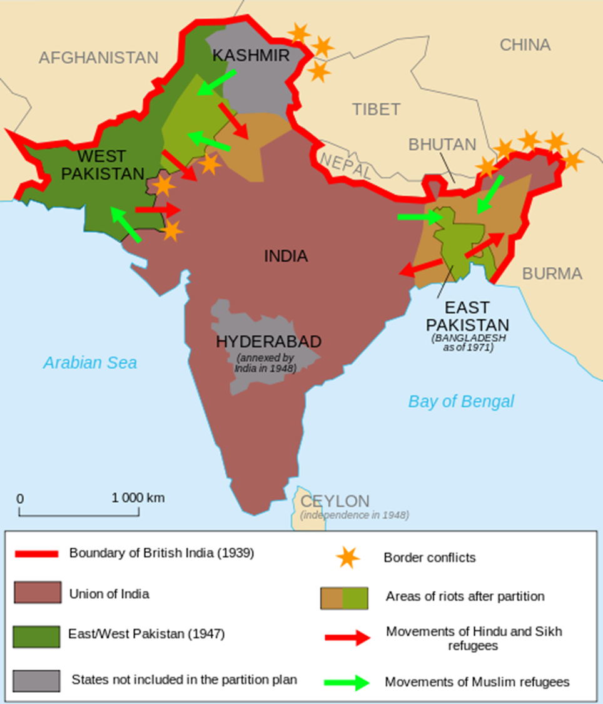
  1947 – Partition of India
    India – controlled by leaders of the majority Congress party
    Pakistan – controlled by leader of the Muslim League, Muhammad Ali Jinnah
    Until the borders of the new nations could be secured, sectarian violence marred the independence movement
      Hundreds of thousands killed (including women and children)
      Whole villages destroyed

Slide 31
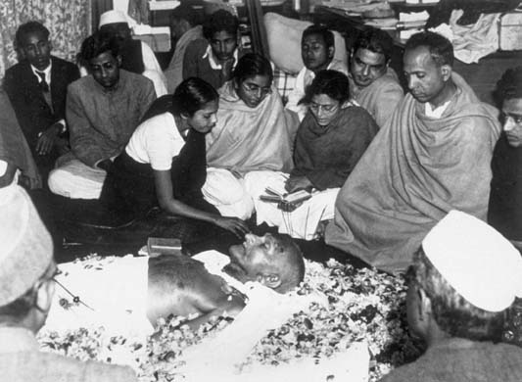
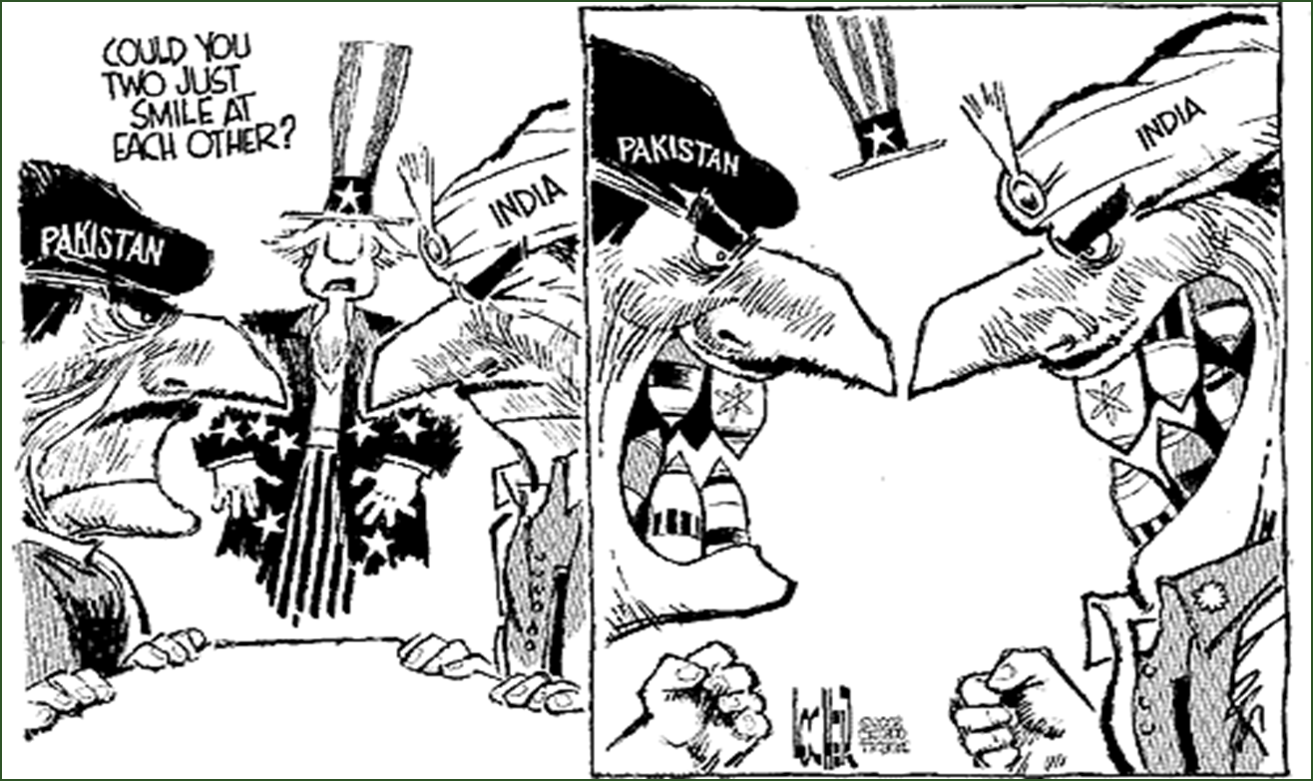
  In 1948, a radical Hindu assassinated Gandhi
    Gandhi’s civil disobedience campaigns inspired successful struggles for independence in Ghana, Nigeria, and other African colonies in the 1950s and 1960s

Slide 32
  With the British withdrawal from colonialism, the French, Dutch, and the United States also began the process of decolonization in Asia
    The U.S. granted independence to the Philippines
    Although they resisted nationalist movements, the Dutch withdrew from Indonesia in 1949
    The French continued to hold Indochina, until forced to withdraw

Slide 33


Slide 34
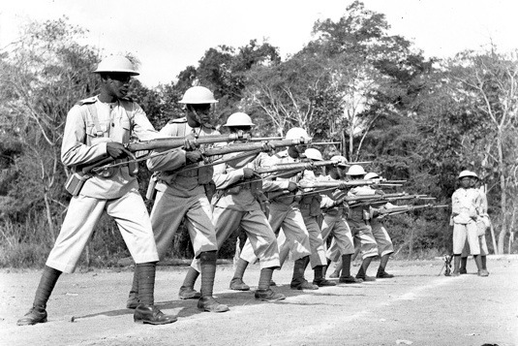
The Liberation of Nonsettler Africa
WWII was even more disruptive to the colonial order imposed on Africa than WWI
  Forced labor
  Confiscations of crops and minerals
  Inflation
  Controlled markets reduced African earnings
  Hundreds of thousands of Africans fought in the war
    Faced renewed racial discrimination once they returned home
    Became staunch supporters of postwar nationalist campaigns in the African colonies of the British and French

Slide 35
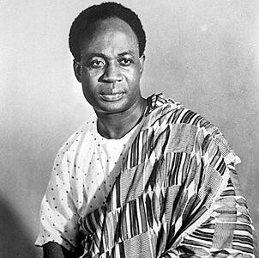
  Kwame Nkrumah
    Led a more radicalized independence movement based on confrontation with the colonial government of the Gold Coast
      Boycotts, mass rallies, and strikes
    1957 - British recognized him as prime minister of independent Ghana
      First independent black African state

Slide 36
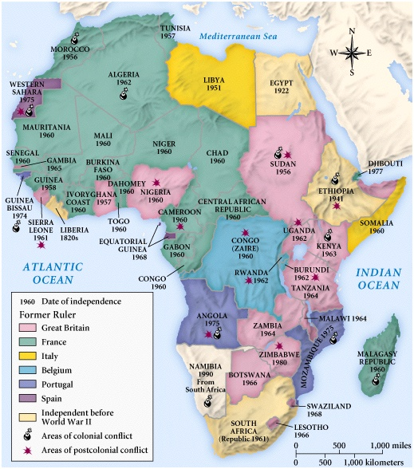
  Between 1956 and 1960, most French colonies in Africa achieved independence
    Hard pressed by costly military struggles to hold on to their colonies in Indochina and Algeria
  1960 - Belgians abandoned their colony in the Congo in the absence of any nationalist movement
  Only Portugal attempted to retain control of its African possessions

Slide 37
Repression and Guerrilla War: The Struggle for the Settler Colonies
  Settler colonies
    Areas were substantial numbers of Europeans had gone to settle permanently in the 19th and early 20th centuries
      Algeria, Kenya, Southern Rhodesia, South Africa
    European settlers blocked both the rise of indigenous nationalist movements and concessions on part of the colonial overlords
      Regarded the colonies to which they had emigrated as their permanent homes
      Fought all attempts to turn political control over to the African majority or even to grant them civil rights
      Refused all reforms by colonial administrators that required them to give up any lands they had occupied
    Many African leaders turned to violent, revolutionary struggles to win their peoples’ independence
      Nonviolent protest tactics were forbidden
      British or French officials feared angering the highly vocal settler minority

Slide 38
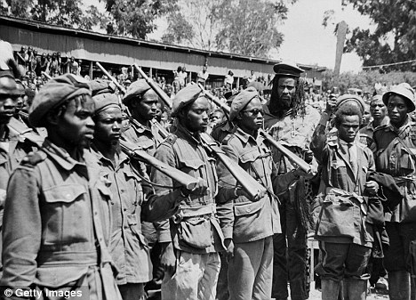
Kenya
  Early 1950s –
    Indigenous Kenyans became impatient with the failure of the nonviolent approach adopted by Jomo Kenyatta and the leading nationalist party
    Formation of the Land Freedom Army
      Radicals mounted a campaign of terror and guerrilla warfare against the British, the settlers and Africans who were considered collaborators
        By 1956 - British defeated the rebels with an all-out military effort to crush the guerrilla movement; British still negotiate with the nationalists, despite strong objections from European settlers
  1963 – multiracial Kenya had won its independence
  Mid-1980s – one of the most stable and more prosperous African states

Slide 39
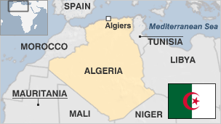
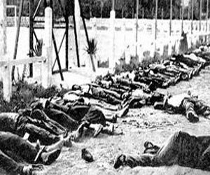
Algeria
  Arab and Berber peoples had to fight for independence from the French
  More than a million European settlers in the colony
  Decade after WWII – sporadic rioting grew into sustained guerrilla resistance
  Mid 1950s – National Liberation Front
    Mobilized large segments of the Arab and Berber population of the colony in a full-scale revolt against French rule
      Rebels were defeated militarily, but gradually negotiated for independence
  1962 – Algerians won their independence

Slide 40
The Persistence of White Supremacy in South Africa
Southern Africa
  Violent revolutions put an end to white settler dominance in the Portuguese colonies of Angola and Mozambique in 1975 and in Southern Rhodesia (now Zimbabwe) by 1980
South Africa
  White minority managed to maintain its position of supremacy
    Equal mix of Dutch-descended Afrikaners and more recently arrive English speakers
    Mid-1980s – 4.5 million settler-descended population
  1948 – Afrikaner National Party
    Emerged as the majority party in the all-while South African legislature
    1961 – gained complete independence from Britain
    Goal: establish lasting white domination over political, social, and economic life of the new nation

Slide 41
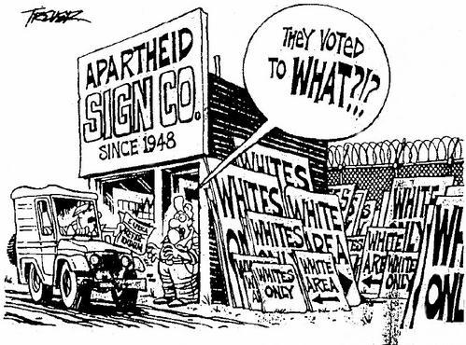
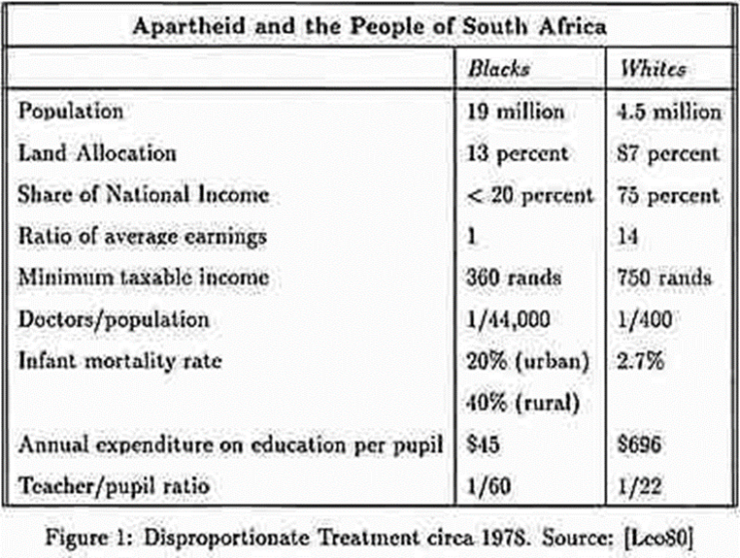
  1948 - Apartheid
    A rigid system of racial discrimination
    Afrikaner minority imposed economic and political discrimination on blacks, mixed-race peoples, and Indians living in South Africa
    Enforced by police state
    Best jobs for whites
    Carefully defined contacts allowed between other racial groups
    Vote and political representation were denied to Africans and Indians
    Limited educational opportunities for black Africans

Slide 42
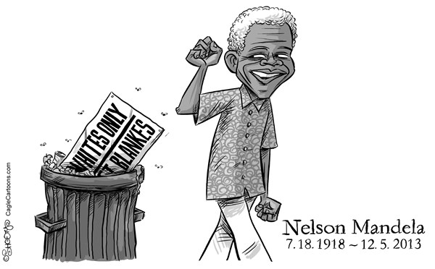
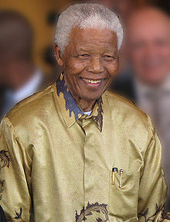
Nelson Rolihlahla Mandela
Nelson Rolihlahla Mandela
  Born 18 July 1918
  South African politician who served as President of South Africa from 1994 to 1999
    First ever to be elected in a fully representative democratic election
  Before being elected President, Mandela was a militant anti-apartheid activist
    1962 - Arrested and convicted of sabotage and other charges, and sentenced to life.
  Mandela served 27 years in prison. Following his release from prison on 11 February 1990, Mandela led his party in the negotiations that led to the establishment of democracy in 1994

Slide 43
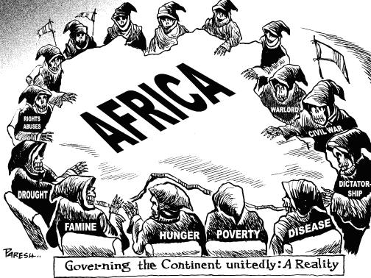
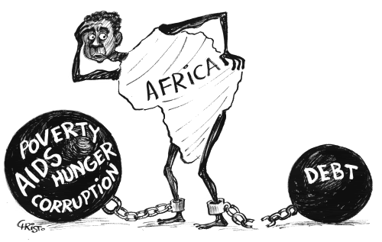

Slide 44
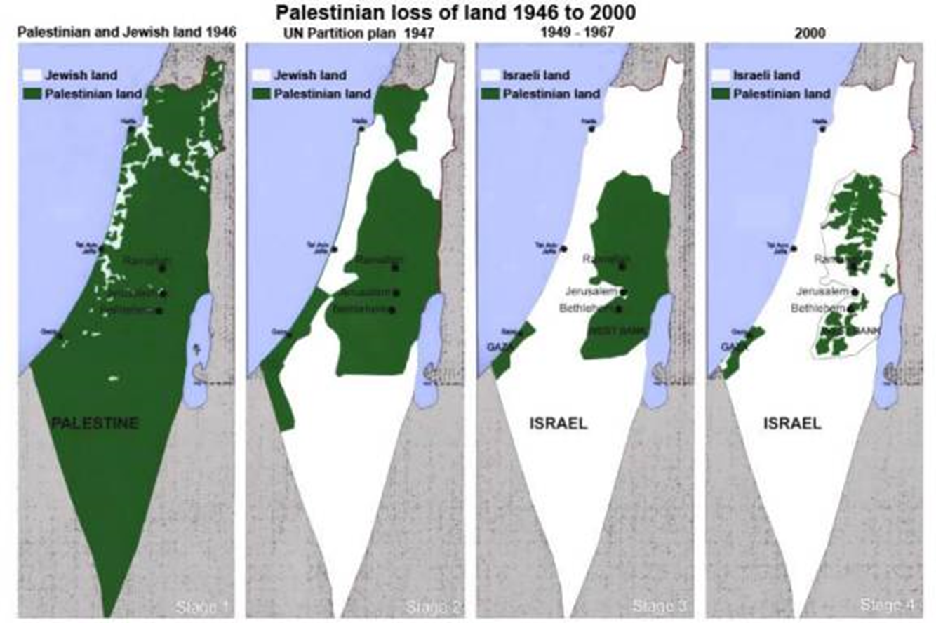
Conflicting Nationalisms: Arabs, Israelis and the Palestinian Question
  In the aftermath of the Holocaust, many supported Zionist demands for creation of a Jewish state
  1937 - a British commission proposed partition of Palestine, which was endorsed by the United Nations in 1948
    The Arab states surrounding the newly formed Israel immediately attacked
      Despite being outnumbered, the Israelis were able to defend their new nation and expand at the expense of their Arab neighbors

Slide 45
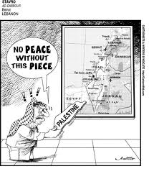

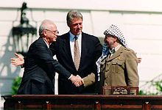
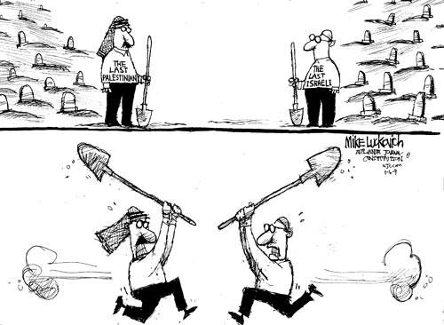
PEACE IN THE MIDDLE EAST!

Slide 46
Conclusion: The Limits of Decolonization
In many parts of the world, decolonization was not a revolutionary procedure.
Power passed from one class of elites to another. Little social and economic reform was involved.
Decolonization also did little to disrupt Western economic dominance of the system of global trade.

